Slide 1

Module: 1
Precipitation
Subject Subject Code
Hydrology & Irrigation Engg 15CV73
Name of the Faculty
SHASHI PRASAD N
Dept. of Civil Engg
K S SCHOOL OF ENGG & Management

Slide 2
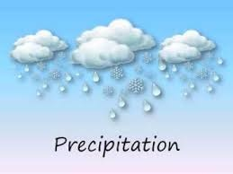
PRECIPITATION
It is defined as any form of moisture reaching the earth’s surface from the atmosphere

Slide 3
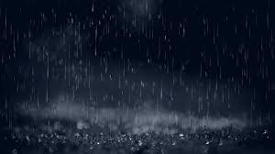
FORMS OF PRECIPITATION
The various forms of precipitation are:
Rain: It is used to describe the precipitation in the form 0f water droplets of sizes larger than 0.5mm.
The maximum size of the rain drop is 6mm

Slide 4

FORMS OF PRECIPITATION
2. Snow: It consist of ice crystals which is usually combine to form flakes.
Its initial density varies from 0.06 to 0.15 kg/cm3
The average density is about 0.1 g/cm3

Slide 5
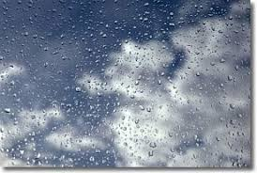
FORMS OF PRECIPITATION
Drizzle: it is a fine sprinkle of numerous water droplets of size less than 0.5mm.
Its intensity is less than 1mm/hr.
The drops are so small that they appear to float in the air

Slide 6
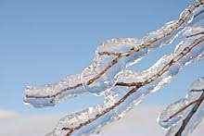
FORMS OF PRECIPITATION
Glaze: when rain or drizzle comes in contact with cold ground at around 0 degree Celsius, the water drops freeze to form an ice coating

Slide 7
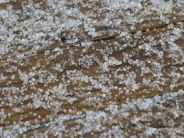
FORMS OF PRECIPITATION
Sleet: it is an frozen rain drops of transparent grains which form when rainfalls through air at sub freezing temperature

Slide 8
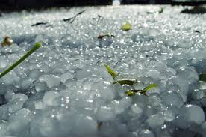
FORMS OF PRECIPITATION
Hail: it forms in the form of irregular pellets or lumps of size more than 8mm.
This usually occur in violent thunderstorms in which vertical currents are strong

Slide 9
TYPES OF PRECIPITATION
Cyclonic precipitation
Convection precipitation
Orographic
precipitation

Slide 10
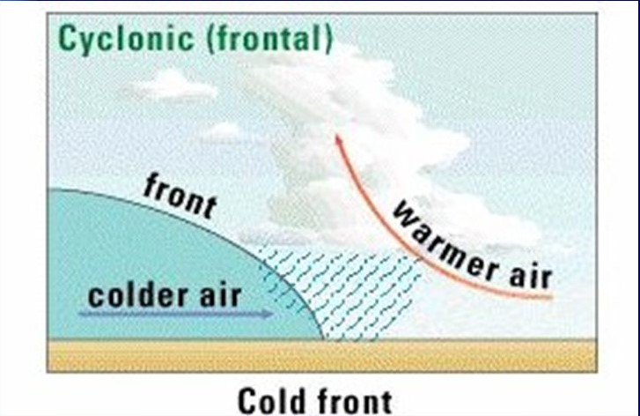
TYPES OF PRECIPITATION
1. Cyclonic Precipitation:
It is a large low pressure region with circular wind motion.
There are two types in cyclonic precipitation:
Tropical Cyclones
Extra-Tropical Cyclones

Slide 11
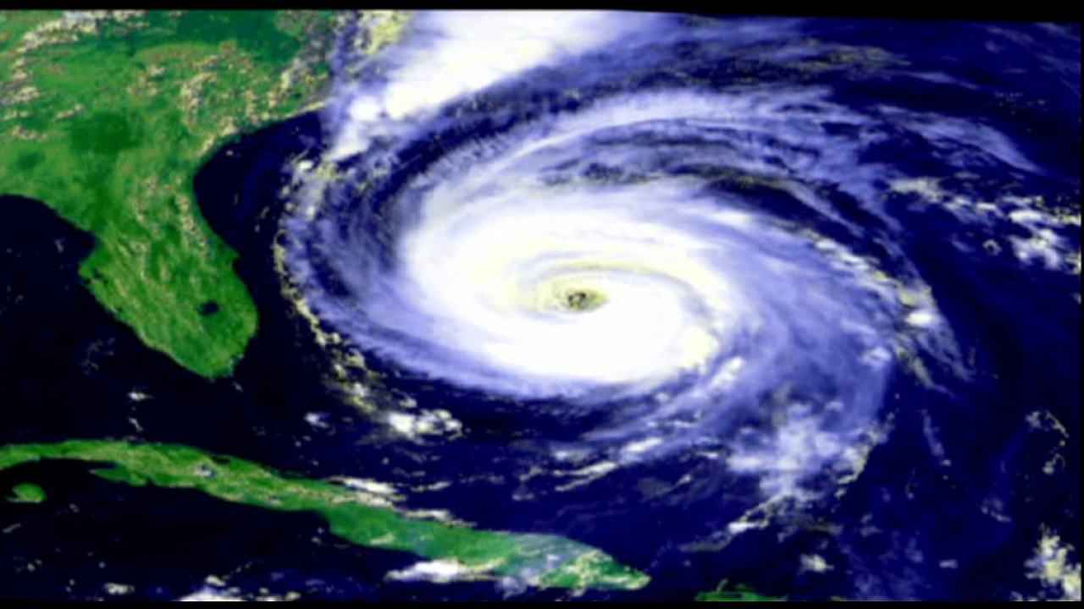
TROPICAL CYCLONES
It is a wind system with an intensely strong depression with MSL pressures, sometimes below 915m bars.
The normal area extent of a cyclone is about 100-200 Km in diameter.
The isobars are closely spaced and the winds are in anticlockwise in the northern hemisphere

Slide 12
TROPICAL CYCLONES
The centre of the storm is called eye which can extend about 10-50km in diameter.
The wind speed gradually decreases towards the outer edge.
The right outside the eye, very strong winds/reaching as much as 200kmph
The pressure also increases outwards.

Slide 13
TROPICAL CYCLONES
The centre of the storm is called eye which can extend about 10-50km in diameter.
The wind speed gradually decreases towards the outer edge.
The right outside the eye, very strong winds/reaching as much as 200kmph
The pressure also increases outwards.

Slide 14
TROPICAL CYCLONES
The rainfall will normally be heavy in entire area occupied by the cyclone.
This cyclone causes heavy damage to the life and property on their land path and intense rainfall and heavy floods in the streams are its usual consequences

Slide 15
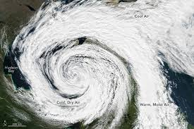
EXTRA-TROPICAL CYCLONE
These are formed in location outside the tropical zone.
They posses a strong counter clockwise wind circulation in the northern hemisphere.
The magnitude of precipitation and wind velocities are relatively lower than these of a tropical cyclones
The duration of this type is usually longer and the area extent also is larger

Slide 16

CONVECTIVE PRECIPITATION
A packet of air which is warmer than the surrounding air due to the localized heating rises because of its lesser density.
Air from the cooler surroundings flows to take up its place thus setting up a convective cell.
The warmer air continues to rise, undergoes cooling and resulting in precipitation
The area extent off such rains is small being limited to a diameter of about 10km.

Slide 17
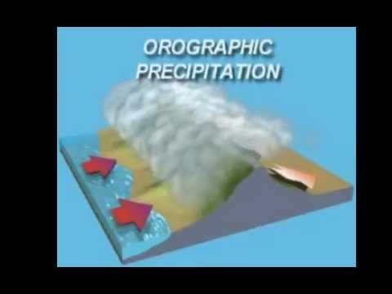
OROGRAPHIC PRECIPITATION
The moist air masses get lifted up to higher altitudes due to the presence of mountains barriers and consequently undergo cooling, condensation and precipitation.
In the mountain ranges, the windward slopes have heavy precipitation and the lee ward slopes light rainfall

Slide 18
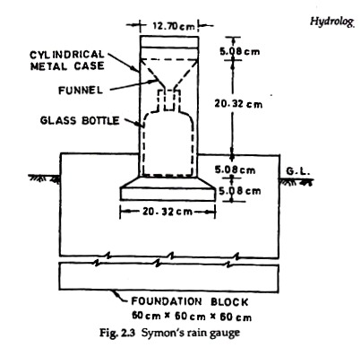
SYMON’S RAIN GUAGES
It is the non-recording rain guages.
It essential consists of a circular collecting area of 12.7 cm in diameter connected to the funnel.
The rim of the collector is set in a horizontal plane at a height of 30.5cm above the ground level.

Slide 19
SYMON’S RAIN GUAGES
The funnel discharges the rainfall, catch into a receiving vessel.
The funnel and the receiving vessels are housed in a metallic container.
Water contained in the receiving vessel is measured by a suitably graduated measuring glass with an accuracy up to 0.1mm.

Slide 20
SYMON’S RAIN GUAGES
The rainfall is measured everyday at 8.30 am and is recorded as the rainfall in a day.
The receiving bottle normally does not hold more than 10cm of the rain.
Proper care must be taken in maintenance and inspections of the rainguages.

Slide 21
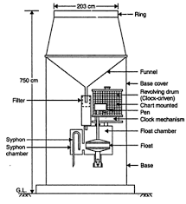
SYPHON’S RAINGUAGES
This is the recording type of rain guages. It is also called as float type rain guages.
It uses the siphon mechanism to empty the rain water collected in the float chamber.
Rain water entering the guage at the top is led into the float chamber through a funnel and filter

Slide 22
SYPHON’S RAINGUAGES
The filter is provided to prevent the dust and other particles .
The float chart consist of the float with a vertical stem protruding outside to the top of which pen is mounted.
This pen rest on a chart secured around a clock driven drum.

Slide 23
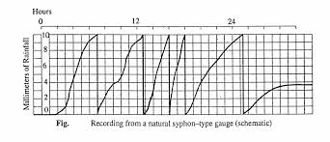
SYPHON’S RAINGUAGES
There is a small compartment by the side of the float chamber which is connected to the float chamber through a small opening at the bottom.
This is called as siphon chamber which houses the small vertical pipe.
This pipe with the bottom end open and the top end almost touching the top of the chamber.

Slide 24
SYPHON’S RAINGUAGES
During the rain water is collected in the float chamber raises the water surface in it and along with the water surface the float also rises enabling the pen to a make a trace of cumulative depth of rainfall on the chart

Slide 25
https://www.youtube.com/watch?v=m_ALjsA1Als
https://www.youtube.com/watch?v=PbdNB6XlQKc

Slide 26
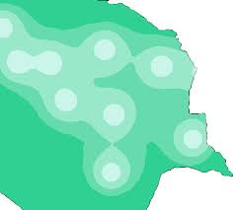
OPTIMUM NUMBER OF RAIN- GUAGE STATIONS
The selected area of a rain guage is very small compared to the areal extent of a storm.
To get a actual representative of rain over a catchment area the number of rain-guages should be large as possible.

Slide 27
OPTIMUM NUMBER OF RAIN- GUAGE STATIONS
The world meteorological organization recommends the following densities
In Flat regions of temperate, Mediterranean and tropical zones:
Ideal – 1 station for 600-900 km2.
Acceptable: 1 station for 900-3000 km2
In mountain region of temperate, Mediterranean and tropical zones:
Ideal – 1 station for 100-250 km2.
Acceptable: 1 station for 250-1000 km2
In arid and polar zones 1 station for 1500-10000 km2 depending upon the feasibility.

Slide 28
OPTIMUM NUMBER OF RAIN- GUAGE STATIONS
From practical considerations of Indian conditions, the Indian Standards recommends the following densities as sufficient
In Plains – 1 station for 520km2.
In region of average elevation of 1000m – 1 station per 260-390 km2.
In predominantly hilly areas with heavy rainfall- 1 station per 130km2

Slide 29
CONSISTENCY OF RAINFALL DATA
It is a technique for checking for inconsistency of a record.
The causes for the inconsistency of a record is due to:
Shifting of a rain-guage to a new location.
The neighbour-hood of the station undergoing a marked change.
Change in ecosystem due to calamities such as landslides etc.
Occurrence of observational error from a certain data

Slide 30
DOUBLE MASS CURVE
A group of 5 to 10 base stations in the neighbour-hood of the problem ‘X’ station is selected.
The data of the annual rainfall of the station ‘X’ and also the average rainfall of the group of the base station covering for a long period is arranged in the reverse chronological order.
The accumulated precipitation of the station ƩPx and the accumulated values of the average of the group of base station ƩPav is calculated starting from the latest record.

Slide 31
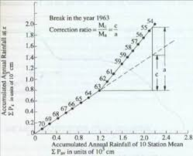
DOUBLE MASS CURVE
Values of ƩPx are plotted against ƩPav for the various consecutive time periods.
A decided break in the slope of the resulting plot indicates a change in precipitation regime of a station ‘X’.
The precipitation values at station ‘X’ beyond the period of change of regime is corrected by using the relation
Pxc =Px * (Me/Ma)

Slide 32
COMPUTATION OF MEAN RAINFALL
There are three methods to calculate the mean rainfall. They are:
Arithmetical Mean Method.
Thiessen- Mean Method.
Isohyetal Method.

Slide 33
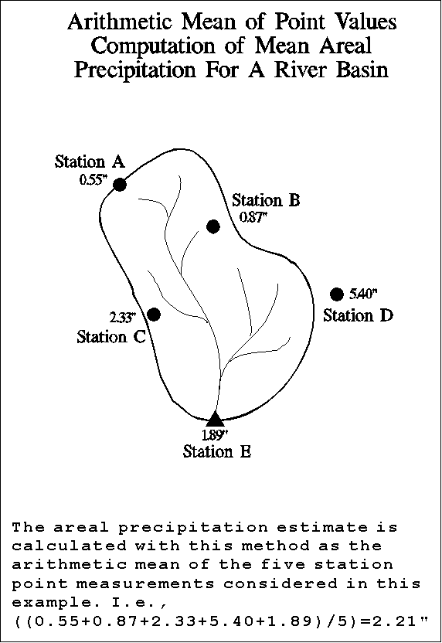
Arithmetical Mean Method.
When the rainfall measured at various stations in a catchment show little variation, the average precipitation over the catchment area is taken as arithmetical Mean Method..

Slide 34
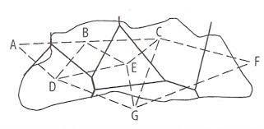
THIESSEN MEAN METHOD
In this method the rainfall recorded at each station is given a weightage on the basis of an area closet to the station.

Slide 35
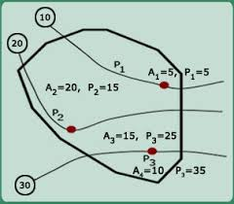
ISOHYETAL METHOD
It is the line joining points of equal rainfall magnitude.

Slide 36
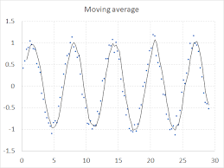
PRESENTATION OF PRECIPITATION DATA – MOVING AVERAGE CURVE
It is a technique for smoothening out the high frequency fluctuations of a time series and to enable the trends, if any noticed.
This technique can be applied to other hydrological parameters such as temperature, wind etc.

Slide 37
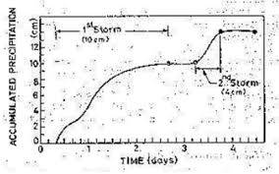
PRESENTATION OF PRECIPITATION DATA – MASS CURVE
It is a plot of the accumulated precipitation against the time plotted in chronological order.
Records obtained from the float type and weighing bucket type guages are of this form.
It is very useful in extracting the information on the duration and magnitude of the storm.

Slide 38
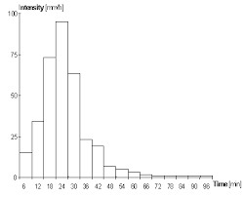
PRESENTATION OF PRECIPITATION DATA – HYETOGRAPH
It is the plot of the intensity of rainfall against the time interval.
It is derived from the mass curve and is usually represented as a bar chart.
It represents the total precipitation received in the period.
The time intervals depends on the purpose required.

