Slide 1
MANOHAR KUMAR K.N
18mat31
Module 1
Engineering Mathematics - III
Assistant Professor
Department of Mathematics
K.S. School of Engineering and Management
Bengaluru - 560109

Slide 2
LAPLACE TRANSFORM
    Laplace Transform is an integral transform which is
    developed by Mathematician Pierre-Simon
    Laplace.
    Laplace transform method is a powerful tool or
    technique for solving Linear differential equation
    with initial condition.
    Generally transform means To change one form to
    another form without changing its value.
    Laplace transform is a simple way of converting
    functions in time domain to the function of
    frequency domain

Slide 3
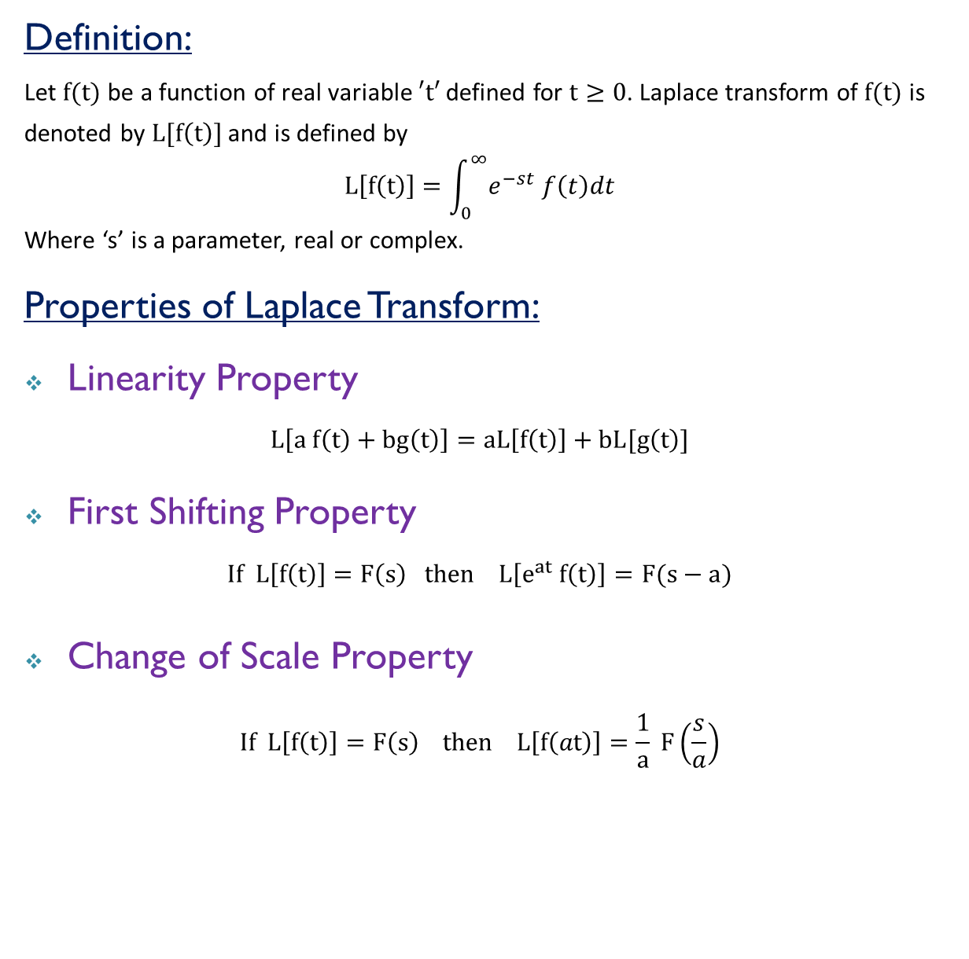
Definition:
Let $f(t)$ be a function of real variable $′t′$ defined for $t≥0$. Laplace transform of $f(t)$ is denoted by $L[f\left(t\right)]$ and is defined by
$$L\left[f\left(t\right)\right]=\int_{0}^{∞}{e^{−st} f\left(t\right)dt}$$
Where ‘s’ is a parameter, real or complex.
Properties of Laplace Transform:
Linearity Property
$$L\left[a f\left(t\right)+bg\left(t\right)\right]=aL\left[f\left(t\right)\right]+bL[g\left(t\right)]$$
First Shifting Property
$$If L\left[f\left(t\right)\right]=F\left(s\right) then L\left[e^{at} f\left(t\right)\right]=F(s−a)$$
Change of Scale Property
$$If L\left[f\left(t\right)\right]=F\left(s\right) then L\left[f\left(at\right)\right]=\frac{1}{a} F\left(\frac{s}{a}\right)$$

Slide 4
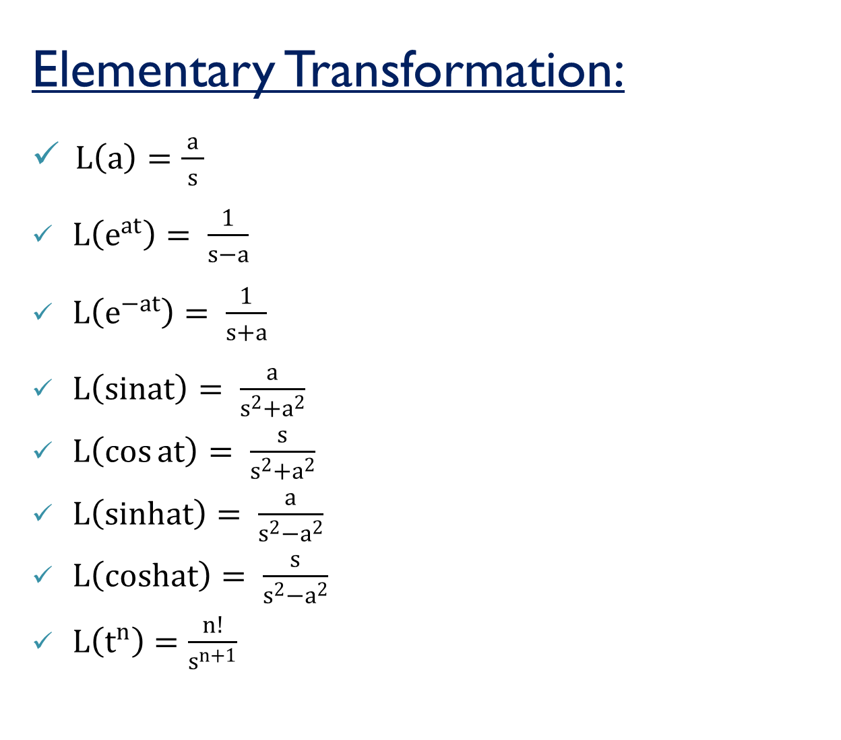
Elementary Transformation:
$L\left(a\right)=\frac{ a }{s}$
$L\left(e^{at}\right)= \frac{1}{s−a}$
$L\left(e^{−at}\right)= \frac{1}{s+a}$
$L\left(sinat\right)= \frac{a}{s^{2}+a^{2}}$
$L\left(\cos{at}\right)= \frac{s}{s^{2}+a^{2}}$
$L\left(sinhat\right)= \frac{a}{s^{2}−a^{2}}$
$L\left(coshat\right)= \frac{s}{s^{2}−a^{2}}$
$L\left(t^{n}\right)=\frac{n!}{s^{n+1}}$

Slide 5
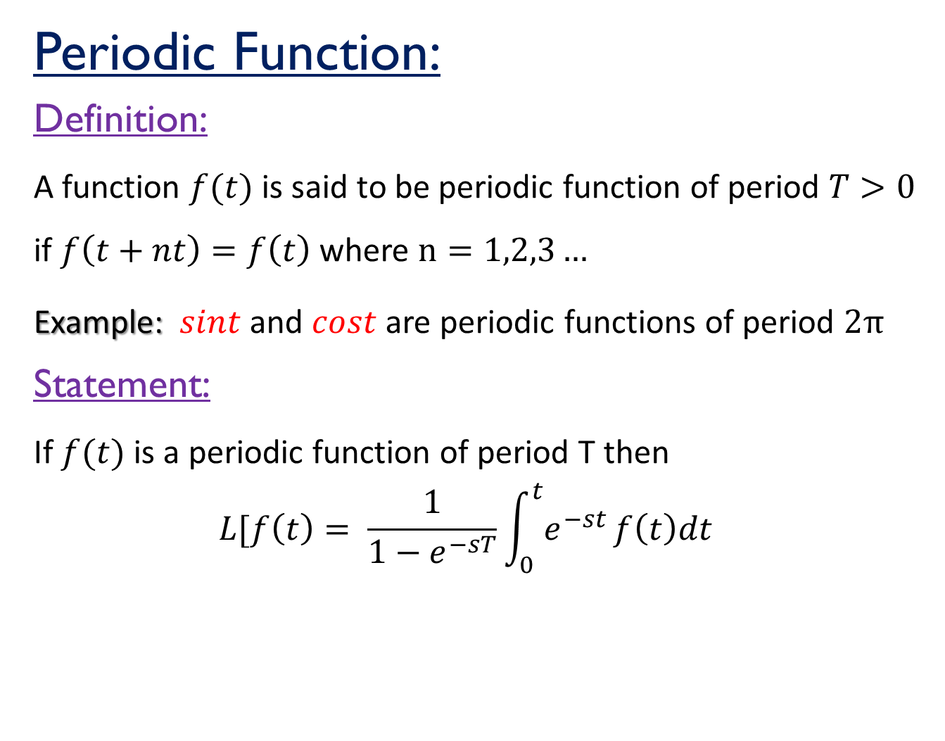
Periodic Function:
Definition:
A function $f(t)$ is said to be periodic function of period $T>0$ if $f\left(t+nt\right)=f\left(t\right)$ where $n=1,2,3…$
Example: $sint$ and $cost$ are periodic functions of period $2π$
Statement:
If $f(t)$ is a periodic function of period T then
$$L[f\left(t\right)= \frac{1}{1−e^{−sT}}\int_{0}^{t}{e^{−st }f\left(t\right)dt}$$

Slide 6
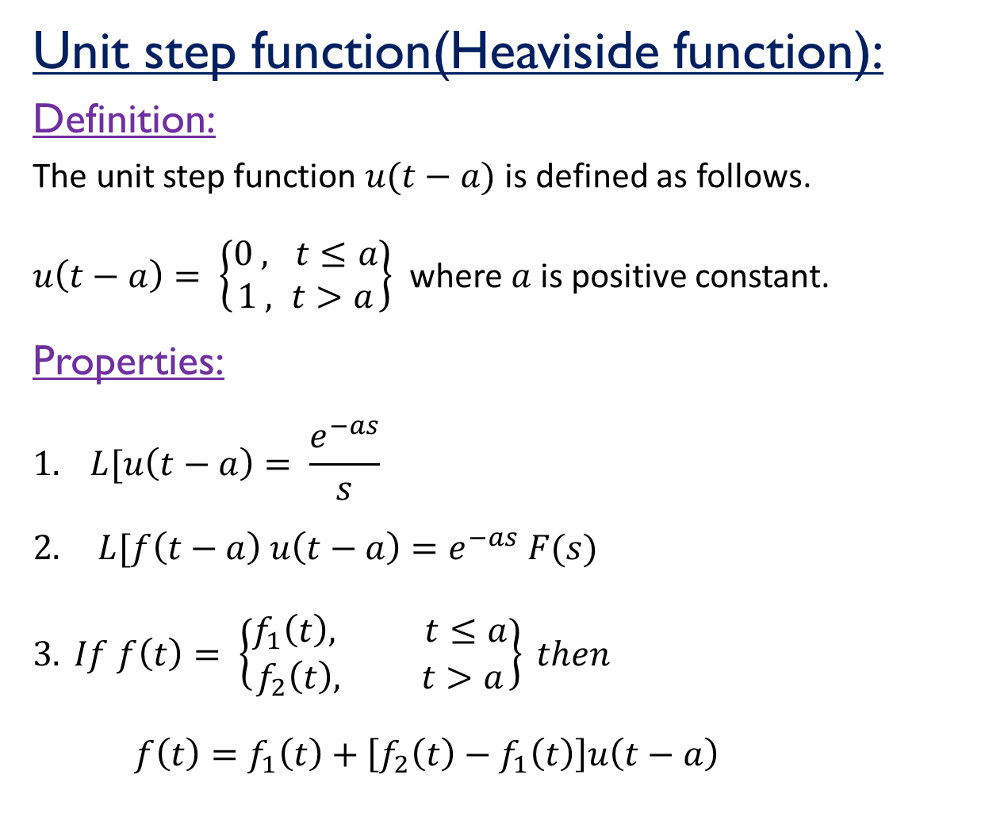
Unit step function(Heaviside function):
Definition:
The unit step function $u(t−a)$ is defined as follows.
$u\left(t−a\right)= \left\{\begin{aligned}0 , t≤a \\ 1 , t>a\end{aligned}\right\}$ where $a$is positive constant.
Properties:
$$1. L[u\left(t−a\right)= \frac{e^{−as}}{s}$$
$$2. L[f\left(t−a\right) u\left(t−a\right)=e^{−as} F(s)$$
$$3. If f\left(t\right)= \left\{\begin{aligned}f_{1}\left(t\right), t≤a \\ f_{2}\left(t\right), t>a\end{aligned}\right\} then$$
$f\left(t\right)=f_{1}\left(t\right)+\left[f_{2}\left(t\right)−f_{1}\left(t\right)\right]u\left(t−a\right)$

Slide 7
Related Links:
1. https://www.khanacademy.org/math/differential-equations/laplace-
transform/laplace-transform-tutorial/v/laplace-transform-1
2. https://www.youtube.com/watch?v=Lmj3s4S62fQ
3. https://www.youtube.com/watch?v=RDtITuZDZi4
4. https://www.youtube.com/watch?v=c9NibpoQjDk
5. https://www.youtube.com/watch?v=9RJml41PFnc

Slide 8
Thank you

