Slide 1

K S SCHOOL OF ENGINEERING AND MANAGEMENT
DEPARTMENT OF ELECTRICAL AND ELCTRONICS ENGINEERING
Topic: Circuit Breakers
Module 4
Name: Mrs Prathiksha
Designation: Assistant Professor
Subject Name: Power System Protection
Subject code: 15EE72

Slide 2
Module 4:Circuit breakers
1. Introduction
2. Fault clearing time of circuit breaker
3. Arc voltage
4. Arc Interruption
5. Types of Circuit breakers

Slide 3
1. Introduction
A circuit breaker is an automatically operated electrical switch designed to protect an electrical circuit from damage caused by excess current from an overload or short circuit. Its basic function is to interrupt current flow after a fault is detected. Unlike a fuse, which operates once and then must be replaced, a circuit breaker can be reset (either manually or automatically) to resume normal operation.

Slide 4
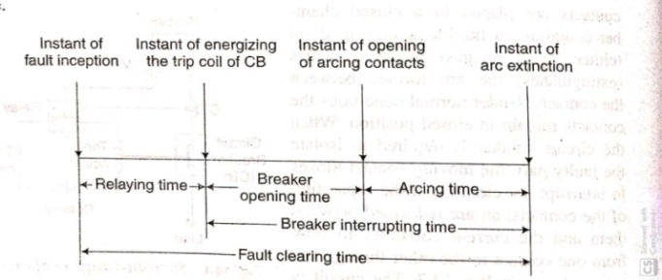
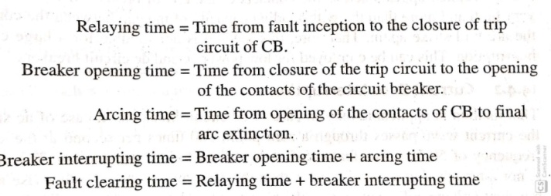
2. Fault Clearing time of CB

Slide 5
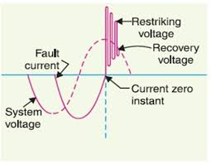
3. Arc Voltage
As soon as the contacts of the circuit breaker separate, an arc is formed. The voltage that appears across the contacts during arcing period is called the arc voltage.

Slide 6
4. Arc Interruption
High resistance Interruption:
In this method, the arc is controlled in such a way that its effective resistance increase with the time, so that the current is reduced to such a value that heat formed by it is not sufficient to maintain the arc or thus arc is extinguished.
The following are the reasons which can increase the resistance of the arc.
Cooling of arc
Increasing the length of the arc
Reducing the cross section of the arc
Splitting of arc

Slide 7
4. Arc Interruption
Current Zero Interruption :
This method is applicable only in AC circuit interruption because there are natural zero of current, 100 times in a second for 50Hz three-phase supply system. This is one of the most significant advantages of AC circuit for arc interruption purpose because the current is not allowed to rise again.
In this method, the arc resistance is kept low until the current is zero where the arc extinguishes naturally, and it’s prevented from restriking after it has gone out at a particular

Slide 8
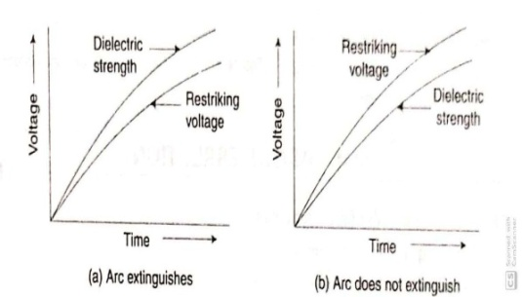
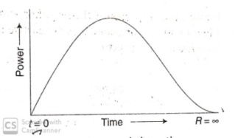
Current Zero Interruption :
Recovery rate theory:
Energy balance theory:

Slide 9
5. Types of Circuit Breaker
Air Break circuit Breaker
Oil Circuit Breaker
Air Blast Circuit Breaker
SF6 Circuit Breaker
Vaccum Circuit Breaker
HVDC Circuit Breaker

Slide 10
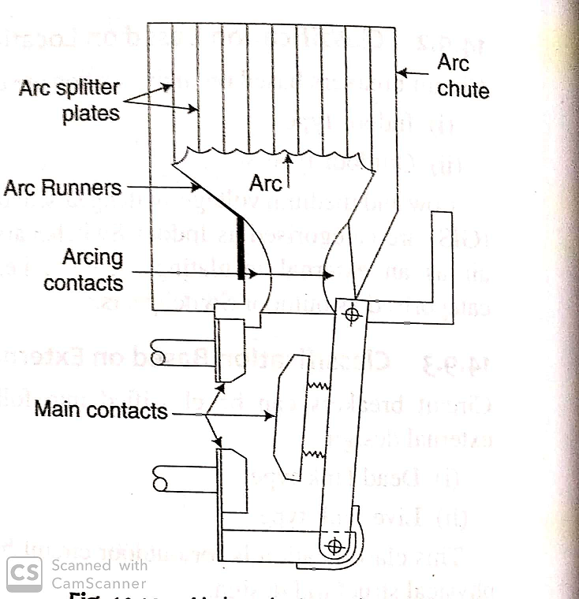
Air Break Circuit Breaker

Slide 11
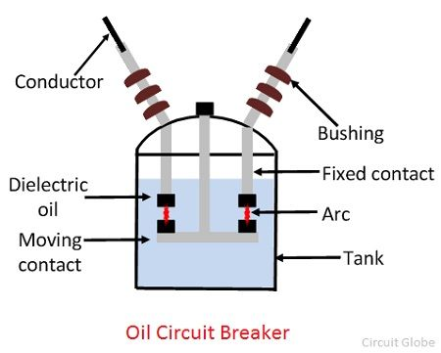
Oil Circuit Breaker
It has fixed and moving contact immersed in oil
When contact separates there is a severe arc which decomposes the oil into gases. The gas is mainly hydrogen
The volume of the gas produced is about 1000 times of the oil decomposed.
Hence the oil is pushed away from arc and the gaseous medium surrounds the arc.
The tank of the CB should be strong to withstand large amount of energy.

Slide 12
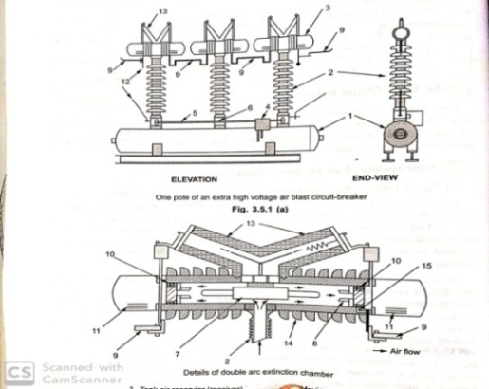
Air Blast Circuit Breaker

Slide 13
Air Blast Circuit Breaker
Air blast circuit breaker used compressed air or gas as the arc interrupting medium.
In the air blast, circuit breaker compressed air is stored in a tank and released through a nozzle to produce a high-velocity jet; this is used to extinguish the arc.
Air blast circuit breakers are used for indoor services in the medium high voltage field and medium rupturing capacity.
The air blast needs an additional compressed air system which supplies air to the air receiver.
When opening air is required, compressed air is admitted to the arc extinction chamber. It pushes away the moving contacts.
In doing so, the contacts are pulled apart, and the air blast moves away the ionized gas along with it and assists arc extinction.
Air blast extinguishes the arc within one or more cycles, and the arc chamber is filled with high-pressure air, which prevents restrikes.

Slide 14
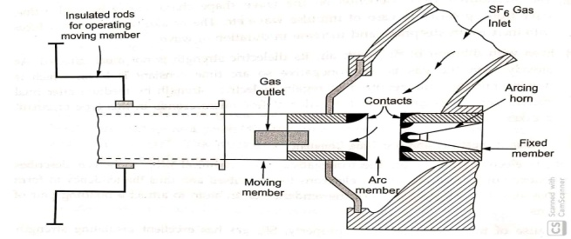
SF6 Circuit Breaker

Slide 15
In the closed position of the breaker, the contacts remain surrounded by sulphur hexafluoride gas (SF6) gas at a pressure of about 2.8 kg/cm².
When the breaker operates, the moving contact is pulled apart and an arc is struck between the contacts.
The movement of the moving contact is synchronized with the opening of a valve. The valve permits sulphur hexafluoride gas (SF6) gas at 14 kg/cm² pressure from the reservoir to the arc interruption chamber.
The high-pressure flow of sulphur hexafluoride gas (SF6) rapidly absorbs the free electrons in the arc path. It forms immobile negative ions which are ineffective as charge carriers.
The result is that the medium between the contacts quickly builds up high dielectric strength and causes the extinction of the arc.
After the breaker operation the valve is closed by the action of a set of springs.

Slide 16
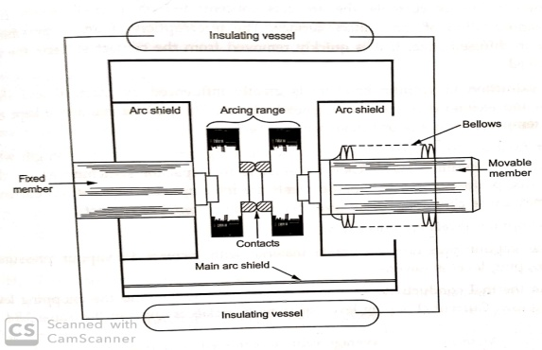
Vaccum Circuit Breaker

Slide 17
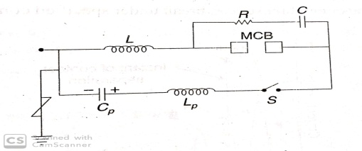
HVDC Circuit Breaker
It consists of a main MCB. It may be SF6 or vacuum CB.
R and C are connected in parallel with the main CB to reduce dv/dt.
L is saturable reactor in series with the main CB. It reduces di/dt before current zero.
Cp and Lp are connected in parallel to produce artificial current zero
Switch s is triggered vacuum gap is switched immediately after the opening of contacts of the main CB.

Slide 18
A breaker which used vacuum as an arc extinction medium is called a vacuum circuit breaker. It has a high insulating medium for arc extinction
In this circuit breaker, the fixed and moving contact is enclosed in a permanently sealed vacuum interrupter.
The arc is extinct as the contacts are separated in high vacuum. It is mainly used for medium voltage ranging from 11 KV to 33 KV.
When the fault occurs in the system, the contacts of the breaker are moved apart and hence the arc is developed between them.
When the current carrying contacts are pulled apart, the temperature of their connecting parts is very high due to which ionization occurs.
Due to the ionization, the contact space is filled with vapour of positive ions which is discharged from the contact material.
The density of vapour depends on the current in the arcing.

Slide 19
NPTEL and Youtube Video Links
http://www.nptelvideos.com/lecture.php?id=8520 –Circuit breaker co-ordination
http://www.nptelvideos.com/lecture.php?id=8532 –Relaying for distributed generation

Slide 20
THANK YOU

