Slide 1

K S SCHOOL OF ENGINEERING AND MANAGEMENT
Topic: STATCOM and SVC
Module No: 2
Name: Ramyashree H P
Subject Name: FACTS and HVDC Transmission
Subject Code: 15EE751

Slide 2




STATCOM
Reactive power delivered by STATCOM is
Reactive power supplied by SVC for mid-point shunt compensation =
STATCOM supplies or absorbs reactive power based on the Q value either positive or negative.
Energy going into its ac terminals must be equal to energy lost and energy stored in the capacitor.

Slide 3
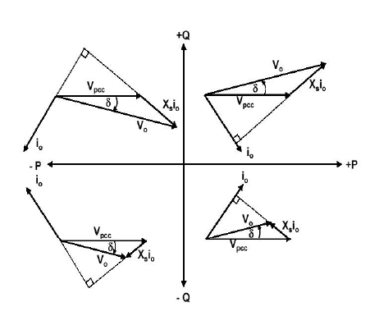
STATCOM
Operating modes of STATCOM

Slide 4
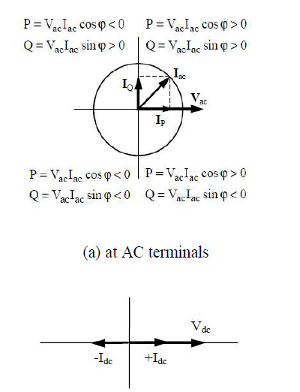
STATCOM
(b) at DC terminals

Slide 5
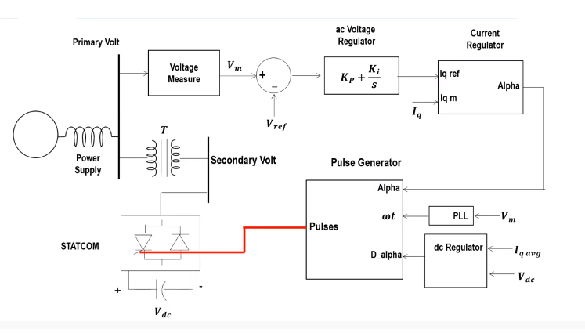
INDIRECT CONTROL OF STATCOM

Slide 6
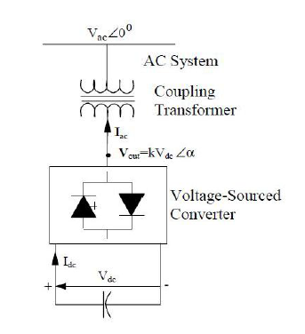
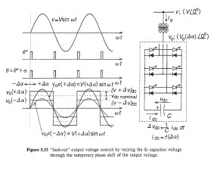
INDIRECT CONTROL OF STATCOM

Slide 7
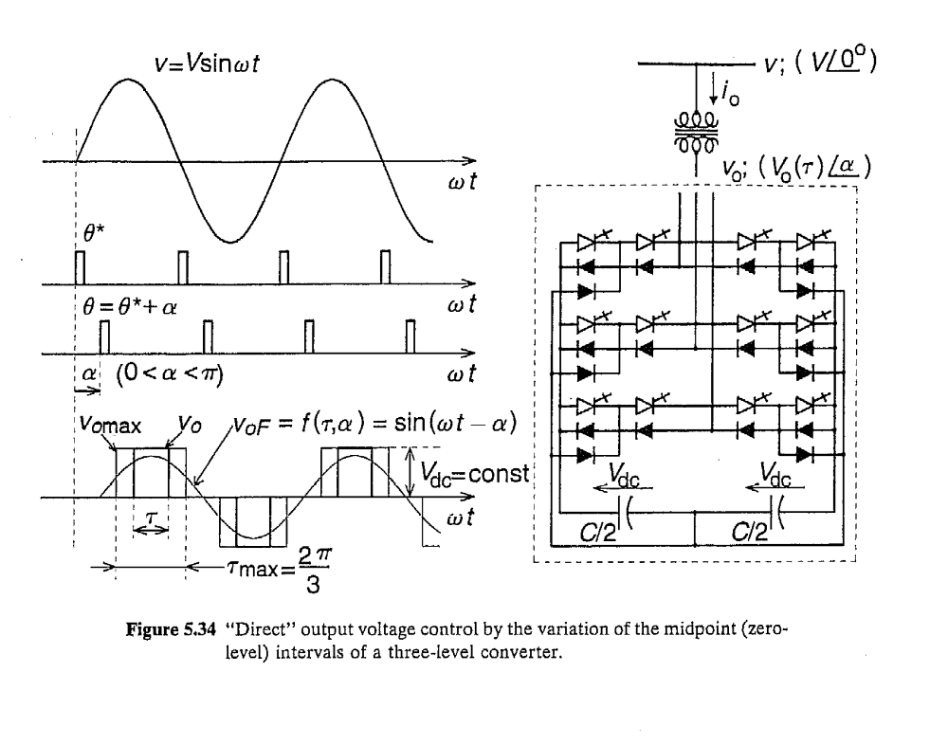
DIRECT CONTROL OF STATCOM

Slide 8
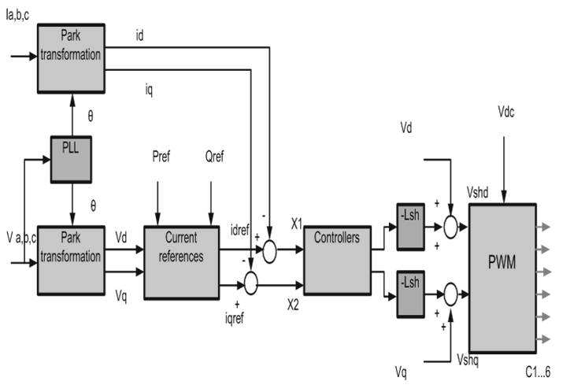
DIRECT CONTROL OF STATCOM

Slide 9
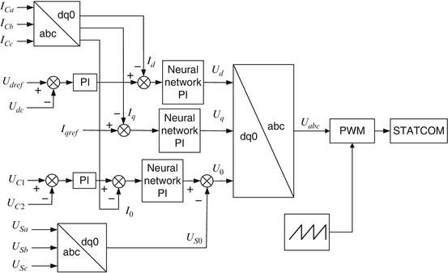
DIRECT CONTROL OF STATCOM

Slide 10
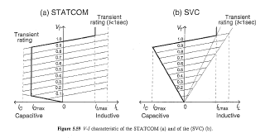
Comparison of STATCOM and SVC
V-I characterisitcs:

Slide 11
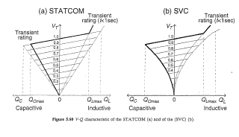
Comparison of STATCOM and SVC
V-Q characterisitcs:
Maximum attainable compensation current of SVC decreases linearly with system ac voltage.

Slide 12
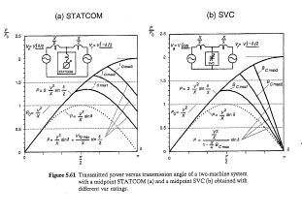
Comparison of STATCOM and SVC
Transient stability:

Slide 13
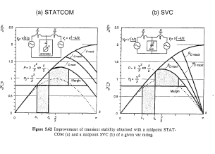
Comparison of STATCOM and SVC

Slide 14
NPTEL VIDEO LINKS
https://www.youtube.com/watch?v=GVxY3nE5mO8&list=PLLy_2iUCG87AVyRAN4QwVQrC8vSg1vWa6
https://www.youtube.com/watch?v=s87izIX-Qso&list=PLLy_2iUCG87AVyRAN4QwVQrC8vSg1vWa6&index=23
https://www.youtube.com/watch?v=vkPrQhS4xj0&list=PLLy_2iUCG87AVyRAN4QwVQrC8vSg1vWa6&index=29

