Slide 1

Semiconductor Diodes and Applications
Module-1
Subject Name: Basic Electronics Subject Code:18ELN14
Syed Waseem Tabraiz
Assistant Professor
K.S. SCHOOL OF ENGINEERING AND MANAGEMENT, BANGALORE - 560109
DEPARTMENT OF ELETRONICS AND COMMUNICATION ENGINEERING

Slide 2
pn Junction and Biasing
A pn junction is a sandwich of p-type and n-type material.
A depletion region (free of excess charge) forms.
An external bias can increase or decrease the width of the depletion
region and the voltage difference between the p and n regions.
There are three biasing conditions of pn Junction.
no Bias Condition
Forward Bias Condition
Reverse Bias Condition

Slide 3
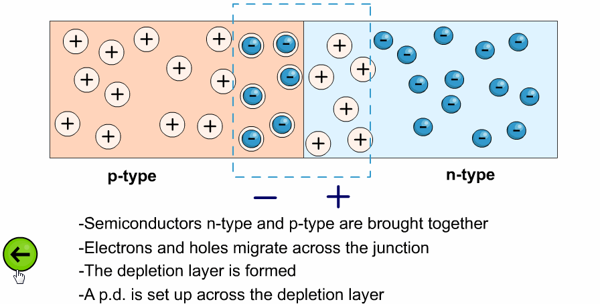
pn Junction Under No Bias

Slide 4
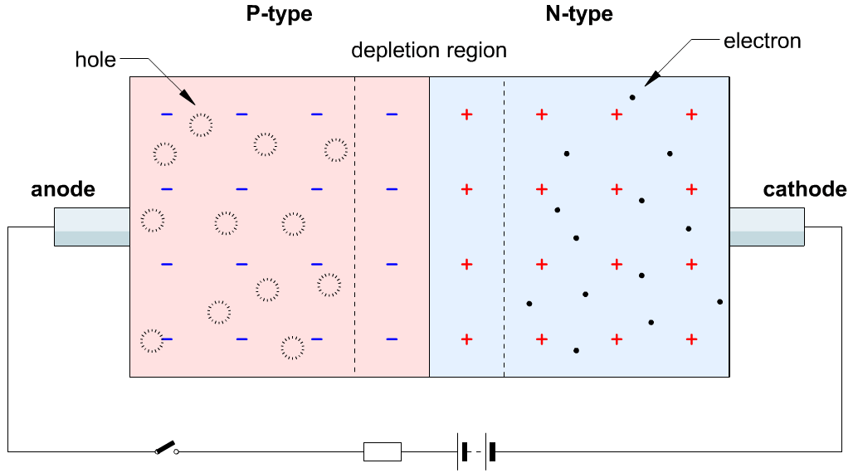
pn Junction Under Forward & Reverse Bias

Slide 5
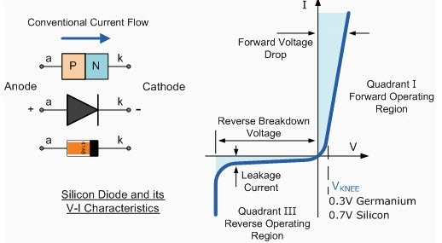
VI Characteristics of Diode

Slide 6
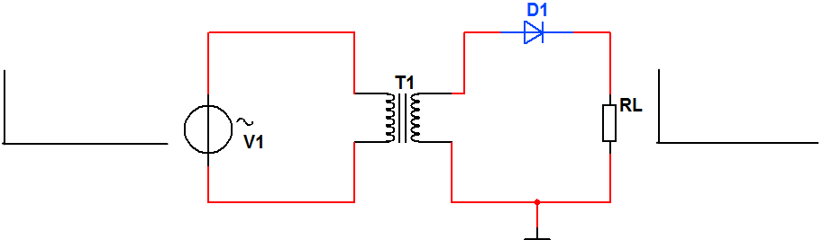
Half-Wave Rectifier
During the positive half-cycle: The diode D1 is forward-biased and conducts current to the
load resistor. The voltage produced across the load by the current has the same shape as the
positive half-cycle of the input voltage, as shown in the above animation.
During the negative half-cycle: The diode is reverse-biased. There is no voltage across the
load, so the output voltage or resistor's voltage is 0 V.

Slide 7
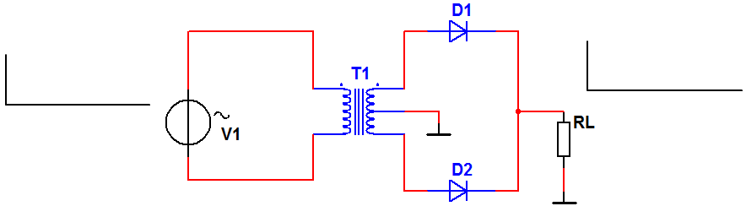
Full Wave Rectifier using Center Tapped Transformer
During the positive half-cycle: The upper diode D1 is forward-biased and the lower diode D2 is reverse biased. The current path is through D1 and the load resistor RL.
During the negative half-cycle: The upper diode D1 is reverse-biased, while D2 is forward biased. The current path is through D2 and the load resistor RL.

Slide 8
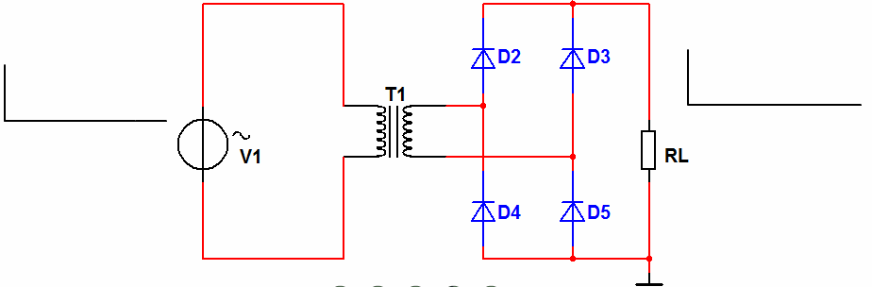
Full Wave Bridge Rectifier
This rectifier circuit uses four diodes. Its simplified behaviour is shown in the animation and explained as follows:
During the positive half-cycle: Diodes D2 and D5 are forward-biased and conduct current which flows first out of the transformer into the D2's anode, then through RL, afterwards through the anode of D5 and then into the negative terminal of the secondary's winding. During this time, diodes D4 and D3 are reverse-biased.
During the negative half-cycle: Diodes D4 and D3 are forward-biased and conduct current which comes out of the terminal of the secondary windings (which in the previous half-cycle was "seen" by these diodes as negative and now as positive). Current enters first through the anode of D3, then proceeds through RL and ground into the anode of D4.

Slide 9
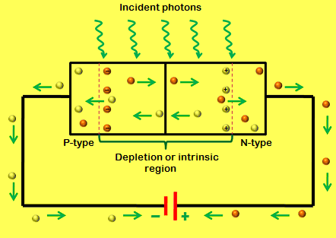
Photodiode
The working principle of a photodiode is, when a photon of ample energy strikes the diode, it makes a couple of an electron-hole. This mechanism is also called as the inner photoelectric effect. If the absorption arises in the depletion region junction, then the carriers are removed from the junction by the inbuilt electric field of the depletion region. Therefore, holes in the region move toward the anode, and electrons move toward the cathode, and a photocurrent will be generated.

Slide 10
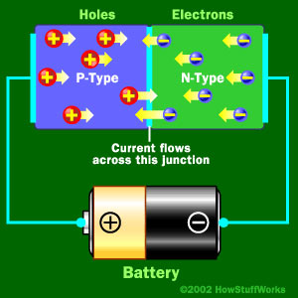
LED Working
The light emitting diode simply, we know as a diode. When the diode is forward biased, then the electrons & holes are moving fast across the junction and they are combining constantly, removing one another out. Soon after the electrons are moving from the n-type to the p-type silicon, it combines with the holes, then it disappears. Hence it makes the complete atom & more stable and it gives the little burst of energy in the form of a tiny packet or photon of light.

Slide 11
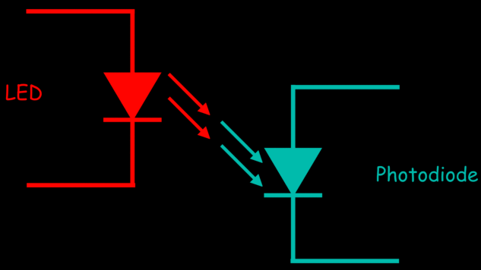
Optocoupler
An optoisolator or an optocoupler is a device that transfers electrical signals between two electrically isolated circuits through light energy. Opto-isolators prevent the high voltages in one part of the circuit from affecting or destroying other parts of the system.

Slide 12
Use Full Links
p-n Junction Diode: https://www.youtube.com/watch?v=D3YMfLZDIrE
Characteristics of p-n Junction Diode:https://www.youtube.com/watch?v=zuZXXeQlHjw
Rectifier Principle: https://www.youtube.com/watch?v=NBLOBkY1hj4
Full Wave Rectifier:
https://www.youtube.com/watch?v=qjxKhB_xf_E

