Slide 1
Applied Thermodynamics
(17ME43)
K.S. SCHOOL OF ENGINEERING AND MANAGEMENT
Module 1-GAS POWER CYCLES
Session delivered by:-
Vinod A
Assistant Professor
Department of Mechanical Engineering
K.S.S.E.M

Slide 2
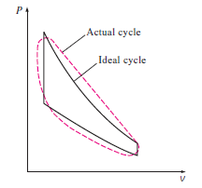
Introduction
A cycle is defined as a repeated series of operations occurring in a certain order.
If the cycle is of a imaginary perfect engine, then the cycle is called as Ideal Cycle.
If the cycle is of the actual engine, then the cycle is called as Actual cycle.

Slide 3
Two important Applications of the Thermodynamics are :
Power Generation
Refrigeration
Both are accomplished by systems that operate on a Thermodynamic Cycle. It can be categorized as Gas cycles and Vapor cycles
In Gas cycles, the working fluid remains in gaseous phase throughout the entire cycle.
In Vapor cycles, the working fluid exists in vapor phase during one part of the cycle and in liquid phase in another part.

Slide 4
Air standard cycles
Carnot cycle
Otto cycle
Diesel cycle
Dual cycle
Stirling cycle
Ericsson cycle
Atkinson cycle (over expanding cycle)

Slide 5
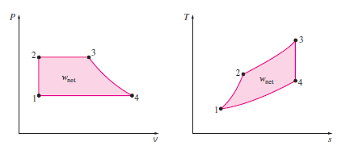
Important Points to remember on Air standard cycles
The ratio of the area enclosed by the cyclic curve to the area under heat-addition process curve represents the Thermal Efficiency.
On both the P-v and T-s diagrams, the area enclosed by the process curves of a cycle represents the net work produced during the cycle (also equivalent to the net heat transfer)

Slide 6
Assumptions in Air Standard Cycles
The working fluid is Air which continuously circulates in a closed loop and always behaves as an Ideal gas.
All the processes in the cycle are internally reversible.
The combustion process is replaced by heat addition process and the exhaust process is replaced by heat rejection process.
The specific heat of the gas remains constant.
i.e., c_{p} = 1.005 kJ/kg-K and c_{v} = 0.718 kJ/kg-K
R = c_{p} – c_{v} = 0.287 kJ/kg-K for Air

Slide 7
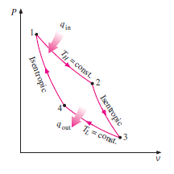
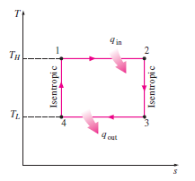
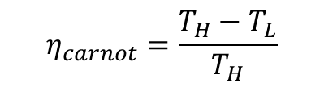
Carnot cycle
Process 1-2: Isothermal Expansion (heat addition)
Process 2-3: Isentropic Expansion
Process 3-4: Isothermal Compression (heat rejection)
Process 4-1: Isentropic Compression
$$η_{carnot}=\frac{T_{H}−T_{L}}{T_{H}}$$
Note: For further details, refer the below link
https://www.youtube.com/watch?v=77EIce2Nu8Y

Slide 8
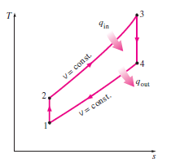
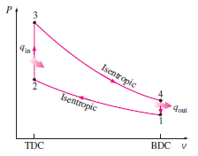
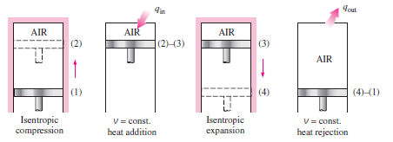
Otto cycle

Slide 9
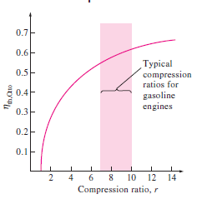
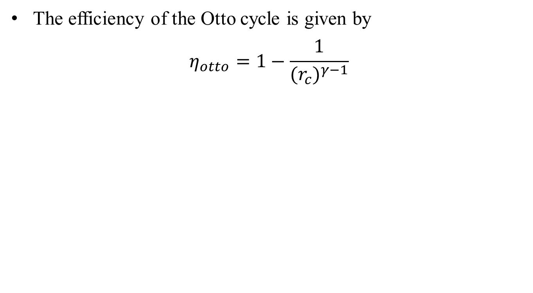
Effect of compression ratio (r_{c}) on Otto cycle
The efficiency of the Otto cycle is given by
$$η_{otto}=1−\frac{1}{({r_{c})}^{γ−1}}$$
It is clear that the efficiency of the Otto cycle depends on the compression ratio r_{c}.
When high compression ratios are used, the temperature of the air-fuel mixture rises above the auto-ignition temperature of the fuel(the temperature at which the fuel ignites without the help of spark) during combustion.
This leads to Engine Knock and reduces the performance causing an engine damage.

Slide 10
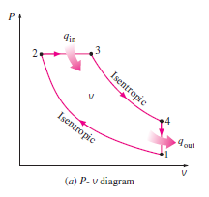
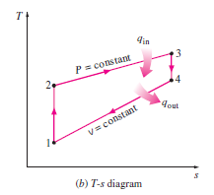
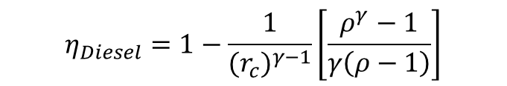
Diesel cycle
Process 1-2: Isentropic Compression
Process 2-1: Isobaric heat addition (constant pressure heat addition)
Process 3-4: Isentropic expansion
Process 4-1: Isochoric heat rejection (constant volume heat rejection)
$$η_{Diesel}=1−\frac{1}{({r_{c})}^{γ−1}}\left[\frac{ρ^{γ}−1}{γ\left(ρ−1\right)}\right]$$
Note: For further details, refer the below link
https://www.youtube.com/watch?v=DLzM-PEwTXg

Slide 11
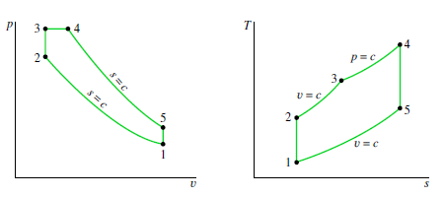
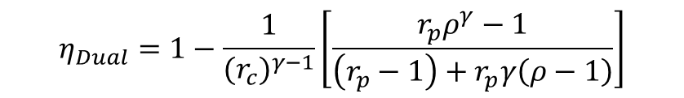
Dual cycle (Limited pressure cycle)
Note: In this cycle, the heat addition occurs in two steps: Process 2-3 and Process 3-4
Process 1-2: Isentropic compression
Process 2-3: Constant volume heat addition
Process 3-4: Constant pressure heat addition
Process 4-5: Isentropic expansion
Process 5-1: Constant Volume heat rejection
$$η_{Dual}=1−\frac{1}{({r_{c})}^{γ−1}}\left[\frac{r_{p}ρ^{γ}−1}{\left(r_{p}−1\right)+r_{p}γ\left(ρ−1\right)}\right]$$

Slide 12
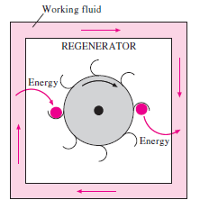
Stirling cycle
Concept of Regeneration
Regeneration is a process during which heat is transferred to a thermal energy storage device (called regenerator) during one part of the cycle and is transferred back to the working fluid in another part of the cycle

Slide 13
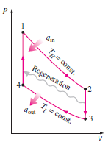
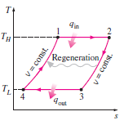
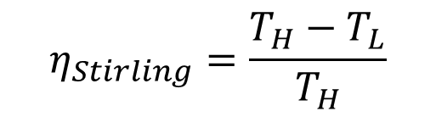
Continued…
$$η_{Stirling}=\frac{T_{H}−T_{L}}{T_{H}}$$

Slide 14
Comparison of Otto, Diesel and Dual cycles
Following are the important factors which are used as the basis for comparison of the cycles:
Compression ratio
Maximum pressure
Heat supplied
Heat rejected
Net work

Slide 15
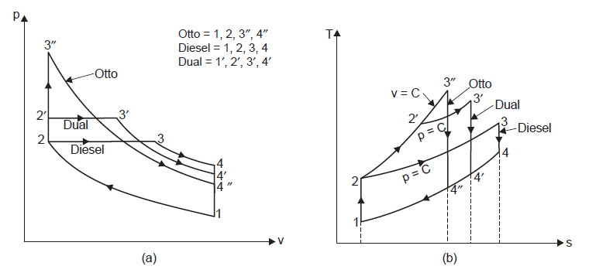
Continued…
1. For the same compression ratio and same heat input

Slide 16
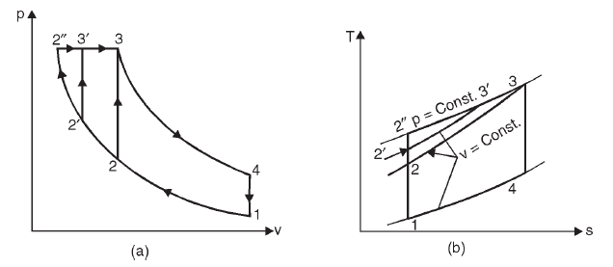
Continued…
2. For the same maximum pressure and Heat input
Otto cycle: 1-2-3-4-1
Dual cycle: 1-2’-3’-4-1
Diesel cycle: 1-2’’-3-4-1

Slide 17
Gas turbines
Brayton cycle
Description and analysis
Methods to improve the thermal efficiency of the cycle
Regenerative gas turbine cycle
Intercooling and reheating in gas turbine cycle

Slide 18
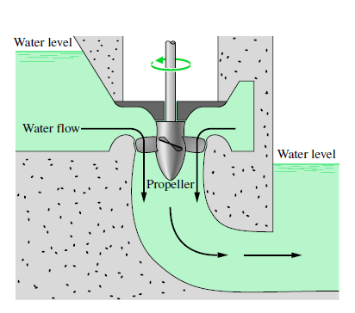
Turbine
A turbine is a device in which work is developed as a result of a gas or liquid passing through a set of blades attached to a shaft free to rotate.

Slide 19
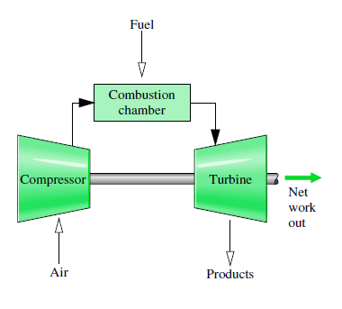
Brayton cycle
Gas turbines usually operate on an Open cycle as shown in the figure.
Fresh air at ambient conditions is drawn into the compressor, where its temperature and pressure are raised.
The high pressure air proceeds into the combustion chamber, where the fuel is burned at constant pressure.
The resulting high-temperature then enter the turbine, where they expand to the atmospheric pressure while producing power.
The exhaust gases leaving the turbine are thrown out, causing the cycle to be classified as an open cycle
Fig: Open cycle gas turbine engine

Slide 20
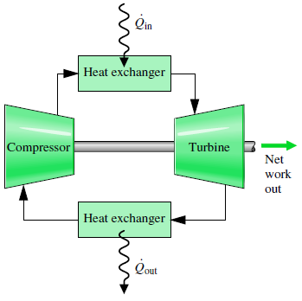
Continued…
The open cycle discussed previously, can be modeled as closed cycle (for analysis) as shown in the figure below.
Here, the compression and expansion remains the same where as the combustion process is replaced by a constant pressure heat addition process from an external source and the exhaust process is replaced by a constant pressure heat rejection process to the ambient air .
The ideal cycle that the working fluid undergoes in this closed loop is the Brayton cycle.

Slide 21
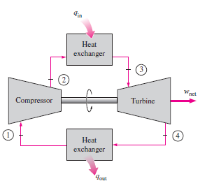
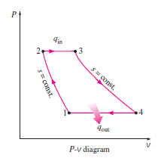
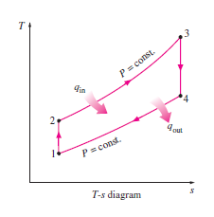
Continued…

Slide 22
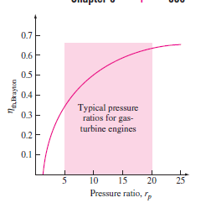
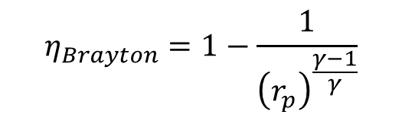
Effect of pressure ratio on the performance of gas-turbine cycle
$$η_{Brayton}=1−\frac{1}{{\left(r_{p}\right)}^{\frac{γ−1}{γ}}}$$
The thermal efficiency of an ideal Brayton cycle depends on the pressure ratio of the gas turbines and the specific heat ratio of the working fluid.
The highest temperature in the cycle occurs at the end of the combustion process (state 3), and it is limited by maximum temperature that the turbine blades can withstand.
This also limits the pressure ratios that can be used in the cycle.

Slide 23
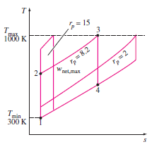
Effect of pressure ratio for Fixed temperature ratio on thermal efficiency
The pressure ratio on the effective area of the cycle (r_{p} = 8.2) is more than the area of the cycle (r_{p} = 2).
But as pressure ratio increases (r_{p} = 15), the area decreases and the work output of the cycle also decreases and thus the cycle efficiency decreases.
Therefore, in a gas turbine power plant, there should be a compromise between the pressure ratio and work output

Slide 24
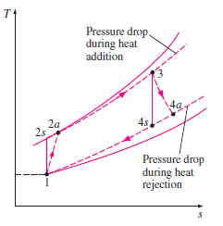
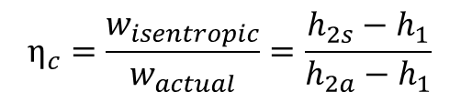
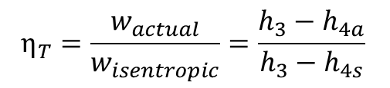
Deviation of Actual Gas-Turbine cycle from the Idealized ones
The actual gas-turbine cycle differs from the ideal Brayton cycle on several accounts.
Some pressure drop is inevitable during heat addition and heat rejection processes.
More importantly, the actual work input to the compressor is more, and the actual work output from the turbine is less because of irreversibilities.
$$η_{c}=\frac{w_{isentropic}}{w_{actual}}=\frac{h_{2s}−h_{1}}{h_{2a}−h_{1}}$$
$$η_{T}=\frac{w_{actual}}{w_{isentropic}}=\frac{h_{3}−h_{4a}}{h_{3}−h_{4s}}$$

Slide 25
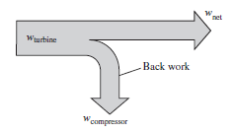
Back work
In gas turbine plants, the ratio of the compressor work to the turbine is very high. Usually more than 50% of the turbine work output is used to drive the compressor.
If the isentropic efficiencies of the compressor and turbine are low, the situation is even worse.

Slide 26
Methods to improve Thermal efficiency of the gas turbines
Increasing the turbine inlet temperatures.
Increase the efficiencies of turbo machinery components.
Adding modifications to the basic cycle
  Regeneration
  Reheating
  Intercooling

Slide 27
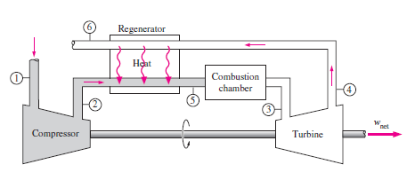
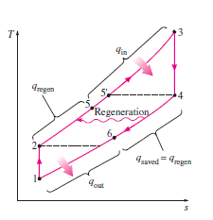
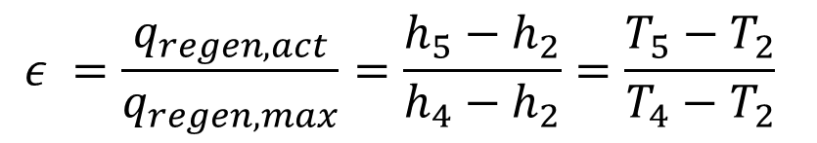
The Brayton cycle with Regeneration
q_{regen, act} = h₅ – h₂
q_{regen, max} = (h_{5’} – h₂) = (h₄ – h₂)
$$ε =\frac{q_{regen, act}}{q_{regen, max}}=\frac{h_{5}−h_{2}}{h_{4}−h_{2}}=\frac{T_{5}−T_{2}}{T_{4}−T_{2}}$$

Slide 28
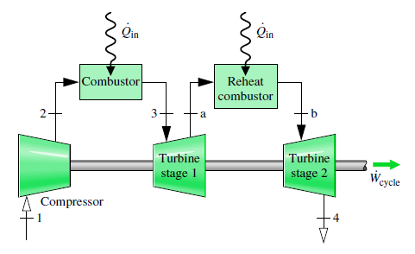
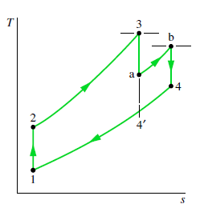
Gas turbines with Reheat
Since, the constant pressure on a T-s diagram diverge slightly with increasing entropy, the total work of the two-stage turbine is greater than that of a single expansion from state 3 to state 4΄.
Thus net work for the reheat cycle is greater than that of the cycle without reheat.
Despite the increase in net work with reheat, the cycle thermal efficiency would not necessarily increase because a greater total heat addition would be required.

Slide 29
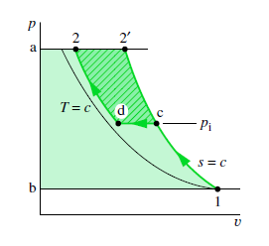
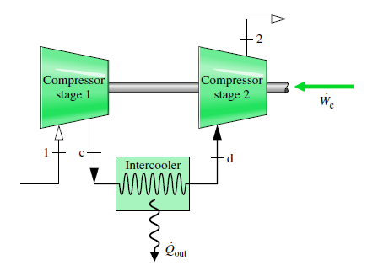
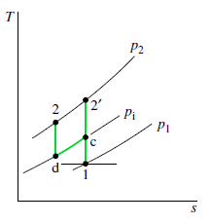
Compression with Intercooling

Slide 30
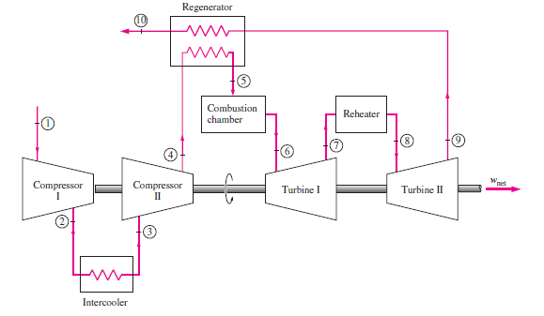
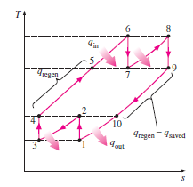
Brayton cycle with Regenerator, Reheating and Intercooling

Slide 31
Thank you!!!!

