Slide 1

Department of MBA – 1st Semester
Subject Name - PRINCIPLES OF MANAGEMENT.
Subject Code :18MBA11
Mr. Manjunath. S
Associate Professor.
Unit-1
Introduction

Slide 2
Course Objectives:
1. To make students understand fundamental concepts and principles of management, including the basic roles, skills, and functions of
Management.
2. To make students knowledgeable of historical development, theoretical aspects and practice applications of managerial process.
3. To understand the basic concepts and theories underlying individual
behavior besides developing better insights into one’s own self.
4. To make students aware of Individual behavior in groups, dynamics groups of, team building and interpersonal effectiveness besides developing a better awareness of how they can be better facilitators for building effective teams as leaders themselves.

Slide 3
COURSE OUTCOMES
1. Comprehend & correlate all the management functions which are
happening around with fundamental concepts and principles of
management.
2. Understand the overview of management, theory of management and practical applications of the same.
3. Effectively use their skills for self-grooming, working in groups and
to achieve organizational goals.
4. Demonstrate their acumen in applying managerial and behavioral
concept in real world/situation.
5. Understand and demonstrate their exposure on recent trends in
management.

Slide 4
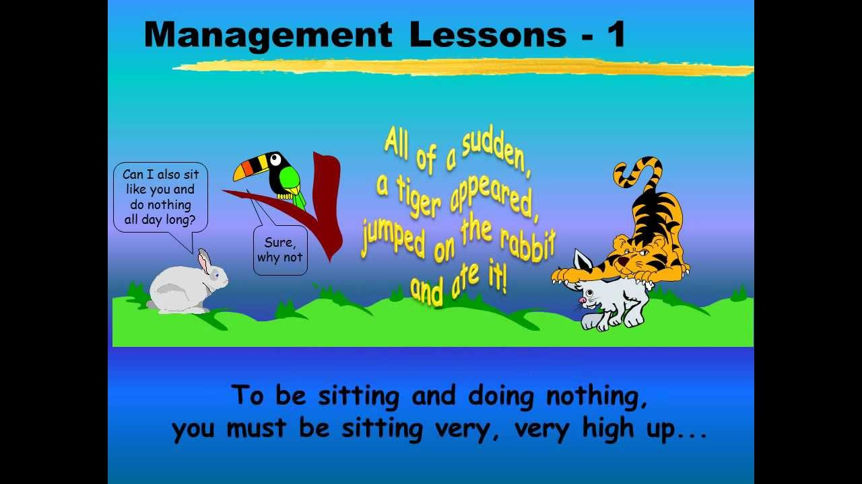

Slide 5
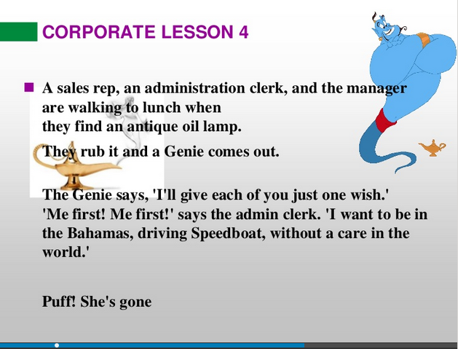

Slide 6
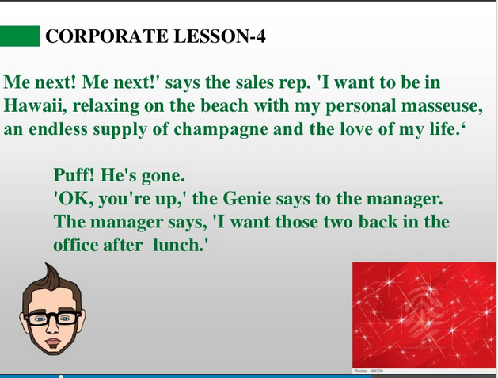

Slide 7
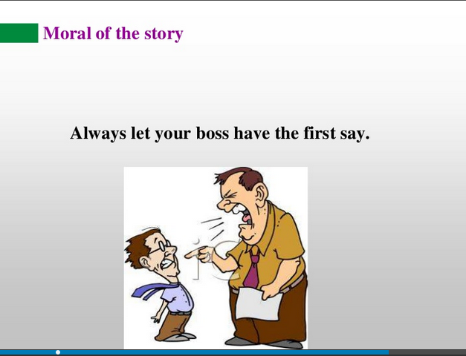

Slide 8
Introduction to Management
Introduction
Definition of management
Nature, Purpose and Functions
Levels and types of managers
managerial roles
skills for managers
evolution of management thought
Fayol’s fourteen principles of management
Recent trends in management

Slide 9


Slide 10
Management
Organization
A consciously coordinated social unit composed of two or more people that functions on a relatively continuous basis to achieve a common goal or set of goals.

Slide 11
Definitions of Management
According to George R Terry “a process consisting of planning, organizing, actuating and controlling performed to determine and accomplish the objectives by the use of people and resources”.
According to Mary Parker Follett: “the art of getting things done through other people”.

Slide 12


Slide 13
Differentiate between management and administration
Basis for comparison | Management | Administration
Meaning | An organized way of managing people and things of a business organization is called the Management. | The process of administering an organization by a group of people is known as the Administration
Authority | Middle and Lower Level | Top level
Role | Executive | Decisive
Area of operation | It works under administration. | It has full control over the activities of the organization.
Applicable to | Profit making organizations, i.e. business organizations. | Government offices, military, clubs, business enterprises, hospitals, religious and educational organizations.
Decides | Who will do the work? And How will it be done? | What should be done? And When is should be done?
Work | Putting plans and policies into actions. | Formulation of plans, framing policies and setting objectives

Slide 14
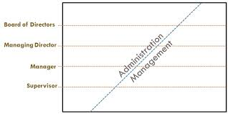
Differentiate between management and administration

Slide 15
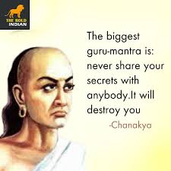

Slide 16
Nature of Management
Multidisciplinary
It includes knowledge/information from various disciplines- economics, statistics, maths, psychology, sociology, ecology, operations research, history, etc.
Management integrates the ideas and concepts taken from these disciplines and presents newer concepts which can be put into practice for managing the organizations.

Slide 17
Dynamic nature of principles
Management has framed certain principles, which are flexible in nature and change with the changes in the environment in which an organization exits.

Slide 18
Mahabharatha Lessons
https://www.youtube.com/watch?v=A7vJ31N_aT0
Description of the above Link : Mahabharata is one of the oldest and greatest epics of Hindu mythology that the world has ever witnessed. there are lot of lessons can be related to Management practices. This link is all about that .

Slide 19
Relative not absolute principles
Management principles are relative, not absolute, and they should be applied according to the need of the organization.
Principles should be applied according to the prevailing conditions.

Slide 20
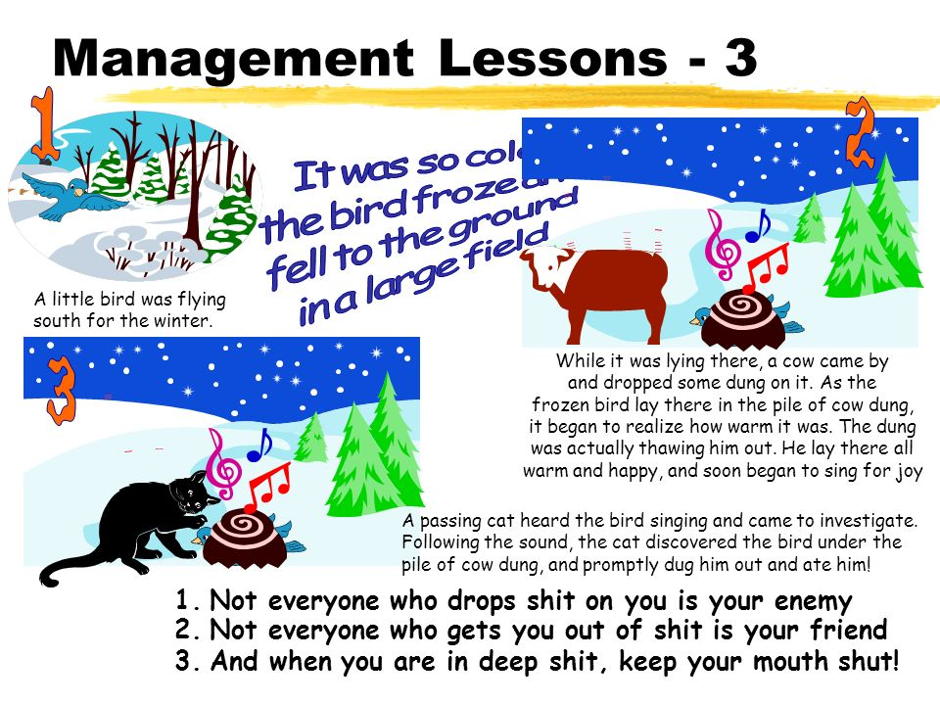

Slide 21


Slide 22
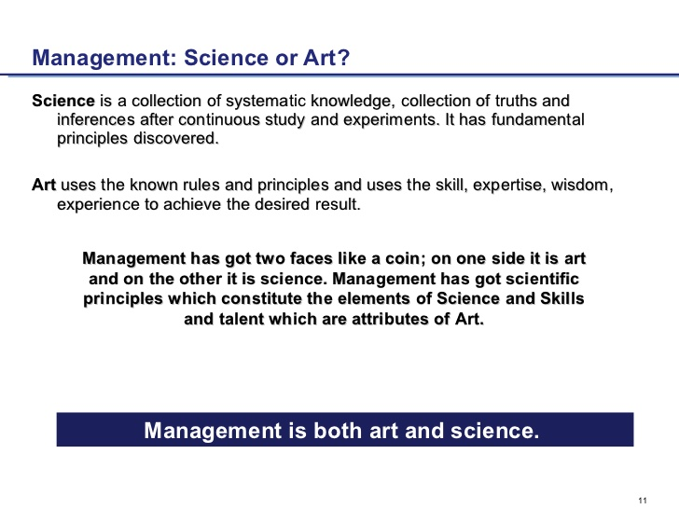

Slide 23
Management – science or art
Management like other practices- whether medicine, music composition, or even accountancy- is an art.
It is know-how. Yet managers can work better by using the organized knowledge about management. It is this knowledge that constitutes science.
Thus, managing as practice is an art; the organized knowledge underlying the practice may be referred to as science.

Slide 24
Universality of management
Management is a universal phenomenon. However, management principles are not universally applicable but are to be modified according to the needs of the situation.

Slide 25
Peter Drucker
https://www.youtube.com/watch?v=BCks9RlKqN4
Description : Peter Drucker hailed as the father of modern management, formulated a theory that is still used today. This link is useful to understand his management philosophy .

Slide 26
Purpose/Importance/Need of Management
It helps in Achieving Group Goals
Optimum Utilization of Resources
Reduces Costs
Establishes Sound Organization
Establishes Equilibrium
Essentials for Prosperity of Society

Slide 27
Functions of Management or Management Process
Planning
Organizing
Staffing
Leading
Controlling

Slide 28
Planning
Selecting missions and objectives as well as the actions to achieve them, which require decision making.

Slide 29
Organizing
Establishing an intentional structure of roles for people to fill an organization.
(creating an environment for human performance).

Slide 30
Staffing
Filling and keeping filled, the positions in the organization structure.
(workforce requirements, inventorying the available people, recruiting, selecting, placing, promoting, appraising, planning careers, compensating and training)

Slide 31
Leading
Influencing people so that they will contribute to organizational and group goals.
(motivation, leadership style, approaches, communication)

Slide 32
Controlling
Measuring and correcting individual and organizational performance to ensure that events conform to plans.
(Against the goals, deviation from standards, accomplishment of plans, measurement of achievements)

Slide 33
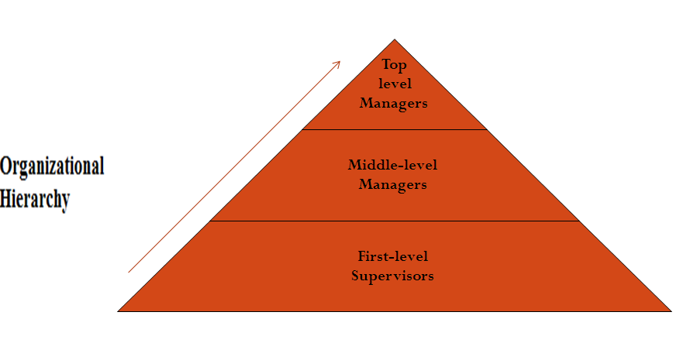
Levels of Managers or Types of Managers

Slide 34
First-line Managers
Are at the lowest level of management
Supervisors, section leads, and foremen are examples of low-level management
These managers focus on controlling and directing.
Low-level managers usually have the responsibility of:
Assigning employees tasks;
Guiding and supervising employees on day-to-day activities;
Ensuring the quality and quantity of production;
Making recommendations and suggestions; and
Up channeling employee problems.

Slide 35
Middle Managers
General Managers, branch managers, and department managers are all examples of middle-level managers
They are accountable to the top management for their department's function
Middle-level managers devote more time to organizational and directional functions
Some of their functions are as follows:
Designing and implementing effective group and intergroup work and information systems;
Defining and monitoring group-level performance indicators;
Diagnosing and resolving problems within and among work groups;
Designing and implementing reward systems supporting cooperative behavior.

Slide 36
Top Managers
Are responsible for making organization-wide decisions and establishing plans and goals that affect the entire organization
The board of directors, president, vice-president, and CEO are all examples of top-level managers.
These managers are responsible for controlling and overseeing the entire organization.
Top-level managers are accountable to the shareholders and general public

Slide 37
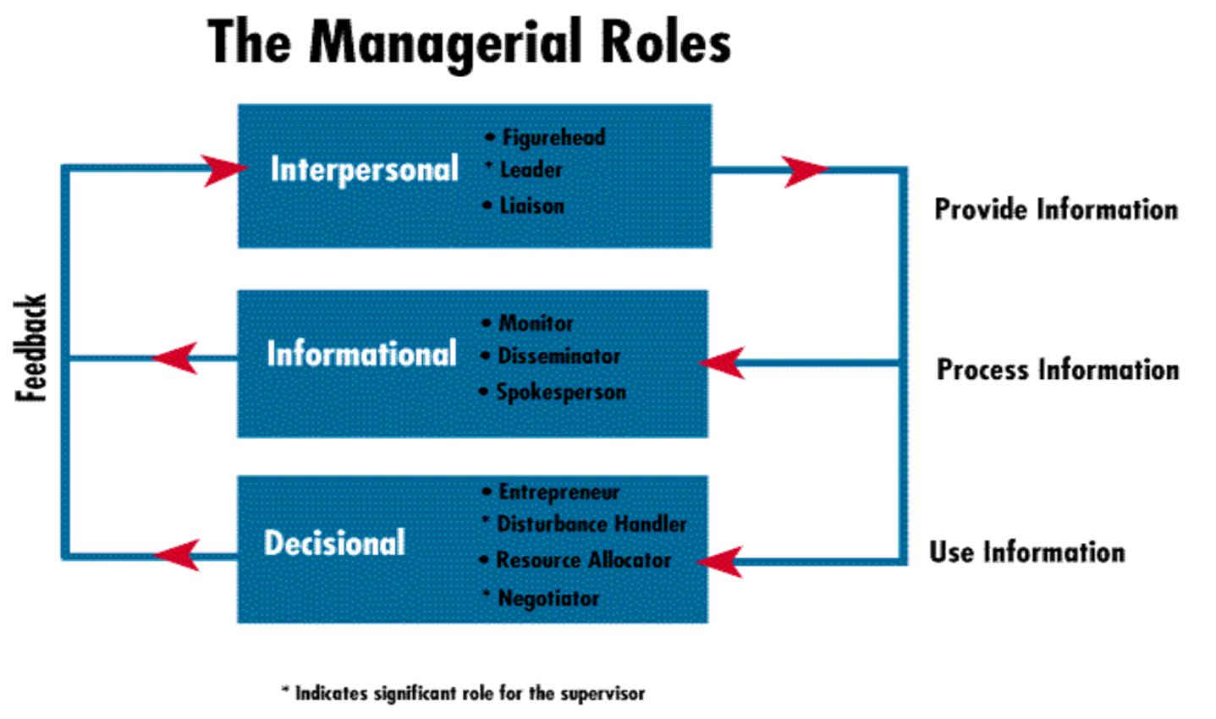
Henry Mintz Berg-Managerial Roles or Roles of Management

Slide 38
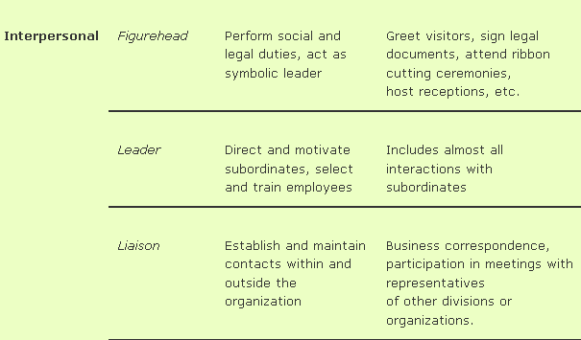
Interpersonal

Slide 39
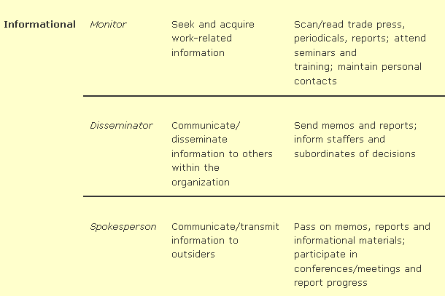
Informational

Slide 40
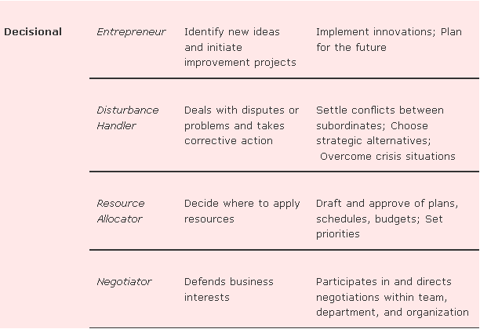
Decisional

Slide 41
Skills for Managers
Conceptual skills
Interpersonal skills or Human skills
Technical skills
Managerial skills
Analytical skills
Decision making skills
Communicating skills

Slide 42
Fayol’s fourteen principles of management
  Division of Work – When employees are specialized, output can increase because they become increasingly skilled and efficient.
  Authority – Managers must have the authority to give orders, but they must also keep in mind that with authority comes responsibility.
  Discipline – Discipline must be upheld in organizations, but methods for doing so can vary.
  Unity of Command – Employees should have only one direct supervisor.
  Unity of Direction – Teams with the same objective should be working under the direction of one manager, using one plan. This will ensure that action is properly coordinated.
  Subordination of Individual Interests to the General Interest – The interests of one employee should not be allowed to become more important than those of the group. This includes managers.
  Remuneration – Employee satisfaction depends on fair remuneration for everyone. This includes financial and non-financial compensation.

Slide 43
  Centralization – This principle refers to how close employees are to the decision-making process. It is important to aim for an appropriate balance.
  Scalar Chain – Employees should be aware of where they stand in the organization's hierarchy, or chain of command.
  Order – The workplace facilities must be clean, tidy and safe for employees. Everything should have its place.
  Equity – Managers should be fair to staff at all times, both maintaining discipline as necessary and acting with kindness where appropriate.
  Stability of Tenure of Personnel – Managers should strive to minimize employee turnover. Personnel planning should be a priority
  Initiative – Employees should be given the necessary level of freedom to create and carry out plans.
  Esprit de Corps – Organizations should strive to promote team spirit and unity.

Slide 44
Recent trends in management
Globalisation
Technology
Sustainability & corporate social responsibility
Business eco system
Psychology

