Slide 1
K S SCHOOL OF ENGINEERING AND MANAGEMENT

Slide 2
By Kusuma M
Assistant Professor
Dept. of Physics
KSSEM

Slide 3
MODULE-4
PHYSICS PRESENTATION ON APPLICATIONS OF LASER

Slide 4
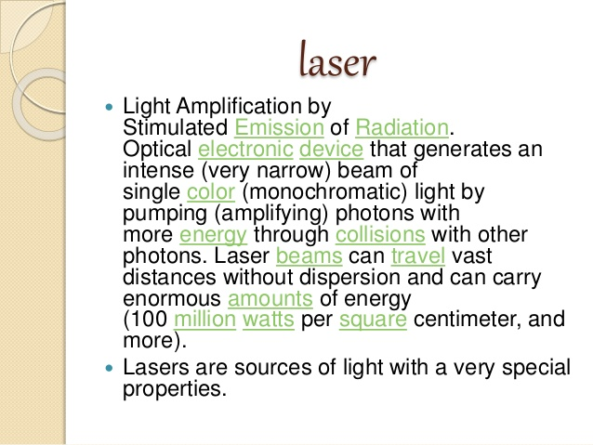

Slide 5
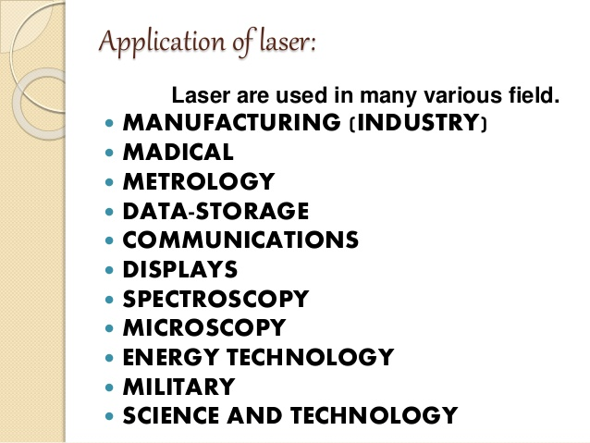

Slide 6
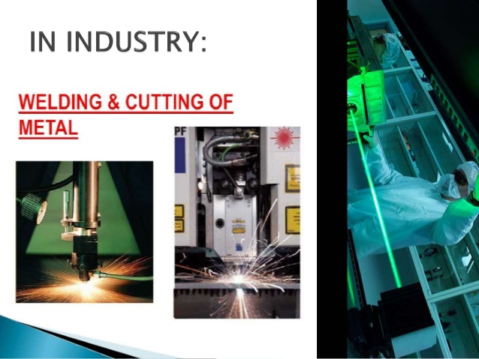

Slide 7
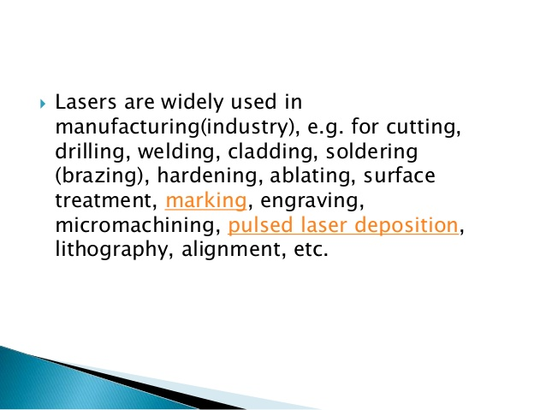

Slide 8
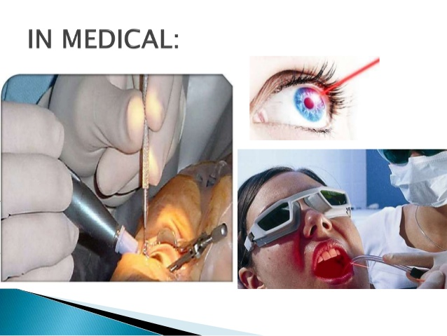

Slide 9
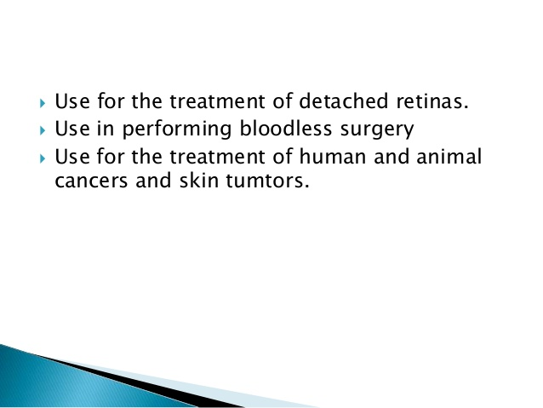

Slide 10
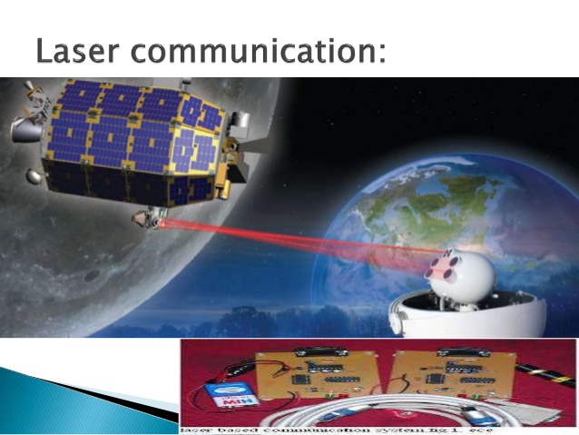

Slide 11
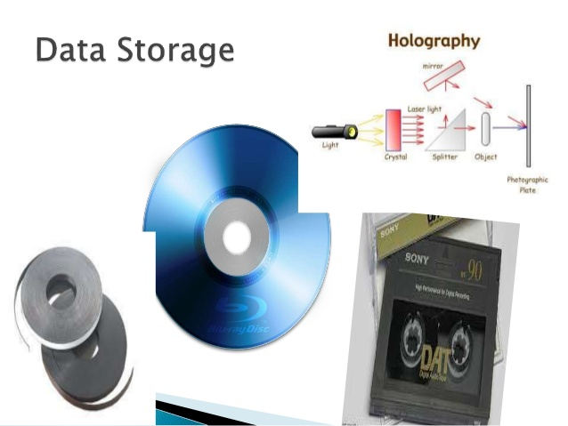

Slide 12
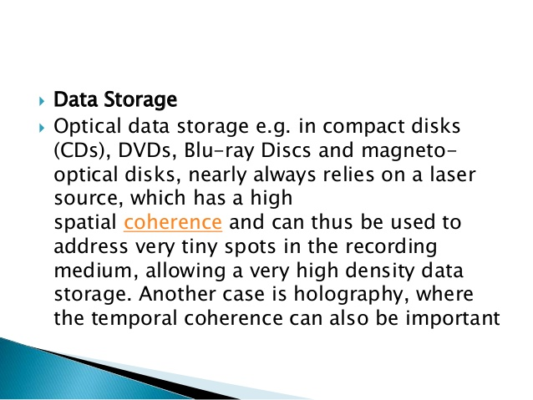

Slide 13
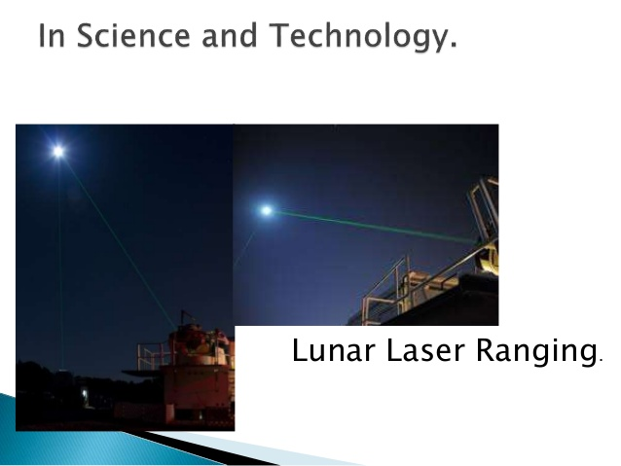

Slide 14
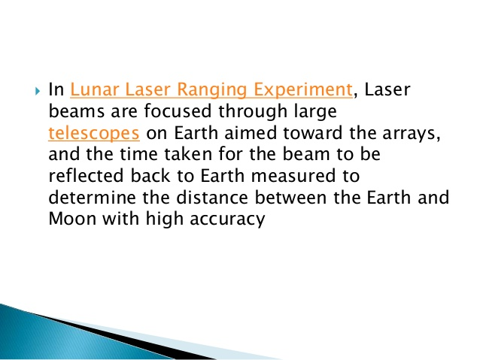

Slide 15
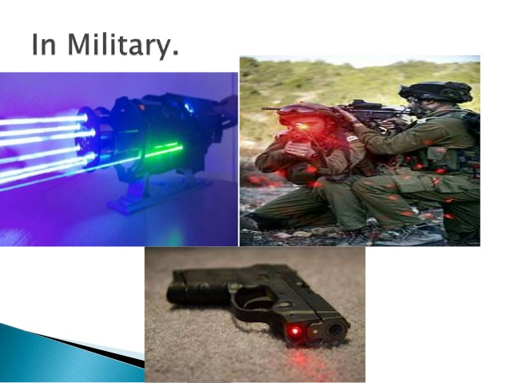

Slide 16
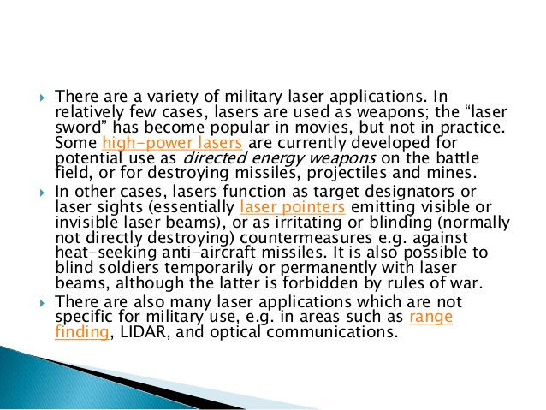

Slide 17
For Further information of Laser topic refer the link given.
https://youtu.be/PK4yFaGHSFc?list=PLLoK_OlIhyBSBiwwPWM5r3bbmXiVjl8U (Laser fundamentals and its Applications)

Slide 18


