Slide 1
Hearty Welcome
to all Parents and Students for the Orientation Programme
(I Year BE Courses)
12th Aug 2019

Slide 2
Contents…..
Introduction to management, faculty and staff
Objectives and Work plans
University Rules and Regulations
DOs and DONTs
Interaction

Slide 3
About Kammavari Sangham…..
Established in 1952
Non-profit oriented organisation
Services:
  Education (KS Polytechnic, KSIT, KSSEM & KSSA)
  Health (KS Hospital)
  Social Services
  Free education, free health treatment and financial assistance for the needy

Slide 4
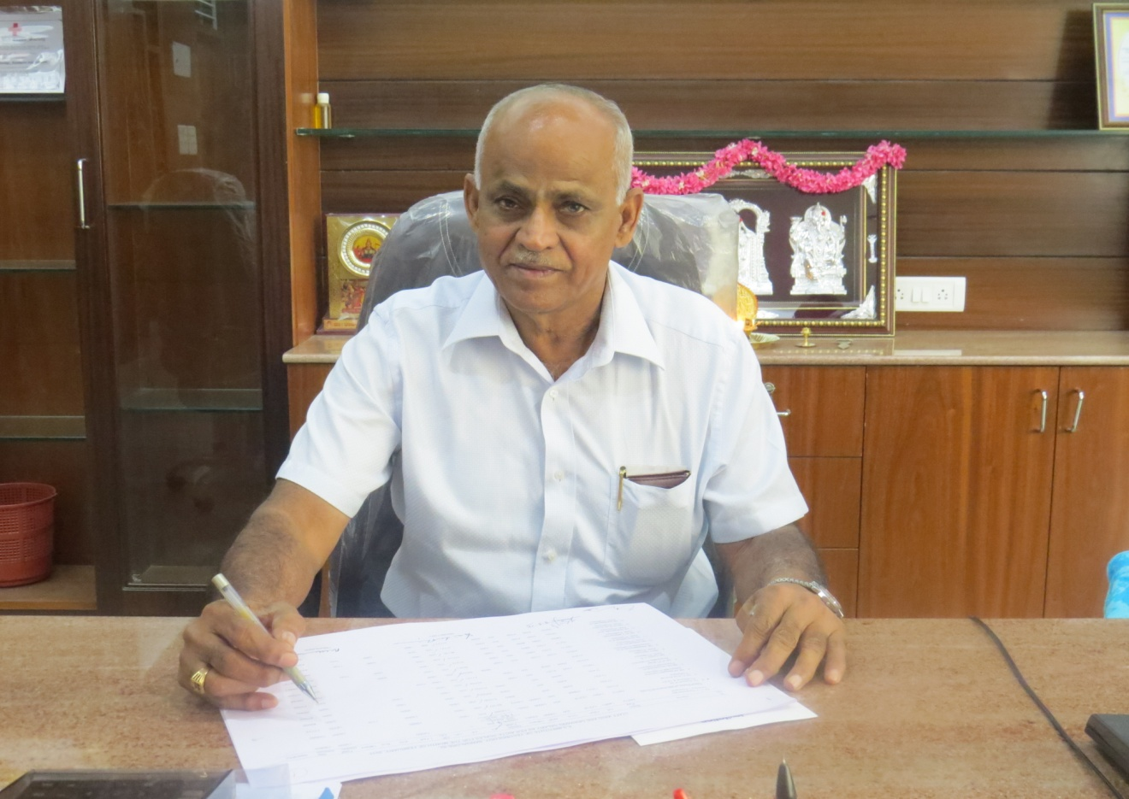
PRESIDENT
KAMMAVARI SANGHAM
Sri. Y.RAMACHANDRA NAIDU

Slide 5
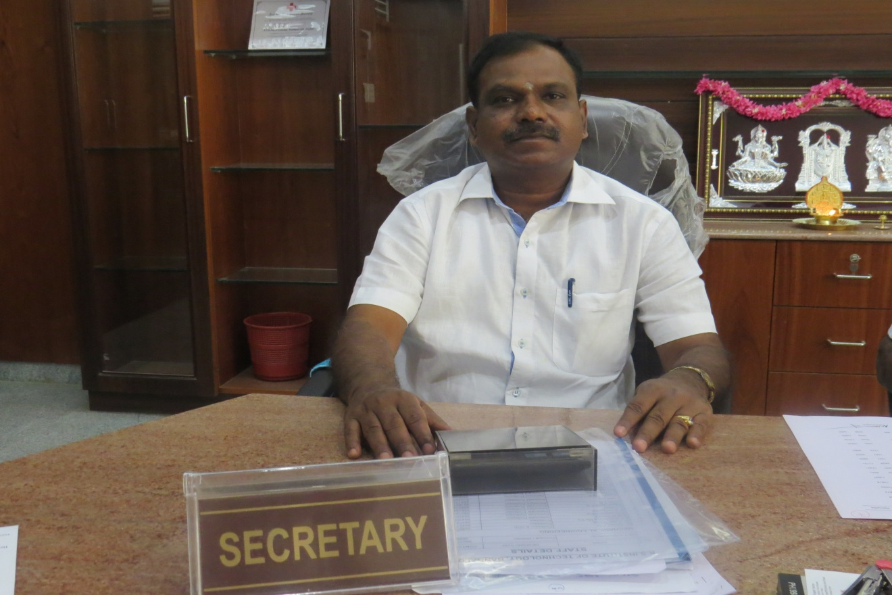
Hon - SECRETARY
KAMMAVARI SANGHAM
Sri. K.VENKATESH NAIDU

Slide 6
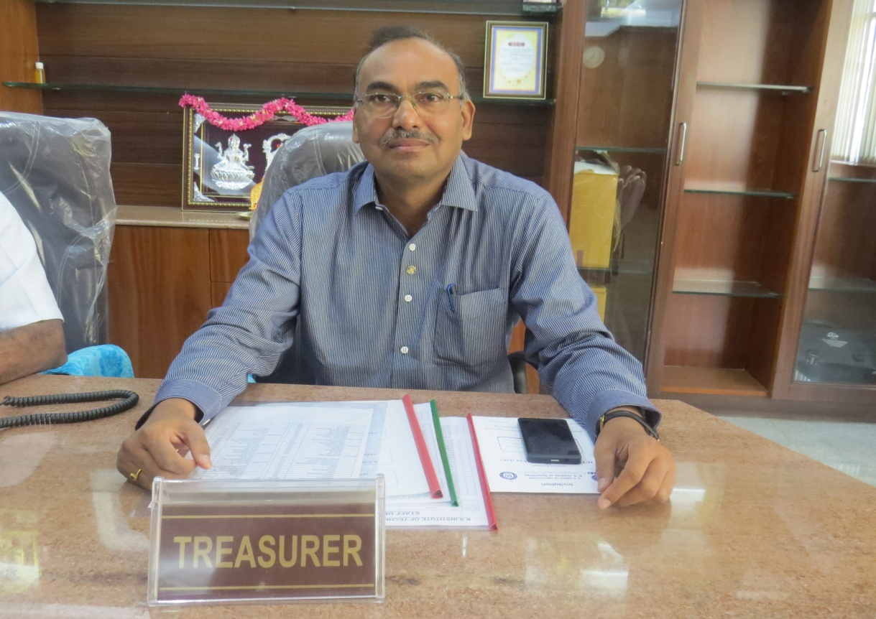
TREASURER
KAMMAVARI SANGHAM
Sri. D.RUKMANGADA

Slide 7
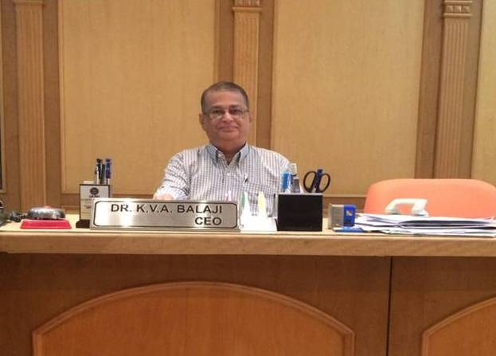
Chief Executive Officer K S Group of Institutions
Dr. K V A BALAJI

Slide 8
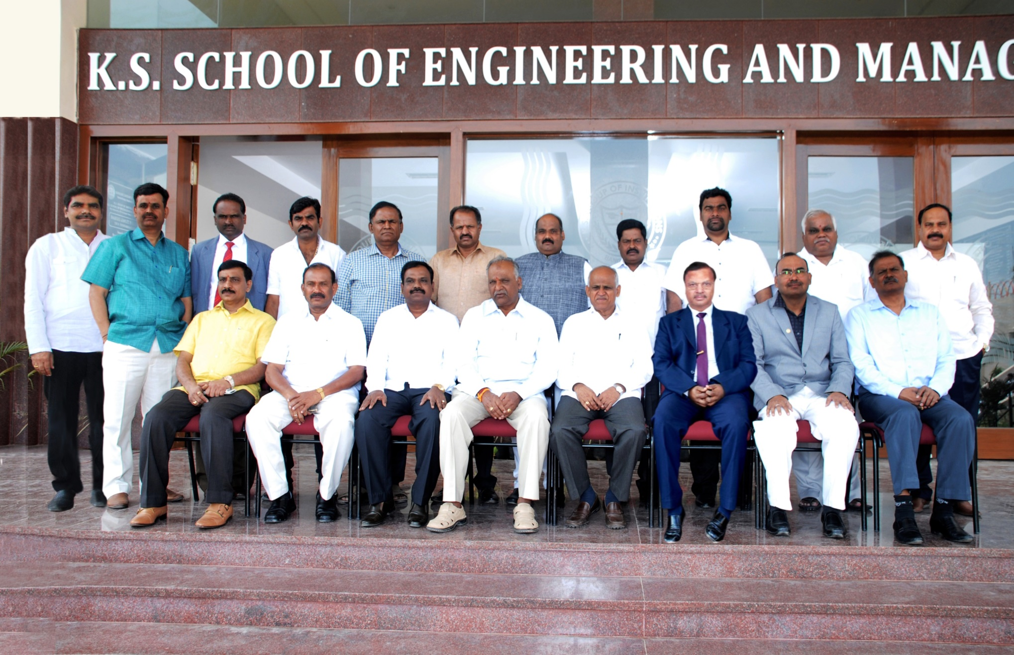
Board of Directors…..

Slide 9
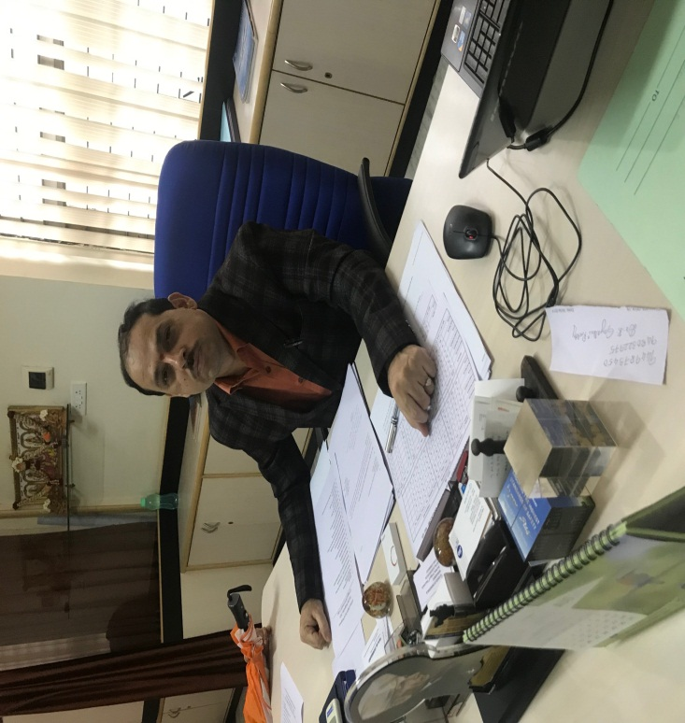
Self…..
Dr. K. Rama Narasimha
Director and Principal, KSSEM
B.E. (Mechanical Engineering)
M.E. (Thermal Power Engineering)
Ph.D. (Heat Pipes)
Teaching, Research and Administration: Over 23 years

Slide 10
Self…..
Ph.D. Guided:
VTU: 6 Research Scholars pursuing Ph.D
M.Tech Thesis Guided: 15
B.E. Thesis Guided: 25
Publications:
20 International Journal Publications
5 International Conference presentations
10 National Conferences

Slide 11
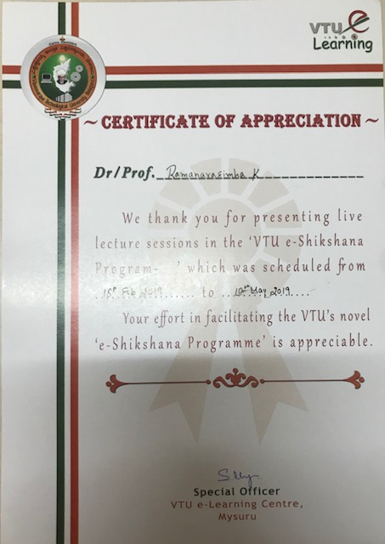
E-Learning Appreciation from VTU for Conducting e-Shikshana Lectures through online which will help the students across Karnataka all the VTU affiliated college during 18th Feb 19 to 10th May 19.

Slide 12
Programmes:
UG Programmes:
BE in:
  Civil Engineering
  Computer Science
  Electronics and Communication Engineering
  Electrical and Electronics Engineering
  Mechanical Engineering
PG Programmes:
M.Tech 1. Engineering Analysis and Design
2. VLSI and Design of Embedded System
3. Structural Engineering
4. Computer Sc and Engineering
MBA (HR, Marketing and Finance)

Slide 13
PhD Programmes:
- Civil Engineering
- Computer Science Engineering
- Electronics and Communication Engineering
- Mechanical Engineering
- Mathematics
- Chemistry

Slide 14
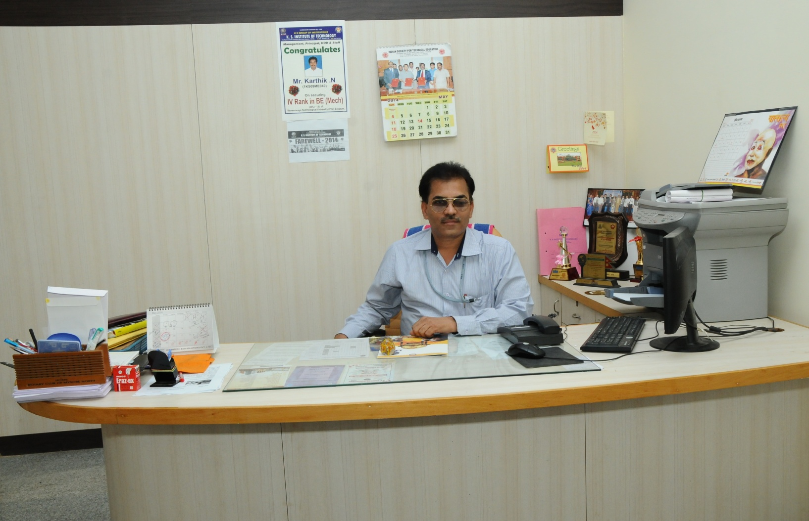
Dr. S B SANGAPPA
PROFESSOR ECE DEPT & PRO
K S GROUP OF INSTITUTIONS

Slide 15
Academic Advisory Board
Dr. H. P. Kincha – Chairman
Dr. K. N. Balasubramanya Murthy – Member
Dr. Y. N. Srikanth – Member
Dr. Shyam Vasudeva Rao – Member
Dr. K. V. A. Balaji – Chief Executive Officer

Slide 16
Key Resource Persons
Dr. B. K. Raghu Prasad – Civil Engg.
Dr. Ram Rastugi P – CSE.
Dr. Neelam Bawane – CSE.
Dr. Joy Prabhakaran – ECE.
Prof. Sasindran Prabhu – ECE.
Prof. Nagaraj M S – Mech.

Slide 17
Glimpse of Faculty

Slide 18
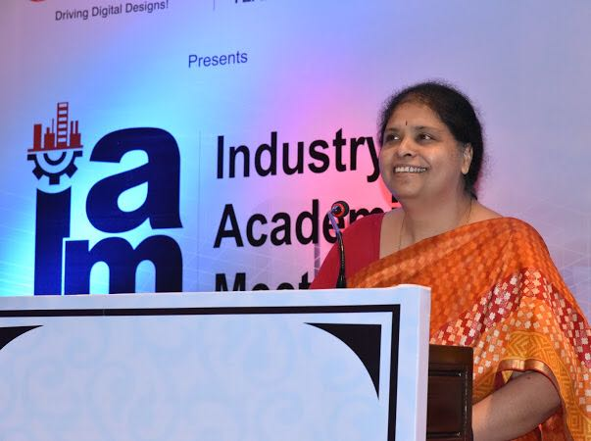
Dr Vijayalakshmi Akella
B.tech from JNTU Hyderabad-
M.E from Andhra University
Ph.D from JNTU Hyderabad
Consultancy:
  Structural design, Cube testing and NDT
Research:
  funded projects worth 30 lacs from Vision group, Govt of Karnataka and VTU
Teaching and Administration:
  Over 30 years of teaching exp
  11 years as HOD
  Co- Authored Text book on Surveying and Levelling published by Prentice Hall of India
  Published several papers in national and International Conferences and Journals
  BOE for VTU

Slide 19
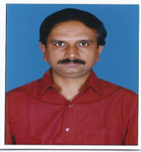
Dr Arekal Vijay
Professor
B.E, Mysore University
M.Tech, NITK, Surathkal
Ph.D, JNTU Anantapur
Teaching & Research:
  10 years of teaching and 5 years of research exp
  Published 8 papers in Journals and Conferences
Consultancy:
13 Years of overseas experience in Civil Engineering.
Consultancy experience include Metro, Airport, Harbour,
  Highways, Tunnels, Reclamation and Petrochemical projects.

Slide 20
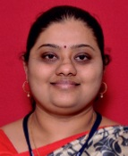
Dr. Vyshali
M.Sc in Geology from Mangalore University
Ph.D from NITK , Surathkal,Karnataka
Research:
  Remote Sensing and GIS
  Water Resources
Teaching
  11 years of teaching exp
  Published several papers in national and International Conferences and Journals
  KSCST project

Slide 21
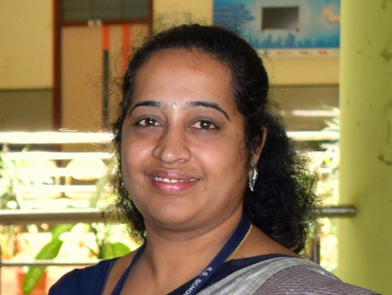
Dr. Savitha B G
savitha.b.g@kssem.edu.in
BE – VTU-2003
M Tech- VTU-2010
Ph.D. – Pondicherry University -2018
Education
Experience
3 years Industry,
9+ years- Teaching
Traffic signal design
Pedestrian Management
Urban transport Planning
Environmental Impact Assessments for civil projects
Expertise
Email-id
Publications
2- International Journals
3- National Journals
3-International Conference
3-National Conference

Slide 22
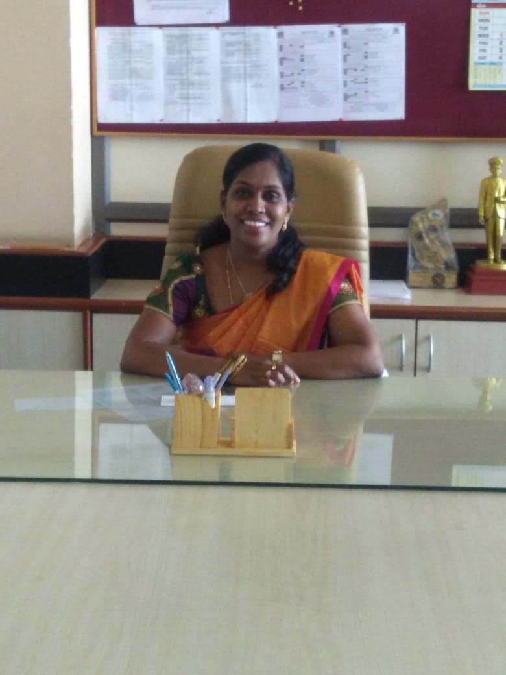
Prof. VEENA R. S.
DESIGNATION : Associate Professor & Head
QUALIFICATION : B.E., M.Tech, (Ph. D)
SPECIALIZATION : Computer Science & Engineering
TOTAL EXPERIENCE : 21 Years of Teaching
Publications:
International Conferences – 03
International Journals – 05
National Conferences – 12
Some of the Achievements:
Adobe Campus Leader at RVCE.
Coordinated CISCO and IBM IoT Hackathons.
Delivered Corporate Training on Microsoft Office & Technologies to RBI employees, Nagpur.
Delivered few Guest Lectures at different institutes like “Virtualization and Cloud Computing”, at KSiSL Institute of Technology, Coimbatore on 05/02/2011.
Chaired Sessions in various Conferences.

Slide 23
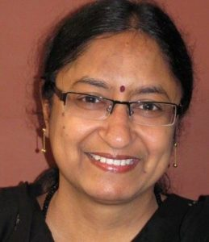
Dr. Neelam Bawane
DESIGNATION : Professor
QUALIFICATION : Ph.D
SPECIALIZATION : Computer Science & Engineering
TOTAL EXPERIENCE : 19 Years of Teaching, Research and Industry
Publications:
International Conferences – 05
International Journals – 02
National Conferences – 01
National Journals – 01
Some of the Achievements:
Authored a book titled “Software Engineering” published by M/s Interline
Publications, Bengaluru in year 2005. Second edition – 2008.
Completed 2 Funded Projects and worked as Consultant.
Coordinated and Judged various Hackathon events.
Faculty for IBM Academic Programs.
Faculty for Wipro Academic Programs WIPRO JUMP START.

Slide 24
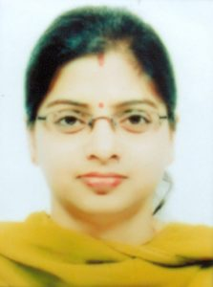
Dr. Vandana Jha
DESIGNATION : Associate Professor
QUALIFICATION : B.E, M.Tech, Ph.D
SPECIALIZATION : Computer Science & Engineering
TOTAL EXPERIENCE : 12 Years of Teaching and Research
Publications:
National Conference – 02
International Conference – 05
International Journals – 05
Some of the Achievements:
The winner of “Best Thesis award” for PhD work titled “Sentiment Analysis in Hindi using Data Mining Algorithms”.
Chaired 2 Sessions in conferences.

Slide 25
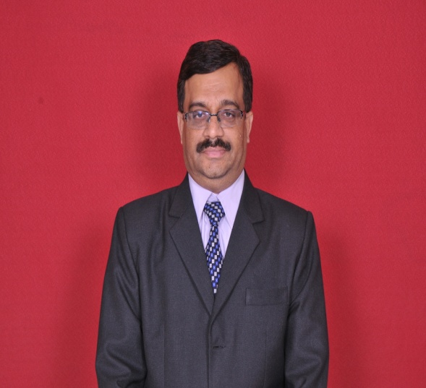
BE (Electronics and Communication Engg.): Gulbarga University
M.E (Digital Electronics): Karnataka University
Ph.D. : Electronics & Communication Engg.: Delhi University
Teaching Experience: 23 years
Ph.D. Guiding: 5
Ph.D. Awarded: 4
Publications: 60 Research Papers in Journals and conferences
Dr. Girish V Attimarad
Prof & Head, Dept. of ECE

Slide 26
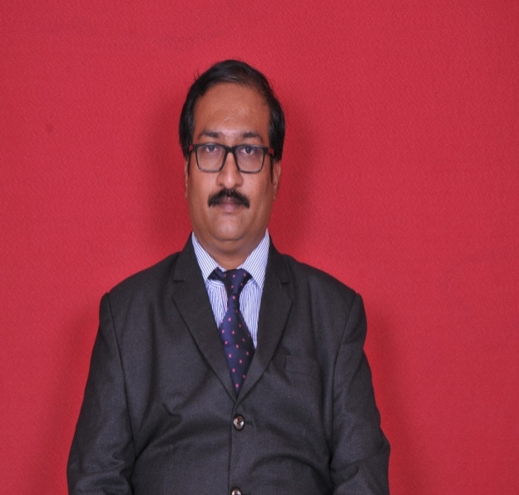
BE (Electronics and Communication Engg.): Periyar University
M.E (Applied Electronics): Sathyabama Deemed University
Ph.D: Electronics & Communication Engg.: Dr.M.G.R. Deemed University
Teaching Experience: 14 years
Ph.D. Guiding: 7
Publications: 36 Research Papers in Journals and conferences
Dr. Karthik P
Prof, Dept. of ECE

Slide 27
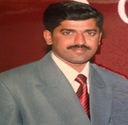
BE (Electronics and Communication Engineering): Mysore University
M.Tech. (Computer Application to Industrial Drives): VTU
Ph.D. : ECE: VTU
Teaching Experience: 18 years
Ph.D. Guiding: 2
Publications: 18 Research Papers in Journals and conferences
Dr. Dushyanth N D.
Prof, Dept. of ECE

Slide 28
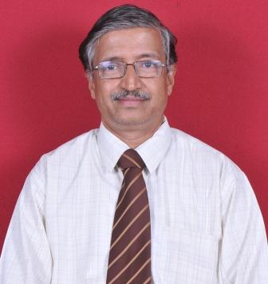
BE (ECE) (Bombay Univ)
ME (Control Systems) (Shivaji Univ)
Experience: 14 years (Teaching)
16 Years (Industry)
Prof. Sanjay Naik
Assoc. Professor,
Dept. Of ECE

Slide 29
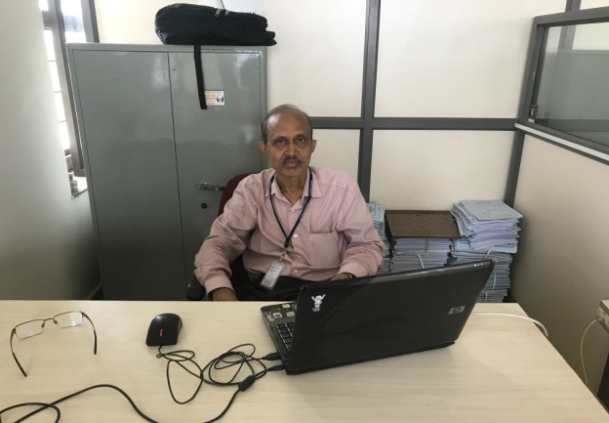
BE (ECE) (Madurai Univ)
ME (Applied Electronics)(Anna Univ)
Experience: 16 Years (Telecom R&D)
18 Years (IT Industry)
Prof. Sasindran Prabhu
Assoc. Professor,
Dept. Of ECE
Key Resource Person

Slide 30
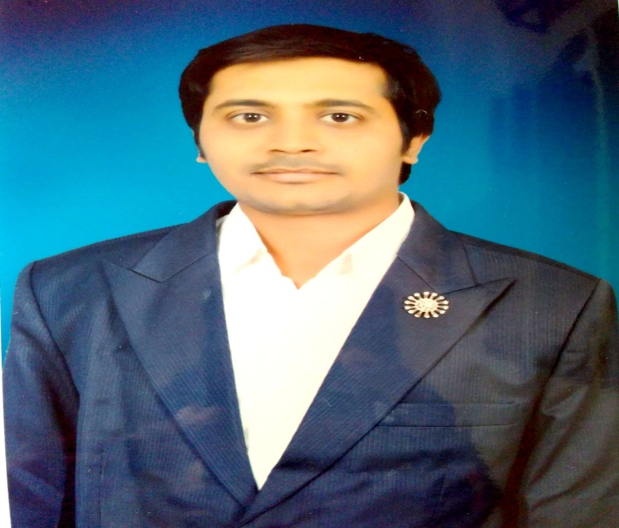
BE (ECE) (VTU)
M.Tech (Electronics) (VTU)
Ph.D (Image Processing and Machine Learning) (VTU)
Experience: 8 years (Teaching)
Research Publications:
International Conference: 04
International Journal: 03
Dr. Kishore M
Assist. Professor,
Dept. Of ECE

Slide 31
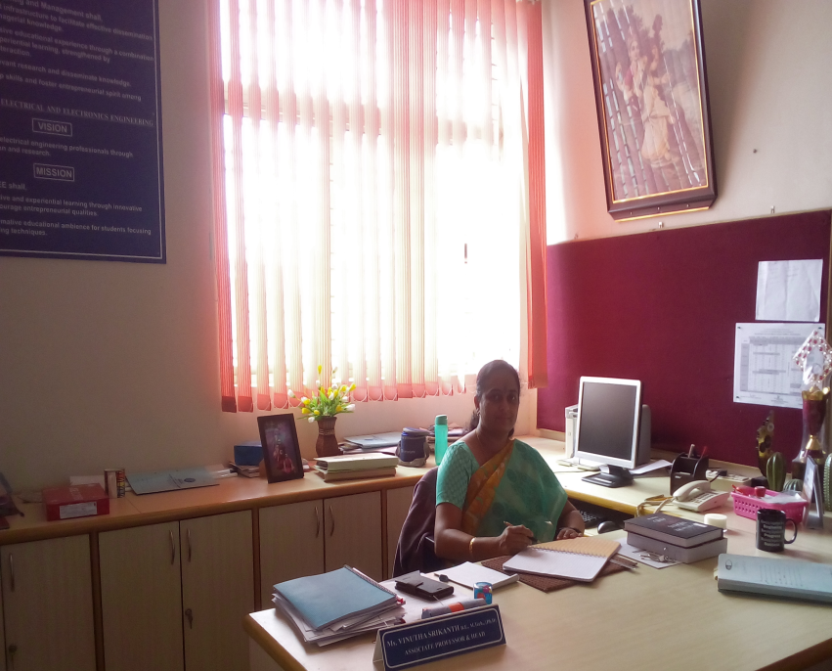
Vinutha Srikanth
Associate Professor and Head
Department of Electrical & Electronics Engineering
Specialisation in the area of Nano-Electronics
Selected for 10 days hands on training on “Characterisation and Fabrication methods for nano materials” at Centre of Nanoscience and Engineering, IISc, Bangalore as a part of INUP programme conducted at National Level through Prime Minister Fund for pursuing Research.
Presented papers in various national and Internationals conferences
Received number of grants for conducting student workshops and faculty development programs from different government organisations
Received “Teacher of Excellence” award for the academic year 2014 – 2015 at KSSEM.
The department believes and aims at
nurturing a tradition of providing an
encouraging and motivating
Environment for faculties as well as students.
I wish my students All the Very Best for all future accomplishments

Slide 32
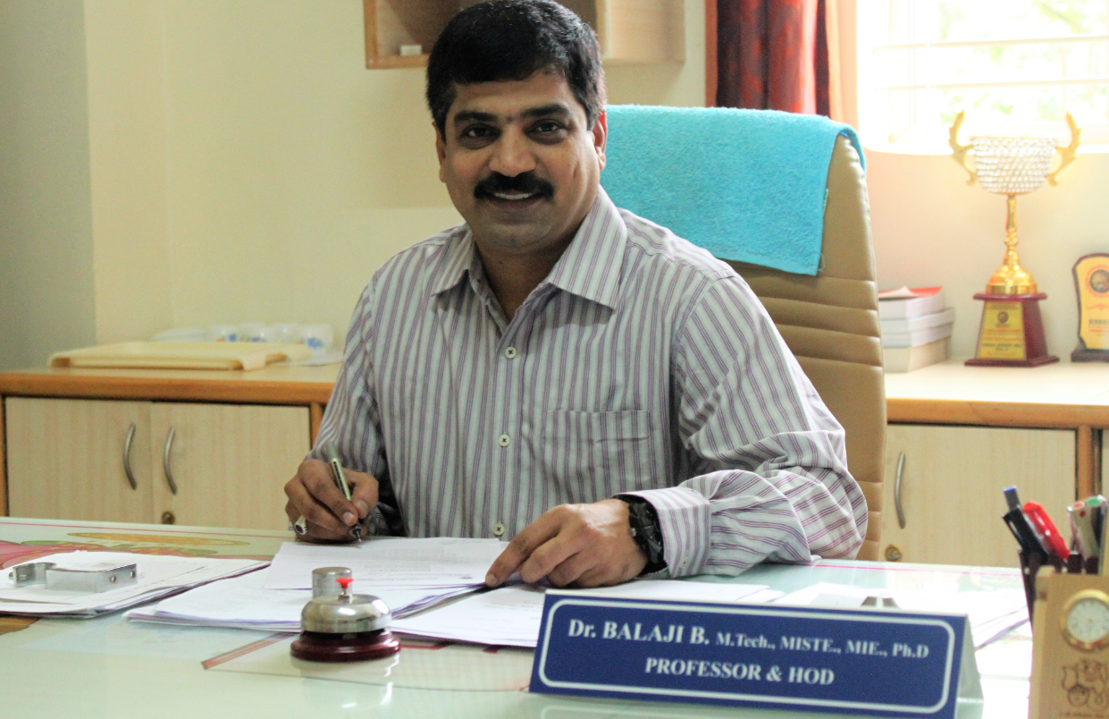
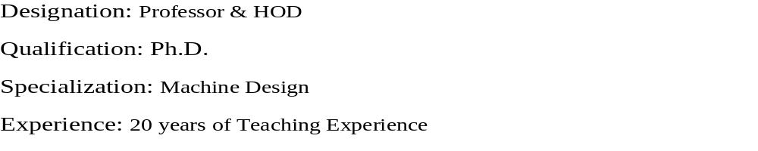
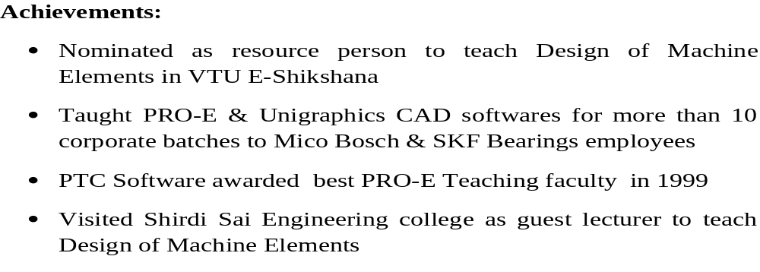
Dr.BALAJI.B
Publications:
International Conference 01
National Conference 02
International Journal 03

Slide 33
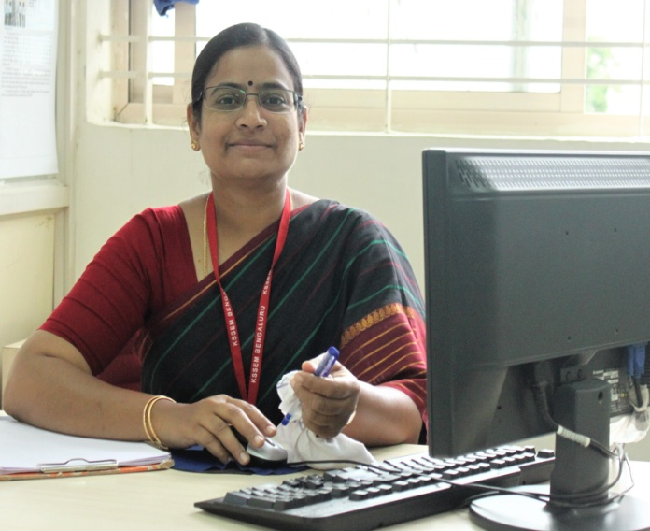
Dr. P N Jyothi
DESIGNATION : Professor
QUALIFICATION : Ph.D.
SPECIALIZATION : Materials and Manufacturing
TOTAL EXPERIENCE : 18 Years of Teaching & Research
Publications:
International Conferences – 04
International Journals – 12
National Conferences – 08
Some of the Achievements:
Secured First Rank in M.Tech (Production Management) in 2002 under Visveswaraya Technological University, Belgaum
Successfully completed KSCST Sponsored project work entitled
“Experimental Studies on Cutting Parameters during Drilling Operation of Mild Steel Using Eco Friendly Vegetable Oil as Cutting Fluid”, under UG student project proposal for the year 2015-2016 & this project received Best Project Award
“Performance evaluation of Nano based bio-oils as cutting fluids for drilling operation of Mild steel”, under UG student project proposal for the year 2016-2017.
“Solar Powered Water Purification using a Natural Coagulant”, under UG student project proposal for the year 2018-2019, this project got 3rd Place at South India Project Exhibition (SIPE-2k19),held at Kalpataru Institute of Technology, Tiptur.
Chaired the sessions at many International Conferences

Slide 34
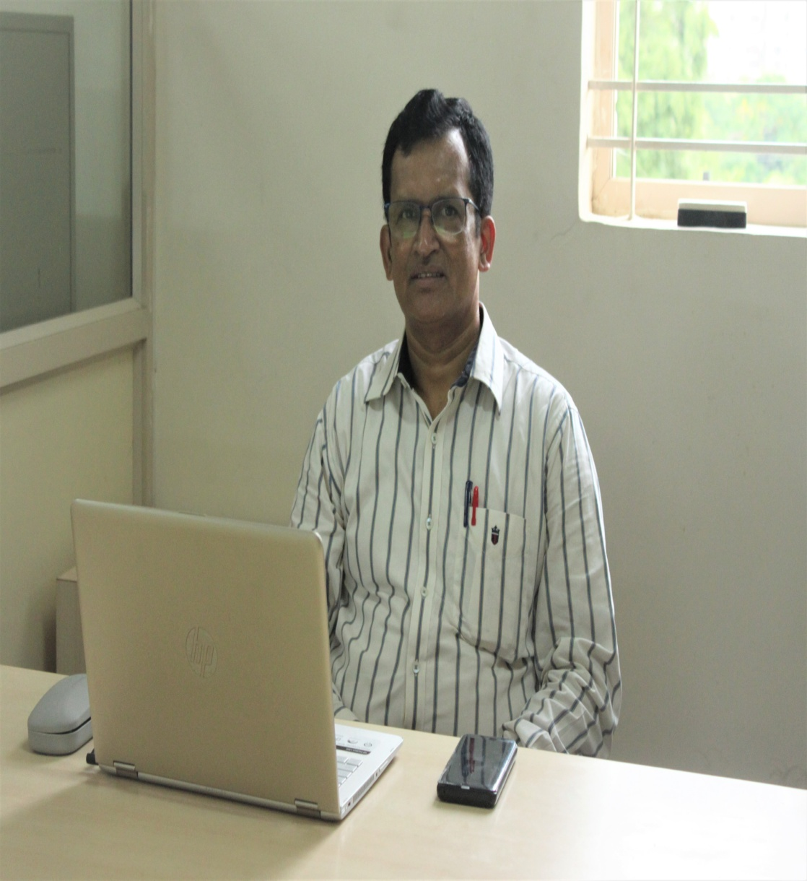
Prof. Nagaraj M S
DESIGNATION : Associate Professor
QUALIFICATION : B.E., M.Tech,
SPECIALIZATION : Mechanical Engineering
TOTAL EXPERIENCE : 34 Years of Industrial Experience
Some of the Achievements:
Coordinated for various internships for final year students
Coordinating for a technical training programme for final year students
Delivered few guest lectures at GT&TC Bangalore on tool engineering.
Guided final year students for various projects on fabrication and solar energy sources.

Slide 35
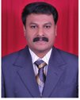
B.Sc. (MPC): Bangalore Univ
M.Sc. (Pure and Applied Maths)
M.Phil (Mathematics)
Ph.D.: Krishnadevaraya Univ
Teaching Experience: 21 years
Ph. D Guiding: 02
Research Publications: 23
Text books published: 26
Dr. C. Vasudev
Professor & Head
Science and Humanity

Slide 36
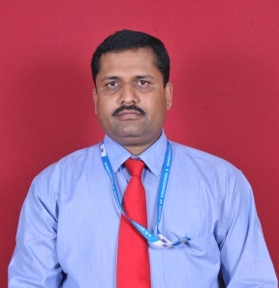
B.Sc. (Chem): Bangalore Univ
M.Sc. (Chem): University of Mysore
Ph.D.: University of Mysore
Teaching Experience: 18 years
Ph.D. Guiding: 3
Research Publications: 4
Dr. Divakara T.R.
Professor in Chemistry

Slide 37
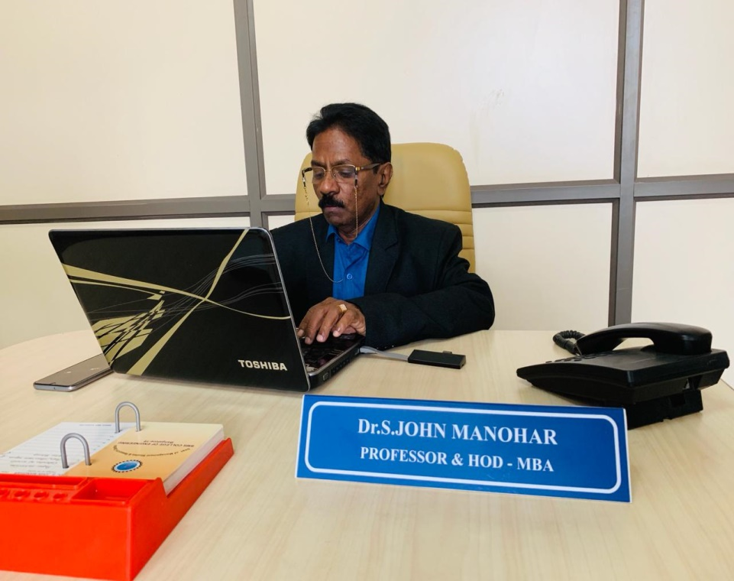
B.Sc. (Loyala College Chennai)
M.B.A. (XLRI Jamshedpur)
Ph.D.: (Madurai Kamaraj Univ)
Industry Experience: 18 Years
Teaching Experience: 19 years
His last tint was in BMS college of Engineering.
Research Guidance:
6 Scholars are awarded Ph.D
6 Scholars are Pursing Ph.D
Research Publications: 100
MBA Projects guided: 120
Dr. S. John Manohar
Professor & Head,
Department of Management Studies

Slide 38
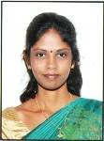
BA (KSOU)
MLISc (IGNOU)
M.Phil (Annamalai),
KSET (Qualified)
Ph.D.: Registered
Experience: 20 years
Mrs. Ambika C.A.
Librarian

Slide 39
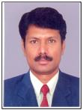
BA (University of Mysore)
B.PEd (University of Mysore)
M.PEd (University of Mysore)
Coach for Archery, Kabaddi, Shuttle Badminton at VTU
Experience: 18 years
Mr. Shivaprakash KM
Physical Ed. Director

Slide 40
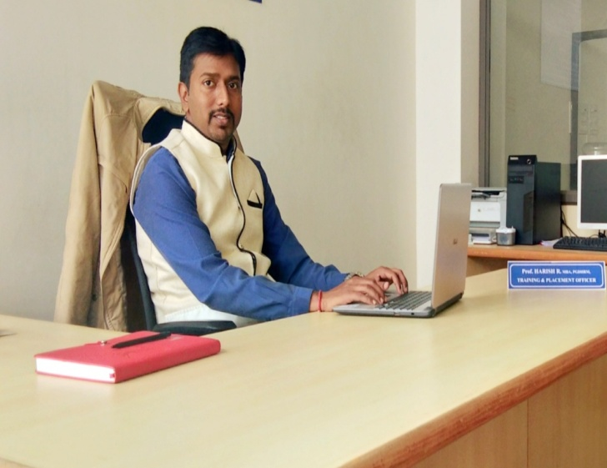
He has done MBA in Marketing and a Post graduate diploma in Human Resource Management .
Currently he is pursuing Ph.D in VTU
Experience: 10 years of experience in Teaching, Placement Officer and Public Relations.
Prof. Harish R
Training and Placement Officer
He has a good network of companies and his objective is to place as many students as possible.

Slide 41
Infrastructure…..
Laboratories
  All Laboratories have high-tech instruments and well equipped
  (Laboratory space is more than specified by VTU)
Library
  VTU related books:
  10% general reading books:
  Continuous addition of volumes
  Reference Section and Magazine Section

Slide 42
Infrastructure…..
Library
  More than 14,000 books
  VTU e-consortium (digital access to journals)
  10% general reading books:
  Continuous addition of volumes
  Reference Section and Magazine Section
  Dedicated Digital Library

Slide 43
Infrastructure…..
Class Rooms
  Spacious Class rooms are available with ergonomically designed furniture
Seminar Halls and Auditorium:
  Seminar halls with seating capacity for 90 & 270 participants
  Auditorium for 200 persons seating capacity
  Multipurpose Hall (1000 seating capacity)

Slide 44
Infrastructure….
Department:
  One block for each department with required number of Class rooms, Staff rooms, Seminar hall and Discussion room

Slide 45

PLACEMENT DETAILS 2019 BATCH
TOTAL NO OF ON-CAMPUS DRIVES | 28
TOTAL NO OF OFF-CAMPUS DRIVES EXCLUSIVELY FOR KSSEM STUDENTS | 11
TOTAL NO OF OFF-CAMPUS DRIVES | 16
TOTAL NO OF POOLED-CAMPUS DRIVES | 4
TOTAL NO OF DRIVES ( AS ON 10TH AUGUST 2019 ) | 59

Slide 46
PACKAGE DETAILS OF 2019 BATCH
HIGHEST PACKAGE ( Above 70% ) | INR 5.5 LPA
AVERAGE PACKAGE (70% to 60%) | INR 3.5 LPA
LOWEST PACKAGE ( Below 59% ) NOTE:-SCORE WELL FOR A BETTER PACKAGE | INR 1.8 LPA

Slide 47

COMPANIES VISITED FOR 2019 BATCH

Slide 48
Ultimate Long Term Goal
Never give-up and keep abreast

Slide 49
Learning Process
Student
Faculty
Parent

Slide 50
Action Plan…..
For student community:
Mentoring: Each student is assigned a faculty as mentor. Mentors are local guardians for the students in this campus
Guest Lectures: from eminent scientists, educationists, industrialists and other resource persons.

Slide 51
Action Plan (Contd..)
For student community:
Internship and Placement Support:
  Final year project internship in industries and corporate
  training on placement preparation and placement with reputed companies
Exposure: to modern corporate world through seminars, workshops and techno-cultural festivals

Slide 52
Action Plan (Contd..)
For student community:
Curricular and Co-curricular Activities: students will be encouraged to take part in curricular and co-curricular activities
Development of Leadership Qualities: Students will be encouraged to organise seminars, quiz programmes and many other such activities

Slide 53
Action Plan (Contd..)
For Faculty:
Faculty Development Programmes: Faculty will be encouraged to participate in faculty development programmes both in-house and external
Research Facilities: Research facilities will be created to carry out research of their own interest

Slide 54
Action Plan (Contd..)
For Faculty:
Resources: Good library support, e-books and access to e-journals
Encouragement to deliver guest lectures: Faculty will be encouraged to deliver guest lectures on various platforms

Slide 55
Action Plan (Contd..)
For Faculty:
Incentives:
  for deriving good results from students
  for authoring text books
  for publishing research papers
  for delivering corporate training
  for industrial consultancy and research work

Slide 56
Action Plan (Contd..)
For Parents:
Progress report: Parents will be intimated about the academic progress
Parents-Students and Staff meeting: Parents-students and staff meeting will be held after the first internal test
Parent-Teacher Meeting will be conducted every semester, so that it will be easy to understand performance of the ward.
Parents have e-mail access to Principal: Parents are encouraged to write to principal directly
principal@kssem.edu.in

Slide 57
Contact Details
principal@kssem.edu.in
hod.civil@kssem.edu.in
hod.cse@kssem.edu.in
hod.ece@kssem.edu.in
hod.eee@kssem.edu.in
hod.mech@kssem.edu.in
hod.science@kssem.edu.in
hod.mba@kssem.edu.in
placement@kssem.edu.in
ped_transport@kssem.edu.in

Slide 58
Glimpse of Activities for Students & Student Achievements

Slide 59
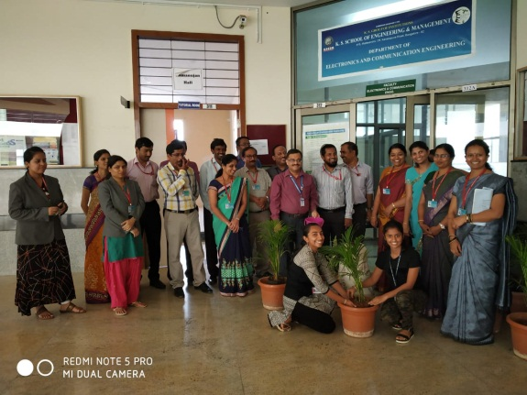
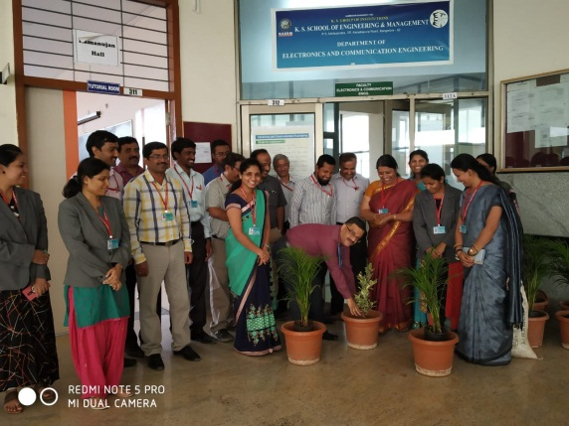
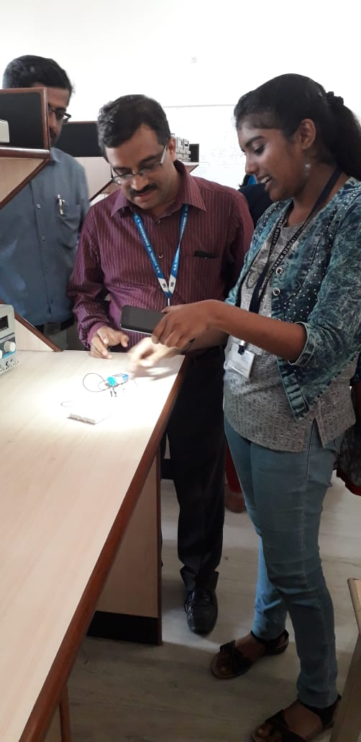
Plantation Event
As a part of Social cause “Save Plant Save Earth”, students of 6th semester ECE Department organized the Plantation event on 22/03/2019. All the faculty members and students have participated in this event by encouraging the students for good cause.
Mini Project Exhibition
The Department of ECE conducted Mini-Project Exhibition on 13th Oct 2018, students 0f 3rd ,5th and 7th sem Exhibited their Mini Project’s, on the topic like Laser Security Alarm system, Railway automatic gate control using Arduino, Solar Mobile Charge etc.
Major objective of the exhibition was to provide the platform of the students by showcasing their innovative projects developed in the final year. The Inaugural of the project exhibition witnessed the presence of HOD and Faculties of the ECE Department.

Slide 60
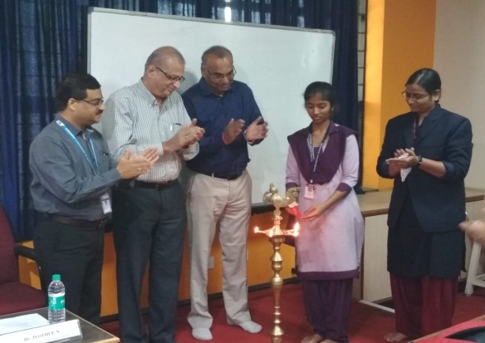
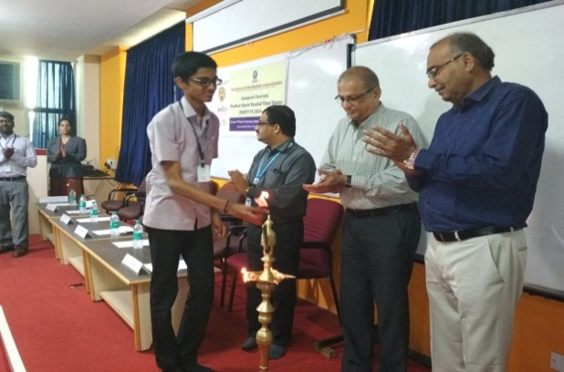
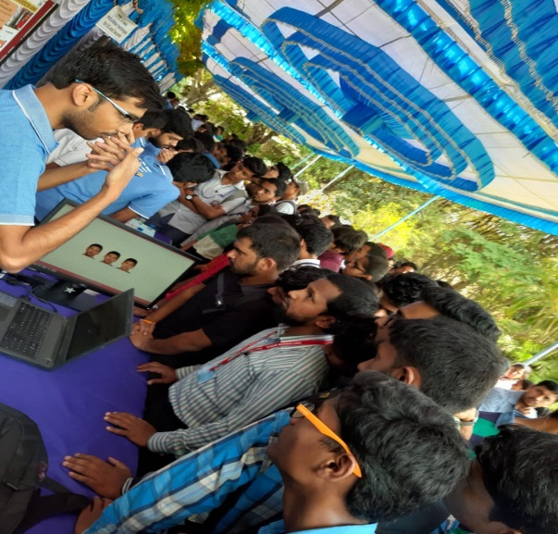
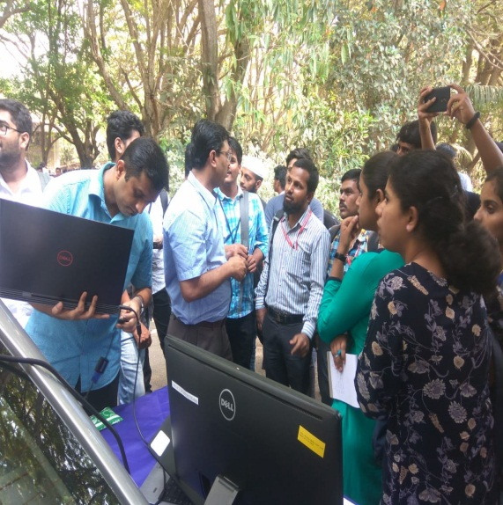
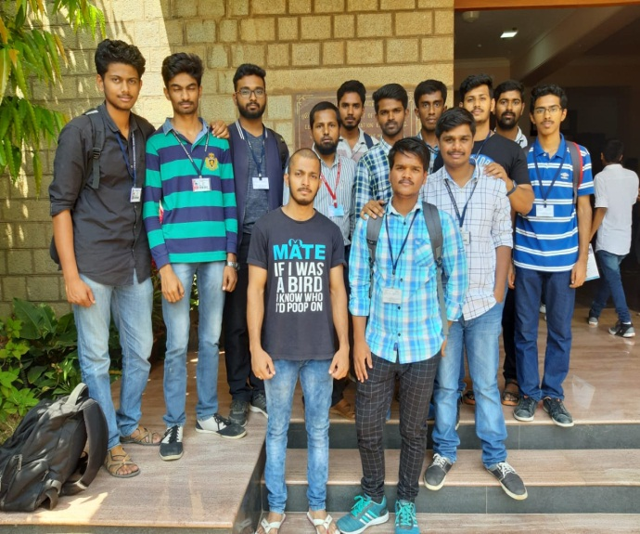
Skill Development Training Program {PMKVY-TI]
The objective of this Skill Certification Scheme is to enable a large number of Indian youth to take up industry-relevant skill training that will help them in securing a better livelihood.
IISC Open Day
On this day, students and the public will have an opportunity to visit the Institute and go around the campus to explore, experience and enjoy the activities of the Institute. The activities will include popular lectures, demonstrations and exhibitions that will be held in the various departments and centers. IISC was open to public on March 23, 2019. IISC show cases its activities to the student community and the general public between 9a.m.–5.00p.m.

Slide 61
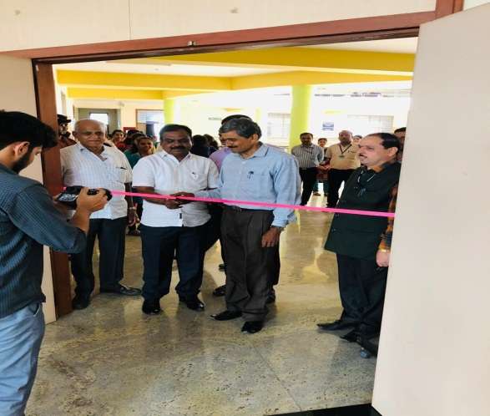
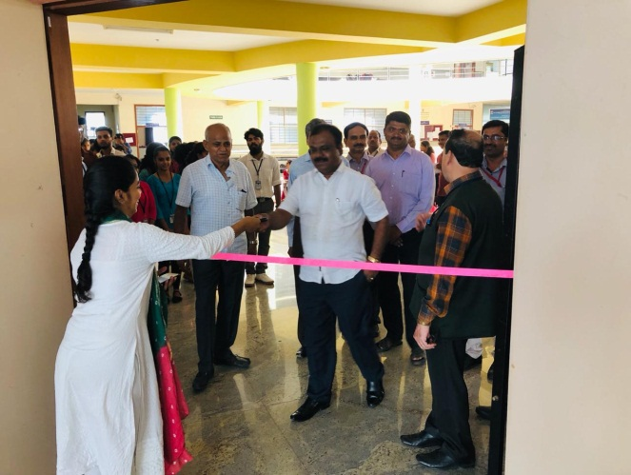
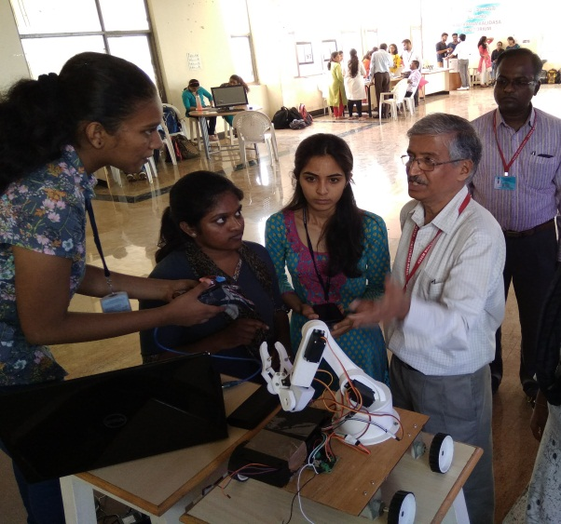
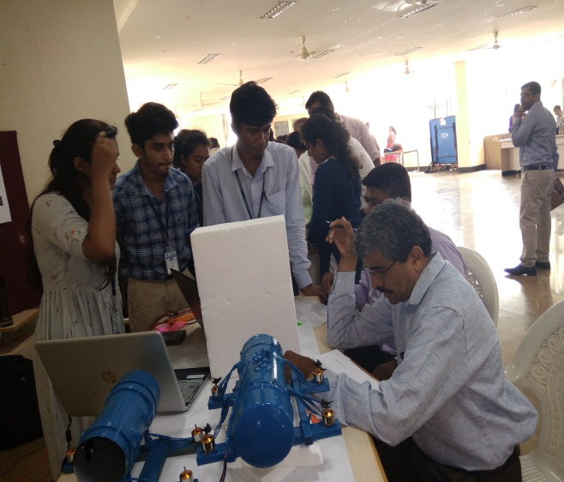
Annual Project Exhibition 2109

Slide 62
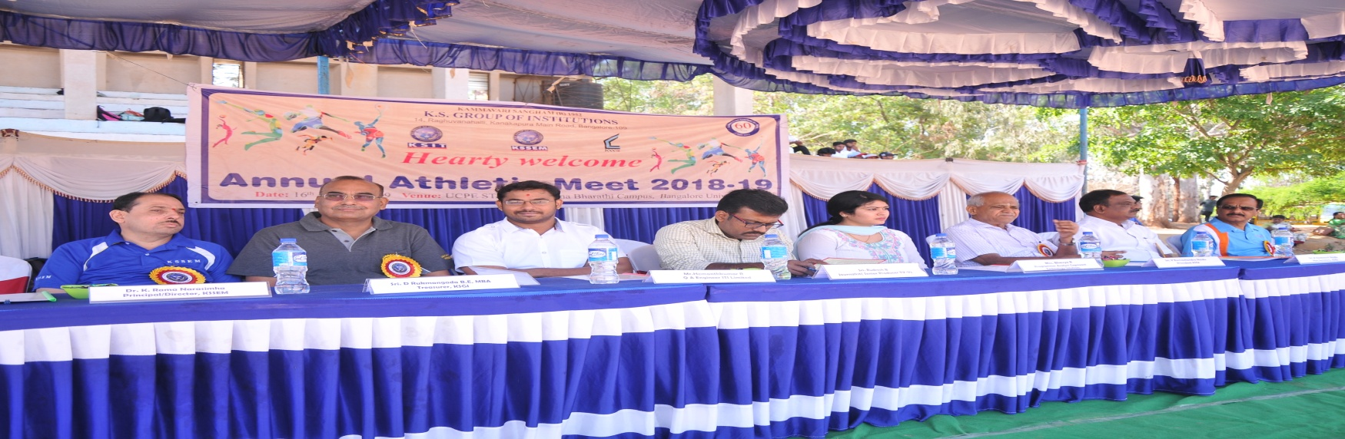
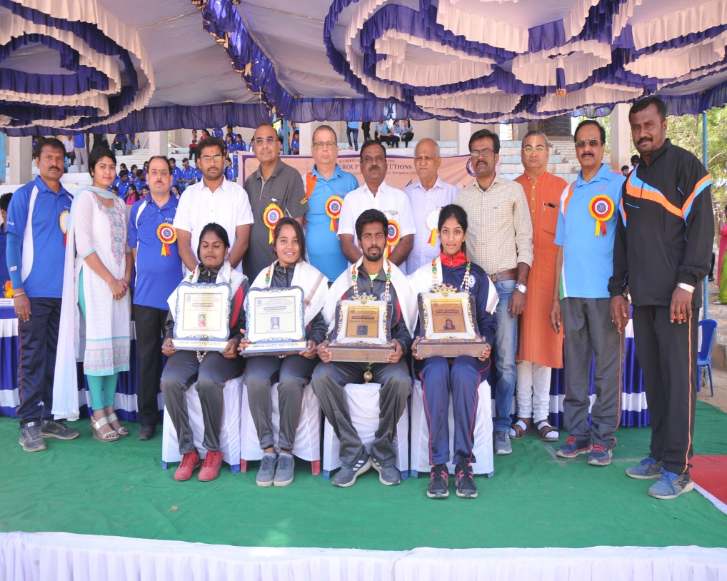
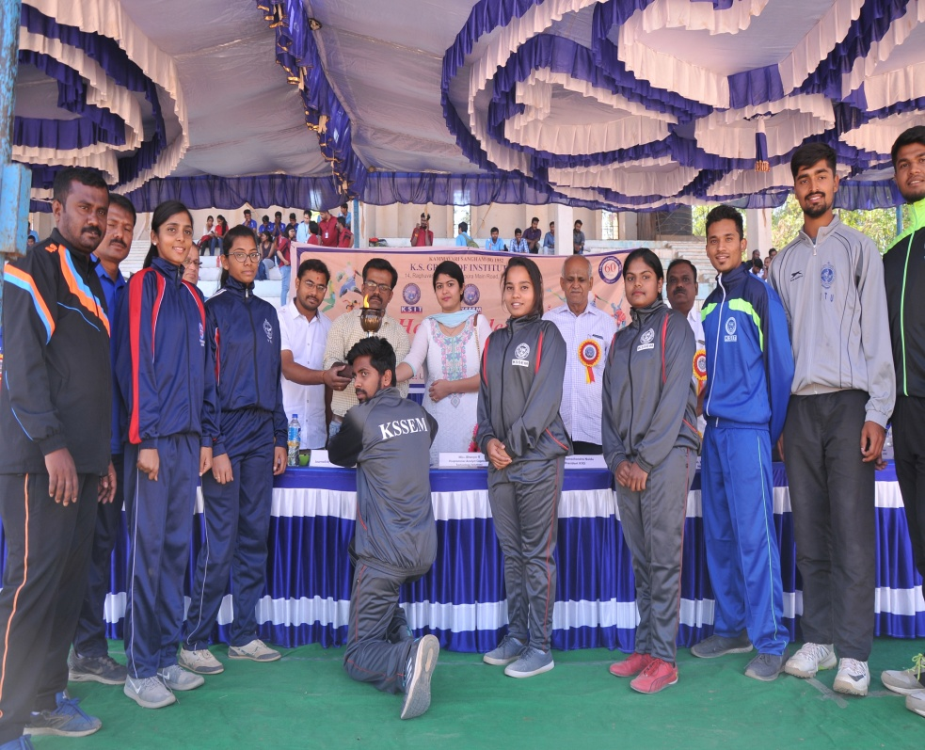

Slide 63
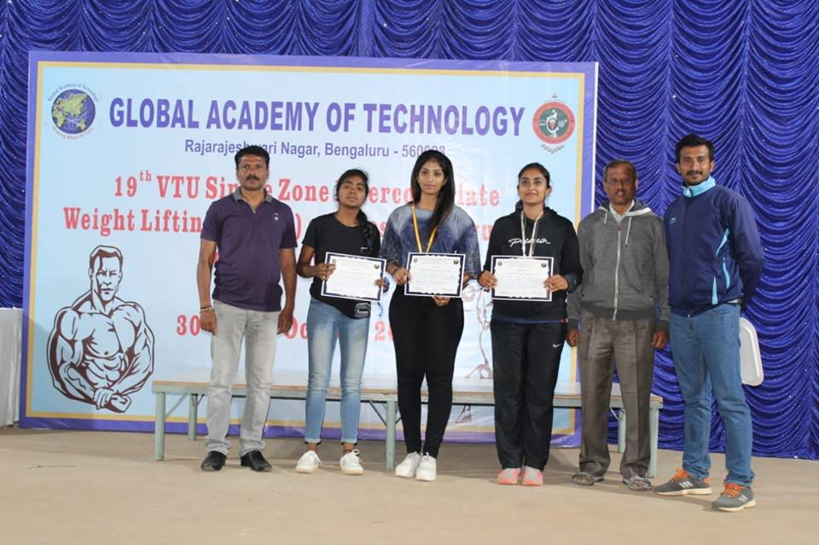
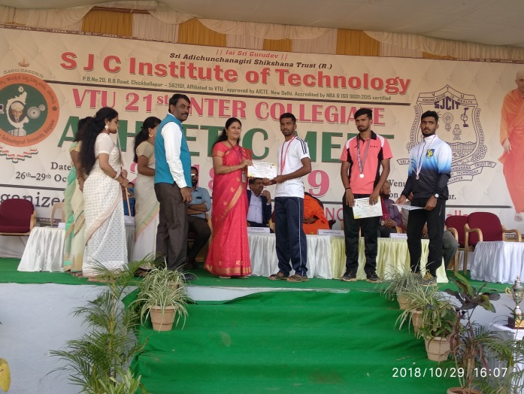



Slide 64





Slide 65







Slide 66



Extra Curricular Activities
Mr. Anantha Somayaji, Director, UniQval Software Solutions Pvt. Ltd has given a talk on 13.04.2018 on Software testing and its career options in industry. The programme is arranged under EXCELTRON forum activities for final year BE students to understand the concept of manual and automated testing, selenium concepts.
Dr. Girish V Attimarad, Professor and HOD, Mr. Sanjay Nayak, Associate Professor, and Mr. Ravikiran from the department presented the talk to the students from all branches of engineering, and discussed the history and importance of electronics and communications, available job opportunities and the current and future trends in technology. The talk included a slideshow on various topics, along with informative videos, and was well-received by the students

Slide 67







Slide 68





Slide 69

Sports Achiever
Sindhu R of 5th Semester, CSE Department participated in 19th VTU Intercollegiate Powerlifting Competition held at Sahyadri College of Engineering and Management, Mangaluru on 28/09/2018 and 29/09/18 and secured Silver Medal.

Slide 70

Sports Achiever
Subhalakshmi of 7th Semester, CSE Department participated in 19th VTU Intercollegiate Powerlifting Competition held at Sahyadri College of Engineering and Management, Mangaluru on 28/09/2018 and 29/09/18 and secured Bronze Medal.

Slide 71

Inter College Project Competition at DSATM
Mohammad Ghouse , Harsha Vardhan N K and Chandan Kumar H R won 3rd place in the inter college project competition held at DSATM for the project “Design and develop a system for generating individual bill as per the usage of water and monitoring its quality” under the guidance of Prof. Veena R.S.

Slide 72
Student Welfare
Teacher Mentors will be assigned to each student to counseling and guiding
Direct access to HODs, mentors and Principal

Slide 73
Official Website www.kssem.edu.in
Official Social Media www.facebook.com/kssem

Slide 74
Rules and Regulations of KSSEM
Dress Code for Boys
* Collarless T-shirts and T-shirts with printed matter, cargo’s , long hairs are not allowed
Dress Code for Girls
* Collarless T-shirts and T-shirts with printed matter, tight skin T-shirts, low waist jeans, short tops, are not allowed

Slide 75
Rules and Regulations of KSSEM
Uniform is compulsory for laboratory, Internal test and University Examinations.
Mobile Phones are banned in the college premises.

Slide 76
Malpractice During the Internals
A fine of Rs.1000/- will be levied and will be awarded 0 marks in that particular subject for the student indulging in malpractice.

Slide 77
Pupilpod – For Attendance
BH - KSEMBG

Slide 78
Participation from parents…..
Moral Support
Help in time management
Progress monitoring
Close interaction
Encouragement and guidance
Frequent visit to college
Student activity monitoring

Slide 79
Request for parents…..
Please do not
Pressurise your ward beyond limits
Curb the talents of your ward
Encourage junk food
Encourage bad opinion about college, neighbours and friends
Encourage malpractice
Encourage too much of outing and freaking out

Slide 80
Request for parents…..
Please do not
Encourage wearing indecent dresses and shabby appearances
encourage laziness by helping them beyond limits

Slide 81
Request for parents…..
Help them to take decisions, but do not force your opinion
Help them to be organised at home and studies
Help them to develop good habits
Provide sufficient time for relaxing and physical exercise

Slide 82


Slide 83


Slide 84
Grade Point Scale
Level | Out-standing | Excellent | Very Good | Good | Above Average | Average | Poor | Fail
Grade | O | S | A | B | C | D | E | F
Grade Points | 10 | 09 | 08 | 07 | 06 | 05 | 04 | 00
Score (Marks) Range (%) | ≥ 90 | <90 ≥ 80 | < 80 ≥70 | < 70 ≥60 | < 60 ≥50 | < 50 ≥45 | < 45 ≥40 | < 40

Slide 85
Illustration of Computation of SGPA
Course | Credit | Grade letter | Grade point | Credit Point (Credit x Grade Point)
Course 1 | 4 | A | 8 | 4x8 = 32
Course 2 | 4 | C | 6 | 4x6 = 24
Course 3 | 4 | B | 7 | 4x7 = 28
Course 4 | 3 | O | 10 | 3x10= 30
Course 5 | 3 | D | 4 | 3x4 = 12
Course 6 | 3 | C | 6 | 3x6 = 18
Course 7 | 2 | S | 9 | 2x9 = 18
Course 8 | 2 | C | 6 | 2x6 = 12
 | 25 |  |  | 174
Thus, SGPA= 174/25=6.96

Slide 86
Illustration of Computation of CGPA
CGPA after Final Semester
Semester 1 | Semester 2 | Semester 3 | Semester 4 | Semester 5 | Semester 6 | Semester 7 | Semester 8
Credit : 25 SGPA:7 | Credit : 25 SGPA:8.5 | Credit : 27 SGPA:9.2 | Credit : 27 SGPA:6.86 | Credit :27 SGPA:8.18 | Credit : 24 SGPA:7.73 | Credit : 24 SGPA:8.68 | Credit : 24 SGPA:9.4
Thus, CGPA=
8.18

Slide 87
Attendance Requirement…..
Minimum of 85% of attendance is mandatory in all classes
However, about 10% attendance can be made up (given exemption) for deserved candidates on following grounds
  Medical
  Participation in University Level Sports, Cultural Activities, Seminars, Workshops and Paper Presentation
  Students fail to meet the minimum attendance requirement in any one subject will have to repeat that year.

Slide 88
Marking Scheme…..
Internal Assessment:
Average of three tests conducted will be considered (for theory classes)
Laboratory: record keeping and one test

Slide 89
Marking Scheme…..
Pass requirements:
Theory Examinations:
Minimum of 21 marks for 60 (i.e. 35%) in main exam and 40 marks for 100 (i.e., 40%, inclusive of main exam and IA Marks)
Ex: Main Examination + IA
21 + 19 = 40 (Pass)
40 + 00 = 40 (Fail)
00 + 20 = 20 (Fail)
21 + 16 = 37 (Fail)
24 + 16 = 40 (Pass)
Practical Examinations:
Internal Marks: Minimum to be obtained is 20 out of 40 (50%)
External Examination Marks: Minimum to be obtained is 21 out of 60 (35%)

Slide 90
Eligibility for Passing
To pass in a theory subject, a student shall secure a minimum of 35% in the external exams and it will be reduced to 60 (minimum 21 marks) an aggregate of 40 marks in the subject summing with internals (19) as per the university.
Theory (60) + internal (40) = Total marks
21 + 19 = 40 (pass)
10 + 20 = 30 (fail)
40 + 00 = 40 (pass)
21 + 10 = 31(fail)

Slide 91
Marking Scheme…..
Pass requirements:
No chance will be given for the improvement of IA in theory subjects
No opportunity will be given for the improvement of IA in practical, once the student has scored minimum required marks
A student failed to secure minimum required marks in the IA of a practical class will not be allowed to appear for main examination in the same topic and he/she has to attend the practical classes once again and score minimum marks before getting eligibility to attend the practical examination.

Slide 92
Promotion and Eligibility Criteria
No restriction for moving from odd (1,3,5 and 7) to immediate even semester.
Maximum of four subjects can be carried on from 1st and 2nd to 3rd semester.
A student is eligible to move to 5th Semester if he/she has completed all subjects of 1st and 2nd and does not have more than four subjects pending together from 3rd and 4th semesters.
A student is eligible to move to 7th Semester if he/she has completed all subjects from 1st to 4th sem and does not have more than four subjects pending together from 5th and 6th semesters.

Slide 93
Class Timings:
Mon-Fri: 8.40 am to 3.50 pm
Alternate Saturday will be holiday except in Aug. Please refer calendar of Events in our website.
Regular Classes: 13th Aug 2019 onwards
Orientation and Bridge Course:
13th Aug 2019

Slide 94
Transport:
Transport has been arranged from almost all corners of the city
Encourage your ward to take up our transport facility

Slide 95
Interaction Please

Slide 96
Room Allotment for First Year Student
Sl.No. | Branch | Section | Room No. | CYCLE
1 | Civil Engg. & CSE | A | N 301 | PHYSICS CYCLE
2 | Computer Science & Engg. | B | 101
 |  | C | 114
3 | Electrical Electronics Engg. & CSE | D | 104
4 | Electronics & Communication Engg. | E | 105 | CHEMISTRY CYCLE
 |  | F | 110
5 | Mechanical Engg. & ECE | G | N 104

Slide 97
Academic Calendar for I Sem
Classes Begin: 13th Aug ‘19
First Test: 11-13 Sept ‘19
Parents-Teacher’s meeting: 23rd Sept ’19
Second Test: 14-16 Oct ‘19
Third Test: 9-11 Dec ‘19
Practical Internals test: 16-18 Dec ’19
Practical External Exams: 23-30 Dec ‘19
Theory Exams: 2-24 Jan ‘19

Slide 98
Thank You All

