Slide 1
LINKED LIST
MODULE 3
Data Structures

Slide 2
Singly Linked list
Linked list is linear collection of data elements called nodes with each node having 2 parts
INFORMATION of element
ADDRESS of next node in the list
Example
External ptr
bat •
cat •
sat •
vat NULL

Slide 3
Representation of linked list in memory
External ptr
X •
T •
A •
K NULL
INFO
LINK
1
2
3
4
5
6
7
8
A
5
START
7
T
2
K
0
X
4

Slide 4
creating a linked list
Array implementation of List
struct listnode {
char info;
int link;
};
struct listnode node[MAX_SIZE];
int ptr=-1;
Linked List using Dynamic variables
struct listnode {
char data;
struct listnode * link;
};
typedef struct listnode *listptr;
Creation
listptr ptr=NULL;
Testing
#define IS_EMPTY(ptr) (!(ptr))
Allocation
cptr=(listptr) malloc (sizeof(listnode));

Slide 5
Traversing a linked list
Algorithm: Traversing(LIST)
This algorithm traverses LIST. The variable PTR points to the node currently being processed
Step 1 : Set PTR:=START
Step 2: Repeat step 3 and 4 while PTR != NULL
Step3: Apply process to INFO[PTR]
Step 4 : Set PTR:=LINK[PTR]
[End of Step2 loop]
Step 5 :exit

Slide 6
Searching in a linked list
Searching in an unordered list
SEARCH ( LIST,START,ITEM,LOC)
LIST is a linked list. This algorithm finds the location LOC of the node where ITEM first appears in the list, or sets LOC =NULL
Step 1: set PTR=START
Step2: repeat step 3 while PTR !=NULL
Step 3: If ITEM= INFO[PTR] then Set LOC:=PTR and exit
Else
Set PTR:=LINK[PTR]
[End of If structure]
[End of step 2 loop]
Step 4: set LOC:=NULL [unsuccessful search]
Step 5:exit

Slide 7
Searching in a linked list
SRCHSL (LIST,START,ITEM,LOC)
LIST is a sorted list. This algorithm finds the location LOC of the node where ITEM first appears in the list, or sets LOC =NULL
Step 1: set PTR=START
Step2: repeat step 3 while PTR !=NULL
Step 3: If ITEM< INFO[PTR] then
Set PTR:=LINK[PTR]
Else ITEM = INFO[PTR] then Set LOC:=PTR and exit
Else set LOC:=NULL and exit
[End of If structure]
[End of step 2 loop]
Step 4: set LOC:=NULL [unsuccessful search]
Step 5:exit

Slide 8
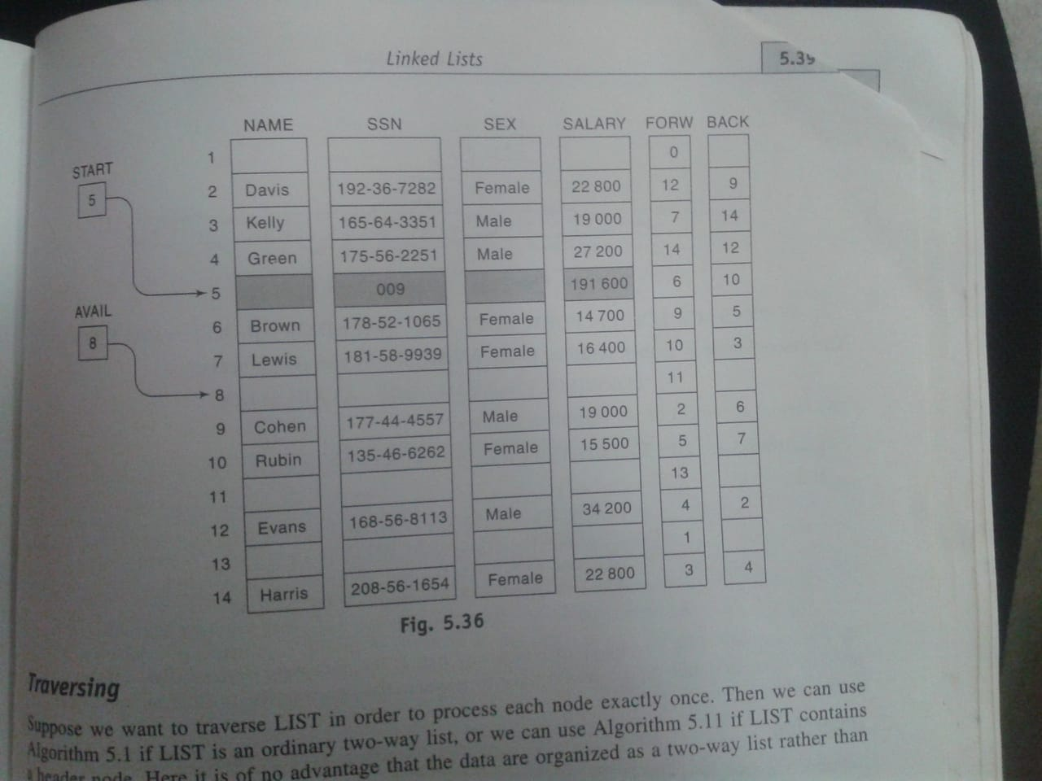

Slide 9
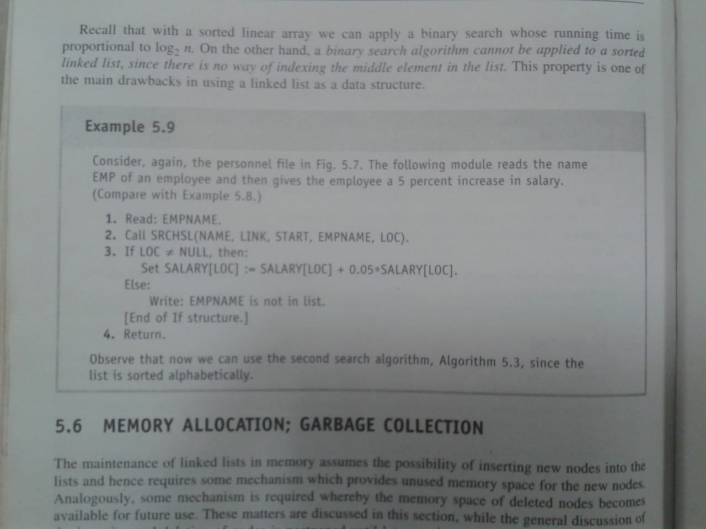

Slide 10
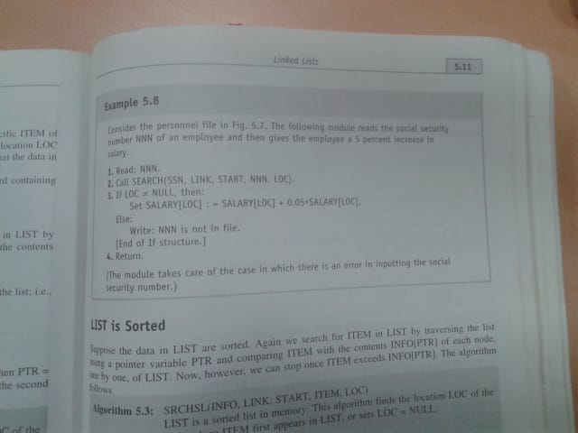

Slide 11
Insert
Before insertion
After insertion
External ptr
bat •
cat •
sat •
vat NULL
External ptr
bat •
cat •
sat •
vat NULL
Eat .

Slide 12
3 cases
Insert at beginning
Insert after a given node
Insert in the sorted list

Slide 13
Insert at beginning
Algorithm: INSFIRST( INFO, LINK, START,AVAIL,ITEM)
This algorithm inserts ITEM as the first node in the list
1 [ OVERFLOW? ] if AVAIL =NULL write OVERFLOW and Exit
2 [ Remove the first node from the AVAIL list]
Set NEW:= AVAIL and AVAIL:=LINK[AVAIL]
3 Set INFO[NEW] := ITEM
4 Set LINK[NEW]:=START
5 Set START:=NEW
6 Exit
start
bat •
cat •
sat •
vat NULL
start
Eat .

Slide 14
Insert after a given node
Algorithm: INSLOC( INFO, LINK, START,AVAIL,LOC,ITEM)
This algorithm inserts ITEM after the given location LOC
1 [ OVERFLOW? ] if AVAIL =NULL write OVERFLOW and Exit
2 [ Remove the first node from the AVAIL list]
Set NEW:= AVAIL and AVAIL:=LINK[AVAIL]
3 Set INFO[NEW] := ITEM
If LOC=NULL then, Set LINK[NEW]:=START and START:=NEW
else
Set LINK[NEW]:=LINK[LOC] and LINK[LOC]:=NEW
[ End of If ]
5 Exit
start
bat •
cat •
sat •
vat NULL
Eat .

Slide 15
Inserting into the sorted list
Algorithm INSERT( INFO, LINK, START, AVAIL, ITEM)
This algorithm inserts ITEM into the sorted linked list
Call FINDA(INFO, LINK, START, ITEM,LOC)
Call INSLOC(INFO, LINK, START, AVAIL,LOC, ITEM)
Exit
Procedure: FINDA(INFO, LINK, START, ITEM,LOC)
This procedure finds location LOC of the last node in a sorted list such that INFO[LOC] is less than ITEM or Sets LOC:=NULL
[ list empty? ] is START =NULL then Set LOC:=NULL and Return
If ITEM < INFO[START] then Set LOC:=NULL and Return
Set TRAIL:= START and PTR:=LINK[START]
Repeat steps 5 and 6 while PTR !=NULL
If ITEM< INFO[PTR] then Set LOC:= TRAIL and Return
[ End of if ]
Set TRAIL :=PTR and PTR:=LINK[PTR]
[End of step 4 loop]
7 Set LOC:= TRAIL
8 Return

Slide 16
SINGLY LINKED LISTS
Linked list
  An ordered sequence of nodes with links
  The nodes do not reside in sequential locations
  The locations of the nodes may change on different runs
ptr
bat •
cat •
sat •
vat NULL

Slide 17
INFO
LINK
1
2
3
4
5
6
7
8
0
AVAIL
5
A
0
1
START
7
T
2
6
8
X
4
3

Slide 18
Memory allocation – garbage collection
A special list which is maintained for the unused memory cells is called as available list
The OS of computer periodically collects all the deleted spaces onto the free storage list
The technique that does this collection is called garbage collection

Slide 19
Application of linked list
As Data structure – insafter , Delafter Operations
To implement other data structures such as Stacks, Queue, ordered list like polynomial etc.

Slide 20
Polynomials
Representation
struct polynode {
int coef;
int expon;
struct polynode * link;
};
typedef polynode * poly_pointer;
poly_pointer a, b, c;
coef expon link

Slide 21
Example
  a= 3x¹⁴+ 2x⁸+ 1
  b= 8x¹⁴- 3x¹⁰+ 10x⁶
a
3 14 .
2 8 .
1 0 null
b
8 14 .
-3 10 .
10 6 null

Slide 22
Adding Polynomials
3 14
2 8
1 0
NULL
a
8 14
-3 10
10 6
NULL
b
11 14
NULL
a->expon == b->expon
d
3 14
2 8
1 0
NULL
a
8 14
-3 10
10 6
NULL
b
11 14
-3 10
NULL
a->expon < b->expon
d

Slide 23
Adding Polynomials (Continued)
3 14
2 8
1 0
NULL
a
8 14
-3 10
10 6
NULL
b
11 14
-3 10
2 8
NULL
d
a->expon > b->expon

Slide 24
Algorithm for Adding Polynomials
poly_pointer padd(poly_pointer a, poly_pointer b)
{
poly_pointer front, rear, temp;
int sum;
rear =(poly_pointer)malloc(sizeof(poly_node));
if (IS_FULL(rear)) {
fprintf(stderr, “The memory is full\n”);
exit(1);
}
front = rear;
while (a && b) {
switch (COMPARE(a->expon, b->expon)) {

Slide 25
case -1: /* a->expon < b->expon */
attach(b->coef, b->expon, &rear);
b= b->link;
break;
case 0: /* a->expon == b->expon */
sum = a->coef + b->coef;
if (sum) attach(sum,a->expon,&rear);
a = a->link; b = b->link;
break;
case 1: /* a->expon > b->expon */
attach(a->coef, a->expon, &rear);
a = a->link;
}
}
for (; a; a = a->link)
attach(a->coef, a->expon, &rear);
for (; b; b=b->link)
attach(b->coef, b->expon, &rear);
rear->link = NULL;
temp = front; front = front->link; free(temp);
return front;
}
Delete extra initial node.

Slide 26
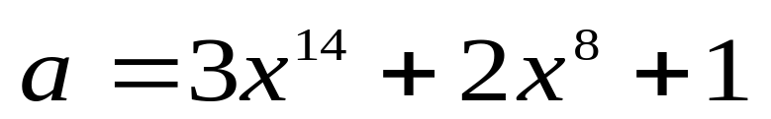
Representing Polynomials As Circularly Linked Lists
Represent polynomial as circular list with header node.
(1) zero
a
-1
Zero polynomial
(2) others
a
-1
2 8
1 0
3 14

Slide 27
Padd Function
poly_pointer cpadd(poly_pointer a, poly_pointer b)
{
poly_pointer starta, d, lastd;
int sum, done = FALSE;
starta = a;
a = a->link;
b = b->link;
d = get_node();
d->expon = -1; lastd = d;
do {
switch (COMPARE(a->expon, b->expon)) {
case -1: attach(b->coef, b->expon, &lastd);
b = b->link;
break;

Slide 28
Padd (Continued)
case 0: if (starta == a) done = TRUE;
else {
sum = a->coef + b->coef;
if (sum) attach(sum,a->expon,&lastd);
a = a->link; b = b->link;
}
break;
case 1: attach(a->coef,a->expon,&lastd);
a = a->link;
}
} while (!done);
lastd->link = d;
return d;
}

Slide 29
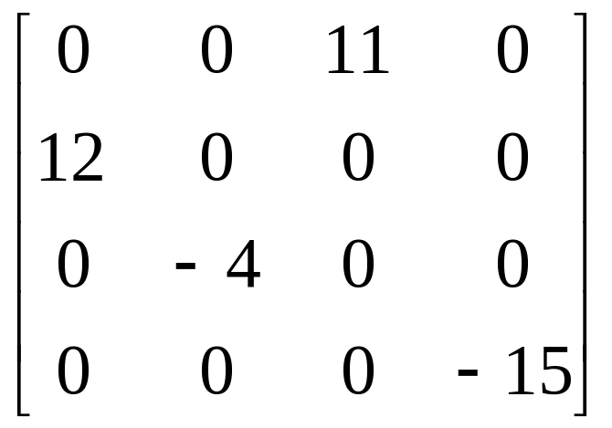
Sparse Matrices
new scheme
Each column (row): a circular linked list with a head node

Slide 30
Sparse Matrices - Representation
# of head nodes = max{# of rows, # of columns}
down
head
right
head node
next
down
entry
row
col
right
entry node
value
entry
i
j
aij
aij

Slide 31
Linked Representation for Matrix
a
H0
H1
H2
H3
4
4
0
2
11
1
0
1
1
12
5
2
1
-4
3
3
Circular linked list
-15

Slide 32
Doubly Linked List
Move in forward and backward direction.
Singly linked list (in one direction only)
How to get the preceding node during deletion or insertion?
Using 2 pointers
Node in doubly linked list
left link field (llink)
data field (item)
right link field (rlink)

Slide 33
Doubly Linked Lists
typedef struct node *node_pointer;
typedef struct node {
node_pointer llink;
element item;
node_pointer rlink;
}
ptr
= ptr->rlink->llink
= ptr->llink->rlink
head node
llink item rlink

Slide 34
ptr
*Figure 4.24:Empty doubly linked circular list with head node (p.180)

Slide 35
node
node
• •
newnode
*Figure 4.25: Insertion into an empty doubly linked circular list (p.181)

Slide 36
Insert
void dinsert(node_pointer node, node_pointer newnode)
{
(1) newnode->llink = node;
(2) newnode->rlink = node->rlink;
(3) node->rlink->llink = newnode;
(4) node->rlink = newnode;
}
head node
llink item rlink
(1)
(3)
(4)
(2)

Slide 37
Delete
void ddelete(node_pointer node, node_pointer deleted)
{
if (node==deleted) printf(“Deletion of head node
not permitted.\n”);
else {
(1) deleted->llink->rlink= deleted->rlink;
(2) deleted->rlink->llink= deleted->llink;
free(deleted);
}
}
head node
(1)
llink item rlink
(2)

Slide 38
Doubly Linked List
Move in forward and backward direction.
Singly linked list (in one direction only)
How to get the preceding node during deletion or insertion?
Using 2 pointers
Node in doubly linked list
left link field (llink)
data field (item)
right link field (rlink)

Slide 39
Doubly Linked Lists
typedef struct node *node_pointer;
typedef struct node {
node_pointer llink;
element item;
node_pointer rlink;
}
ptr
= ptr->rlink->llink
= ptr->llink->rlink
head node
llink item rlink

Slide 40
ptr
*Figure 4.24:Empty doubly linked circular list with head node (p.180)

Slide 41
node
node
• •
newnode
*Figure 4.25: Insertion into an empty doubly linked circular list (p.181)

Slide 42
Insert
void dinsert(node_pointer node, node_pointer newnode)
{
(1) newnode->llink = node;
(2) newnode->rlink = node->rlink;
(3) node->rlink->llink = newnode;
(4) node->rlink = newnode;
}
head node
llink item rlink
(1)
(3)
(4)
(2)

Slide 43
Delete
void ddelete(node_pointer node, node_pointer deleted)
{
if (node==deleted) printf(“Deletion of head node
not permitted.\n”);
else {
(1) deleted->llink->rlink= deleted->rlink;
(2) deleted->rlink->llink= deleted->llink;
free(deleted);
}
}
head node
(1)
llink item rlink
(2)

Slide 44
Circularly Linked Lists
circular list vs. chain
ptr
3 14
2 8
1 0
avail
ptr
temp
avail
...

Slide 45
Web Link
https://www.youtube.com/watch?v=gJ6f3qGwGAU&list=PLc2MoXNv7E4mtsPlnn9BnTOENXsGyoDgR

