Slide 1

K. S. School of Engineering and Management
Curve Fitting
Vinutha S V
Assistant Professor
Department of Mathematics

Slide 2

K.S. SCHOOL OF ENGINEERING AND MANAGEMENT, BENGALURU-109
VINUTHA S.V.
ASSISTANT PROFESSOR
DEPARTMENT OF BASIC SCIENCE
K.S.S.E.M

Slide 3




Fitting a Parabola
For the given set of data (x_{i}, y_{i}), i= 1, 2 ,3, … ,n, we fit a Parabola where a, b and c can be determined by the normal equations given by

Slide 4
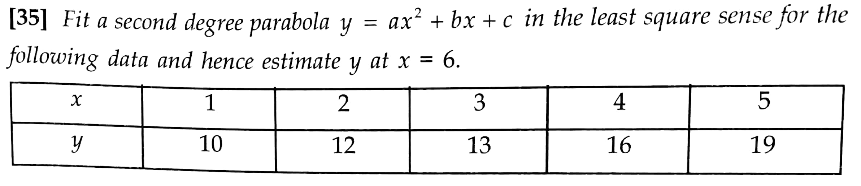
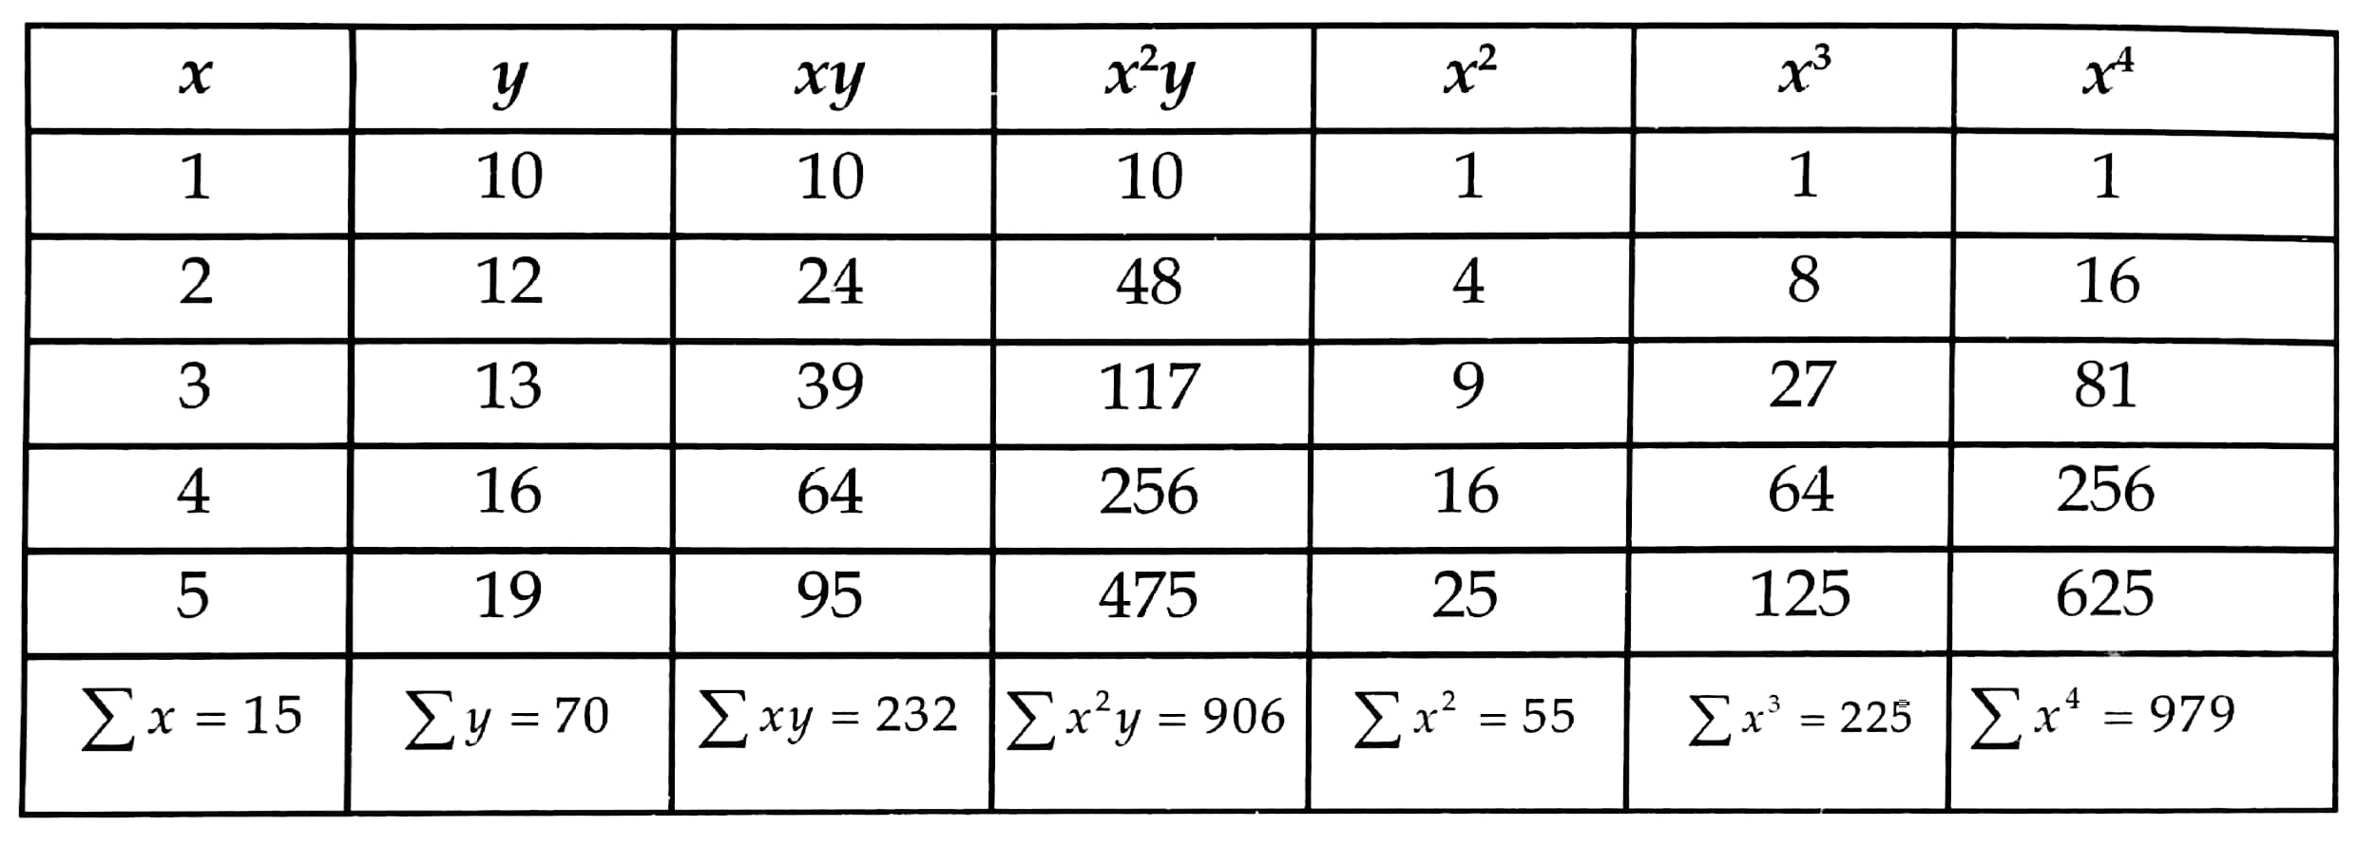

Slide 5
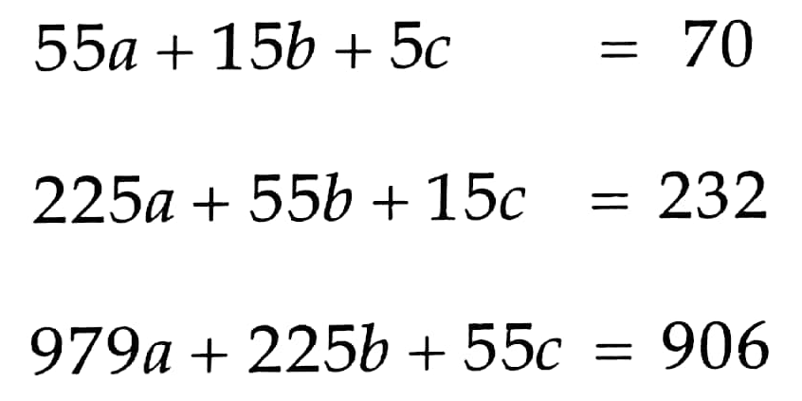
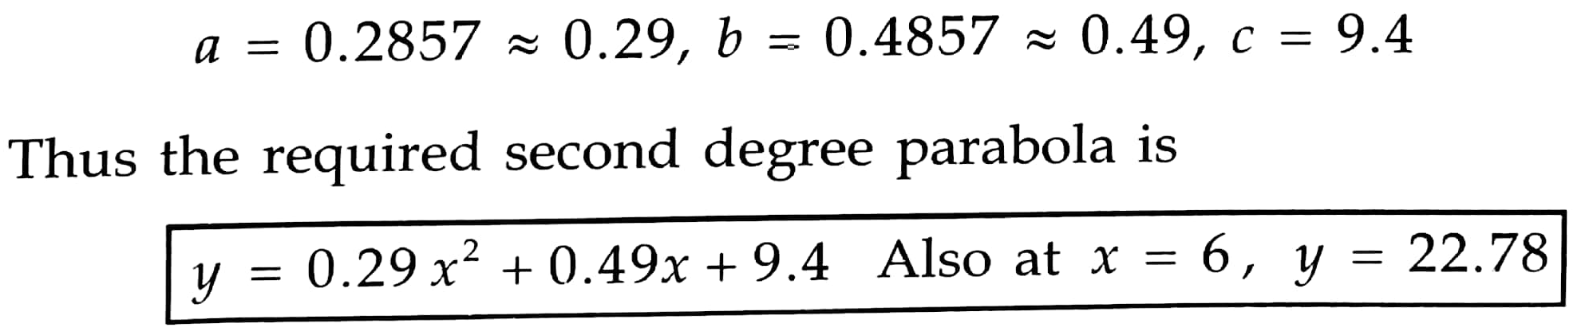

Slide 6
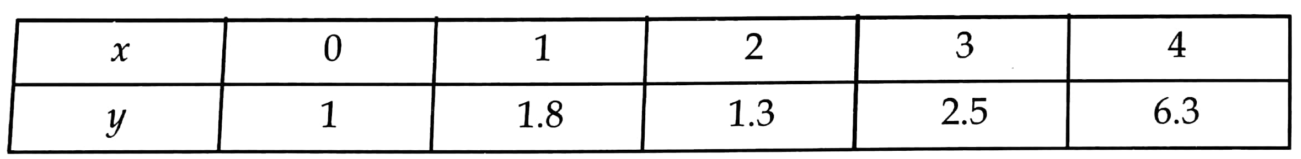
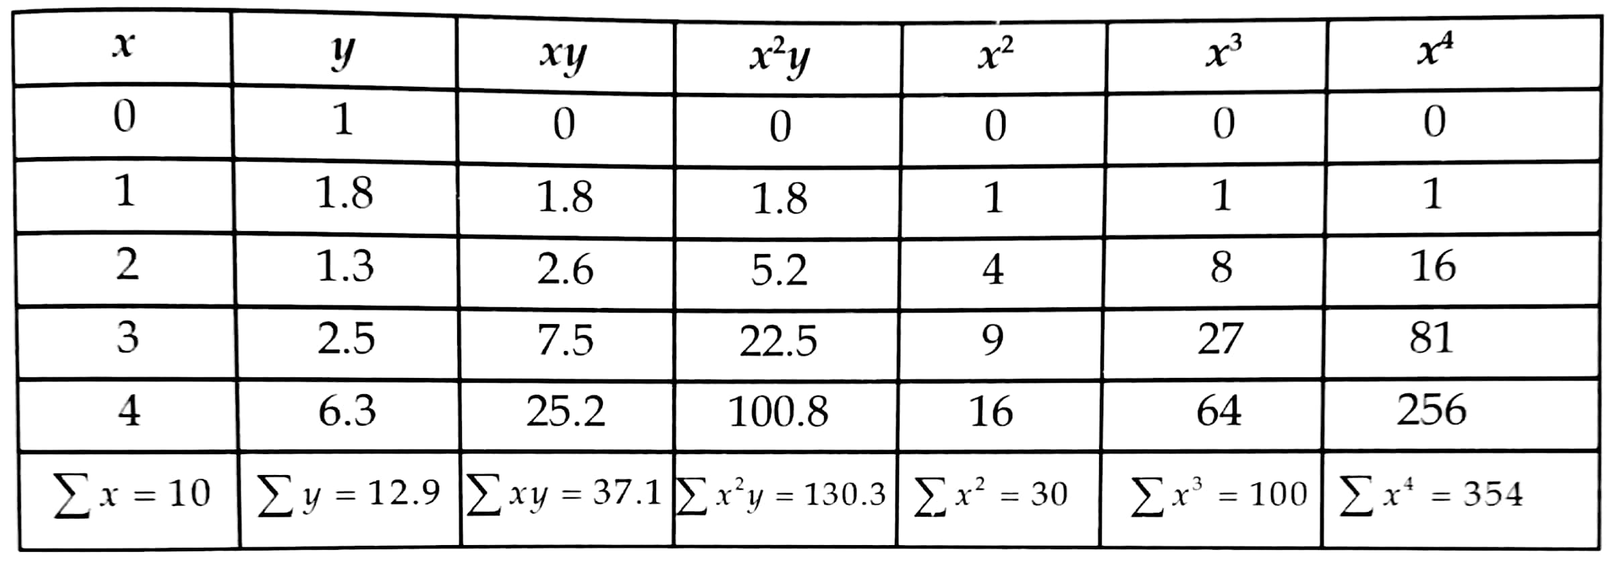

Slide 7




Therefore the required parabola is

Slide 8
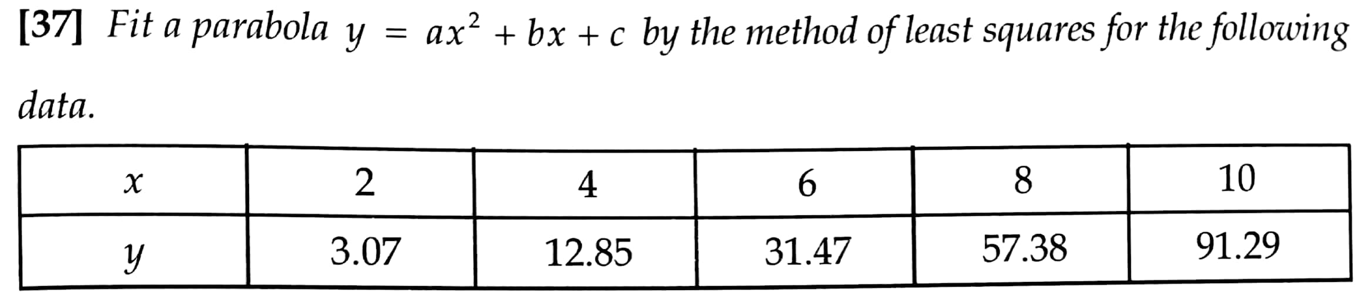
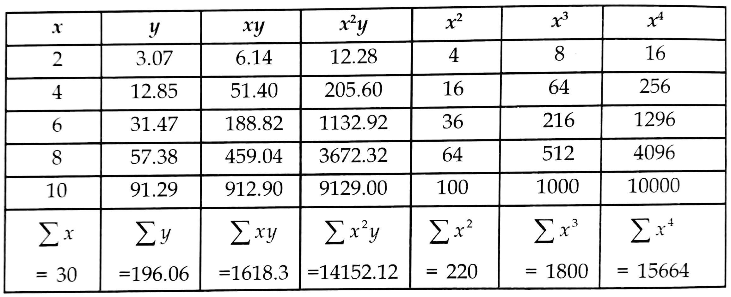

Slide 9
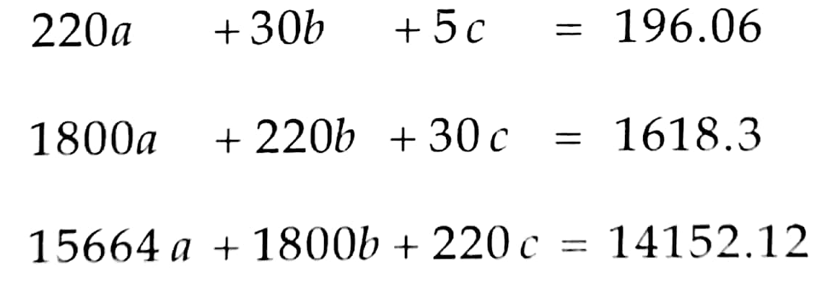
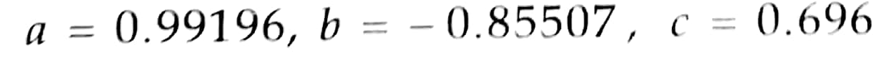
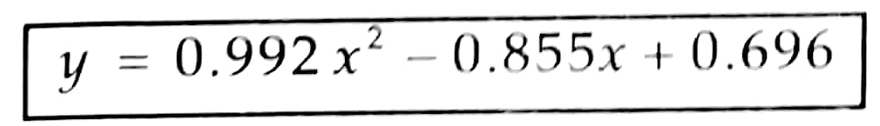
Therefore the required parabola is

Slide 10
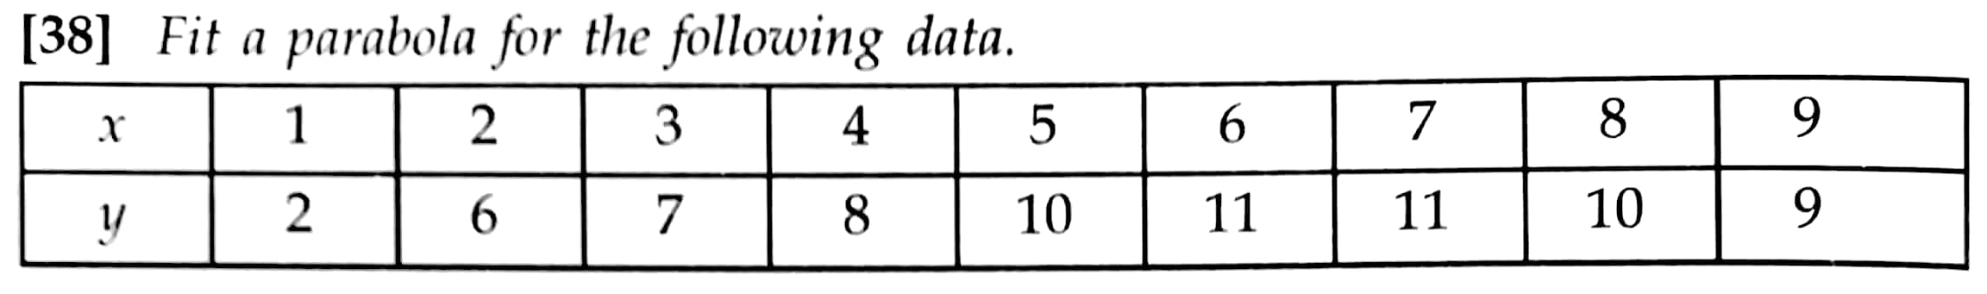
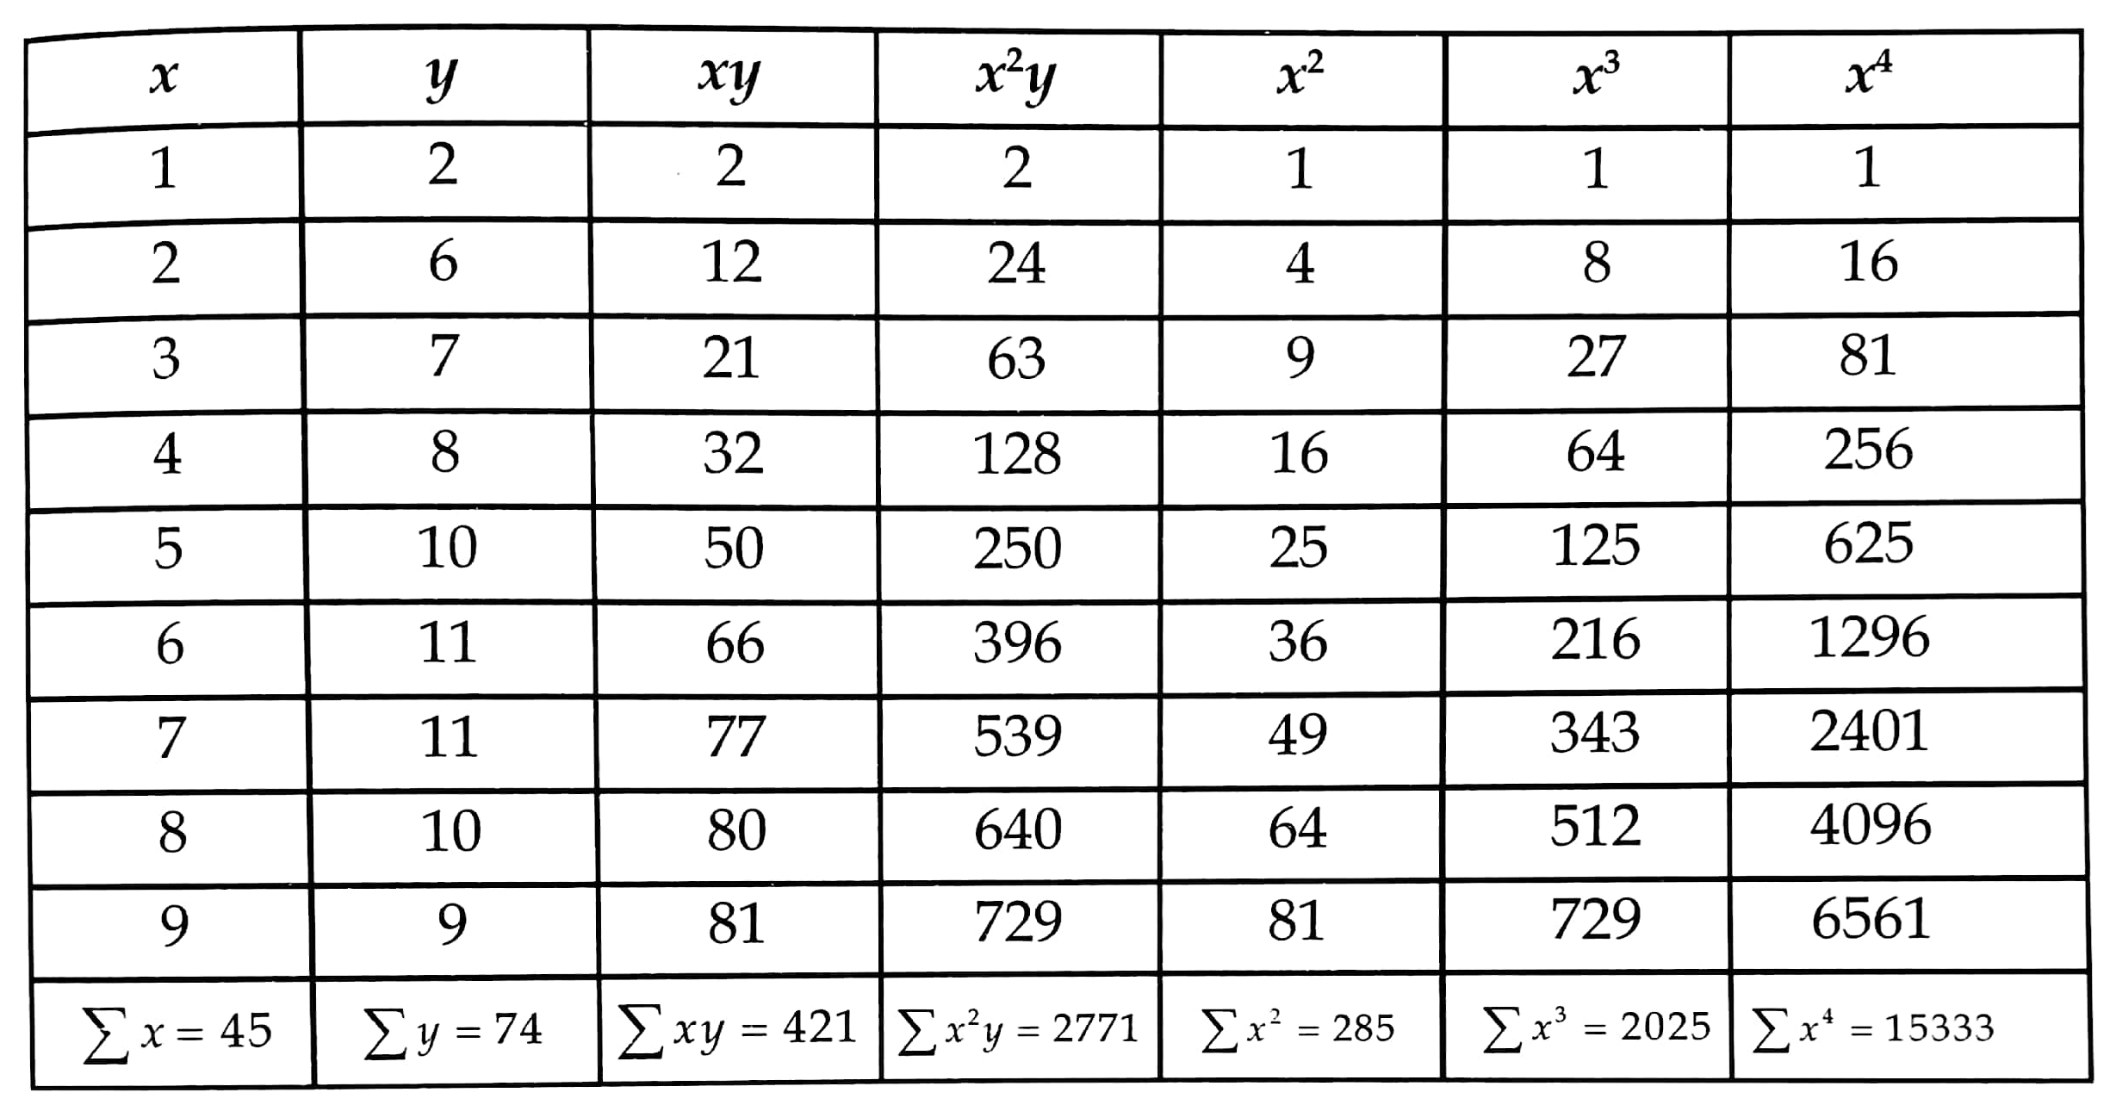

Slide 11



Therefore the required parabola is

Slide 12
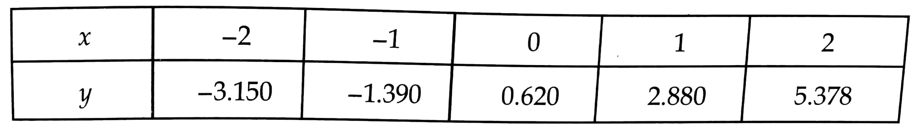
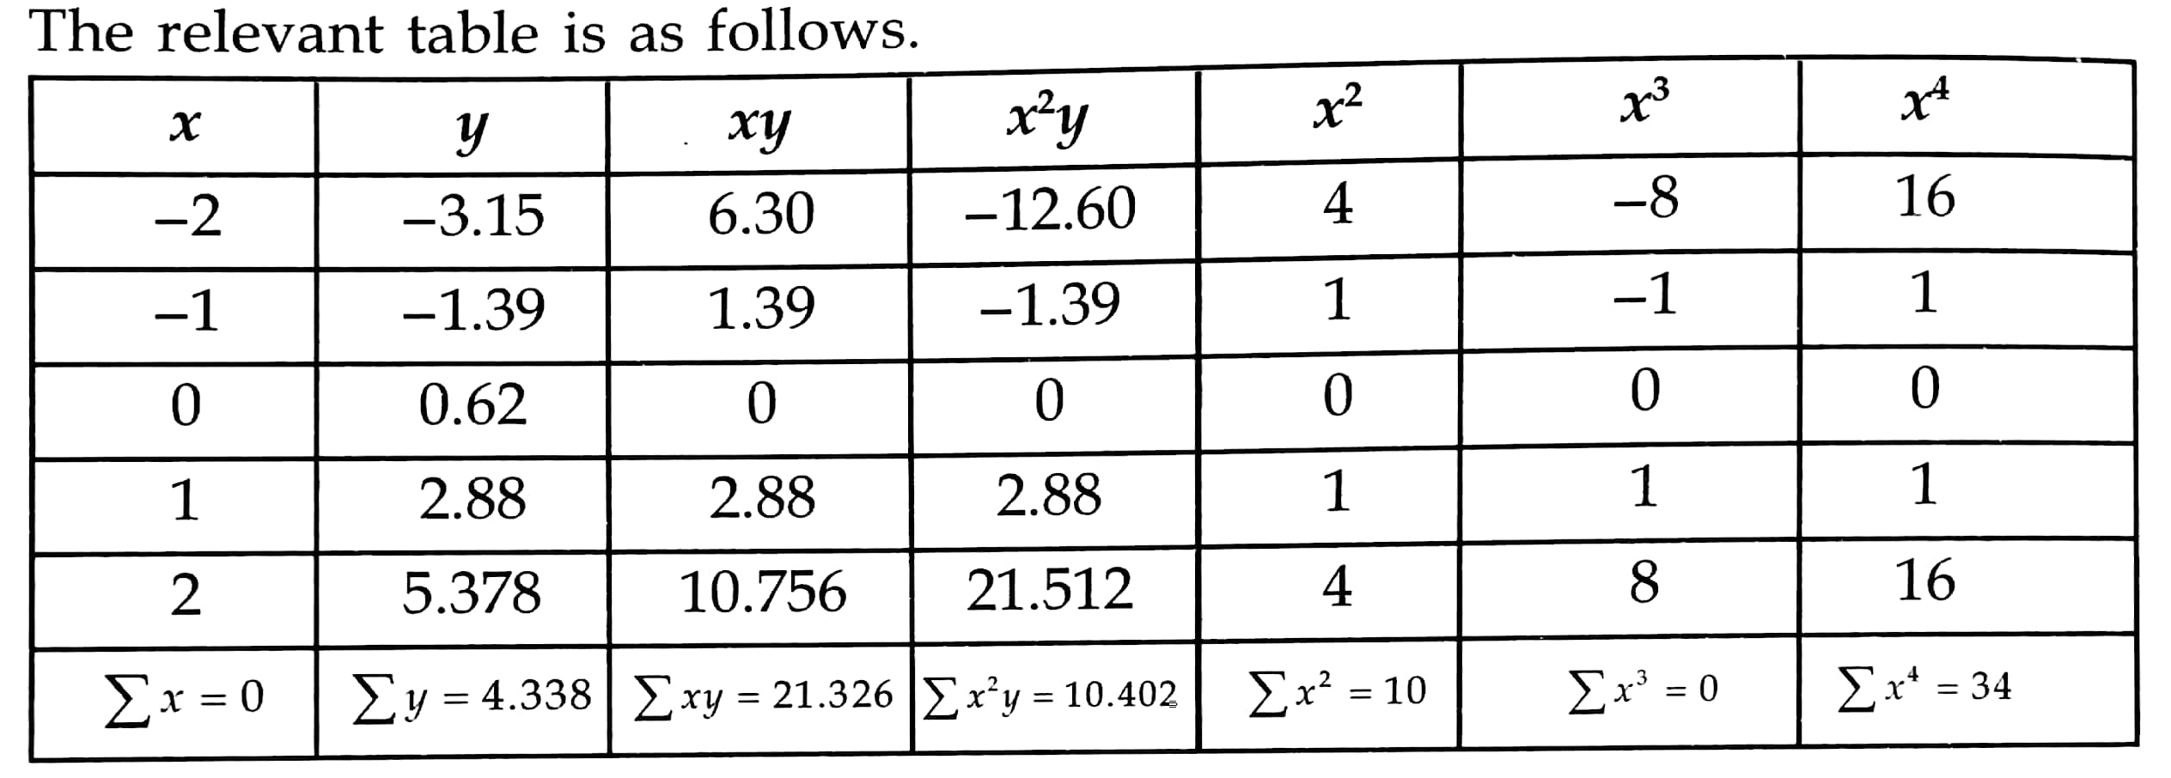

Slide 13



Therefore the required parabola is

Slide 14
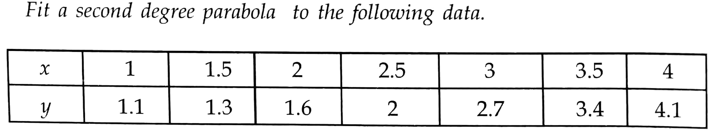
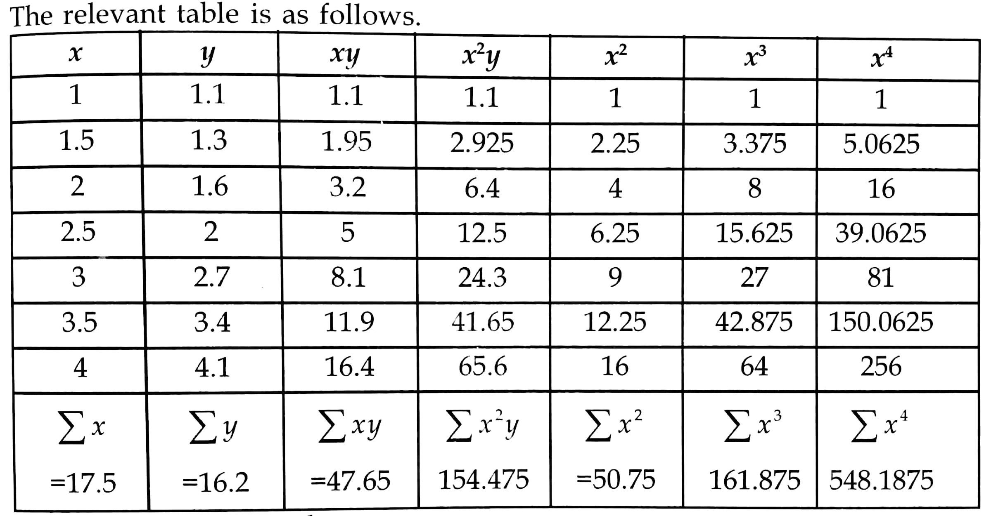

Slide 15


Therefore the required parabola is

Slide 16
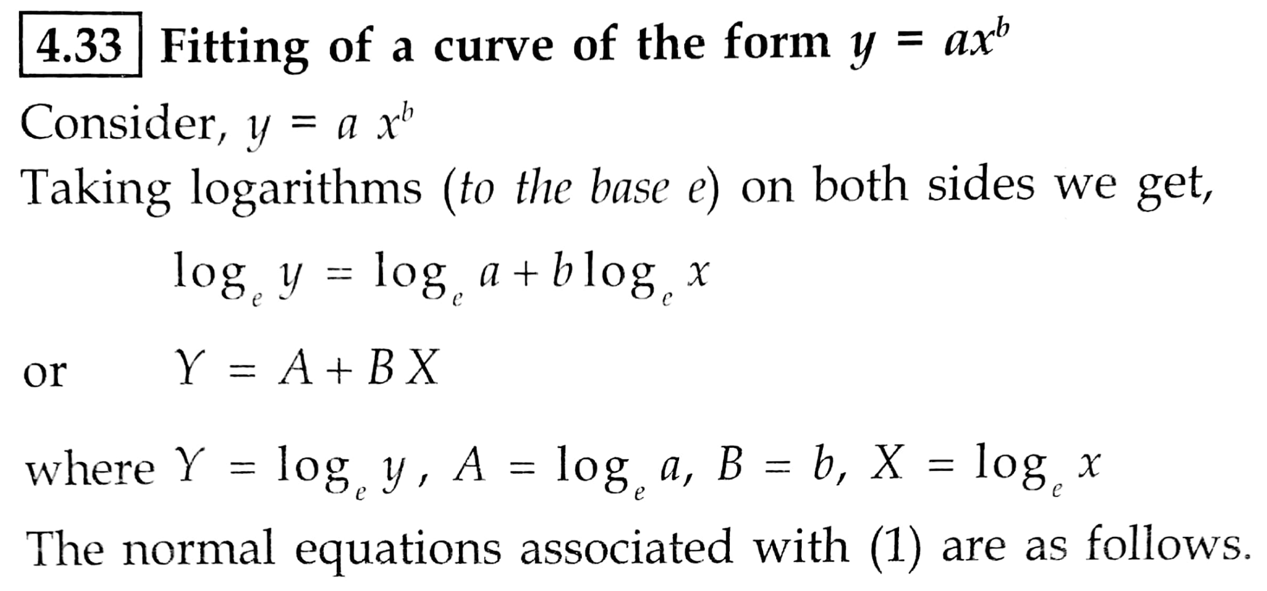


1

Slide 17
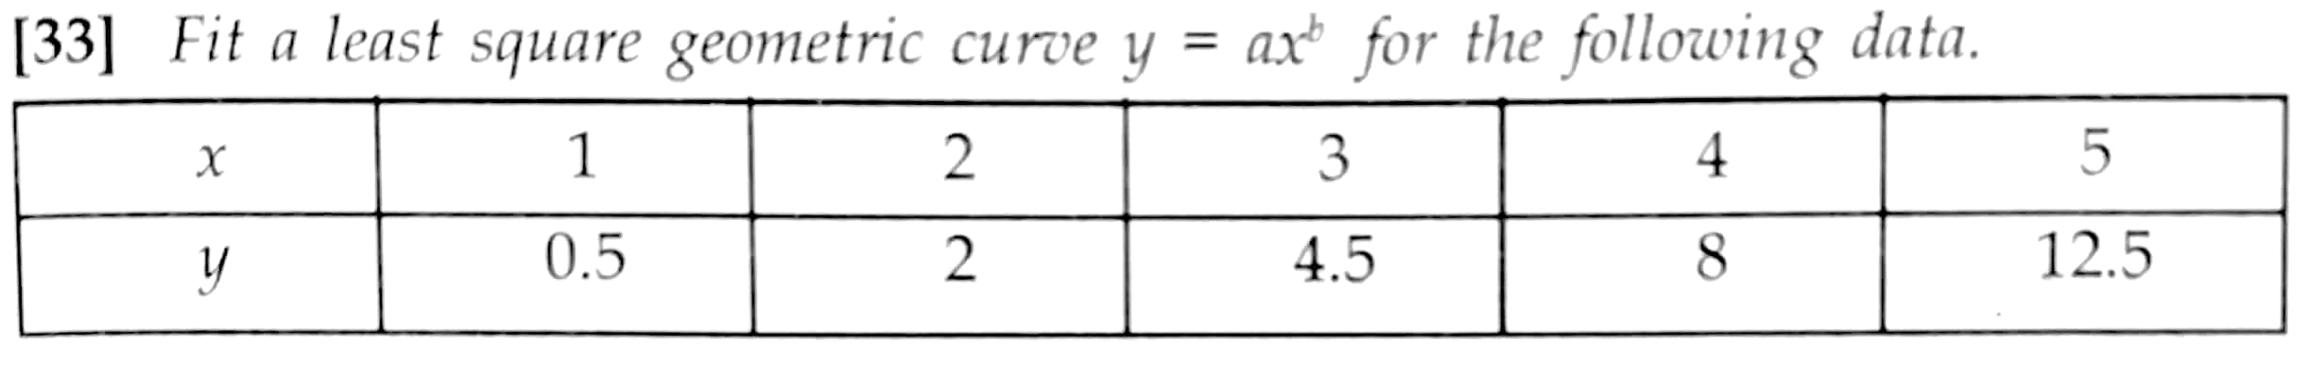
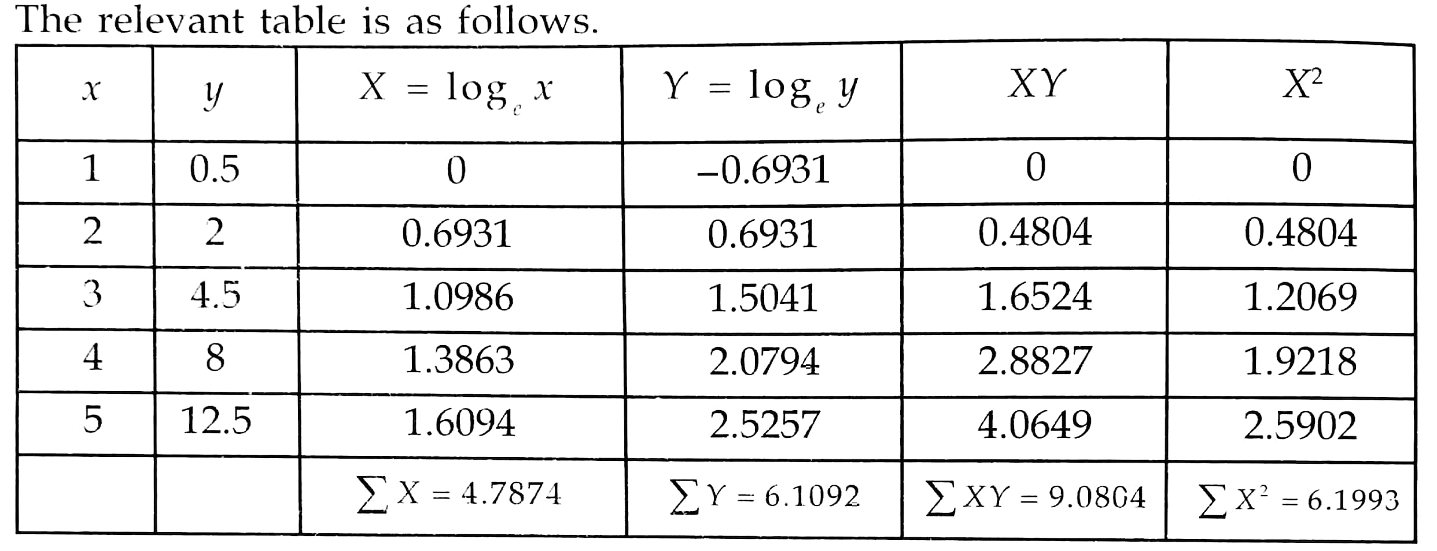

Slide 18





Slide 19
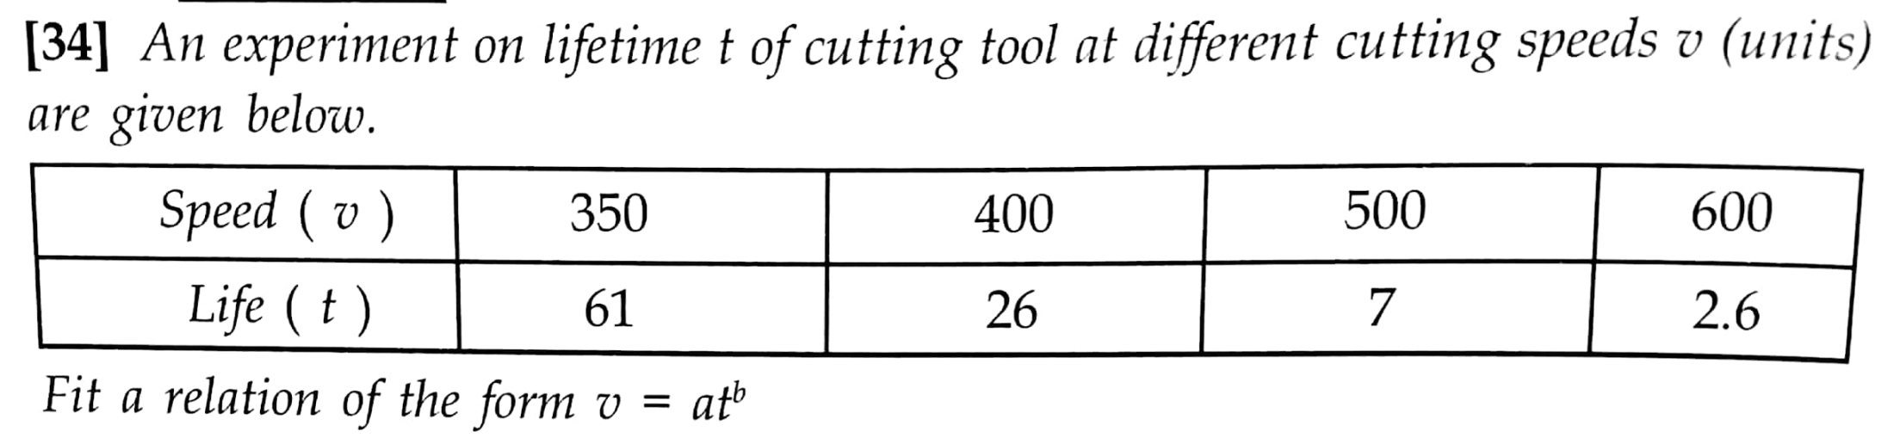
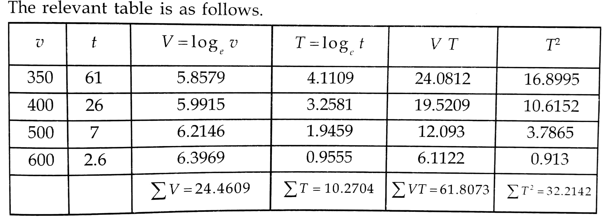

Slide 20




Slide 21


Slide 22
https://www.youtube.com/watch?v=OQpbFvYWNxM
https://www.youtube.com/watch?v=Qy1YAKZDA7k&list=PLU6SqdYcYsfL1Mrdj7bs2A6bQOU7FMqKX

