Slide 1
Module-3
ENVIRONMENT
&
ECOSYSTEM
Prepared by : Parashuram . A. Kutakanakeri
Assistant professor
Mechanical department
KSSEM, Bangalore

Slide 2
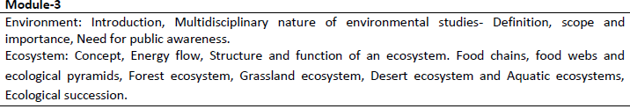
Contents

Slide 3
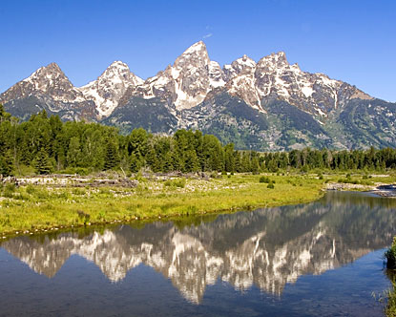
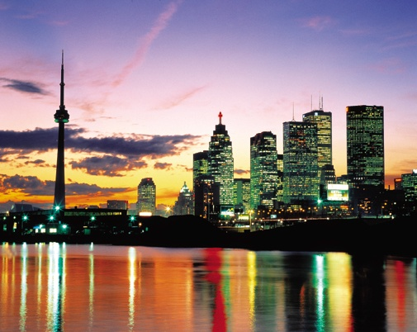
“the sum total of water, air and land and the inter-relationships that exist among them and with the human beings, other living organisms and materials”
Environment is everything that surrounds us, both natural and man-made.

Slide 4
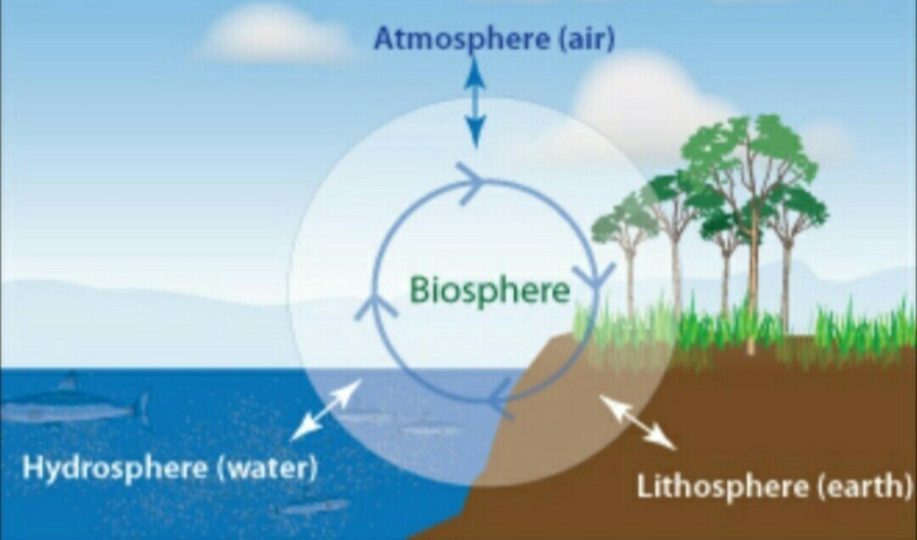
Segments of environment

Slide 5
ENVIRONMENTAL KNOWLEDGE
It is essential
  To identify the env. problems
  To know the root cause of the problems
  To know the intensity and effect of the env. problems
  To attain a knowledge and understand the diff. processes of ecological systems which in turn helps to solve the problems.
  To develop an appropriate technology which will advocate safe, creative, environmentally sound and suitable solutions to the env. problems.

Slide 6
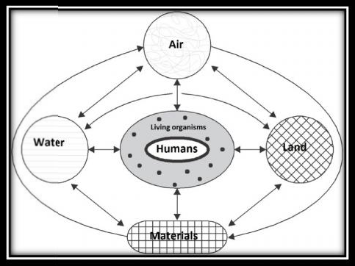
Multidisciplinary nature of Environment Studies:
Air, water and land surrounding us constitute our environment, and influence us directly.
different aspects of Environment we can classify into Urban and rural areas, as we know urban environment is somewhat different from rural environment.
Most of the natural landscapes in cities have been changed and modified by man-made artificial structures like multi-storied buildings, commercial complexes, factories, transportation networks and so on

Slide 7
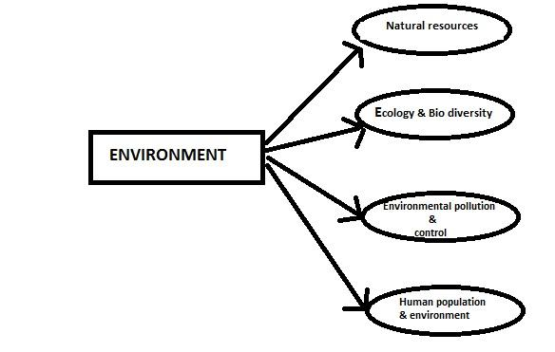
SCOPE
In the recent years, the scope of environmental studies has expanded dramatically the world over. Several career options have emerged in these fields .
Environmental studies can also be highly specialized concentrating on more technical aspects like environmental science, environmental engineering or environmental management.

Slide 8
Carrier opportunities
Research & Development (R & D) in environment
Green advocacy
Green marketing
Green media
Environment consultancy

Slide 9

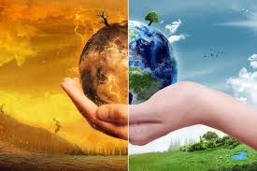
Public Awareness for Environment
Earth natural resources are dwindling and our surroundings is being progressively degraded by human activities , its evident that measures have to be taken

Slide 10

1) International Efforts for Environment
Environmental issues received international attention about 35 years back in Stockholm Conference, held on 5th June,1972. Since then we celebrate World Environment Day on 5th June.

Slide 11
2) Public Awareness for Environment
Public participation is possible only when the public is aware about the ecological & environmental issues.
There is a proverb “If you plan for one year, plant rice, if you plan for 10 years, plant trees and if you plan for 100 years, educate people.” If we want to protect and manage our planet earth on sustainable basis, we have no other option but to make all persons environmentally educated.

Slide 12
3) Role of Contemporary Indian Environmentalists in Environmental Awareness
In our country, efforts to raise environmental awareness have been initiated, and several landmark judgements related to environmental litigations have highlighted the importance of this subject to general public. Two noted personalities who need a mention here, are Justice Kuldeep Singh, known popularly as the green judge and Sh. M.C. Mehta, the green advocate, who have immensely contributed to the cause of environment.

Slide 13

4) Role of Government
Concept of Ecomark : In order to increase consumer awareness about environment, the Government of India has introduced a scheme of eco- labeling of consumer products as ‘Ecomark’ in 1991.
In a drive to disseminate environmental awareness ‘Eco-Clubs’ for children and ‘Eco-task force’ for army men have also been launched by the government.

Slide 14
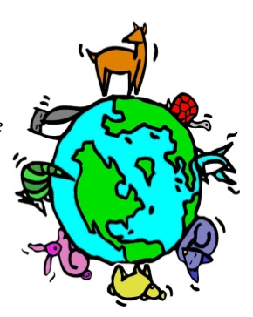
ECOSYSTEM
Ecology is the scientific study of how living organism interact with one another and with their physical environment
ecology deals with the study of organisms in their natural home interacting with their surroundings.The Surroundings or environment consists of other living organisms (biotic) and physical (abiotic) components.

Slide 15
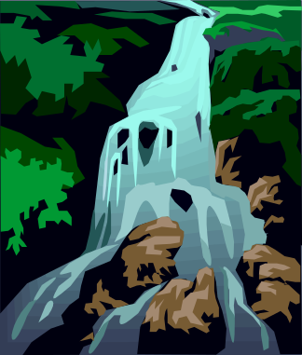


What makes ecosystems different?
Amount of water
1
Amount of sunlight
2
3
Type of soil

Slide 16
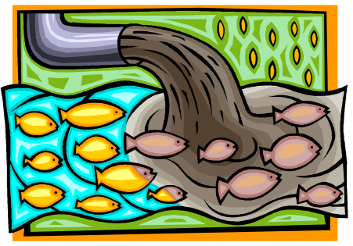



What causes ecosystems to change?
Changes caused by humans:
1
Water pollution
2
Air pollution
3
Land pollution
4
Construction

Slide 17



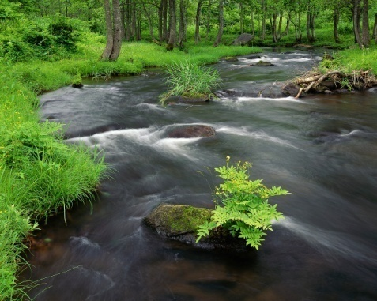
How can humans help to prevent changes in ecosystems?
1
Use resources wisely
2
Laws that control pollution
3
Clean up litter
4
Keep rivers and lakes clean

Slide 18
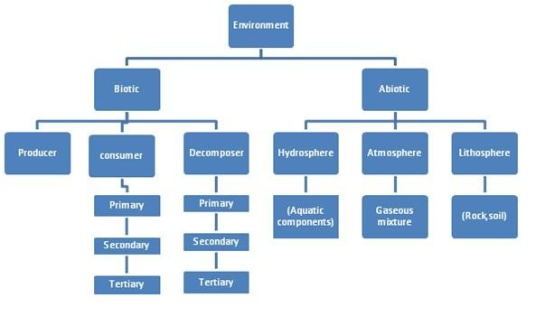

Slide 19
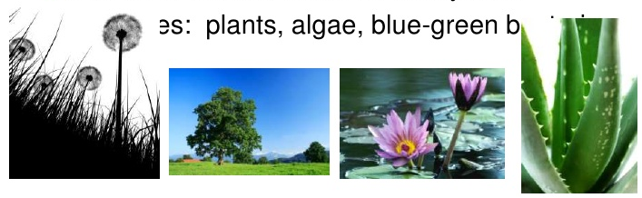
BIOTIC COMPONENTS:
a)Producers:
These are mainly producing food themselves e.g., Green plants produce food by photosynthesis in the presence of sunlight from raw materials like water and carbon dioxide. They are known as photo-autotrophs

Slide 20
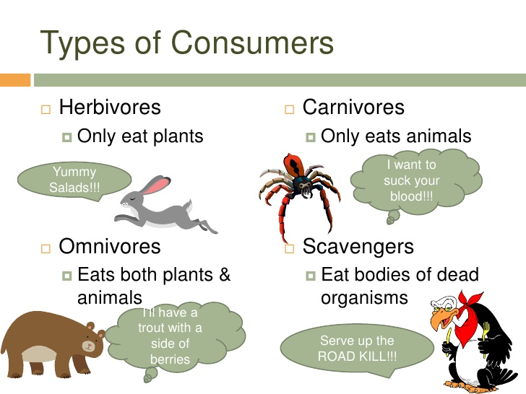
b)Consumers:
These organisms get their food by feeding on other organisms. They are of the following types:
Herbivores—which feed on plants e.g. rabbit, insect.
Carnivores—which feed on herbivores as secondary carnivores (e.g., frog, small fish) or tertiary carnivores (e.g., snake, big fish), which feed on other consumers.
Omnivores—which feed on both plants and animals e.g.,
humans, rats, many birds.
Detritivores—which feed on dead organisms e.g., earth worm, crab, ants.

Slide 21
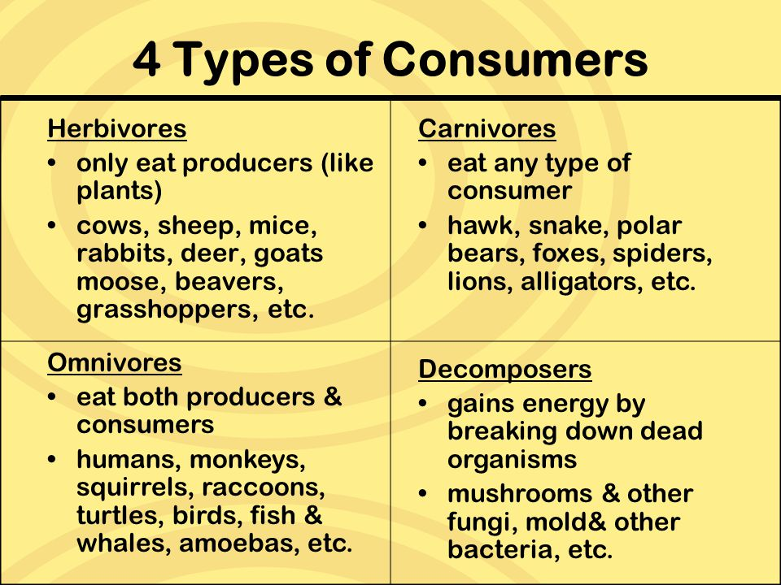

Slide 22
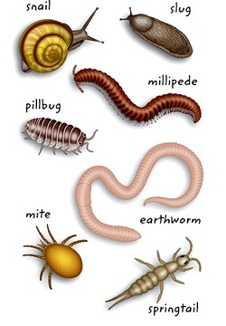
c) Decomposers:
These are micro-organisms which break down organic matter into inorganic compounds and in this process they derive their nutrition. They play a very important role in converting the essential nutrients from unavailable organic form to free inorganic form that is available for use by plants e.g., bacteria, fungi.

Slide 23
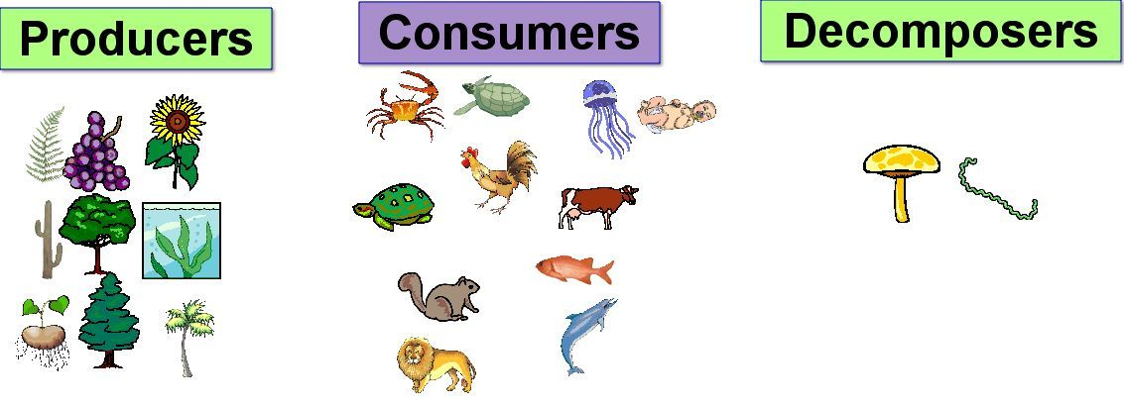

Slide 24
ABIOTIC COMPONENTS:
Physical components include sunlight, solar intensity, rainfall, temperature, wind speed and direction, water availability, soil texture etc.
Chemical components include major essential nutrients like C, N, P, K, H2, O2, S etc. and micronutrients like Fe, Mo, Zn, Cu etc., salts and toxic substances like pesticides. These physico-chemical factors of water, air and soil play an important role in ecosystem functioning.

Slide 25
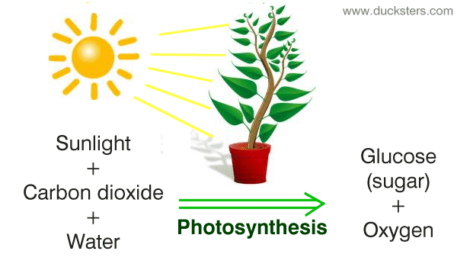
Functions of ecosystem:
Primary function:
The primary function of all ecosystem is manufacture of starch ( Photo synthesis)

Slide 26
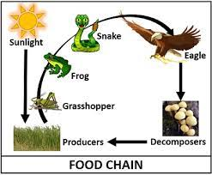
Secondary function:
the secondary function of all ecosystem is distribution of energy in the form of food to all consumers.
Tertiary function:
Cycling of decomposed matter by decomposers

Slide 27
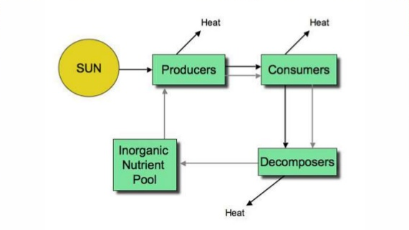
Energy flow
Every ecosystem has several interrelated mechanisms that affects the human life .
These are the water cycle , the carbon cycle , the oxygen cycle , Nitrogen cycle and the energy cycle.
Every ecosystem is controlled by these cycle.

Slide 28
Nutrient cycles
Water cycle
Carbon cycle
Nitrogen cycle
Oxygen cycle
Energy cycle

Slide 29
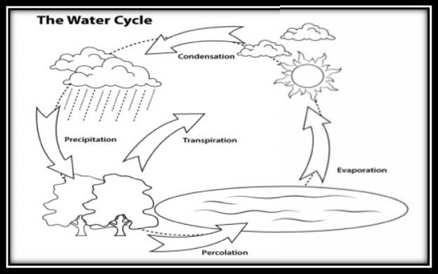
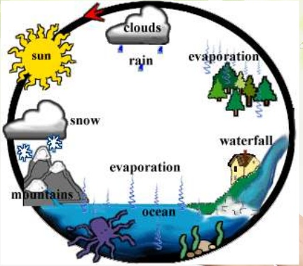
Water cycle

Slide 30
When it rains, the water runs along the ground & flow into rivers or flows directly into the sea.
A part of rain water that falls on land percolates into the ground this is stored underground throughout the rest of the years
The water is drawn up from the ground by plants along with the nutrients from the soil. the water is transpired from the leaves as water vapour and returned to the atmosphere. As it is lighter than the air, water vapour rises and form clouds.
Winds blows the cloud for long distances and when the cloud ride higher , the vapour condenses and change into droplets , which falls on the land as rain.

Slide 31
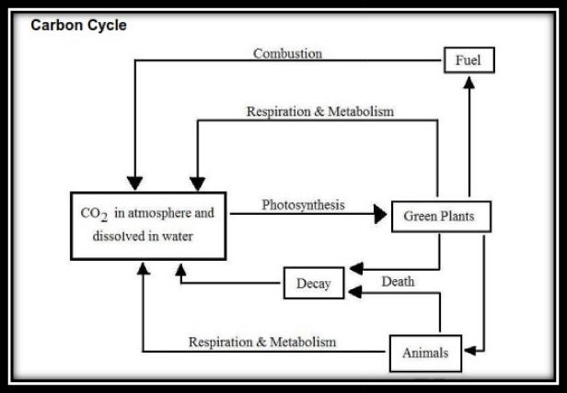
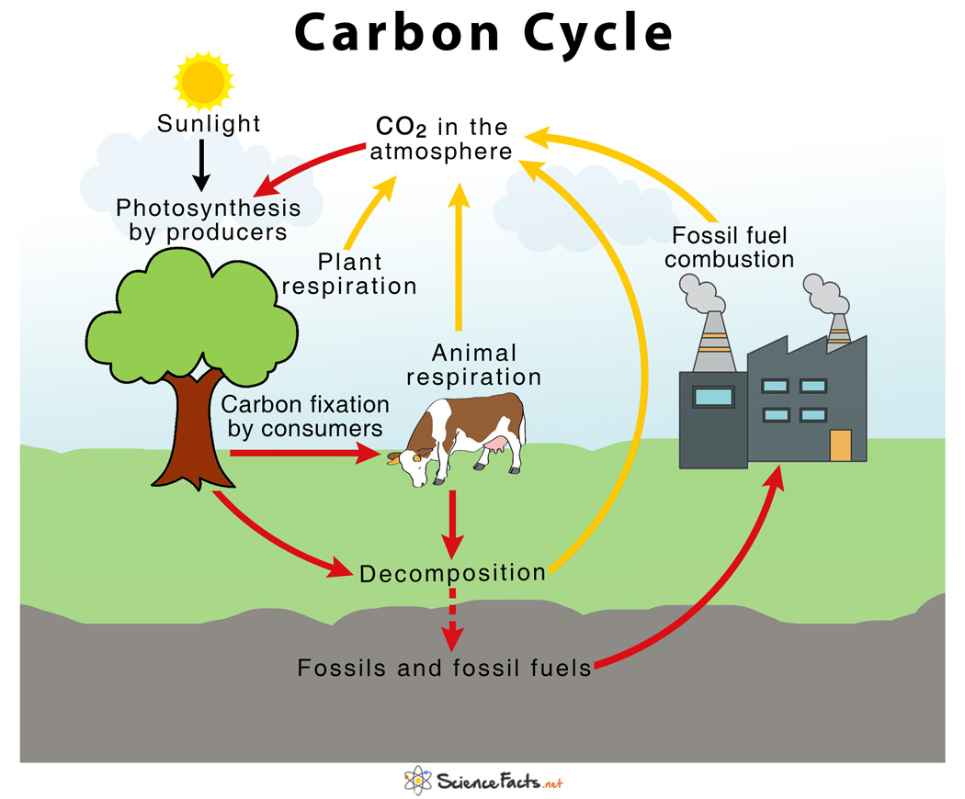
carbon cycle

Slide 32
The carbon which occurs in organic compounds , is included in both biotic and abiotic parts of the eco system.
Plants use photosynthesis process for their growth and development.
In this process, plants releases oxygen into the atmosphere on which animals depends for their respiration.
Herbivores animals feeds on plant material ,which is used by them for energy and for their growth
Both plants releases oxygen and animals releases carbon dioxide during respiration. they also return fixed carbon to the soil in the waste they excrete.
When plants and animals die they return their carbon to the soil . these processes complete the carbon cycle.

Slide 33
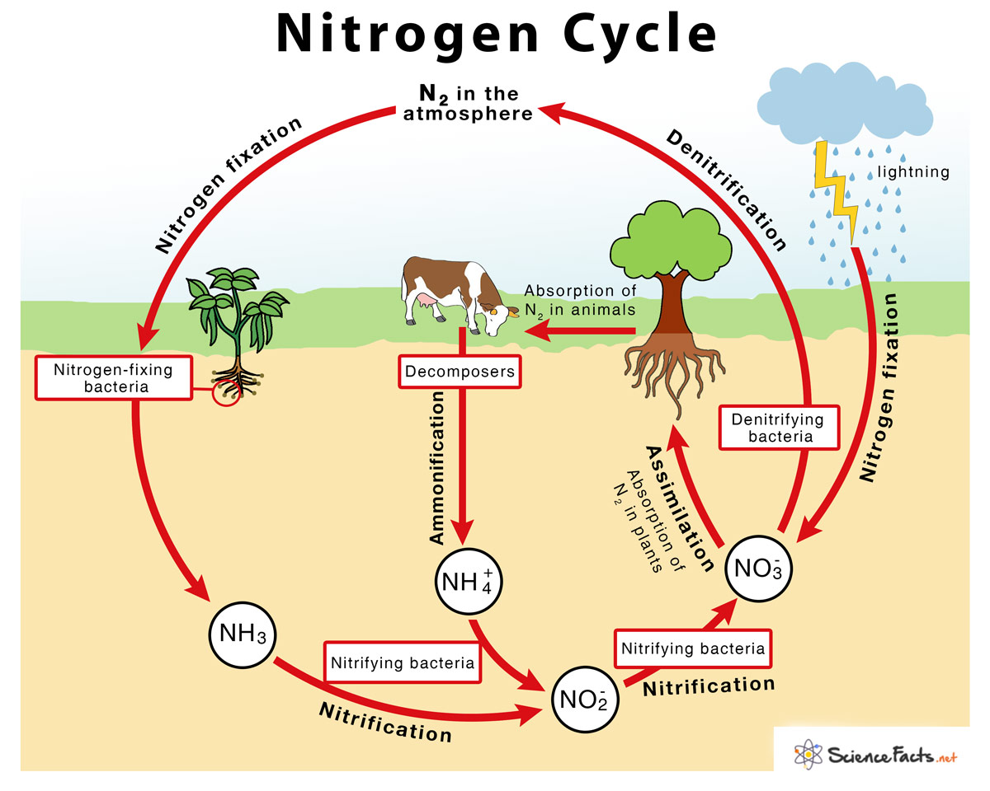
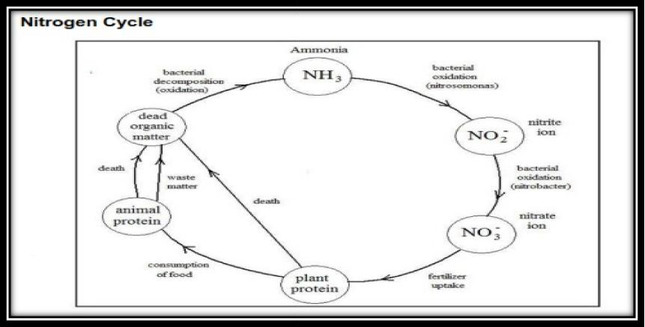
Nitrogen cycle

Slide 34
Carnivorous animal feeds on herbivorous animals that live on plants.
When animals defecate, this waste material is broken down by worms and insects mostly beetles & ants.
These small ‘soil animals’ break the waste material into smaller bits on which microscopic bacteria and fungi can act.
This material is thus broken down further into nutrients that plant can absorb & use for their growth. Thus the nutrients are recycled back from animals to plants.
Similarly, the bodies of dead animals are also broken down into nutrients that are used by the plants for their growth.
Thus the nitrogen cycle on which life is dependent is completed

Slide 35
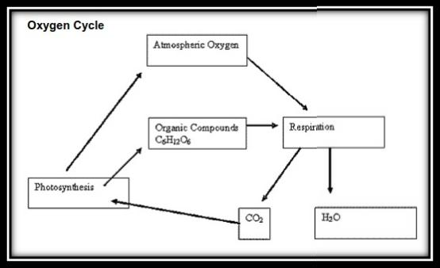
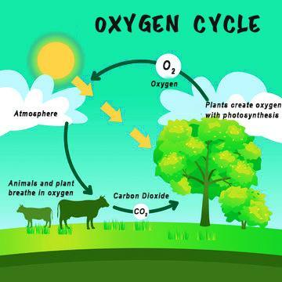
Oxygen cycle

Slide 36
The oxygen cycle is the bio-geo- chemical cycle that describes the movement of oxygen within and between its three main reservoirs
1. The atmosphere (air) 2. The bio sphere (living things) 3. Lithosphere (earth crust)
The main driving factor of the oxygen cycle is photosynthesis, which is responsible for the modern earth atmosphere and life.
Plants are the main creators of oxygen in the atmosphere through the process of photosynthesis. Here the trees use sunlight and carbon dioxide to produce energy and releases oxygen.
The animals breathe oxygen and Breathe out carbon di oxide, the plant can then use this carbon dioxide and cycle is complete

Slide 37
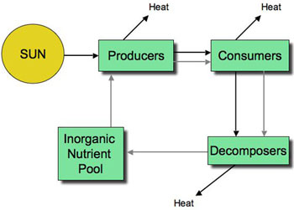
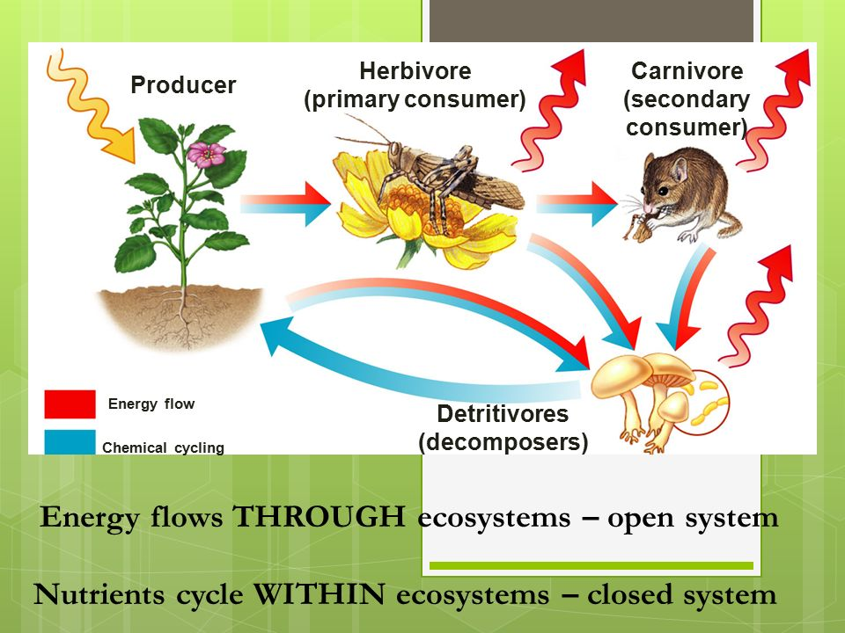
Energy cycle

Slide 38
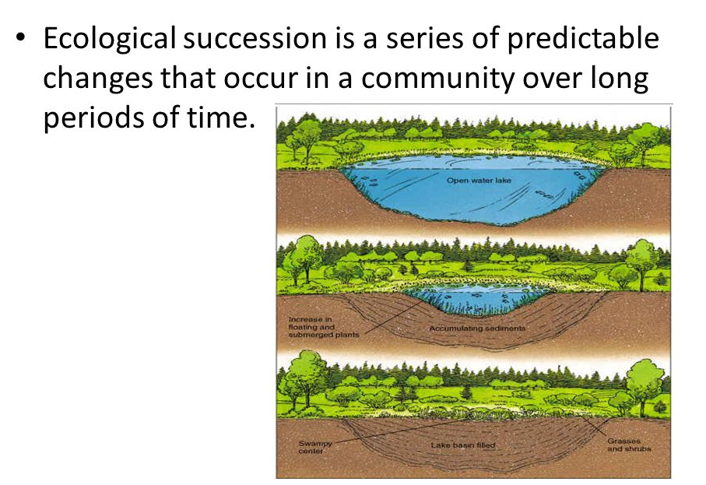
Ecological succession

Slide 39
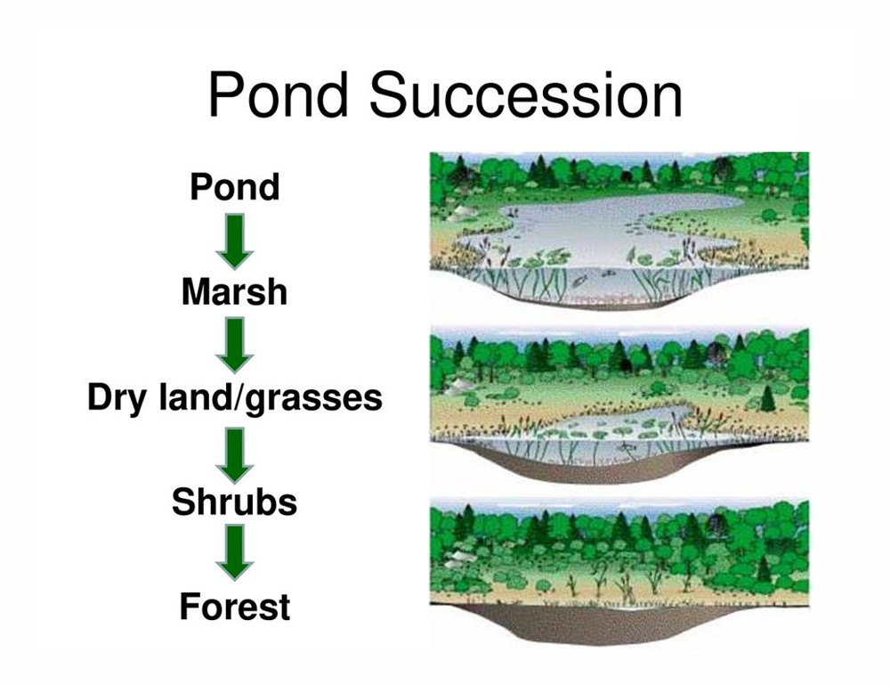

Slide 40
Primary succession: the process of creating life in an area where no life previously existed.
Secondary succession : the process of destabilization that follows a disturbance in an area where life has formed an ecosystem

Slide 41
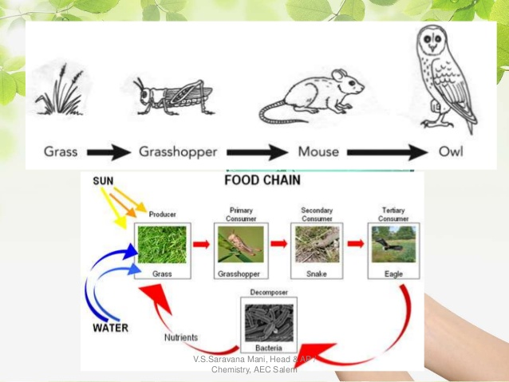
Food chain

Slide 42
It’s very simple in structure, it is defined as uni- liner transfer of energy from one trophic level to next trophic level, called as food chain.
The sequence of the transfer of food energy from one organism to another in an ecological community.
In a typical food chain plants are eaten by herbivores, which are then eaten by carnivores. These carnivores are in turn eaten by other carnivores.

Slide 43
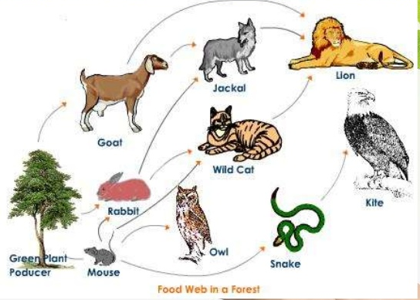
Food web

Slide 44
The interlocking pattern of various food chain in an ecosystem is known as food web . in food web many food chains are interconnected , where different types of organisms are connected at different tropic level.
Ex: Grass may be eaten by insects , rats ,deers etc. these may be eaten by carnivores ( Snakes and tigers)

Slide 45
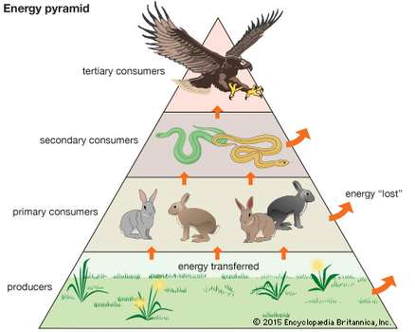
Food pyramid
Graphical representation of structure and function of tropic levels of an ecosystem , starting with producers at bottom and each successive tropic level forming the apex is known as as an ecological pyramid

Slide 46
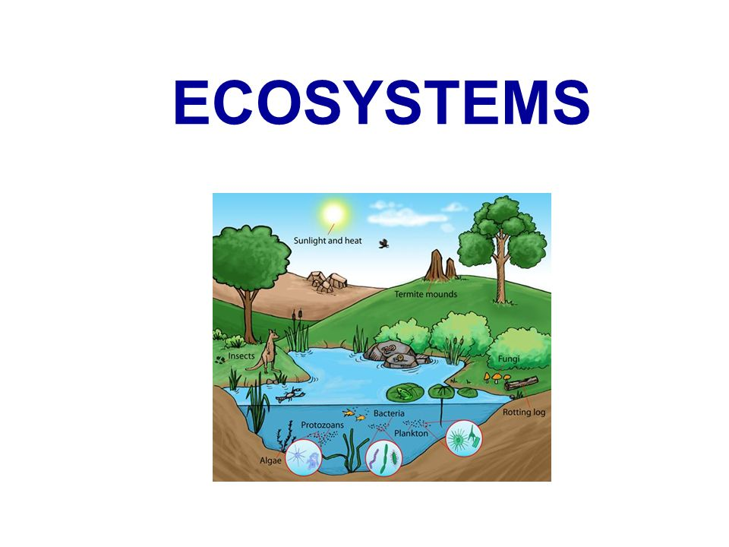
ECOSYSTEM
An Ecosystem is a community of plants ,animals and smaller organisms that live , feed reproduce and interact in same area or environment.
A complex relationship between the living organisms , habitat and resources of given area.
A ecosystem is a community of living and non-living things consider as a unit

Slide 47
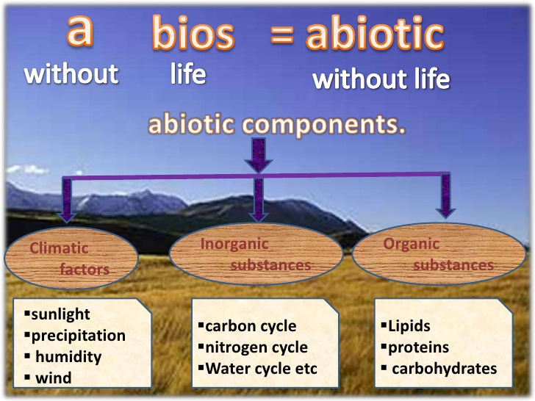
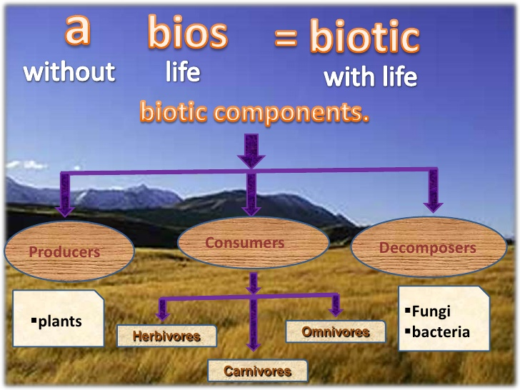
Structures of Ecosystem

Slide 48
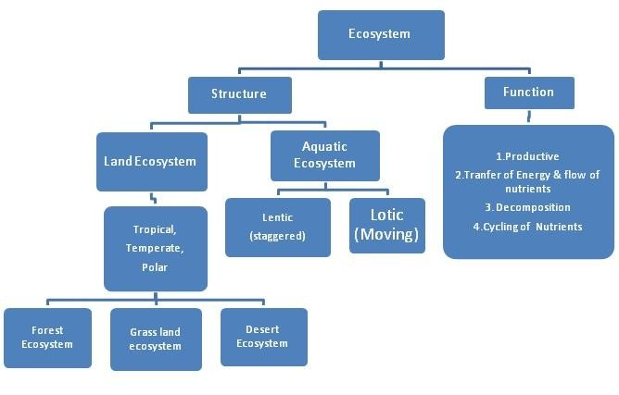

Slide 49
Types of Ecosystem
Natural Ecosystem:
Natural ecosystem operate themselves under natural conditions based on the habitat type , it can be further classified in to two types:
a)Terrestrial Ecosystem
This ecosystem is related to land
Ex: Forest ecosystem, Grass land ecosystem and Desert ecosystem etc.

Slide 50
b) Aquatic Ecosystem
This ecosystem is related to water. It is further sub classified in to two types based on the salt content
i) Running water ecosystem
Ex: rivers, stream
ii)Standing water ecosystem
Ex: Pond, Lake

Slide 51
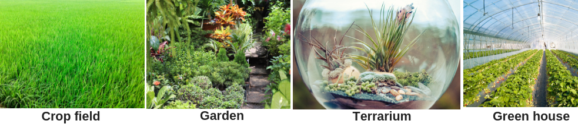
Artificial Ecosystem
man made Ecosystem
Ex : garden, park , aquarium , crop field

Slide 52
Different Ecosystem
Forest ecosystem
Grass Land ecosystem
Desert ecosystem
Aquatic ecosystem

Slide 53
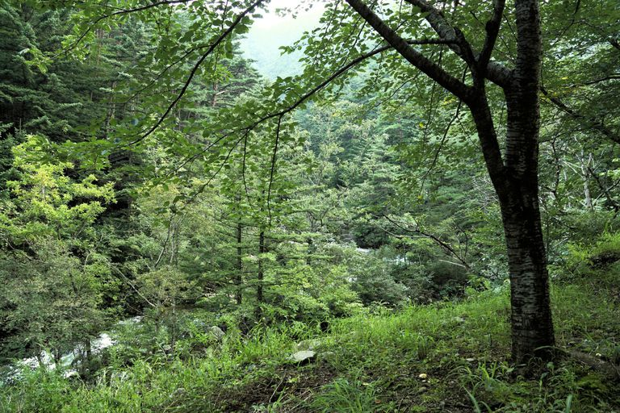
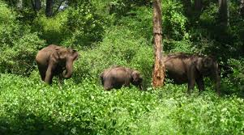
Forest Ecosystem
Coniferous forests: Grow in the Himalayan mountain region, where the temperature are low. These forests have tall stately trees with needle like leaves and downward sloping branches so that the snow can slip off the branches.
Broad leaved forests: They have several types, such as evergreen forests, deciduous forests, thorn forests, and mangrove forests. Broadleaved forests have large leaves of various shapes.

Slide 54
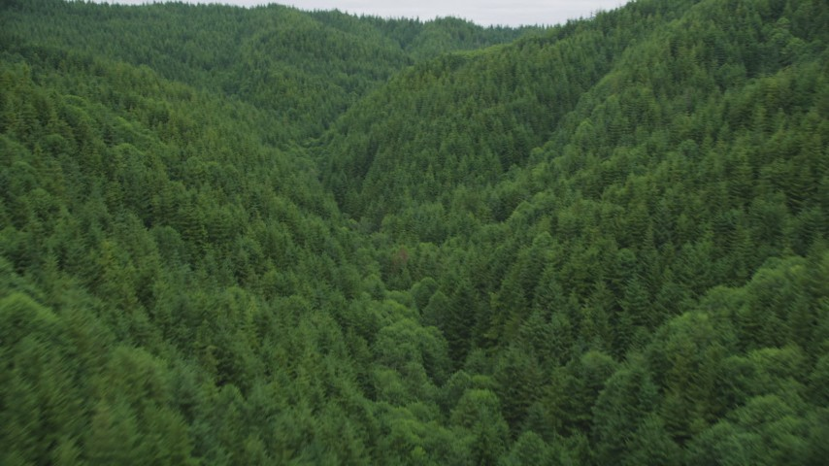
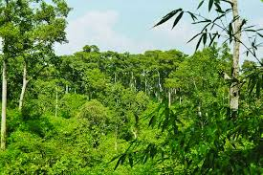
Evergreen forests
Grow in the high rainfall areas of the western ghats, North eastern india and the Andaman & nicobar islands. These forests grow in area where the monsoon lasts for several months.
The trees overlap with each other to form a continues canopy. Thus very little light penetrates down to the forest floor.

Slide 55
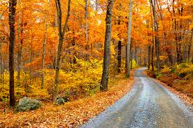
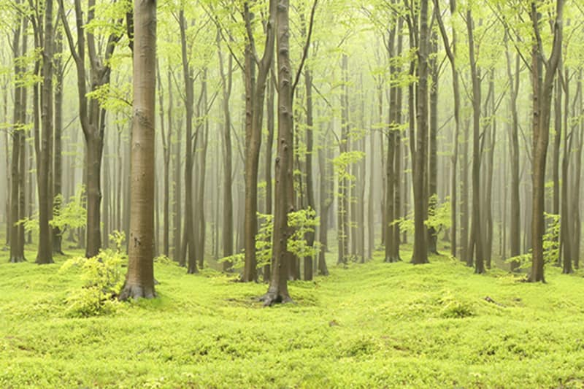
Deciduous Forest
These are found in regions with a moderates amount of seasonal rainfall that lasts for only few months.
The deciduous trees shed their leaves during the winter and the hot summer months.
The forest frequently has a thick undergrowth as light can penetrate easily onto the forest floor

Slide 56
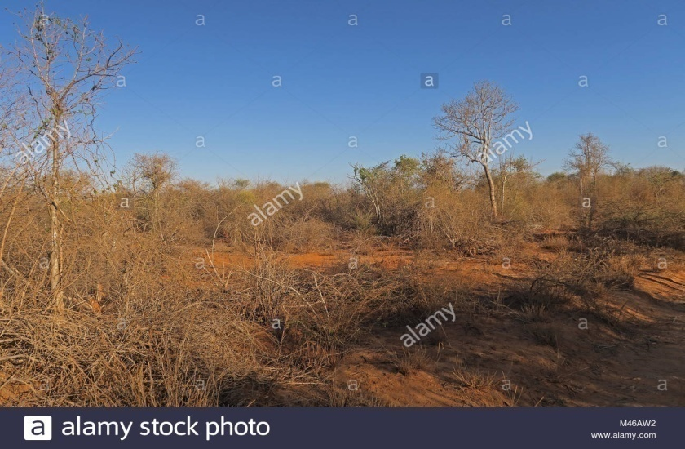
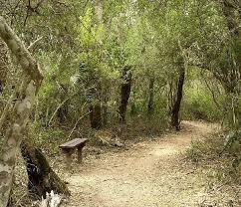
Thorn forest
these are found in the semi-arid regions of india .The trees, which are sparsely distributes are surrounded by open grassy areas. Thorny plants are able to conserve water.

Slide 57
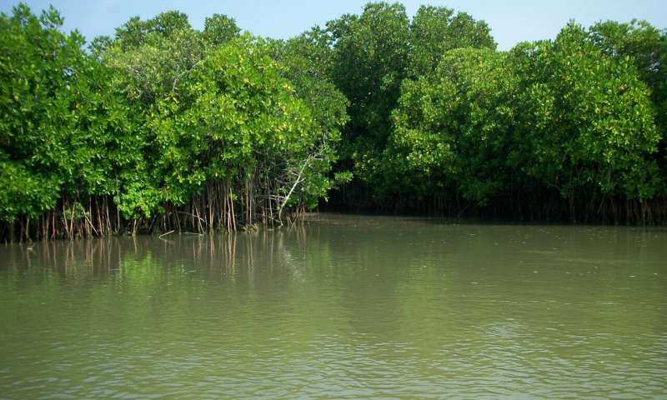
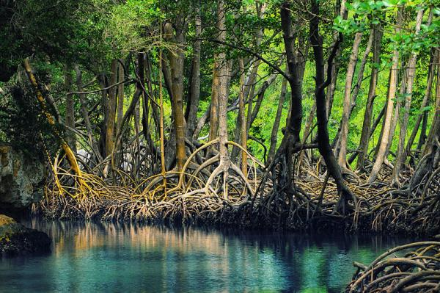
Mangrove forests
these grow along the coast especially in the river deltas. These plants are able to grow in a mix of saline and fresh water
They grow luxuriantly in muddy areas covered with silt that the river have brought down. The mangrove trees have breathing roots that emerge from the mud banks.

Slide 58
Conservation of forest ecosystem
The forest can be conserved only when its resources are used carefully. This can be done by using alternate sources of energy instead of fuel wood.
The natural forests with all their diverse species must be protected as national parks and wildlife sanctuaries where all the plants and animals can be preserved.

Slide 59

Services of Forest ecosystem
Control the flow of water
Water shed protection
Help in increase the ground water level
Prevent the soil erosion
Control the temperature
Absorb the CO₂

Slide 60

Threats to Forest Ecosystem
Deforestation
Poaching
Over exploitation of resources
Development activities
(Mining & dams )
Changing land use pattern
Fragmentation
Habitat degradation

Slide 61


Grass Land ecosystem
A wide range of landscapes in which the vegetation is mainly formed by grasses and small annual plants forms a variety of grass lands ecosystems with their specific plants and animals.
Grasslands covers areas where rainfall is usually low and / or soil depth & quality is poor. The low rainfall prevents the growth of a large number trees and shrubs, but is sufficient to support the growth of grass cover during the monsoon

Slide 62


The Himalayan pastures belt:
it extends up to the snowline. The grasslands at a lower form patches along with coniferous or broad leaved forests.
These Himalayan pastures: have a large variety of grasses and herbs, There are also a large number of medicinal plants.

Slide 63


The Terai
This consists of patches of tall grass lands interspersed with a sal forest ecosystem. The patches of tall elephants grass, are located in the low lying waterlogged areas.
This ecosystem extends as a belt south of the Himalayan foothfills.

Slide 64


The Semi-arid plains
This is located in western india, central india and the deccan are covered by grassland tracts with the patches of thorn forest and are covered with seasonal grasses and herbs on which its fauna is dependent.

Slide 65


The Shola grasslands
It consists of patches on hill slopes along with the shoal forests on the western ghats,nilgiris and annamalai ranges. This forms a patchwork of grassland on the slopes and forest habitats along the streams and low lying areas.

Slide 66
Conservation of grass land ecosystem
Grassland should not be overgrazed and areas of the grasslands should be closed for grazing.
fires must be prevented and rapidly controlled.
To protect the most natural undisturbed grassland ecosystem, sanctuaries and national parks must be created.

Slide 67
Desert ecosystem
Deserts and semi –arid areas are located in western india and the deccan plateau. The climate in these vast tracts is extremely dry, which means the rate of evaporation is more than rate of rainfall.
Desert and semi-arid regions have a number of highly specialized insects and reptiles.

Slide 68



Slide 69



Slide 70


Slide 71
Aquatic ecosystem
The aquatic ecosystem consists the marine environments of the seas and the fresh water systems in lakes, rivers, ponds and wetlands. These ecosystem provide human beings with a wealth of natural resources, the aquatic
ecosystem are classified into freshwater,brakish and marine ecosystem, which are based on the salinity levels.

Slide 72

Fresh water eco systems: they have running water are streams and rivers. Ponds, tanks and lakes are ecosystems where water does not flow and have expanses of shallow water with aquatic vegetation, which forms an ideal habitat for fish, crustaces and water birds.

Slide 73


Marine ecosystem: are highly saline,while brackish areas have less saline water such as in river deltas

Slide 74


Brackish water ecosystem: In river deltas are covered by mangrove forest and are among the world’s most productive ecosystem in terms of biomass production. The largest mangroves swamps are in the sunder bans in the delta of the Ganges.

Slide 75
WEB LINK
https://www.youtube.com/watch?v=C6YrPt1ygX8
https://www.youtube.com/watch?v=rC8TwL49RFA

