Slide 1
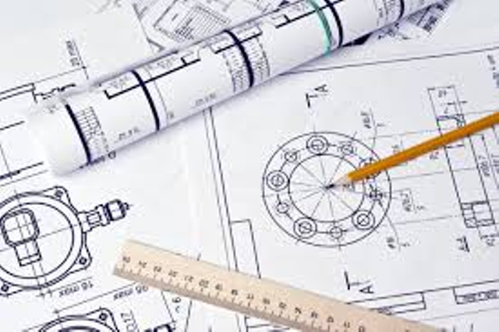
Computer aided Engineering Drawing – BECDK203
Presentation by,
Dr. Abhishek M R
Associate Professor
Department of Mechanical Engineering
KSSEM, Bangalore - 560109

Slide 2


Slide 3
Describe the CAR

Slide 4
Drawing is important for all branches of engineering.

Slide 5
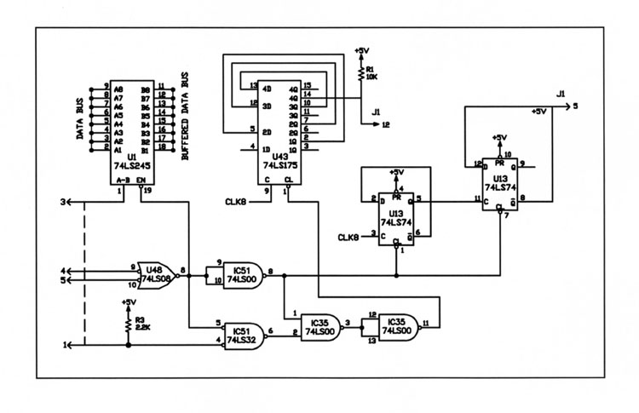
Electrical circuit

Slide 6
Describe the Circuit

Slide 7
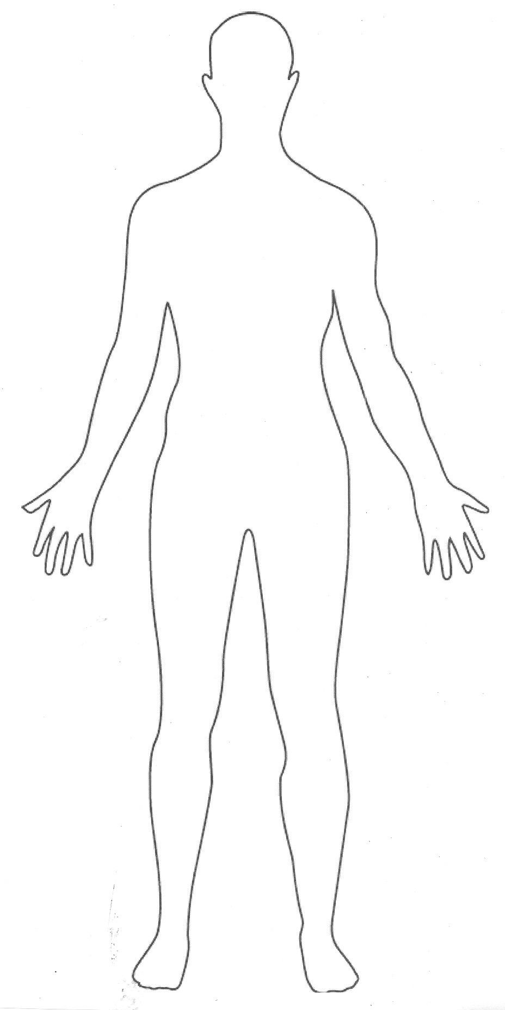
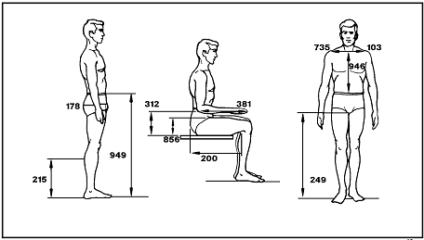
Definition of Engineering Graphics
Drawing | Engineering Graphics

Slide 8
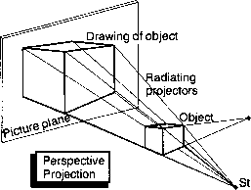
Projection

Slide 9
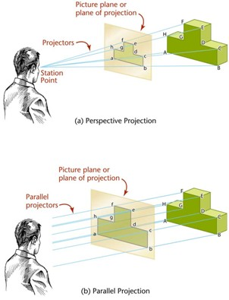
Types of Projection

Slide 10
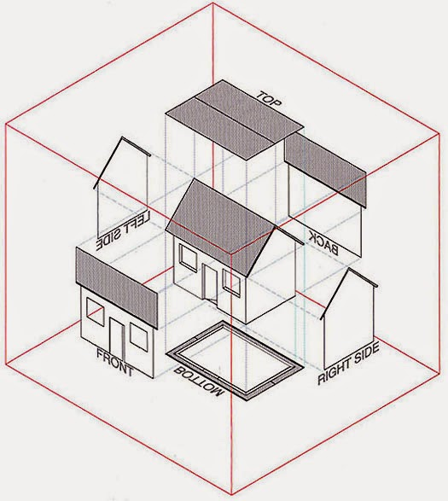
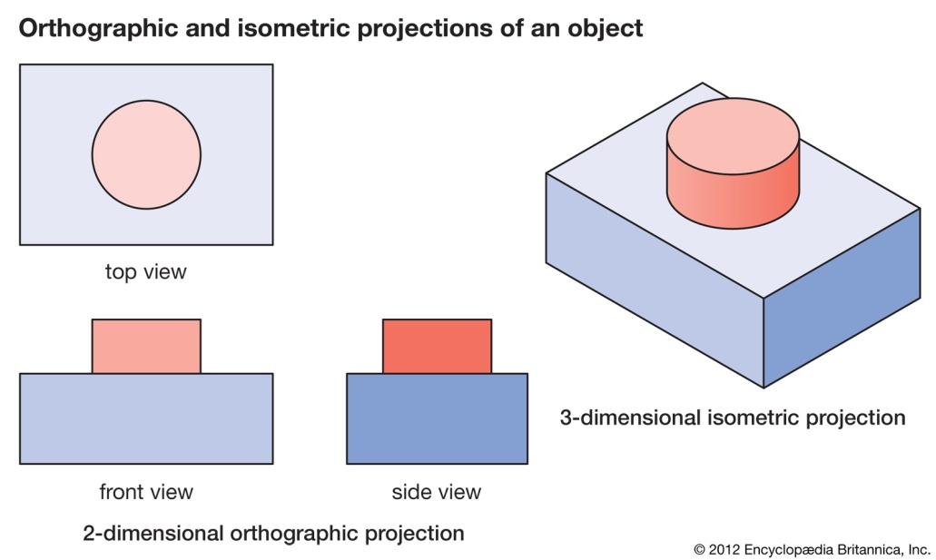
Orthographic Projection
Isometric Projection

Slide 11

Drawing Instruments

Slide 12
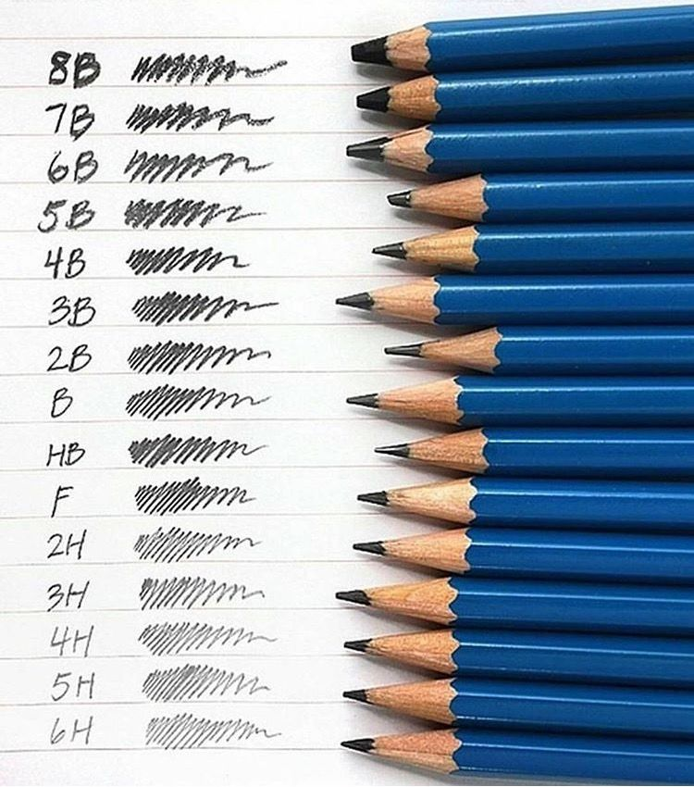
Types of Pencils

Slide 13
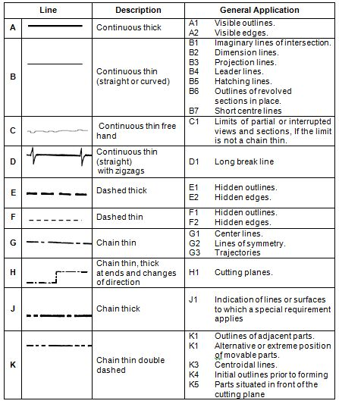
Line Conventions

Slide 14
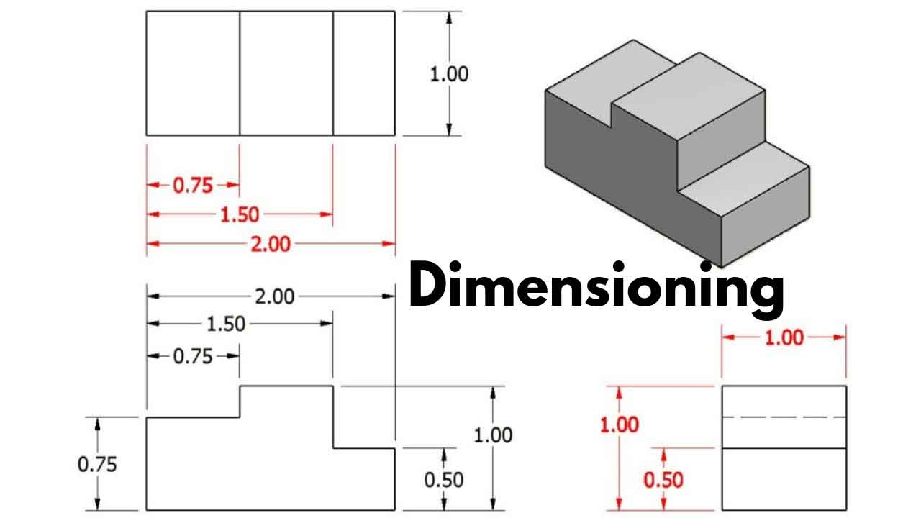
Dimensioning
Projection line
Dimensioning line
Dimension Value
Arrow
Shape Dimensioning
System of dimensioning
Unidirectional
Aligned

Slide 15
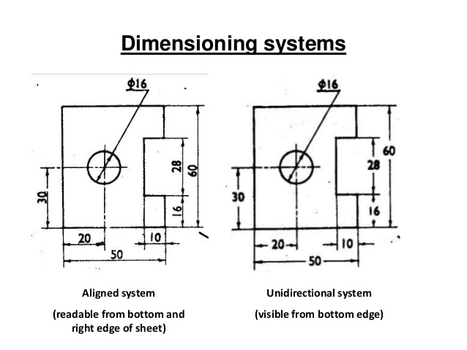

Slide 16
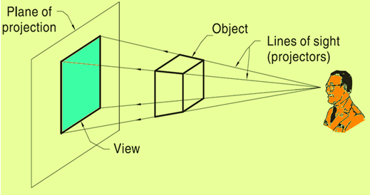
Plane of Projection

Slide 17
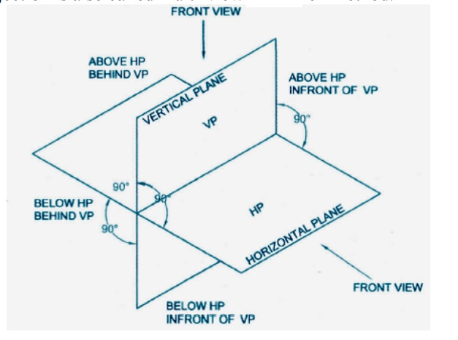
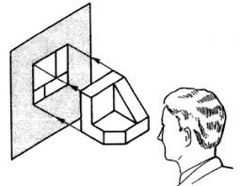

Slide 18
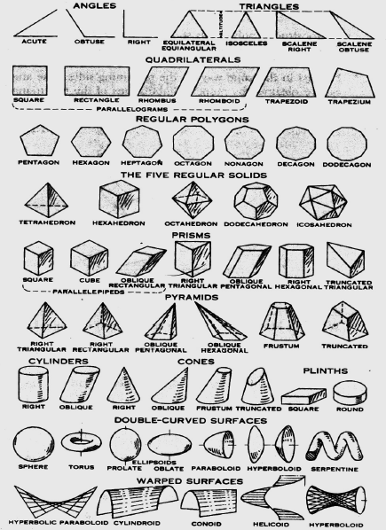

Slide 19
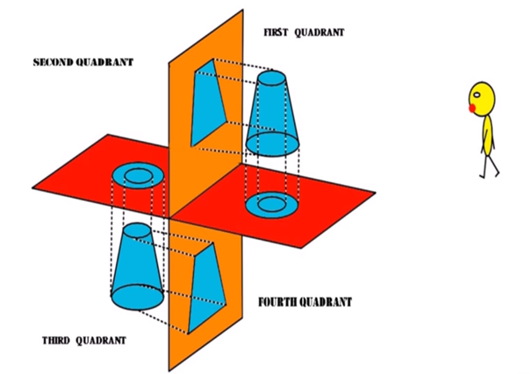

Slide 20
Reference links
https://www.youtube.com/watch?v=KjtAAVKie84 (Basics of Drawing)
https://www.youtube.com/watch?v=mcxUTNkSyp4 (1st and 3rd Angle Projection)
https://www.youtube.com/watch?v=NUxBqIuxKQc (2nd and 4th Angle Projection)

Slide 21


