Slide 1

MODULE-1
SIMPLE STRESSES AND STRAINS
Sub Name: STRENGTH OF MATERIALS
Sub Code: 21CV33
Name of Faculty: Dr. Vijayalakshmi Akella / Amrutha Dhiraj
Dept. of Civil Engineering
K S School of Engineering and Management
Notes:
Motion
(Basic)
Note: This video template is optimized for Microsoft PowerPoint 2010.
In PowerPoint 2007, video elements will play, but any content overlapping the video bars will be covered by the video when in slideshow mode.
In PowerPoint 2003, video will not play, but the poster frame of the videos will remain in place as static images.
The video:
Plays automatically after each slide transition.
Is 15 seconds long.
Seamlessly loops for infinite playback.
To add slides or change layout:
To add a new slide, on the Home tab, in the Slides group, click the arrow under New Slide, then click under Motion Background Theme, select the desired layout.
To change the layout of an existing slide, on the Home tab, in the Slides group, click Layout, then select the desired layout.
Other animated elements:
Any animated element you insert will begin after the slide transition and the background video has started.

Slide 2
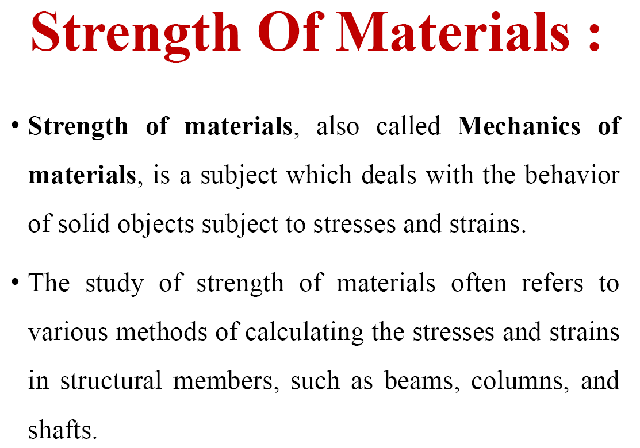

Slide 3
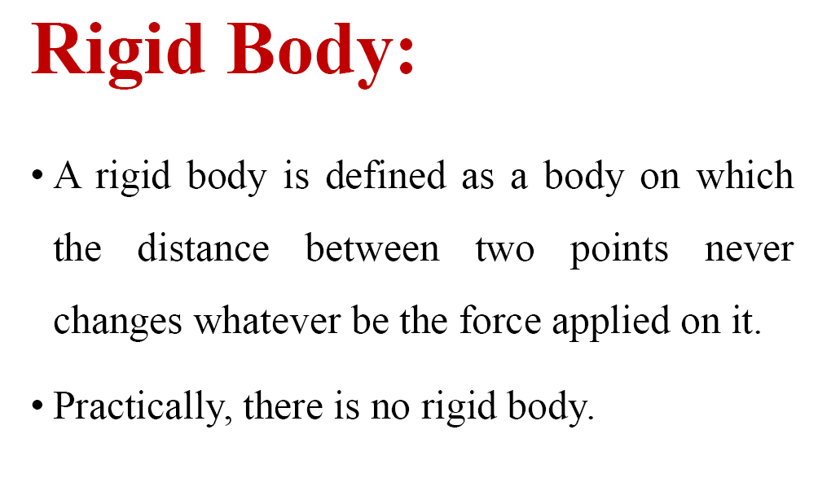

Slide 4
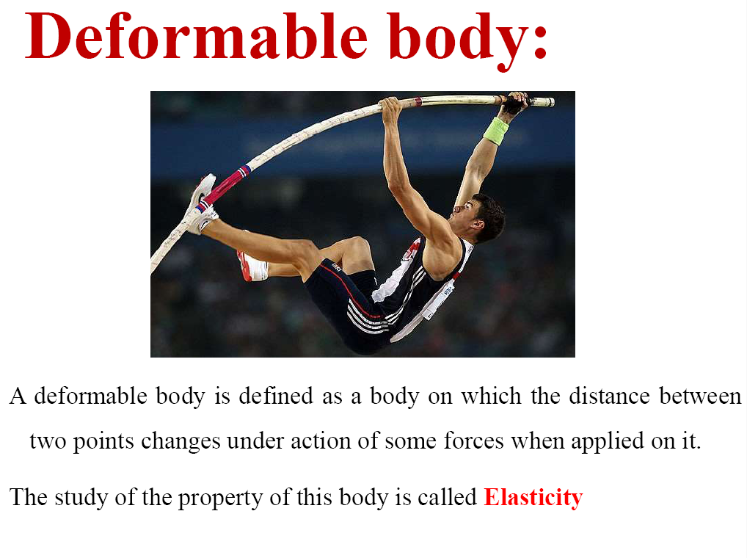

Slide 5
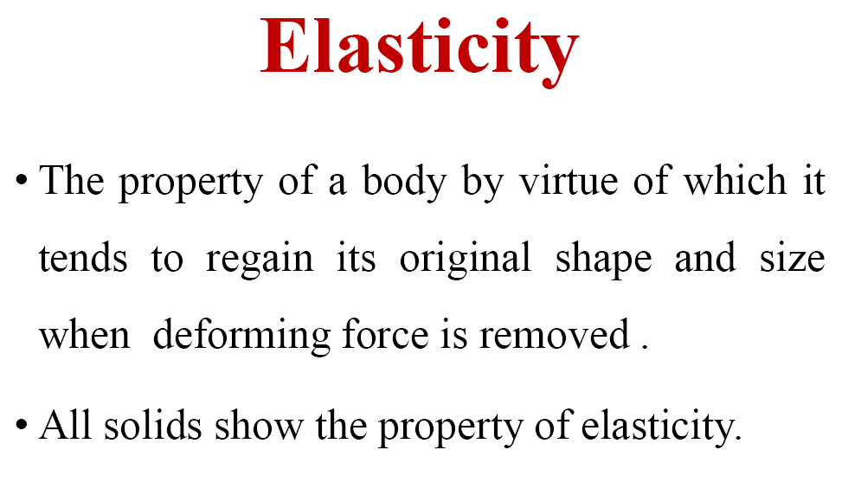

Slide 6
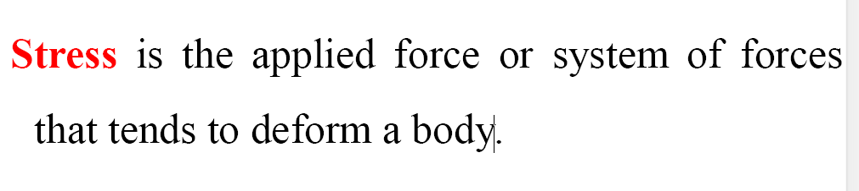
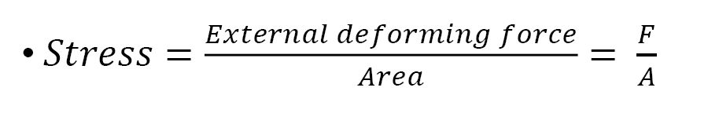
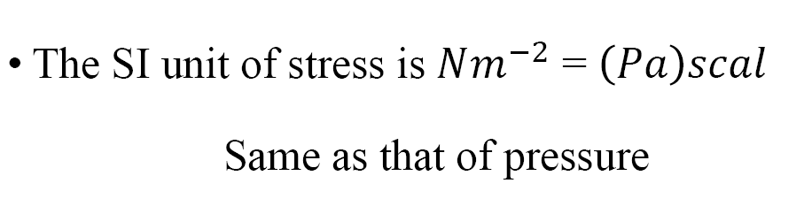

Slide 7
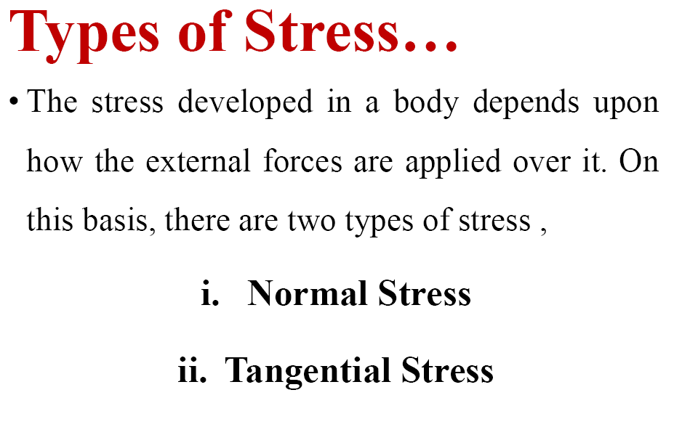

Slide 8
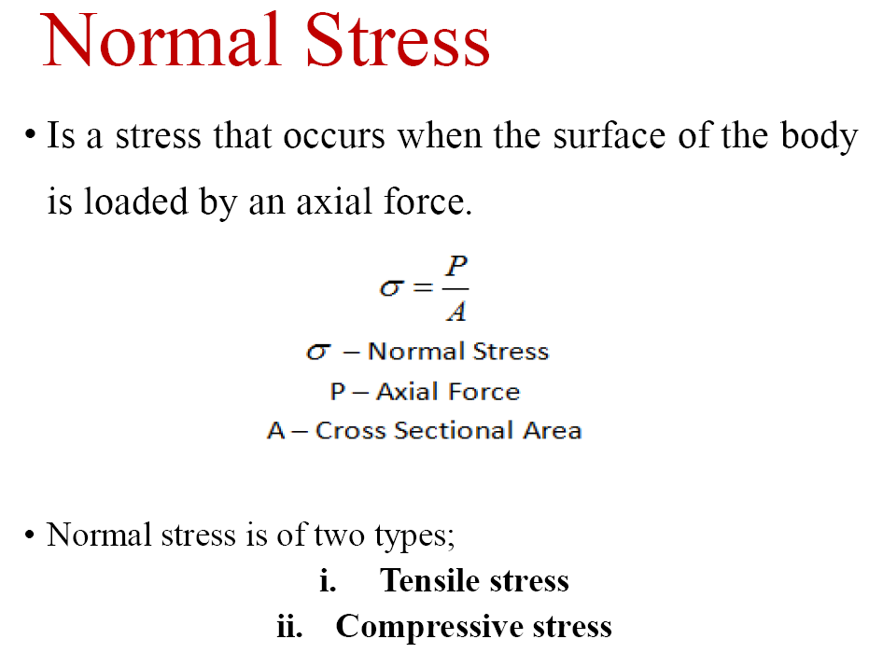

Slide 9
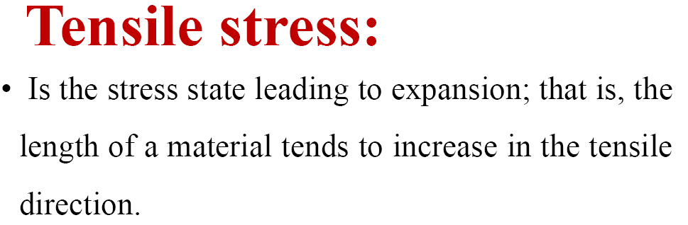
Tensile strength of a material can be measured by
testing it with an Universal Testing Machine (or
UTM)

Slide 10
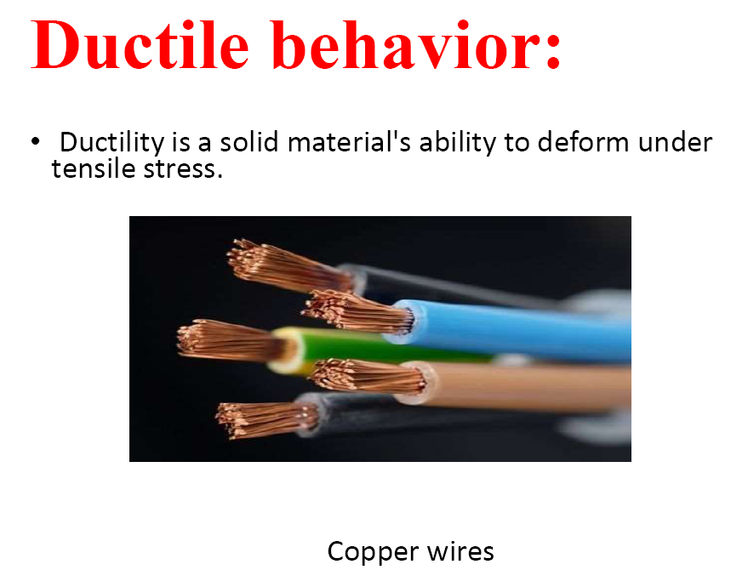

Slide 11
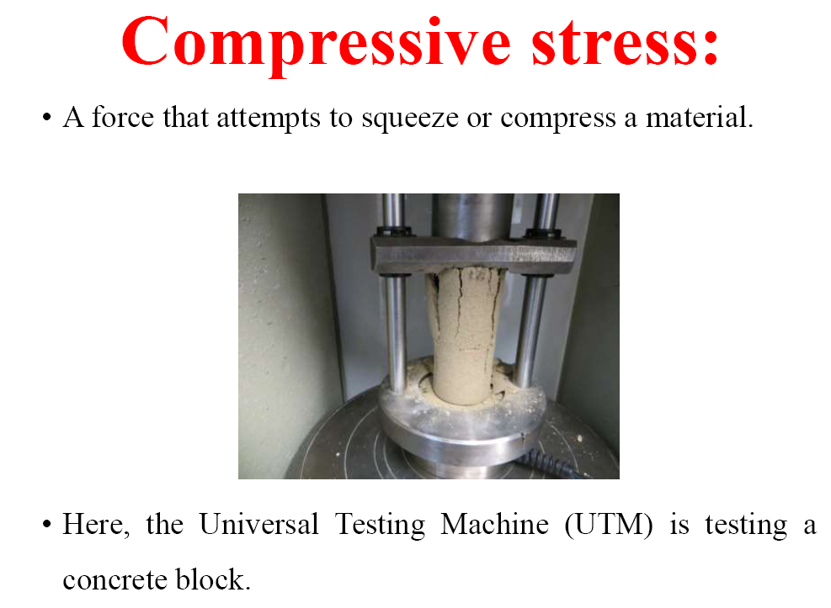

Slide 12
Shearing Stress or Tangential Stress: When the direction of the deforming force or external force is parallel to the cross-sectional area, the stress experienced by the object is called shearing stress or
tangential stress

Slide 13
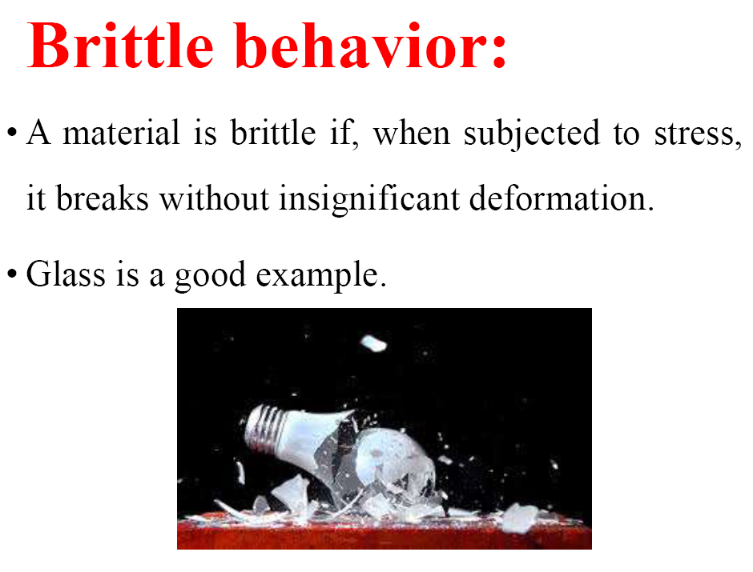

Slide 14
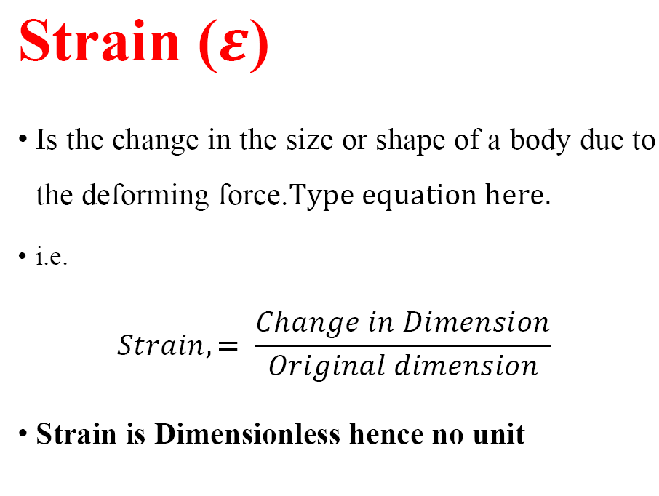

Slide 15
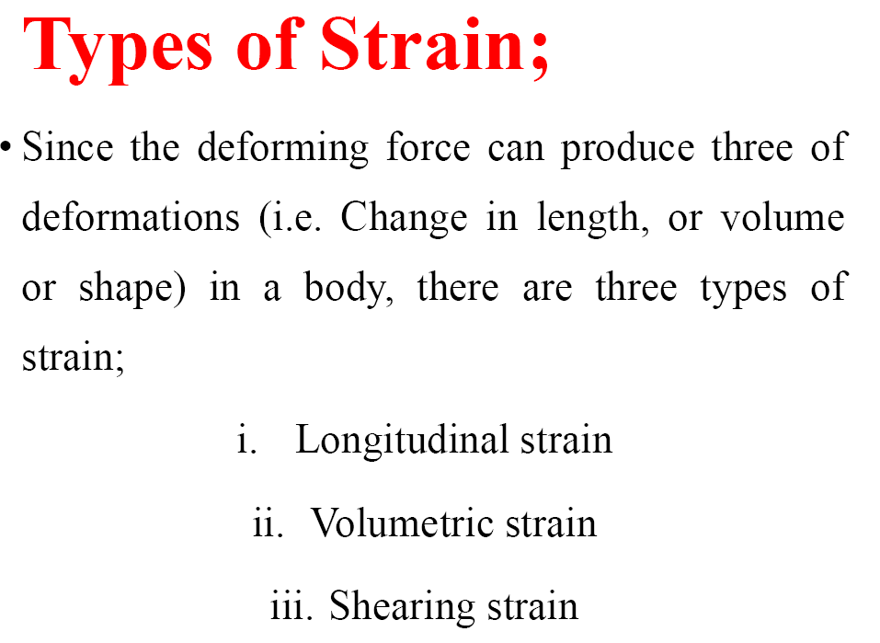

Slide 16
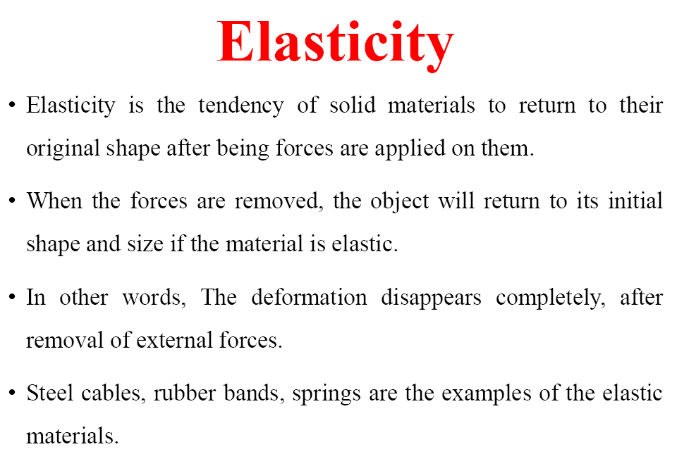

Slide 17
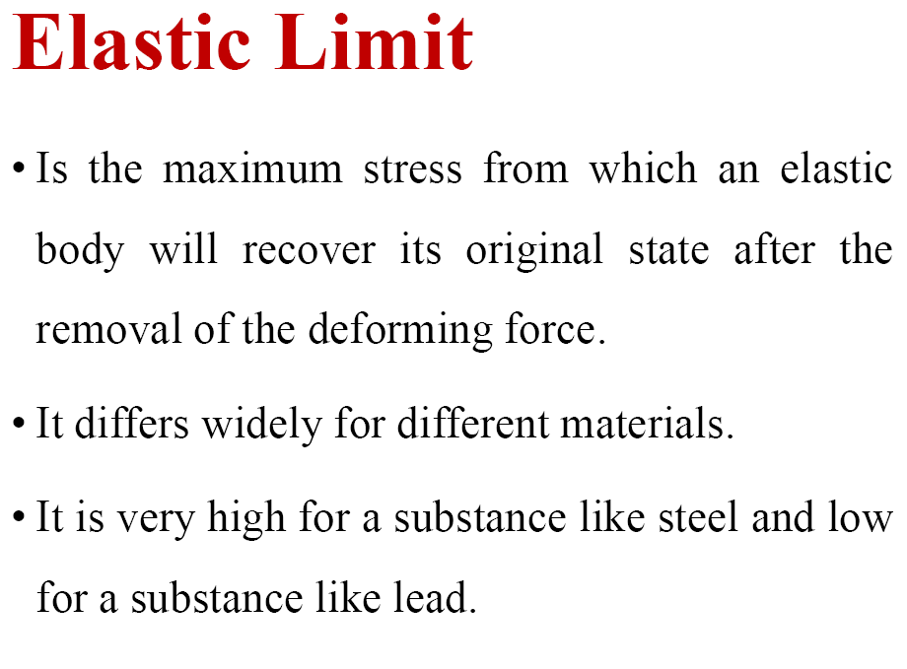

Slide 18
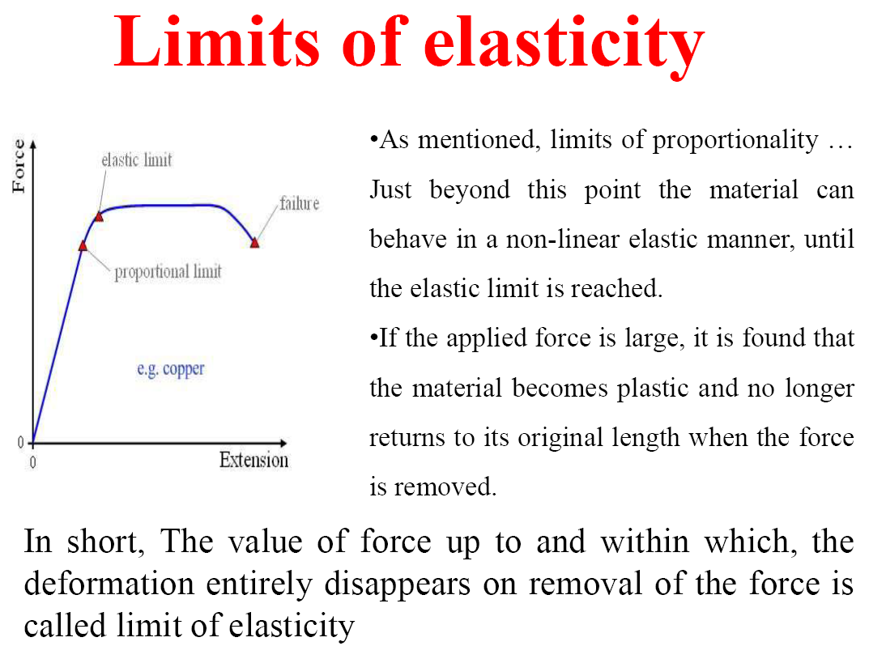

Slide 19
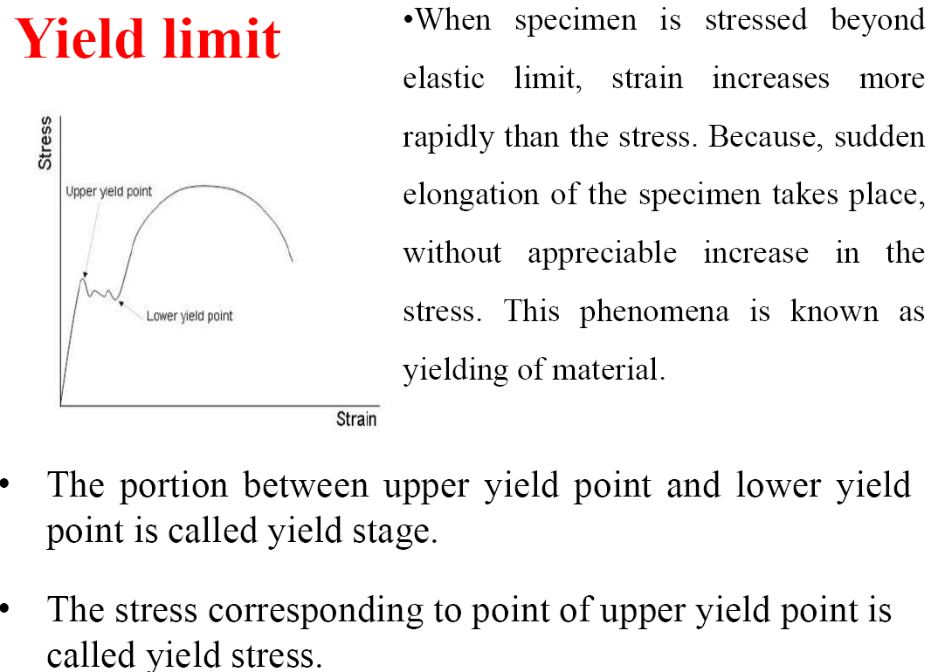

Slide 20
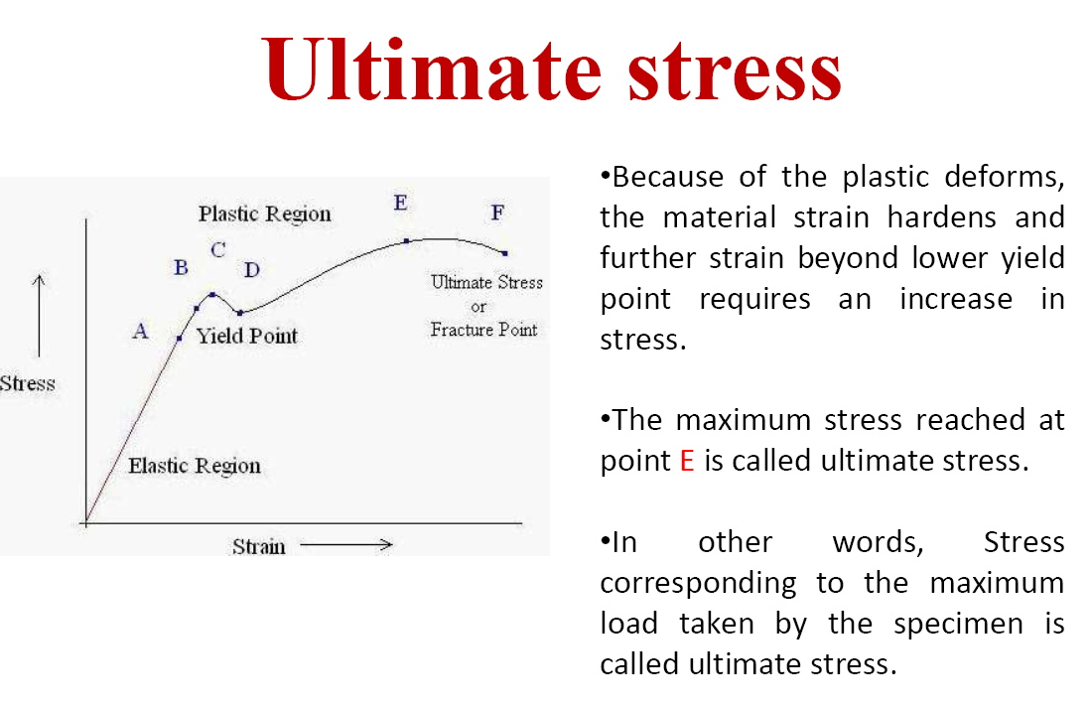

Slide 21
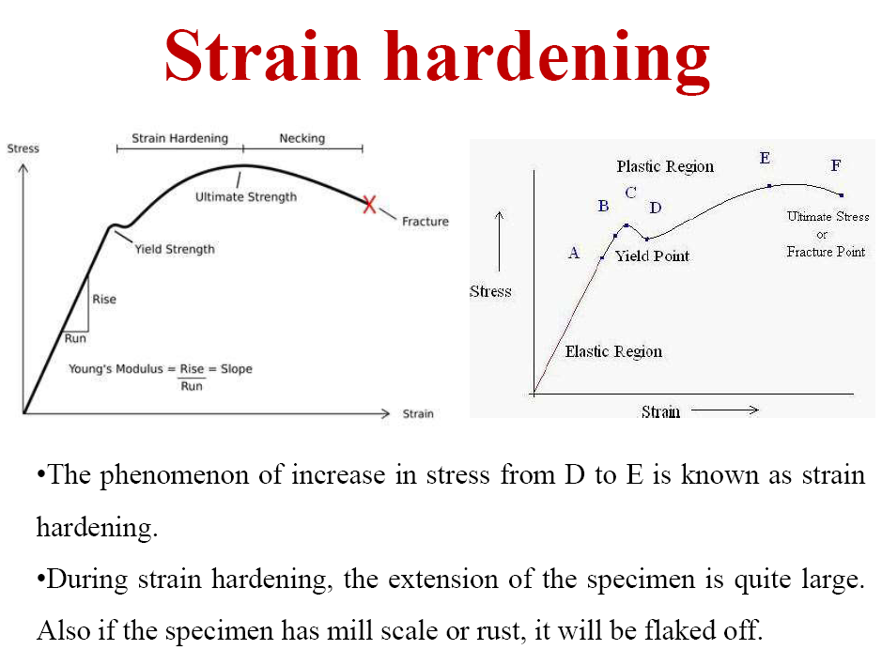
Strength of Materials, 21CV33

Slide 22
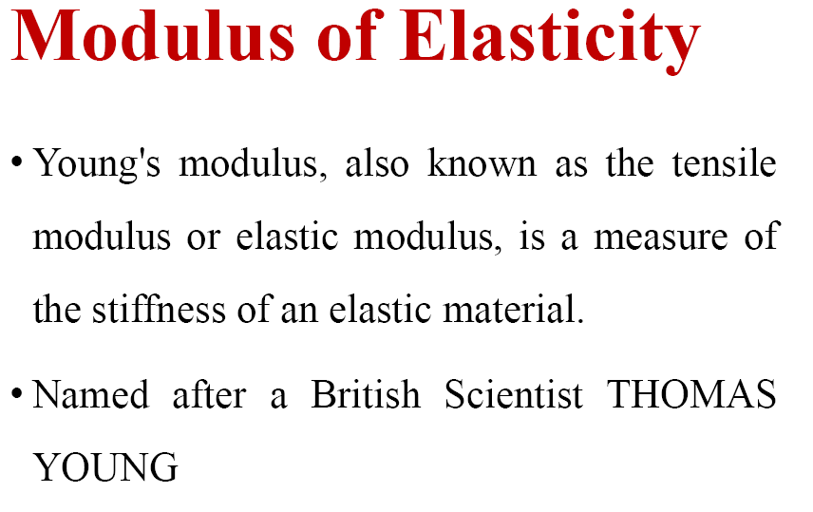
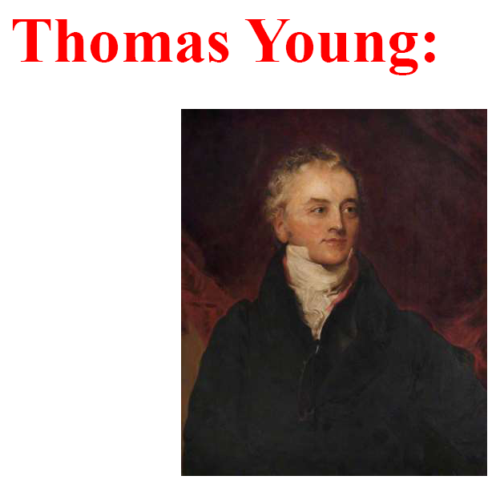

Slide 23
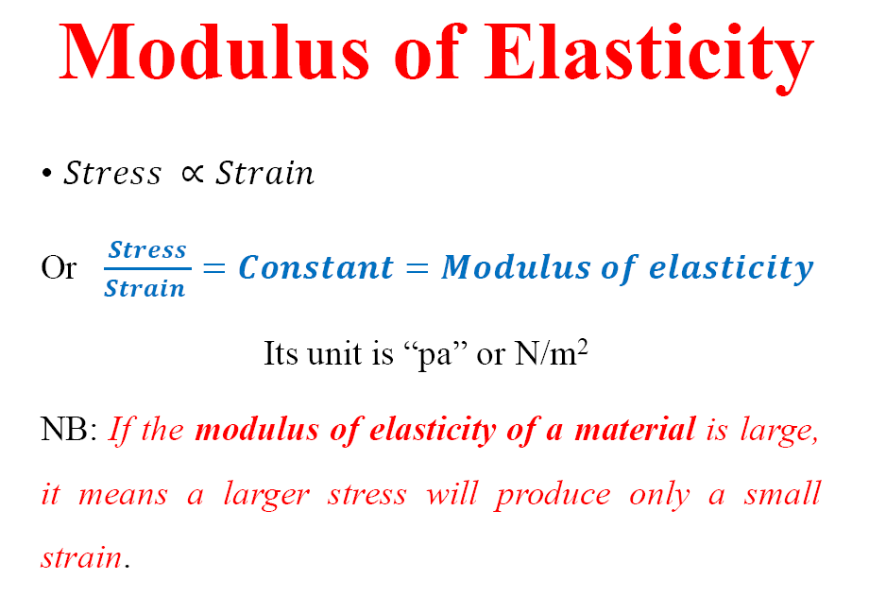

Slide 24
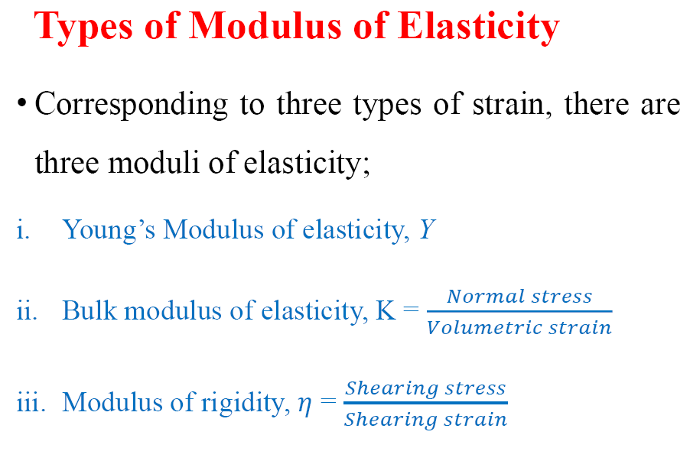
E
G

Slide 25
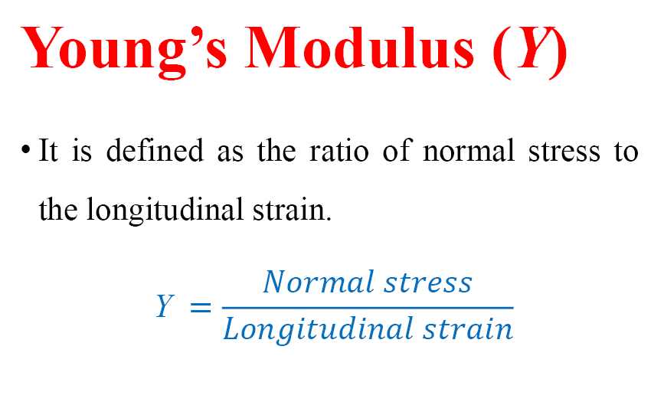
(E)
E

Slide 26
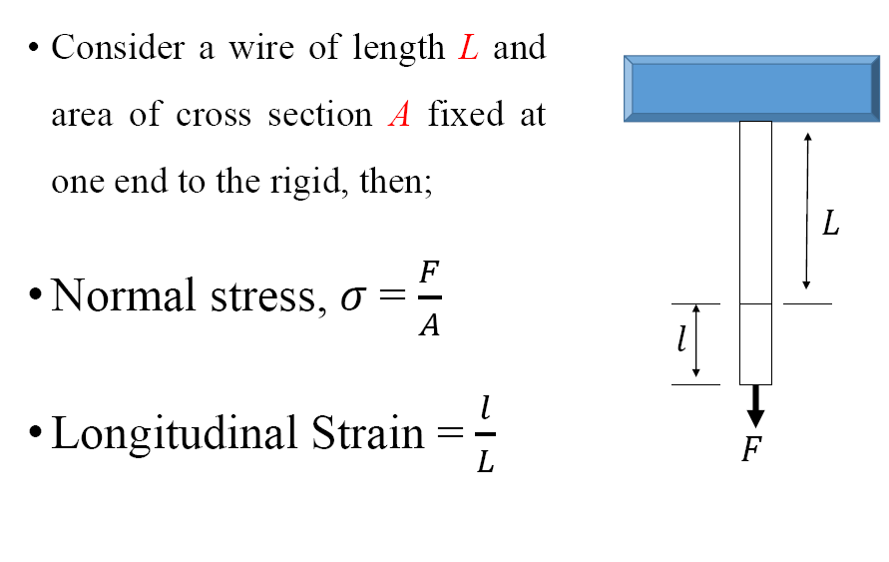
dL
dL
E=FL/A.dL
Or, dL=FL/AE

Slide 27
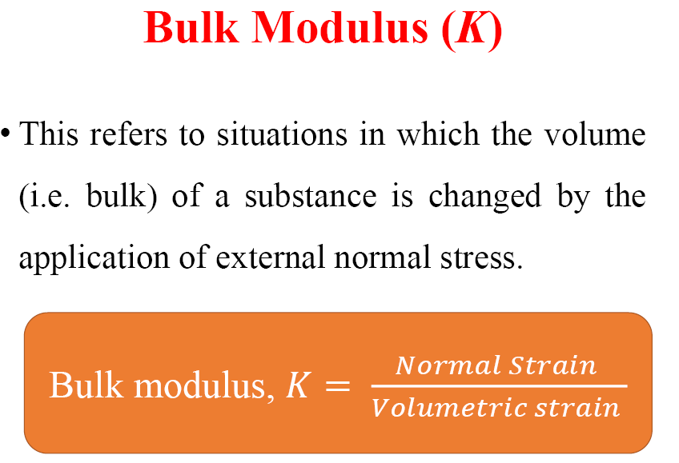

Slide 28
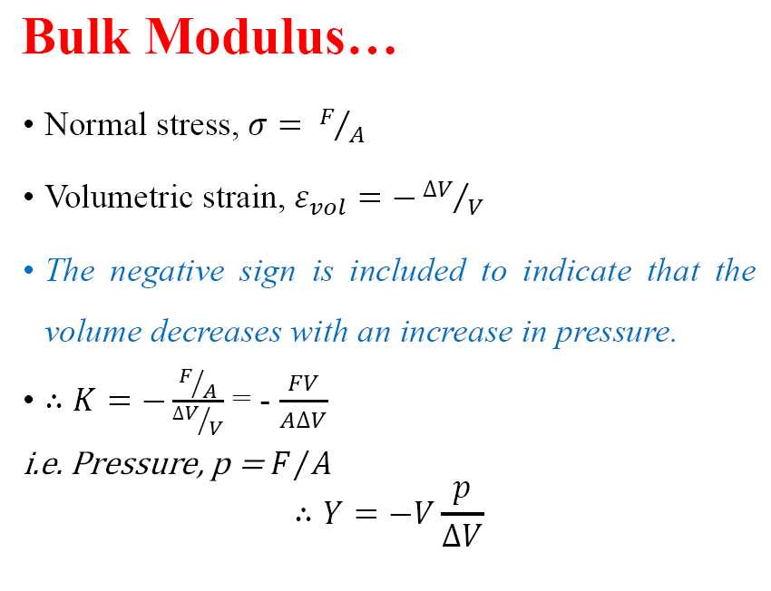

Slide 29
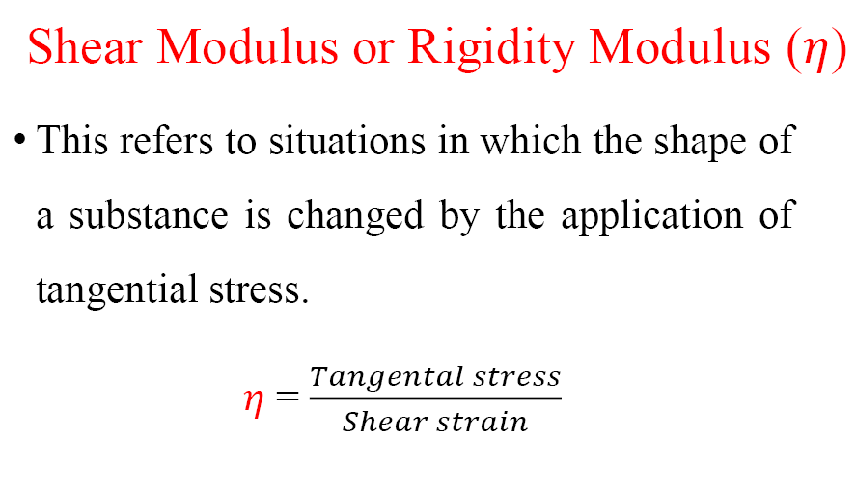
(G)
G
Tangential Stress

Slide 30
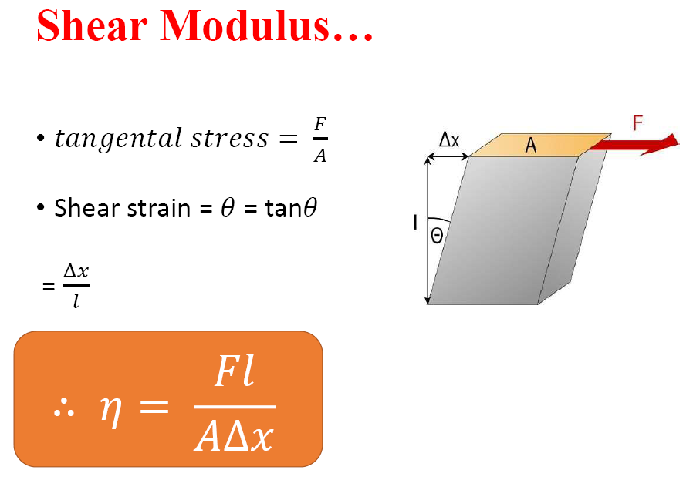

Slide 31
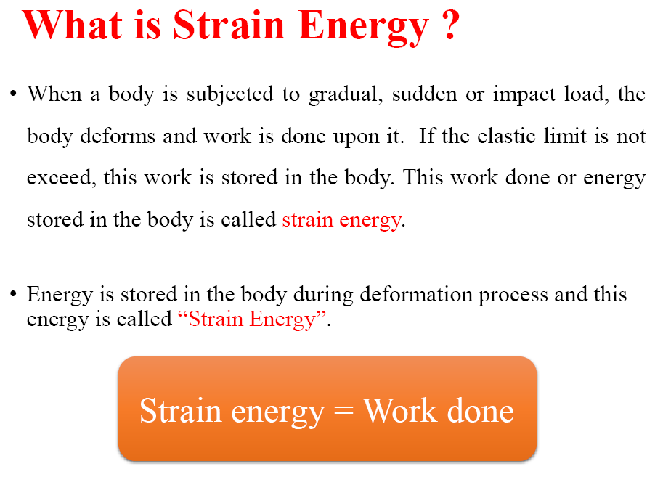

Slide 32
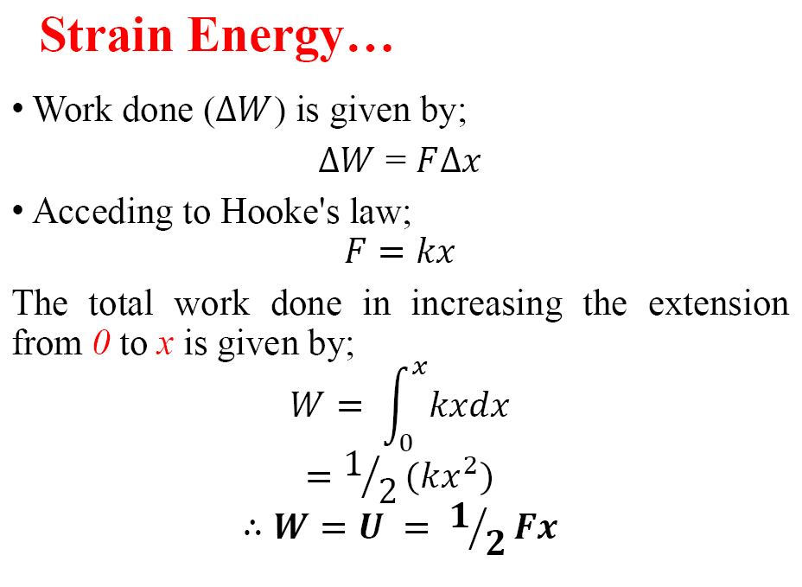

Slide 33
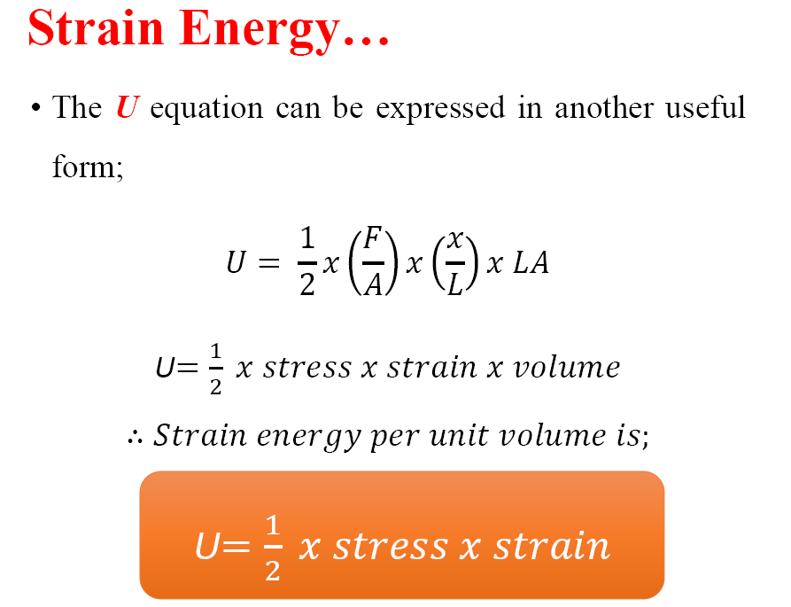

Slide 34
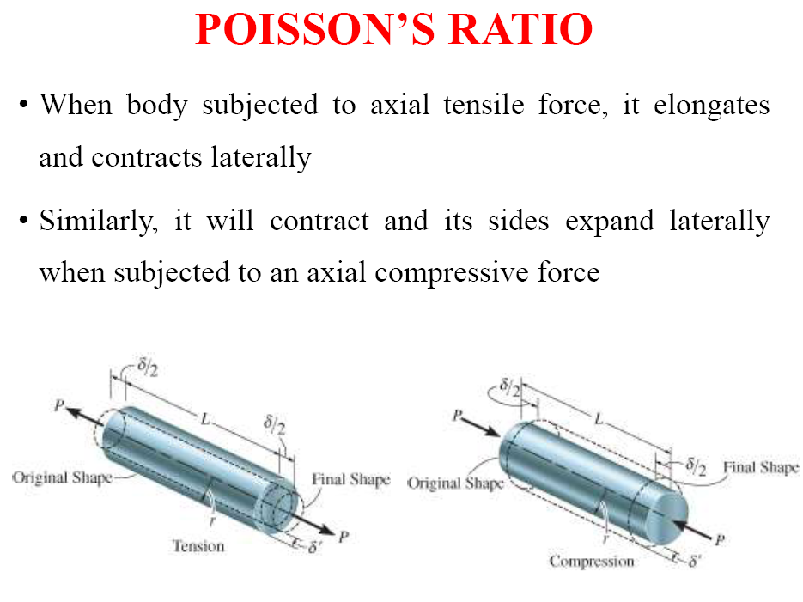

Slide 35
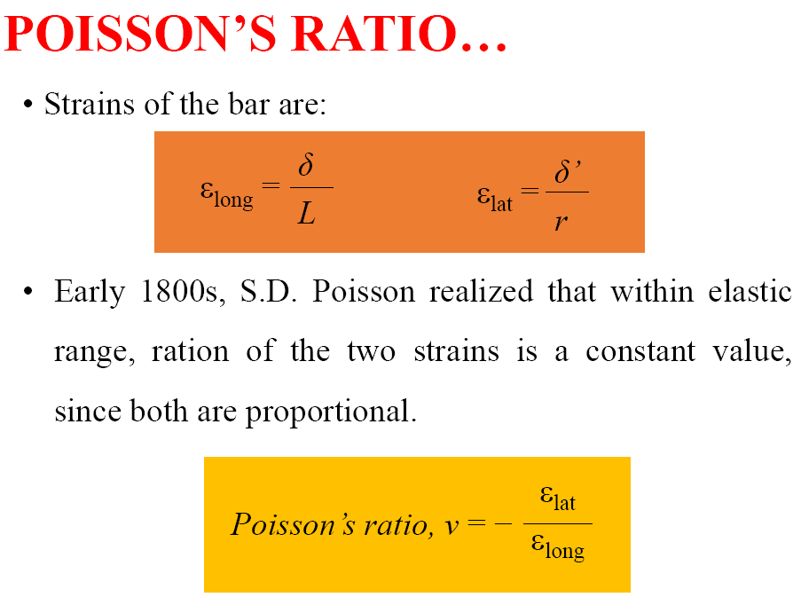

Slide 36
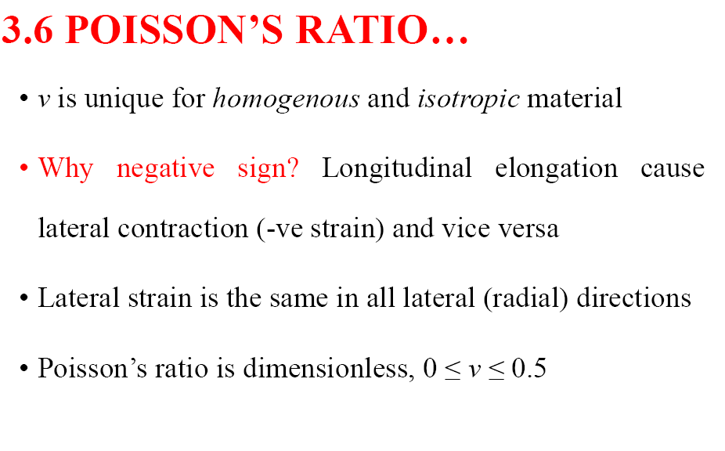

Slide 37
Useful links
http://www.digimat.in/nptel/courses/video/105105108/L16.html

Slide 38
THANK YOU

