Slide 1

Sub Name: Public Health Engineering
Sub Code: 21CV43
Name of Faculty: Dr. Rashmi H R
Dept. of Civil Engineering
K S School of Engineering and Management
Notes:
Motion
(Basic)
Note: This video template is optimized for Microsoft PowerPoint 2010.
In PowerPoint 2007, video elements will play, but any content overlapping the video bars will be covered by the video when in slideshow mode.
In PowerPoint 2003, video will not play, but the poster frame of the videos will remain in place as static images.
The video:
Plays automatically after each slide transition.
Is 15 seconds long.
Seamlessly loops for infinite playback.
To add slides or change layout:
To add a new slide, on the Home tab, in the Slides group, click the arrow under New Slide, then click under Motion Background Theme, select the desired layout.
To change the layout of an existing slide, on the Home tab, in the Slides group, click Layout, then select the desired layout.
Other animated elements:
Any animated element you insert will begin after the slide transition and the background video has started.

Slide 2
Course Learning objectives: This Course will enable the students to
1.Analyze the variation of water demand and to estimate water requirement for a community.
2. Study drinking water quality standards and to illustrate qualitative analysis of water.
3. Analysis of physical and chemical characteristics of water and wastewater.
4.Understand and design of different unit operations and unit process involved in water and wastewater treatment process
5. Design various oxidation processes

Slide 3
Teaching-Learning Process (General Instructions) These are sample Strategies; which teacher can use to accelerate the attainment of the various course outcomes.
1. Apart from conventional lecture methods various types of innovative teaching techniques through videos, animation films may be adopted so that the delivered lesson can progress the students in theoretical, applied and practical skills.
2. Arrange field visits to give brief information about the water and wastewater treatment plant.
3. Encourage collaborative (Group Learning) Learning in the class.
4. Ask at least three HOTS (Higher-order Thinking) questions in the class, which promotes critical thinking and enhance the knowledge of treatment processes.
5. Adopt Problem Based Learning (PBL), which fosters students, Analytical skills, develop thinking skills such as the ability to evaluate, generalize, and analyze information rather than simply recall it.
6. Seminars, surprise tests and Quizzes may be arranged for students in respective subjects to develop skills

Slide 4
Course outcome (Course Skill Set)
At the end of the course, the student will be able to:
1. Estimate the average and peak water demand for a community.
2. Evaluate water quality and environmental significance of various parameters and plan suitable treatment system.
3. Design the different units of water treatment plant.
4. Design the various units of wastewater treatment plant.
5. Design of various AOPs and low cost treatment units.

Slide 5
Module-1
Introduction: Water: Need for protected water supply, Demand of Water: Types of water demands - domestic demand, industrial, institutional and commercial demand, public use and fire demand estimation, factors affecting per capita demand, Variations in demand of water, Peak factor. Design period and factors governing design period. Methods of population forecasting and numerical problems. Physico chemical characteristics of water Sampling.
Module-2
Water Treatment: Objectives, Unit flow diagrams – Significance of each unit, Aeration process Limitations and types. Sedimentation - Theory, settling tanks, types and design with numerical, Coagulation and flocculation, types of coagulants. Filtration: Mechanism, theory of filtration, types of filters: slow sand, rapid sand and pressure filters. Operation and cleaning. Design of slow and rapid sand filter without under drainage system, Numerical.
Module-3
2Disinfection:Methods of disinfection with merits and demerits. Breakpoint chlorination, Softening: Lime soda and Zeolite process. Wastewater: Introduction: Need for sanitation, methods of sewage disposal, types of sewerage systems, Treatment of municipal waste water: Waste water characteristics sampling, significance and techniques, physical, chemical and biological characteristics, Numerical on BOD.

Slide 6
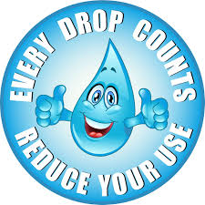
Module-4
Treatment Process: flow diagram for municipal waste water Treatment unit operations and process Screens: types, disposal. Grit chamber, oil and grease removal. Primary and secondary settling tanks, Suspended growth system - conventional activated sludge process and its modifications, numerical.
Module-5
Attached growth system – Trickling filter, numerical on Trickling filters, bio-towers and rotating biological contactors. Principle of stabilization ponds, oxidation ditch. Sludge digesters (aerobic and anaerobic), Equalization. Thickeners and drying beds.

Slide 7
Textbooks:
Howard S. Peavy, Donald R. Rowe, George T , Environmental Engineering - McGraw Hill International Edition. New York,2000
S. K. Garg, Environmental Engineering vol-I, Water supply Engineering – M/s Khanna Publishers, New Delhi2010
B.C. Punmia and Ashok Jain, Environmental Engineering I-Water Supply Engineering, Laxmi Publications (P) Ltd., New Delhi2010.

Slide 8
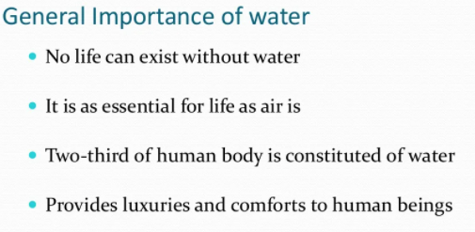

Slide 9
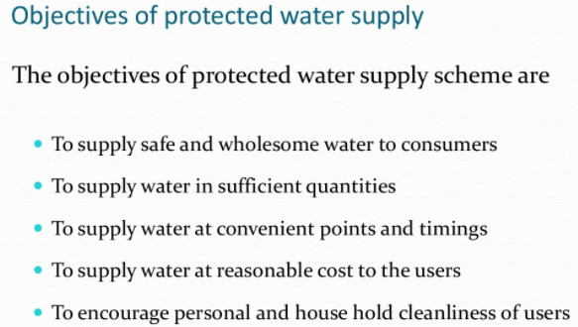

Slide 10
Need for protected water supply.
• Protected water supply means the supply of water that is treated to remove the impurities and made safe to public health. Water may be polluted by physical and bacterial agents.
• The protected water supply system is only available in urban areas and only to some extent in rural areas. But the country like India is essentially a village based country and majority of population which lives in rural villages need safe and portable water for usage.
• Most of the rural population if not provided with protected water supply systems. They are mostly depending upon the conventional sources like wells, ponds and streams etc are generally in polluted condition.
• People consuming this water without any treatment they are bound to suffer from water borne diseases like typhoid, dysentery, cholera, poliomyelitis, Jaundice, gunia worm etc.
• The rural water supply system aim to provide reasonable quantity of safe wholesome water to satisfy demands of people and thus helping in maintaining better sanitation and beautification of surroundings, thereby reducing environmental pollution.

Slide 11
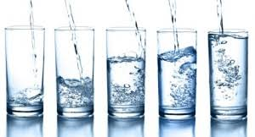
DEMAND OF WATER
While designing the water supply scheme for a town or city, it is necessary to determine the total quantity of a water required for various purposes by the city.
As a matter of fact the first duty of the engineer is to determine the water demand of the town and then to find suitable water sources from where the demand can be met. But as there are so many factors involved in demand of water, it is not possible to accurately determine the actual demand.
Certain empirical formulae and thumb rules are employed in determining the water demand, which is very near to the actual demand.

Slide 12
Following are the various types of water demands of a city or town:
Domestic water demand
Industrial water demand
Institution and commercial water demand
Demand for public use
Fire demand and loses and wastes

Slide 13
Domestic Water Demand
The quantity of water required in the houses for drinking, bathing, cooking, washing
etc is called domestic water demand and mainly depends upon the habits, social status, climatic conditions and customs of the people.
As per IS: 1172-1993, under normal conditions, the domestic consumption of water in India is about 135 litres/day/capita. But in developed countries this figure may be 350 litres/day/capita because of use of air coolers, air conditioners, maintenance of lawns, automatic household appliances.
The details of the domestic consumption are,
Drinking---------------------- 5 litres
Cooking---------------------- 5 litres
Bathing---------------------- 55 litres
Clothes washing ----------- 20 litres
Utensils washing ---------- 10 litres
House washing------------- 10 litres
Flushing of water closets--30 litres
135 litres/day/capita

Slide 14
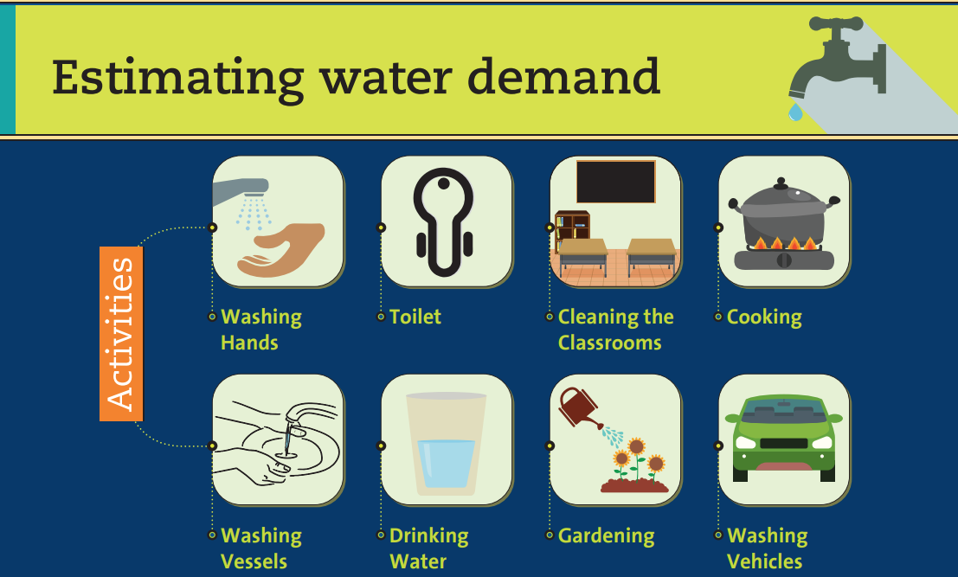

Slide 15
Industrial water demand.
Industrial require a large volume of water for manufacturing processes, cooling operation, steam generation, for processing and sanitation purposes etc, this part of water in known as ‘industrial demand’.
In industrial cities, the per capita water requirement may finally be computed to be as high as 450 liters/person/day or so, as compared to the normal industrial requirement of 50 liters/person/day.
The water required in the industries mainly depends on the type of industries, which are existing in the city. The water required by factories, paper mills, Cloth mills, Cotton mills, Breweries, Sugar refineries etc. comes under industrial use. The quantity of water demand for industrial purpose is around 20 to 25% of the total demand of the city.

Slide 16
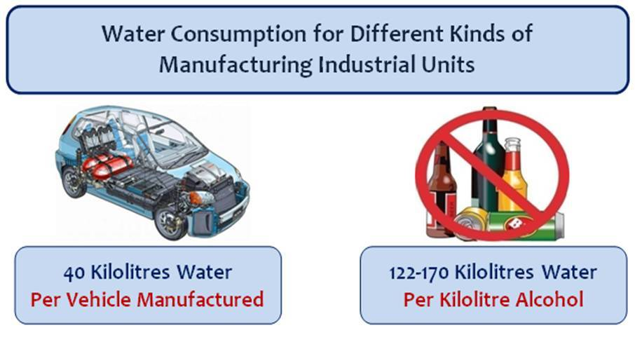

Slide 17
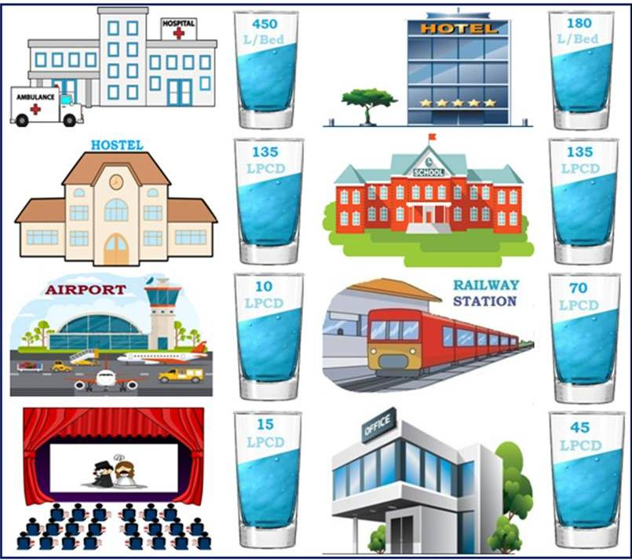
Institution And Commercial water Demand
Universities, Institution, commercial buildings and commercial centers including
office buildings, warehouses, stores, hotels, shopping centers, health centers, schools, temple, cinema houses, railway and bus stations etc. comes under this category.
As per IS: 1172-1963, water supply requirements for the public buildings other than residences as follows.

Slide 18
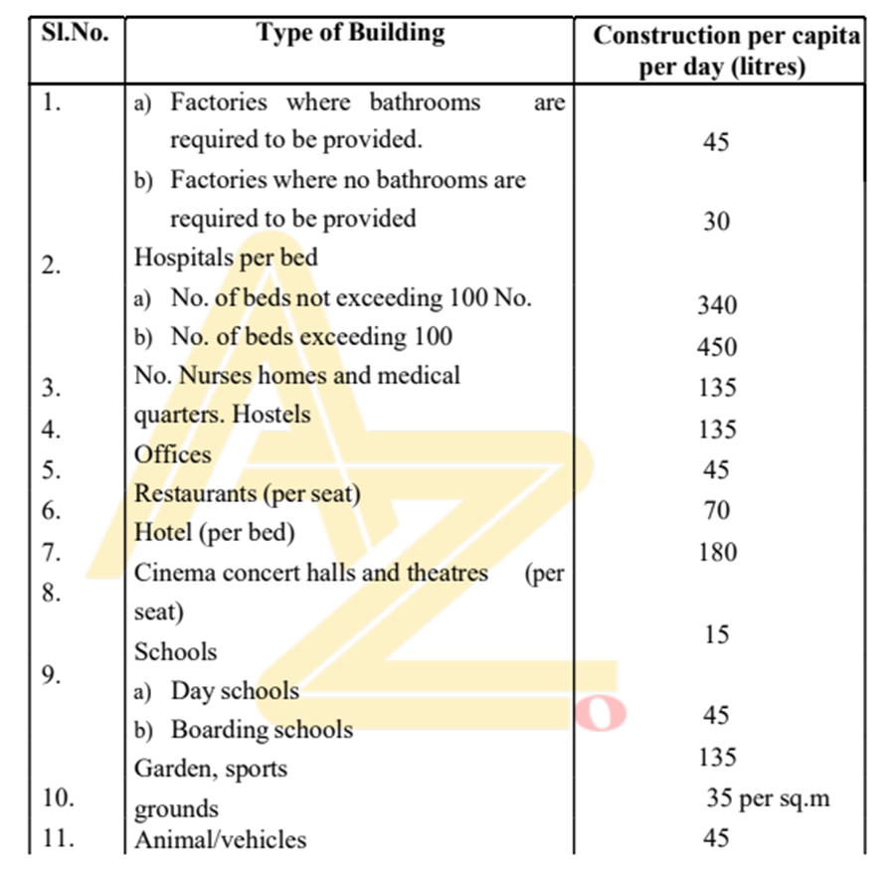

Slide 19
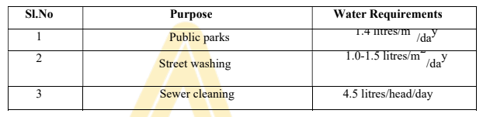
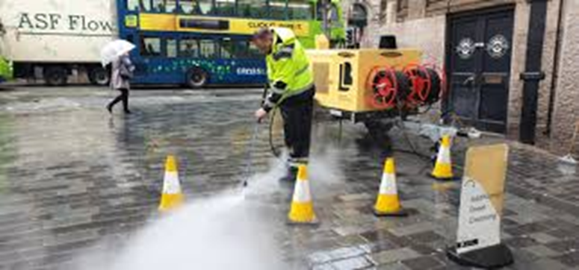
Demand for Public Use
Quantity of water required for public utility purposes such as for washing and sprinkling on roads, cleaning of sewers, watering of public parks, gardens, public fountains etc comes under public demand. To meet the water demand for public use, provision of 5% of the total consumption is made designing the water works for a city. The requirements of water for public utility shall be taken as given in Table,

Slide 20
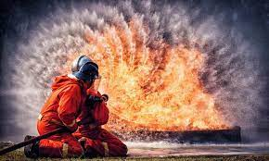
Fire Demand

Slide 21
Fire Demand
Fire may take place due to faulty electric wires by short circuiting, fire catching
materials, explosions, bad intension of criminal people or any other unforeseen mis
happenings. If fires are not properly controlled and extinguished in minimum possible time, they lead to serious damage and may burn cities.
All the big cities have full fire-fighting squads. As during the fire breakdown large
quantity of water is required for throwing it over the fire to extinguish it, therefore provision is made in the water work to supply sufficient quantity of water or keep as reserve in the water mains for this purpose. In the cities fire hydrants are provided on the water mains at 100 to 150 m apart for fire demand.
The quantity of water required for fire fighting is generally calculated by using different empirical formulae. For Indian conditions kuichings formula gives satisfactory results.

Slide 22
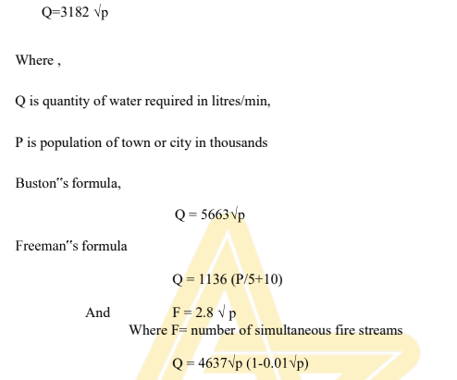

Slide 23
Though the total demand of water for extinguishing fire is usually very small, the rate of consumption is very high. It depends upon bulk, congestion and fire resistance buildings.
The minimum limit of fire demand is the amount and rate of supply that would extinguish the largest probable fire in the city. Fire hydrants of 15 to 20 cm diameter are normally provided on all street corners, and at suitable intermediate points. These are generally connected to water supply mains. When fire occurs, pumps installed on fire brigade trucks are rushed to the
site and connected to fire hydrants from where they throw jet of water under very high pressure. The pressure varies between 1 to 2kg/cm2.
For a fire of moderate ,three streams each of 1100 litres/minute are required. For a city of one lac population, the fire flow required, by National Board of Fire Underwriters comes out to be 40500 litres/minute. Assuming an average total consumption of 150litres/day .thus the rate of flow required for the fire demand, is very much higher than the total flow rate required for the purposes. However, the provision for fire demand is made only for 3 to 5 hours fire flow. The total quantity of water calculated on yearly basis is usually very small because fire breaks out only few times in a year.

Slide 24
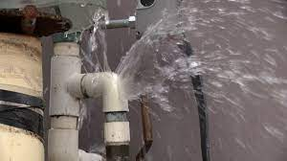
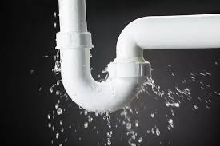
Losses And Wastes
All the water, which goes in the distribution, pipes does not reach the consumers. The following are the reasons
Losses due to defective pipe joints, cracked and broken pipes, faulty valves and fittings.
Losses due to, consumers keep open their taps of public taps even when they are not using the water and allow the continuous wastage of water.
Losses due to unauthorised and illegal connections
While estimating the total quantity of water of a town; allowance of 15% of total
quantity of water is made to compensate for losses, thefts and wastage of water.

Slide 25
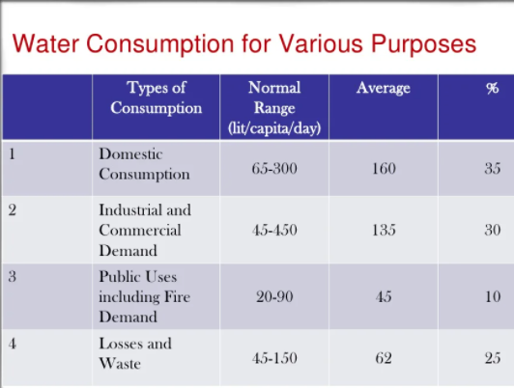

Slide 26
PER CAPITA DEMAND
If Q is the total quantity of water required by various purposes by a town per year and p is population of town, then per capita demand will be.
Per capita demand = Q/ P x 360 litres/day
Per capita demand of the town depends on various factors like standard of living, no. and type of commercial places in a town etc. For an average Indian town, the requirement of water in various uses is as under,
i. Domestic purpose ------------- 135 litres/c/d
ii. Industrial use ------------------- 40 litres/c/d
iii. Public use ---------------------- 25 litres/c/d
iv. Fire Demand -------------------- 15 litres/c/d
v. Losses, Wastage and thefts ---- 55 litres/c/d
Total: 270 litres/capita/day
The total quantity of water required by the town per day shall be 270 multiplied with the total population in litres/day.

Slide 27
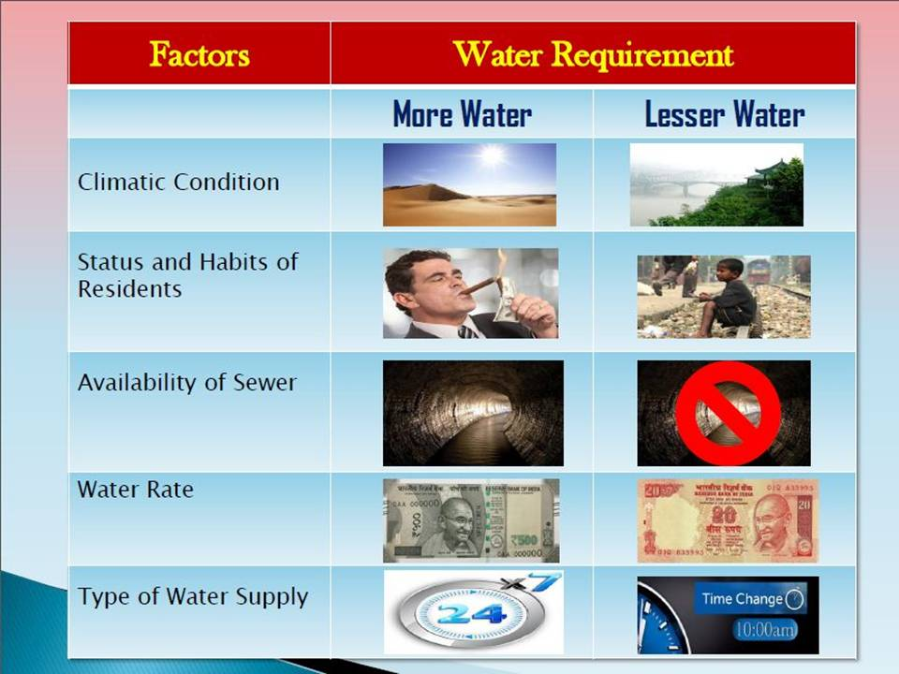
FACTORS AFFECTING PER CAPITA DEMAND
The following are the main factors affecting for capita demand of the city or town.
Climatic conditions
Size of community
Living standard of the people
Industrial and commercial
activities
Pressure in the distribution
system
System of sanitation
Cost of water

Slide 28
Useful links
https://archive.nptel.ac.in/courses/105/105/105105201/
https://archive.nptel.ac.in/courses/105/105/105105178/

