Slide 1

MODULE-1
INTRODUCTION
Subject & Subject CODE
DESIGN OF PRESTRESSED CONCRETE (18CV81)
Name of the Faculty:
NAVEENA M P
Dept. of Civil Engg
K S School of Engg & Management

Slide 2
Prestressed concrete
In ordinary reinforced concrete, tensile stresses by steel alone and compressive stresses are taken up by concrete. This concrete below the neutral axis is ignored since it is weak in tension.
Although steel takes up to the tensile stresses, the concrete at the tensile zone develops minute cracks. The load-carrying capacity of such concrete sections can be increased if steel and concrete both are stressed before the application of external loads.
This is the concept of prestressed concrete. As per the ACI committee, prestressed concrete is that concrete in which internal stresses of suitable magnitude are introduced so that these stresses resulting from the external loadings can be counteracted to a desired degree.

Slide 3
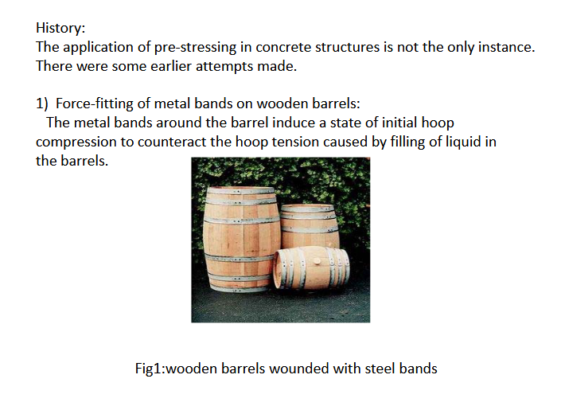

Slide 4
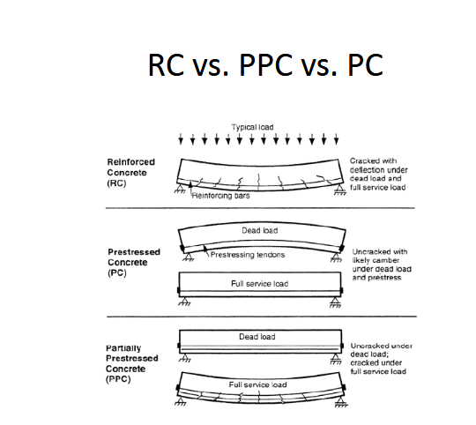

Slide 5
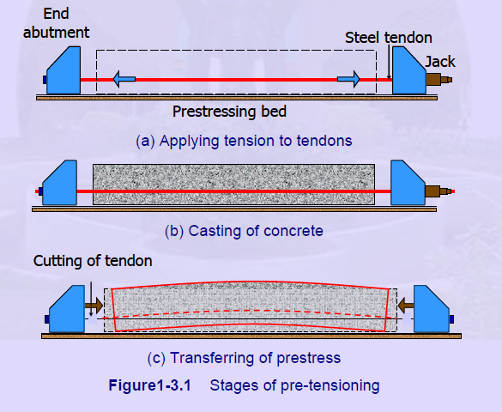
Pre tensioning :
In Pre-tensioning, the steel tendons are tensioned before the concrete is cast. The tendons are temporarily anchored against some abutments and then cut or released after the concrete has been placed and hardened.

Slide 6
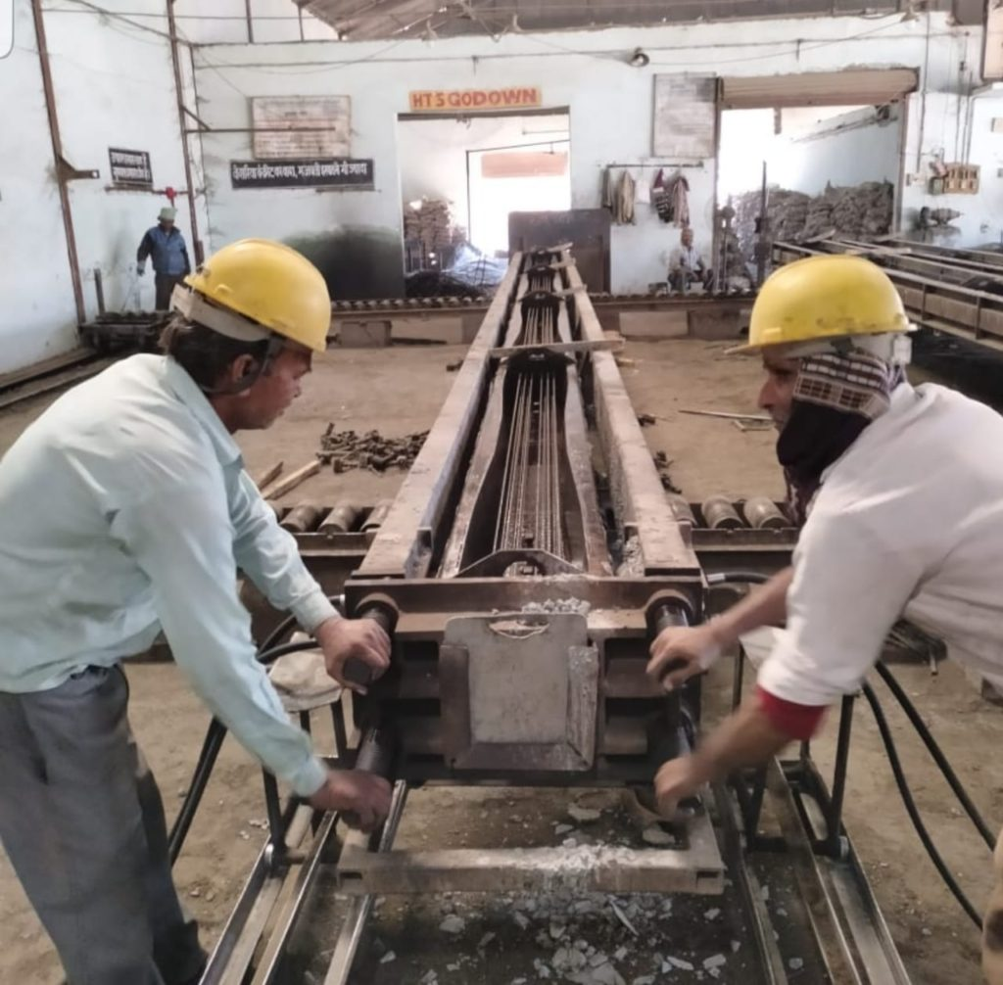
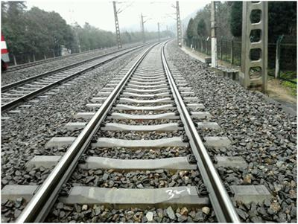
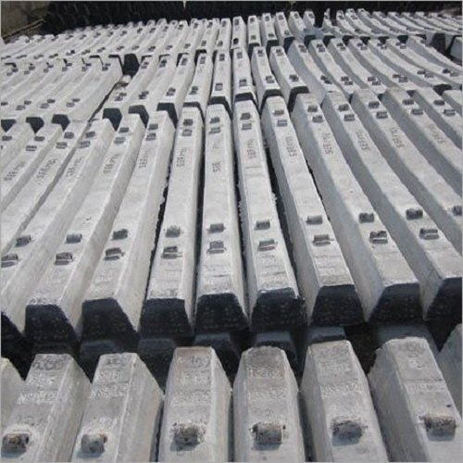

Slide 7
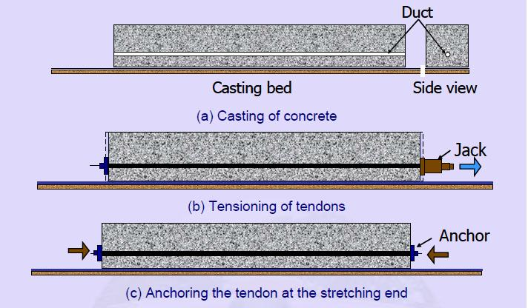
Post tensioning :
In Post-tensioning, the steel tendons are tensioned after the concrete has been cast and hardened

Slide 8
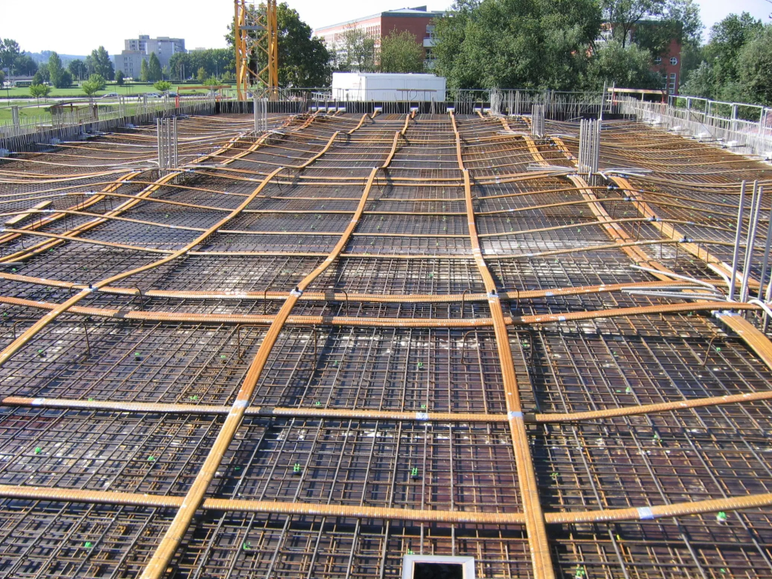
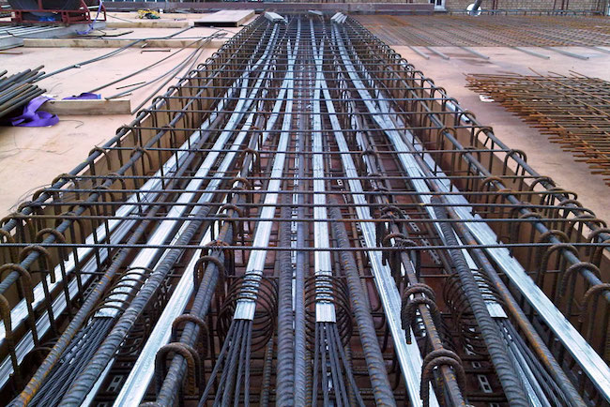

Slide 9
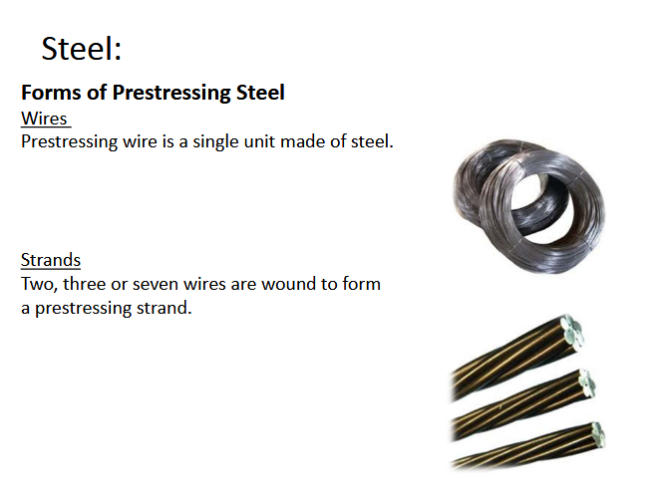
Tendons

Slide 10
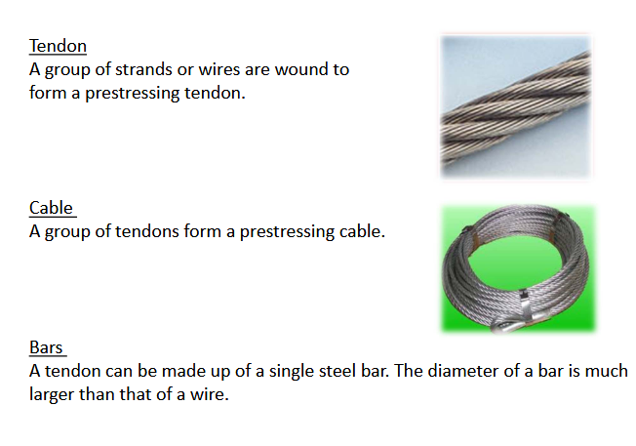

Slide 11
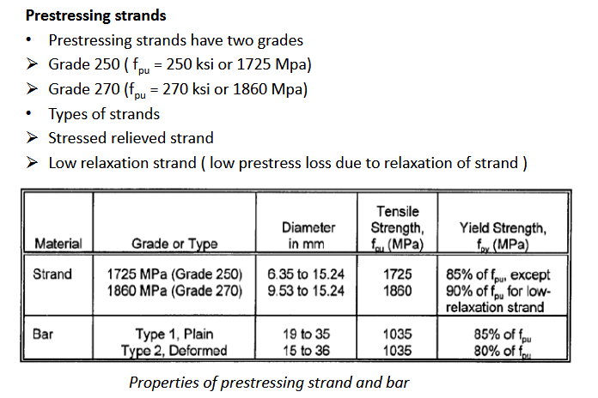

Slide 12
USEFUL WEBLINKS:
https://archive.nptel.ac.in/
https://strusoft.com/

