Slide 1

Module 1
Introduction
Subject Name: Management and Entrepreneurship for IT Industry (18CS51)
Name of the Faculty: Mrs. Amitha S and Mrs Sandhya A Kulkarni
Department of Computer Science and Engineering
K S School of Engineering and Management, Bengaluru-560109

Slide 2




INTRODUCTION

Slide 3
Management and Entrepreneurship for IT Industry
Subject code: 18CS51
Author:
Principles of Management-P.C. Tripathi, P.N. Reddy, 4th/6th Edition 2010.
Reference book
1. Management and Enterpreneurship- N.V.R . Naidu & T. Krishna Rao

Slide 4


Outline
Meaning of Management
Nature & Characteristics of Management
Scope of Management
Functional Areas of Management Goals of Management
Levels of Management
Development of Management Thoughts Early, Modern Management Approaches

Slide 5
Outline
Nature of Planning Importance of Planning
Types of Plans
Steps in Planning
Nature & purpose of Organization
Types of Organization
Meaning of Staffing
Process of Recruitment & Selection

Slide 6
Importance of Management
Management is a critical element in the economic growth of a country.
Management is the dynamic, life giving element in every organization.

Slide 7
Definition of Management
‘the art of getting things done through people’ -Mary Parker Follet
“a process consisting of planning, organizing, actuating and controlling performed to determine and accomplish the objectives by the use of people and resources”- George R Terry
There are four views of management:
Management is a process.
Management is a discipline.
Management is a human activity.
Management is a career.

Slide 8
Definition of Management
“Management is the direction and maintenance of an internal environment in an enterprise where individuals working in groups can perform efficiently and effectively towards the attainment of group goals”- Koontz and O’Donnel
“Management is the art of knowing what you want to do and then seeing that it is done in the best and cheapest way” - F.W. Taylor
“Management is the art and science of decision making and leadership” - Donald J Clough

Slide 9
NATURE OF MANAGEMENT
Multidisciplinary
Dynamic nature of principles
Continuous Process
Management – science or art
Universality of management

Slide 10
CHARACTERISTICS OF MANAGEMENT
Management is a continuous process
Management is an art as well as science
Management aims at achieving predetermined objectives
Management is a factor of production
Management is decision-making
Universal application

Slide 11
CHARACTERISTICS OF MANAGEMENT
Management is needed at all levels
Management aims at maximum profit
Dynamic
Management as a career
Management is a discipline

Slide 12
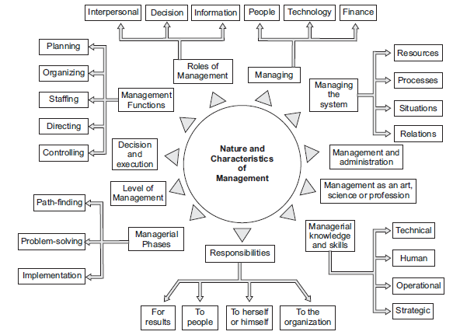

Slide 13
FUNCTIONAL AREAS OF MANAGEMENT
Production/Operation:
responsible
for all Purchasing,
production related activities like
Materials management, Research & Development etc..
Marketing:
-involves the distribution of organizations’ products to the buyers.
-Sub activities like Advertising, Marketing research, Sales management.

Slide 14
Finance and accounting: deals with intelligent
investment of financial resources and record-keeping of various transactions
-sub functions are Financial Accounting, Management Accounting, Costing, Investment Management, Taxation
Personnel: management of human resources
sub-activities are Recruitment and Selection, Training and Development, Wage and Salary Administration, Industrial Relations
Management Information System Strategy

Slide 15
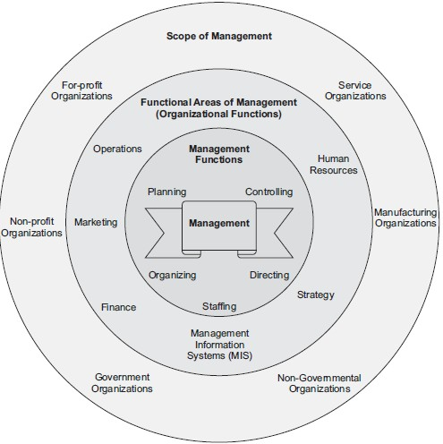
SCOPE OF MANAGEMENT

Slide 16
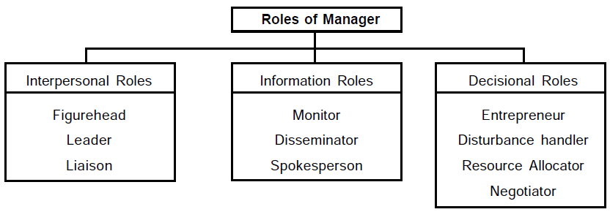
ROLES OF MANAGEMENT

Slide 17
Interpersonal role: interacting with people both organizational members and outsiders.
Figure head role: duties of ceremonial nature such as attending social functions of employees, taking an important customer to lunch & so on.
Leader role: leading the subordinates motivating and encouraging them.
Liaison: connecting link between his organization & outsiders , cultivate contacts outside his vertical chain to collect information useful for his organization.

Slide 18
Information roles: involves communication.
Monitor: monitoring role, collects information about all the factors which affects his activities
Disseminator: possesses privileged information to his subordinates who otherwise not be in a position to collect it.
Spokesperson: interacting with
represents outsiders
his organization while like customers, suppliers,
financers, government & other agencies of the society.

Slide 19
Decisional roles: involves choosing most appropriate alternative among all so that organizational objectives are achieved in an efficient manner1
Entrepreneur: constantly looks out for new ideas & seeks to improve his unit by adopting it to dynamic environment.
Disturbance handler: works like a fire-fighter manager contains forces and events which disturb normal functioning of his organization.
Negotiator: negotiates with various groups in the organization. Such groups are employees, shareholders and other outside agencies.

Slide 20
Management Levels
Top-level management (president, executive vice president)
Middle managers
(chief engineer, division head etc.)
First-line managers (foreman, supervisor, section chief)

Slide 21
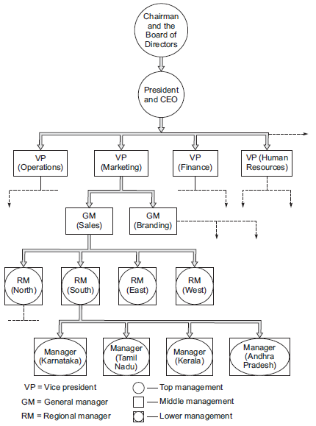

Management Levels

Slide 22
Top level management:
-determines goals and objectives
-performs overall planning, organizing, staffing, directing and controlling
-integrates organization with environment, balances the interest groups & is responsible for overall results.

Slide 23
Middle management:
-establishes programs for department & carries out functions for achieving specific goals.
-training and development of employees, integrating various parts of the department.

Slide 24
Supervisory management:
-concerned with efficiency in using resources of the organization.
-supervisor is an executor of policies & procedures making a series of decisions with well-defined & specified premises.

Slide 25



Managerial Level
Lowest
Middle Top
Skills required versus management

Slide 26
Managerial Skills:
Managers need three types of skills:
Technical:
Specific subject related skills such as engineering, accounting, etc…
Interpersonal: Skills related to dealing with others and leading, motivating, or controlling them
Conceptual:
Ability to discern the critical factors that determine as organization’s success or failure. Ability to see the forest in spite of the trees.
will

Slide 27
EVOLUTION OF MANAGEMENT
Classification:
-Early management approaches
Taylor’s scientific management
Foyal’s administrative management
bureaucracy
-Neo classical approches
human relations movement
behavioural approach
-Modern management approaches
quantitative/management science
systems approach
contingency approach.

Slide 28
Taylor’s Scientific Management
Principles:
Time & Motion Study
Differential Payment
Drastic Reorganization of Supervision
Scientific Recruitment & Training
Intimate Friendly Cooperation b/w the management & Workers

Slide 29
Taylor’s Scientific Management
General Approach
Developed standard method for performing each job.
Selected workers with appropriate abilities for each job.
Trained workers in standard method.
Supported workers by planning work and eliminating interruptions.
Provided wage incentives to workers for increased output.

Slide 30
Taylor’s Scientific Management
Contributions
Demonstrated the importance of compensation for performance.
Initiated the careful study of tasks and jobs. Demonstrated the importance of personnel and their training.
Criticisms
Did not appreciate social context of work and higher needs of workers.
Did not acknowledge variance among individuals.
Tended to regard workers as uninformed and ignored their ideas

Slide 31

Administrative Management
Focus:
Organization rather than the individual
Delineated the management functions of planning, organizing, commanding, coordinating, and controlling
Henri Fayol:
Developed a set of 14 general principles of management.
His managerial functions of planning, leading, organizing, and controlling are routinely used in modern organizations.

Slide 32




Administrative Management
14 General Principles of Management
 Division of labor
 Authority
 Discipline
 Unity of command
 Unity of direction
 Subordination of individual interest
 Remuneration
 Centralization
 Scalar chain
 Order
 Equity
 Stability and tenure of staff
 Initiative
 Union of strength

Slide 33
Foyal’s Administrative Management
Criticisms
Leads to formation of small groups Results in dissatisfaction of workers
Theses principles result onto formation of mechanistic organizational structure.

Slide 34
Bureaucratic Management
Focuses on the overall organizational system and is based upon firm rules, policies, and procedures; a fixed hierarchy; and a clear division of labor
Max Weber (1864-1920), a German sociologist and historian, is most closely associated with bureaucratic management.

Slide 35

Bureaucratic Management
Envisioned a system of management that would be based upon impersonal and rational behavior.
Conceptualized the approach referred to as bureaucracy.
  Division of labor
  Hierarchy of authority
  Rules and procedures
  Impersonality
  Employee selection and promotion
to management

Slide 36


Quantitative Approaches
Is characterized by its use of mathematics, statistics, and other quantitative techniques for management decision making and problem solving. This approach has four basic characteristics:
Decision- making focus
Measurable
criteria
Quantitative
model
Computers

Slide 37
Decision-Making Focus
The primary focus of the quantitative approach is on problems or situations that require some direct action, or decision, on the part of management.
Measurable Criteria
The decision-making process requires that the decision maker select some alternative course of action. The alternatives must be compared on the basis of some measurable criteria.

Slide 38
Quantitative Model
To assess the likely impact of each alternative on the stated criteria, a quantitative model of the decision situation must be formulated.
Computers
Computers are quite useful in the problem- solving process.

Slide 39
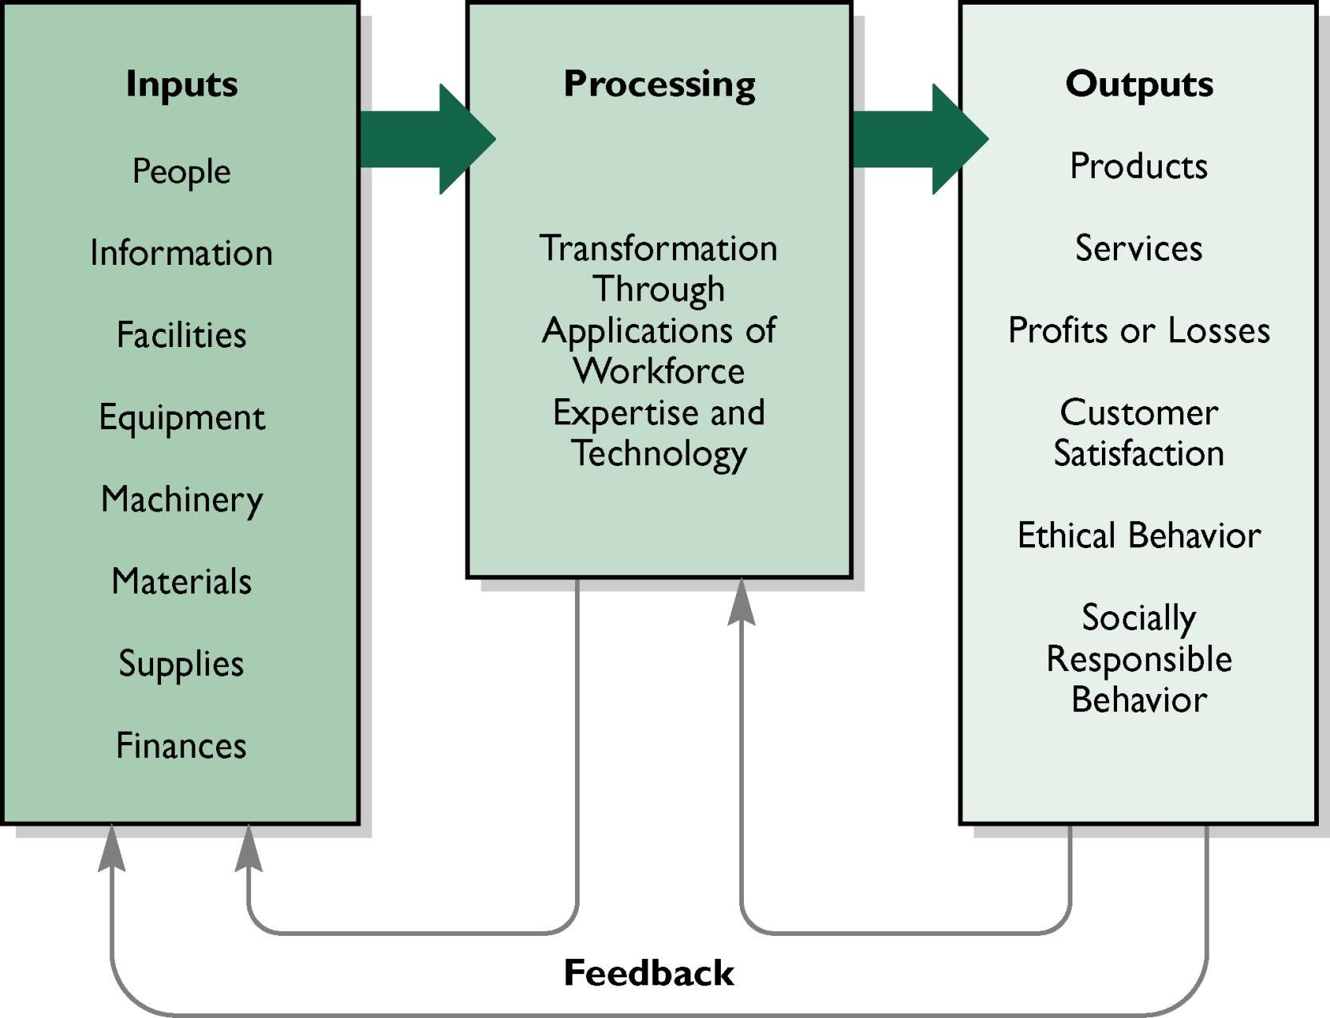
Systems Approach

Slide 40
System is powerful collection of people, objects & procedures for operating within an environment so as to achieve a pre-determined objectives.
A system is a set of interdependent parts. (task, structure, people technology)
System can be either open or closed. System has a boundary.
Manager integrates his available facilities with goal achievement.
Uses
Quick Perception
Better Planning
Limitations
Complicated
Expensive

Slide 41
Contingency Perspective
A view that proposes that there is no one best approach to management for all situations.
Asserts that managers are responsible for
is
determining which managerial approach
likely to be most effective in a given situation.
This requires managers to identify the key contingencies in a given situation.

Slide 42
Example of the Contingency Perspective
Joan Woodward discovered that a particular management style is affected by the organization’s technology.
Woodward identified and described three different types of technology:
Small-batch technology
Mass-production technology
Continuous-process technology

Slide 43
Planning Definition
Planning is deciding in advance what to do, how to do it, when to do it and who is to do it. It bridges the gap from where we are and to where we want to go. It is in essence the exercise of foresight.
Planning is an intellectual process which requires a manager to think before acting.
Planning is the management function that includes decisions and actions to insure future results. - Peter Drucker

Slide 44
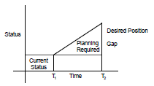
Nature Of Planning
Planning: A Rational Approach
Planning: An Open System Approach Flexibility of Planning
Pervasiveness of Planning

Slide 45
Importance of Planning
Minimizes Risk and uncertainty Lead to success
Focuses attention on the Organization Goals Facilitates Control
Trains Executives
Minimize waste and redundancy Reduce the impact of change

Slide 46
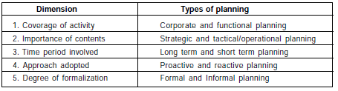
FORMS OF PLANNING

Slide 47
What is STRATEGIC planning?
Is defining and prioritizing long-term plans that includes examining an organization’s purpose, mission, philosophy and goals in the light of its external environment
It is proactive and future-oriented, focuses on a 3-5 year operation of the organization
It generally aims at creating an image of the desired future and design ways to make plans a reality

Slide 48
What is TACTICAL planning?
Deciding how resources of the organization will be used to achieve strategic goal.
Ex1: Unit Director plans a meeting of staff nurses to reinforce knowledge gained from orientation of new staff… may get endorsement from the Division Chief Nurse who has set her own staff development plan for the whole division.
Ex2: Unit Director reviews with staff medicine supplies

Slide 49
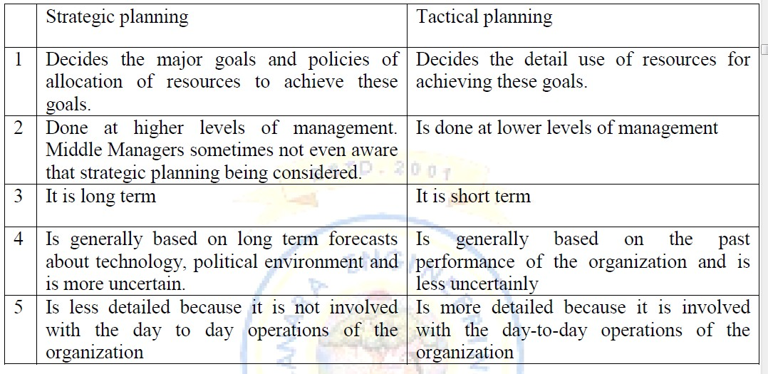
Strategic Vs Tactical Planning

Slide 50
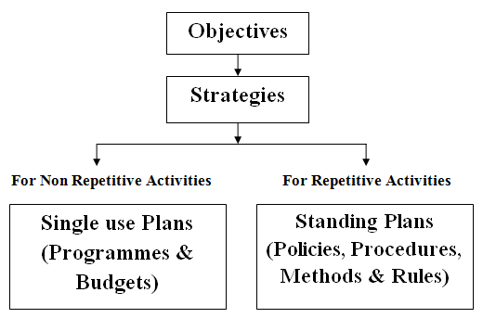
Types of Plans

Slide 51
Objectives
Goals or aims which the management wishes to achieve.
Specific target to be reached by an organization Objective Vs Vision
Vision is the dream that an entrepreneur creates in his waking hours of his prefer future
Objective Vs Purpose
Purpose is primary role defined by the society or a broad aim
Objective Vs Mission
Mission is unique aim that sets the organization apart from other of its type

Slide 52
Objectives:
To increase number of intake by 10% by December 2020.
To achieve 100% placement in the current year.
Purpose:
Impart education
Mission:
Provide the right environment to develop quality education for all, irrespective of caste, creed or religion to produce future leaders.
Create opportunities for pursuit of knowledge and all round
development.
Impart value education to students to build sense of integrity, honesty and ethics.
Vision: what the business's future will look like
To be an Engineering Institute of highest repute and produce world- class engineers catering to the needs of mankind

Slide 53
Characteristics of objectives
Objectives are multiple in number. Objectives are either tangible or intangible. Objective have a priority.
Objectives are generally arranged in a hierarchy.
Objectives sometimes clash with each other.

Slide 54

Objectives must be clear & acceptable. Objectives must support one another. Objective have a priority.
Objectives must be precise & measurable. Objectives should always remain valid.

Slide 55




Provide basis for planning. Act as motivator.
Eliminate haphazard action. Facilitate coordinated behavior. Basis for managerial control.
Facilitate better management. Lessen misunderstanding & conflict. Provide legitimacy.

Slide 56
Strategies
A strategy is a plan which considers environmental opportunities and threats and the organizational strengths and weakness and provides an optimal match between the firm and external environment.
Two activities involved formulation are
Environmental appraisal
Corporate appraisal.
in strategy

Slide 57
Environmental Appraisal
Political and legal factors: Stability of government, taxation and licensing laws, fiscal policies, restrictions on capital etc.
Economic factors: Economic development, distribution of personal income, trend in prices, exchange rates etc.,
Competitive factors: Identifying principal competitors & analysis of their performance, anti- monopoly laws, protection of patents, brand names etc.
Social and Cultural
social
factor: Literacy characteristics, rate
level,
of
Religious &
urbanization

Slide 58
Corporate Appraisal
It involves identifying and analyzing company’s strength & weakness.
For example a companies strength may be low cost manufacturing skill, excellent product design, efficient distribution etc.,. Its weakness may be lack of physical and financial resources.
A company must plan to exploit these strengths to maximum and circumvent it’s weakness.

Slide 59
Policies
A policy is a general guideline for decision making.
Policy is a verbal, written or implied overall guide, setting up boundaries that supply the general limits and directions in which managerial action will take place.
Ex1 Advertisement policy: to avoid cut- throat competition with its rivals
Ex2 Recruitment policy: select the best possible candidate to vacancies

Slide 60
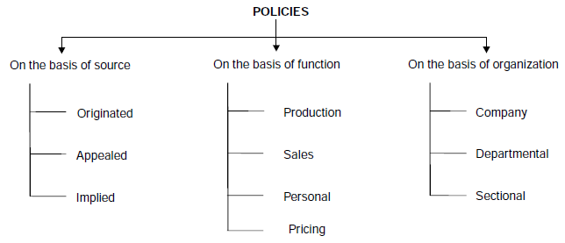
Types of policies

Slide 61
Advantages of Policies
Policies ensure uniformity of action at various organization points which make actions more predictable.
Since the subordinates need not consult superiors, it speeds up decision.
Policies make easier for the superior to delegate more and more authority to his subordinates because, he knows that whatever decision the subordinates make will be within the boundaries of the policies.
Policies give a practical shape to the objectives by directing the way in which predetermined objectives are to be attained.

Slide 62
Procedures
A procedure provides a detailed set of instructions for performing a sequence of actions involved in doing a certain piece of work.
Advantages of procedures.
They indicate a standard way of performing a task.
They result in simplification and elimination of waste.
Procedure improves the efficiency of employees.
Procedure serves as a tool of control by enabling managers to evaluate the performance of their subordinates.

Slide 63
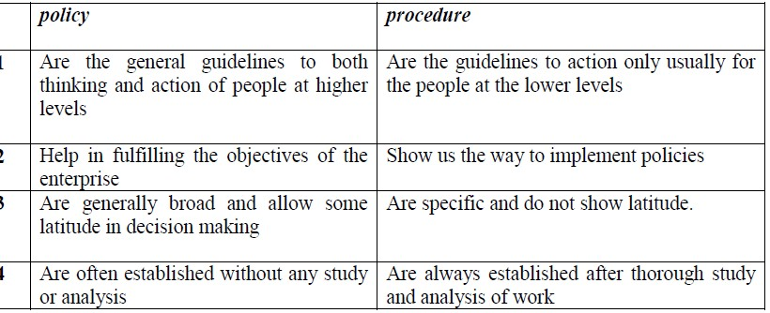
Policy v/s Procedure

Slide 64
Methods
A method is a prescribed way in which one step of procedure is to be performed.
It means an established manner of doing an operation.
Methods help in increasing the effectiveness and usefulness of procedures.
By improving methods, reduced fatigue, better productivity and lower costs can be achieved.

Slide 65
Rules
The rules are the simplest and most specific type of standing plans.
Rules are detailed and recorded instructions that a specific action must or must not be performed in a given situation. Rules are more rigid than policies.
Rules generally pertain to the administrative area of a procedure. Rules demand strict compliance. Their violation is generally associated with some sort of disciplinary action.

Slide 66
Programmes
Are precise plans or definite steps in proper sequence which need to be taken to discharge a given task.
It lays down the time to be taken for completion of each step.
Essential ingredients are time phasing and budgeting.
Is a complex of objective, policies, procedures, task assignments, steps to be taken, resources to be employed and other elements to carry out a given course of action.
Single step in a programme is set up as a project
A schedule specifies the time when each series of actions should take place.

Slide 67
Budgets
A financial and/or quantitative statement prepared prior to definite period time, of the policy to be pursued during that period, for the purpose of obtaining a given objective.
A budget is a statement of expected results expressed in quantitative terms i.e. rupees, man hours, product units etc.
It provides a standard by which actual operations can be measured and variation could be controlled.
The important budgets are sales budgets, production budgets, cash budgets, and revenue and expenses budgets.

Slide 68
Steps in Planning:
Establishing Verifiable Goals or Set of Goals to be Achieved.
Establishing Planning Premises.
Internal and External premises.
Tangible and Intangible premises.
Controllable and non-controllable premises.

Slide 69
- Internal and External premises.
(Internal premises include sales forecasts, the organization, skill of labor,
policies , programmes of
External premises may be Technological change, Population Growth, Sociological factor, Govt policies & regulation etc..)
- Tangible and Intangible premises.
(Tangible examples: population growth, industry demand, capital and resources. Intangible: political stability, sociological factors, business and economic
environment)
- Controllable and non-controllable premises.
(uncontrollable factors: strikes, wars, natural emergency, and legislation etc.
controllable factors: company’s advertising
calamities,
agency, skill of the terms of
competence of management member’s
labor force, availability of resources in
capital and labor,)

Slide 70
Steps in Planning:
Deciding the Planning Period.
Lead time in development & commercialization of new product.
Time required to recover capital investments or pay back period.
Length of commitments already made.
Finding Alternative Course of Action. Evaluating and Selecting a Course of Action.
Developing Derived Plans.
Measuring and Controlling the Progress.

Slide 71
Organization Definition
An organization can be defined as a social unit or human grouping deliberately structured for the purpose of attaining specific goals.
An organization can also be defined as the process of identifying and grouping of the work to be performed, defining and delegating responsibility and authority and establishing relationships for the purpose of enabling people to work most effectively together in the accomplishment of their objectives.

Slide 72

Characteristics of an Organization
Has a purpose, goal or goals.
Has a clear concept of major duties or activities to achieve the purpose.
Classification of activities into jobs. Establishment of relationship between these jobs.

Slide 73
Nature of Organization
People: An organization is basically
made up of group
of people, i.e., an identifiable group
of people
contributing their efforts towards the attainment of goals.
Common purpose: Organization exist to achieve certain objectives and people of an organization share this common purpose.
Co-ordination: There is a mechanism of co-ordination among people and different part of the organization.

Slide 74
Nature of Organization
Authority: There are different hierarchy levels in an organization which defines authority of people.
Division of work: The total work of an organization is divided into smaller activities in the form of different functions & sub functions
Environment: organization are part of a large environment and therefore they are influenced by external environment

Slide 75
Purpose of Organization
To facilitate pattern of communication: By grouping activities and people, structure(organization) facilitates communication between people centered on their job activities.
To allocate authority and responsibility: It specifies who is to direct whom and who is accountable for what results. The structure helps the organization members to know what his role is and how it relates to others role.
To locate decision centers: Organization structure determines the
location of decision making in the organization.
For example, a departmental store may leave pricing decision to the lower level manager while in oil refinery pricing decision is at top level.
To create proper balance: Organization structure creates the proper balance and emphasis of activities. People responsible for the enterprise success might be placed higher in the organization.

Slide 76
Purpose of Organization
To stimulate creativity: Organization stimulates independent, creative thinking and initiative by providing well- defined areas of work with broad attitude of the development of new and improved ways of doing things.
To encourage growth: The organization structure provide framework within which an enterprise functions. If the organization structure is flexible, it will help in meeting challenges and creating opportunities for growth.
To make use of technological improvements: A sound organization structure which is adoptable to changes can make the best possible use of latest technology.

Slide 77
Types of Organization
Based on official recognition
Formal organization
Informal organization
Based on internal structure
Line organization
Functional organization
Line & Staff organization
Committee organization

Slide 78
Differences between Formal & Informal Organization
Item | Formal Organization | Informal Organization
Origin | Official and started with definite purpose | Unofficial & developed naturally, based on individual & group goals
Structure | Definite structure with clearly defined authority & responsibility relationship | No formal structure
Control | Formal rules & regulation | Group norms
Communication | Formal & official channels of communication | Grapevine
Size | Can grow to very large size | Generally very small

Slide 79
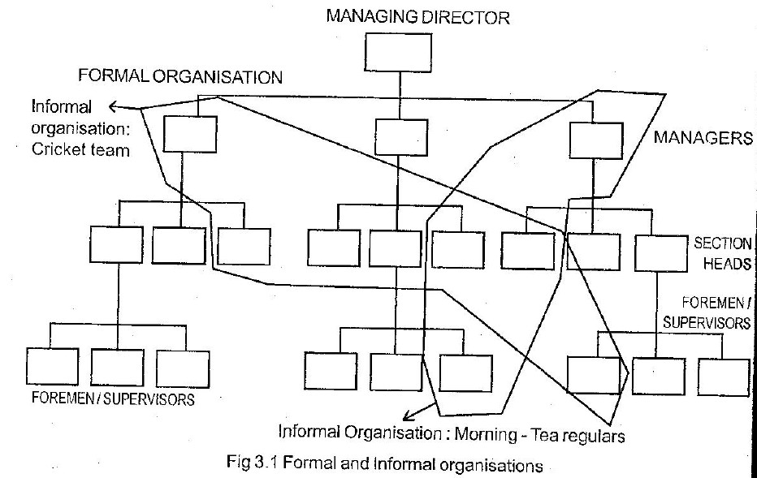

Slide 80
Line organization
It is the basic framework for the whole organization.
It represents a direct vertical relationship which authority flows.
This is a vertical structure one person delegate’s authority to his subordinate & who in turn delegates to his subordinate & so on.

Slide 81
Line organization
The advantages of line organization are
Simplicity
Quick decision and speed of action. Unity of control.
Clear division of authority and responsibility.
Discipline and better coordination Direct communication.

Slide 82
Line organization
The disadvantages of line organization are
The organization is rigid and inflexible Being an autocratic system, managers may become dictators and not leaders.
There is scope of favour-ism and nepotism.
Red-tape and bureaucracy.
Lack of specialization.

Slide 83
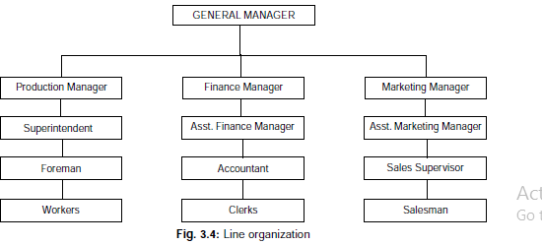
Line organization

Slide 84
Functional Organization
In functional organization the specialists are made available in the top positions throughout the enterprise.
A functional in charge directs the subordinates throughout the organization in his particular area of business operation.

Slide 85

Functional Organization
The advantages of functional organization
Specialization.
Reduces the burden on the top executives. Offers greater scope for expansion.
A functional manager is required to have expertise in one function only.
This makes it easy for executive development.

Slide 86
Functional Organization
The disadvantages of functional organization
Violates principles of unity of command. The operation of functional organization is too complicated.
It develops specialists rather than generalists. Lack of coordination among functional executives which delays decision making.

Slide 87
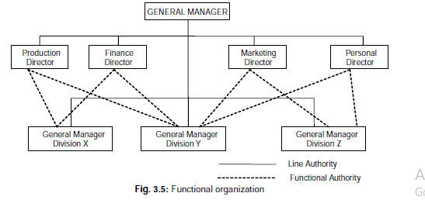
Functional Organization

Slide 88
Line and Staff Organization
In line and staff organization, the line authority remains the same as it does in the line organization.
In addition, the specialists are attached to line managers to advice them on important matters.
The staff officials do not have any power of command in the organization as they are employed to provide expert advice to the line

Slide 89
Line and Staff Organization
The advantages of line and staff organization:
Specialized knowledge
Reduction of burden on line managers.
Better decisions, as staff specialists help the line managers
Unity of command
Flexible when compared to functional organization.

Slide 90
Line and Staff Organization
The disadvantages of line and staff organization:
Allocation of duties between line and staff is not clear.
There is generally conflict between line and staff executives.
Since staffs are not accountable, they may not be performing well.
Difference between orientations of line and staff. Line executive’s deals with in problem

Slide 91
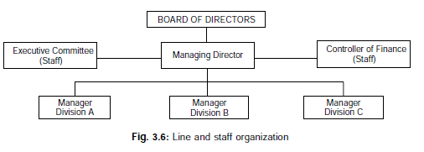
Line and Staff Organization

Slide 92
COMMITTEES:
A committee is a group of people who have been formally assigned some task or some problem for their decision and implementation.
Classification of committees:
Advisory committees
Executive committees.
These two committees may have same individuals as members. Their functions are separated by time, place, and title.
Standing committee
Ad hoc task force

Slide 93
Advisory committees:
Committees are vested with staff authority
Only have a recommendation role and cannot enforce implementation of their advice or recommendation.
Examples of advisory committees formed in business enterprises: works committees, sales committees, finance committees etc.

Slide 94
Executive committees:
Vested with the line of authority
Not only take decisions but also enforce decisions and thus perform a double role of taking a decision and ordering its execution.
Example: Board of directors is an example of an executive committee. Are also classified as standing committees or ad-hoc task forces.

Slide 95
Standing committees: Are formed to deal with current organizational problem. Example: finance committee in a company, loan approval committee in a bank etc. Members of this committee are chosen because of their title or position, instead of individual qualifications or skills.
Ad-hoc committees: Have a short duration, dissolved after the task is over, or the problem is solved and their members are chosen for their skills and experience.

Slide 96
STAFFING
The function of staffing is defined as:-
“Filling and keeping filled various positions in the organization structure”.
This includes “identifying work force requirements, inventorying the people available, recruiting, selecting, placing, training, promoting, apprising etc…

Slide 97
Importance of staffing
Staffing ensures higher productivity by placing the right man in the right job.
It helps to avoid disruption of production schedule due to shortage of staff.
It helps to prevent under utilization of personnel through over manning and reduces cost of production.
It identifies talented and competent people and places them in correct position.
It trains the people and helps them to move up in the organizational structure.

Slide 98
RECRUITMENT
Recruitment can be defined as the process of identifying the sources for prospective candidates and stimulate them to apply for the job.
i.e it is the process of attracting employees to the company.
Before the process of recruitment, the management should have proper plan on :
Number of employees to be recruited. The qualification of employees required. The time frame need to recruit.
The process of recruitment and the cost involved in it depend on the size of the enterprise and the type of persons to be recruited.

Slide 99
Sources of recruitment:-
The sources of recruitment can be broadly classified into two categories:
Internal sources. External sources.
Internal sources:
Internal sources involve transfer and promotion. Transfer involves the shifting of an employee from one job to another.
Many companies follow the practice of filling higher jobs by promoting employees who are considered fit for such positions.
Filling higher positions by promotion motivates employees, boosts employee’s morale.

Slide 100
External Sources
Direct recruitment: An important source of recruitment is direct recruitment by placing a notice on the notice board of the enterprise by specifying the details of the jobs available. This is also known as recruitment at factory gate.
Unsolicited applications: Many qualified persons apply for employment to reputed companies on their own initiative. Such applications are known as unsolicited applications.

Slide 101
External Sources
Advertising: Large enterprises particularly when the vacancy is for higher post or there are large number of applications use this source where advertisements are made in local and national level newspapers.
Employment agencies: This is the good source of recruitment for unskilled and semiskilled jobs. The employment exchanges bring job givers in contact with job seekers.

Slide 102
SELECTION
Selection refers to evaluation of the candidates with respect to their qualifications and the job requirements and those who satisfy the requirements are only selected.
Selection criteria: these are established usually on the basis of current and some future job requirements. These criteria’s include educational qualifications, knowledge, skills, experience etc..
Application form: the candidates are required to complete an application form. In this form applicant gives relevant personal data.( qualification, specialization, experience, personal interests etc..) . The applications are carefully scrutinized to decide the suitable applicants to be called for next stage of selection.

Slide 103
Screening interview: those who are selected on the basis of application form are called for initial screening interview.
This interview is the most important means of evaluating the poise or appearance of the candidate. It is also used for obtaining informal clarification given in the application form.
Employment tests: for further assessment of a candidate’s nature and abilities some tests are conducted. These tests include
Intelligence test.
Proficiency and aptitude test.
Vocational test.
Personality test.

Slide 104
Group discussion:
this test is conducted to
assess the candidate’s communication and presentation skills, interpersonal skill, leadership qualities and ability to pull on in a team work.
Checking references: if candidate is found satisfactory in the above tests, employer may like to get some important personal details about the candidate, such as his character, past history, background etc..

Slide 105
Physical or medical examination: it is carried out to assess the physical fitness of the candidate for the present job.
Final interview: this interview is conducted for those who are ultimately selected for employment. In this interview, the candidates are given an idea about their future prospects within the organization.
Appointment order: appointment orders are given to finally selected candidates, giving the position offered, scale of pay and other benefits and terms and conditions of employment.

Slide 106
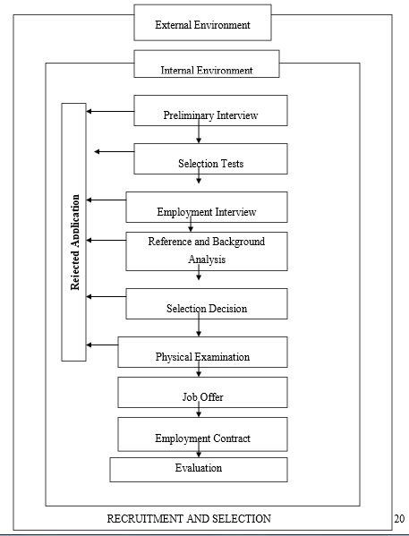

Slide 107
Useful links
https://www.youtube.com/watch?v=orzkxx9kzrI

