Slide 1

Module-3
NoSQL Big Data Management,
MongoDB and Cassandra
Department of Computer Science and Engineering
K S School of Engineering and Management, Bengaluru-560109
By,
Mrs. R S Geethanjali
Assistant Professor,
Dept. of CSE, KSSEM, Bangalore

Slide 2
This Chapter
Focuses on providing detailed concepts of
- NoSQL data architectural patterns,
- management of Big Data,
- data distribution models,
- handling of Big Data problems using NoSQL,
- MongoDB for document and Cassandra for columnar stores.

Slide 3
BIG Data and Distributed Systems
Big Data uses distributed systems.
A distributed system consists of multiple data nodes at clusters of machines and distributed software components.
The tasks execute in parallel with data at nodes in clusters.
The computing nodes communicate with the applications through a network.

Slide 4
Features of distributed-computing architecture
Increased reliability and fault tolerance:
The important advantage of distributed computing system is reliability.
If a segment of machines in a cluster fails then the rest of the machines continue work.
When the datasets replicate at number of data nodes, the fault tolerance increases further.
The dataset in remaining segments continue the same computations as being done at failed segment machines.

Slide 5
2. Flexibility makes it very easy to install, implement and debug new services in a distributed environment.
Sharding is storing the different parts of data onto different sets of data nodes, clusters or servers.
Speed: Computing power increases in a distributed computing system as shards run parallelly on individual data nodes in clusters independently (no data sharing between shards).

Slide 6
Scalability: Consider sharding of a large database into a number of shards, distributed for computing in different systems. When the database expands further, then adding more machines and increasing the number of shards provides horizontal scalability.
Resources sharing: Shared resources of memory, machines and network architecture reduce the cost.
7. Open system makes the service accessible to all nodes.
8. Performance: The collection of processors in the system provides higher performance than a centralized computer, due to lesser cost of communication among machines (Cost means time taken up in communication).

Slide 7
The demerits of distributed computing are:
issues in troubleshooting in a larger networking infrastructure,
additional software requirements and
security risks for data and resources.

Slide 8
Big Data solutions
Big Data solutions uses a scalable distributed computing model with shared-nothing architecture.
Examples:
Hbase, MongoDB and Cassandra.
key terms used in database systems.
Class refers to a template of program codes that is extendable. Class creates instances, called objects. A class consists of initial values for member fields, called state (of variables), and implementations of member functions and methods called behavior. An implementation means program codes along with values of arguments in the functions and methods (Java Class uses methods, C++ functions.)

Slide 9
Object is an instance of a class in Java, C++, and other object-oriented languages. Object can be an instance of another object (for example, in JavaScript).
Tupple is an ordered set of data which constitutes a record. For example, one row record in a table. A row in a relational database has column fields or attributes. Example of a tupple is (JLRWSale, Week 1, 138, Week 2, 232, ..., week 52, 186) in an RDBMS table. Here, JLRWSale means Jaguar Land Rover Weekly Sale. (JLRWSale, Week 1, 138) is also a tupple, and gives JLR week 1 sales = 138. (Week 2, 232, ..., week 52, 186) means week 2 sales = 232 abd 52 sales = 186 JLRs.

Slide 10
Transaction means execution of instructions in two interrelated entities, such as a query and the database.
Database transactional model refers to a model for transactions, such as the one following the ACID
My SQL refers to a widely used open-source database, which excels as a content management server.
Oracle refers to a widely used object-relational DBMS, written in the C++ language that provides applications integration with service-oriented architectures and has high reliability. Oracle has also released the NoSQL database system.
DB2 refers to a family of database server products from IBM with built-in support to handle advanced Big Data analytics.

Slide 11
Sybase refers to database server based on relational model for businesses, primarily on UNIX. Sybase was the first enterprise-level DBMS in Linux.
MS SQL server refers to a Microsoft-developed RDBMS for enterprise-level databases that supports both SQL and NoSQL architectures.
PostgreSQL refers to an enterprise-level, object-relational DBMS. PostgreSQL uses procedural languages like Pen and Python, in addition to SQL.

Slide 12
3.2.1 NOSQL DATA STORE
SQL is a programming language based on relational algebra.
It is a declarative language and it defines the data schema .
SQL creates databases and RDBMSs uses tabular data store with relational algebra.
Tuples are named attributes. A tuple identifies uniquely by keys called candidate keys.
Transactions on SQL databases exhibit ACID properties. ACID stands for atomicity, consistency, isolation and durability.

Slide 13
ACID Property Meaning
Atomicity of transaction means all operations in the transaction must complete, and if interrupted, then must be undone (rolled back).
Consistency in transactions means that a transaction must maintain the integrity constraint, and follow the consistency principle.
Isolation of transactions means two transactions of the database must be isolated from each other and done separately.
Durability means a transaction must persist once completed.

Slide 14
Triggers, Views and Schedules in SQL Databases
Trigger is a special stored procedure. Trigger executes when a specific action(s) occurs within a database, such as change in table data or actions such as UPDATE, INSERT and DELETE. For example, a Trigger store procedure inserts new columns in the columnar family data store.
View refers to a logical construct, used in query statements. A View saves a division of complex query instructions and that reduces the query complexity. Viewing of a division is similar to a view of a table. View does not save like data at the table. Query statement when uses references to a view, the statement executes the View. Query (processing) planner combines the information in View definition with the remaining actions on the query. A query

Slide 15
planner plans how to break a query into sub-queries for obtaining the required answer. View, hides the query complexity by dividing the query into smaller, more manageable pieces.
Schedule refers to a chronological sequence of instructions which execute concurrently. When a transaction is in the schedule then all instructions of the transaction are included in the schedule. Scheduled order of instructions is maintained during the transaction. Scheduling enables execution of multiple transactions in allotted time intervals

Slide 16
Join in SQL Databases
SQL databases facilitate combining rows from two or more tables, based on the related columns in them.
Joins, if and only if a given Join condition satisfies. Number of Join operations specify using relational algebraic expressions.
SQL provides JOIN clause, which retrieves and joins the related data stored across multiple tables with a single command, Join.
For example, consider an SQL statement:

Slide 17
Select KitKatSales From TransactionsTbl INNER JOIN ACVMSalesTbl ON TransactionsTbl.KitKatSales = TransactionsTbl.KitKatSales,
The statement selects those records in a column named KitKatSales which match the values in two tables: one TransactionsTbl and other ACVMSalesTbl.
RDBS Issues:
Relational databases and RDBMS developed using SQL have issues of scalability and distributed design. This is because all tuples need to be on the same data node.
The traditional RDBMS has a problem when storing the records beyond a certain physical storage limit. This is because RDBMS does not support horizontal scalability

Slide 18
Example
Consider sharding a big table in a DBMS into two. Assume writing first 0.1 million records (1 to 100000) in one table and from 100001 in another table.
Sharding a database means breaking up into many, much smaller databases that share nothing, and can distribute across multiple servers. Handling of the Joins and managing data in the other related tables are cumbersome processes, when using the sharding.
The problem continues when data has no defined number of fields and formats.

Slide 19
For example, the data associated with the choice of chocolate flavours of the users of ACVM. Some users provide a single choice, while some users provide two choices, and a few others want to fill three best flavours of their choice.
User Id Choice
1 Dairy Milk
2 Dairy Milk, Kit Kat
3 KitKat, Snicker, Munch
Defining a field becomes tough when a field in the database offers choice between two or many. This makes RDBMS unsuitable for data management in Big Data environments as well as data in their real forms.

Slide 20
3.2.1 NoSQL
`NoSQL' term conveys two different meanings:
does not follow SQL compliant formats,
"Not only SQL" use SQL compliant formats with variety of other querying and access methods.
NoSQL is a new approach of thinking about databases, such as schema flexibility, simple relationships, dynamic schemas, auto sharding, replication, integrated caching, horizontal scalability of shards, distributable tuples, semi-structures data and flexibility in approach.

Slide 21
Issues with NoSQL
lack of standardization in approaches,
processing difficulties for complex queries.
Big Data NoSQL or Not-Only SQL
NoSQL DB does not require specialized RDBMS like storage and hardware for processing.
Storage can be on a cloud.

Slide 22
NoSQL data store characteristics are as follows:
NoSQL is a class of non-relational data storage system with flexible data model. Examples of NoSQL data-architecture patterns of datasets are
- key-value pairs,
- name/value pairs,
- Column family Big-data store,
- Tabular data store,
- Cassandra (used in Facebook/Apache),
- HBase, hash table [Dynamo (Amazon S3)],
- JSON (CouchDB), JSON (PNUTS),
- JSON (MongoDB), Graph Store, Object Store, ordered keys and semi-structured data storage systems.

Slide 23
NoSQL not necessarily has a fixed schema, such as table;
do not use the concept of Joins (in distributed data storage systems);
Data written at one node can be replicated to multiple nodes. Data store is thus fault-tolerant.
The store can be partitioned into unshared shards.

Slide 24
Features in NoSQL Transactions NoSQL transactions have following features:
(i) Relax one or more of the ACID properties.
(ii) Characterize by two out of three properties (consistency, availability and partitions) of CAP theorem, two are at least present for the application/service/process.
(iii) Can be characterized by BASE properties (Basically Available, Soft State, Eventual consistency) principles

Slide 25
BASE Properties
BASE | Optimistic behavior | Accept temporary database inconsistencies
 | Basically Available | Availability by replication
 | Soft state | It is the user’s application’s task to guarantee Consistency
 | Eventually consistent | Weakly Consistent, the database will be consistent in the long run; ‘stale/past’ data is OK.

Slide 26
Table 3.1 gives the examples of widely used NoSQL data stores.
Apache's HBase | HDFS compatible, open-source and non-relational data store written in Java; A column-family based NoSQL data store, data store providing BigTable-like capabilities; scalability, strong consistency, versioning, configuring and maintaining data store characteristics
Apache's MongoDB | HDFS compatible; master-slave distribution model; document-oriented data store with JSON-like documents and dynamic schemas; open-source, NoSQL, scalable and non-relational database; used by Websites Craigslist, eBay, Foursquare at the backend
Apache's Cassandra | HDFS compatible DBs; decentralized distribution peer-to-peer model ; open source; NoSQL; scalable, non-relational, column-family based, fault-tolerant and tune able consistency, used by Facebook and Instagram
Apache's CouchDB | A project of Apache which is also widely used database for the web. CouchDB consists of Document Store. It uses the JSON data exchange format to store its documents, JavaScript for indexing, combining and transforming documents, and HTTP APIs
Oracle NoSQL | Step towards N0SQL data store; distributed key-value data store; provides transactional semantics for data manipulation, horizontal scalability, simple administration and monitoring
Riak | An open-source key-value store; high availability (using replication concept), fault tolerance, operational simplicity, scalability and written in Erlang

Slide 27
CAP Theorem
Among C, A and P, two are at least present for the application/service/process.
Consistency means all copies have the same value like in traditional DBs.
Availability means at least one copy is available in case a partition becomes inactive or fails.
Partition means parts which are active but may not cooperate (share) as in distributed DBs.

Slide 28
Consistency in distributed databases means that all nodes observe the same data at the same time. Therefore, the operations in one partition of the database should reflect in other related partitions in case of distributed database.
2. Availability means that during the transactions, the field values must be available in other partitions of the database so that each request receives a response on success as well as failure. (Failure causes the response to request from the replicate of data). Distributed databases require transparency between one another. Network failure may lead to data unavailability in a certain partition in case of no replication. Replication ensures availability.
3. Partition means division of a large database into different databases

Slide 29
Partition tolerance: Refers to continuation of operations as a whole even in case of message loss, node failure or node not reachable.
Brewer's CAP (Consistency, Availability and Partition Tolerance) theorem demonstrates that any distributed system cannot guarantee C, A and P together.
1. Consistency- All nodes observe the same data at the same time.
2. Availability- Each request receives a response on success/failure.
3. Partition Tolerance-The system continues to operate as a whole even in case of message loss, node failure or node not reachable.

Slide 30
Partition tolerance cannot be ignored for achieving reliability in a distributed database system. Thus, in case of any network failure, a choice can be:
• Database must answer, and that answer would be old or wrong data (AP).
• Database should not answer, unless it receives the latest copy of the data (CP).
The CAP theorem implies that for a network partition system, the choice of consistency and availability are mutually exclusive.

Slide 31
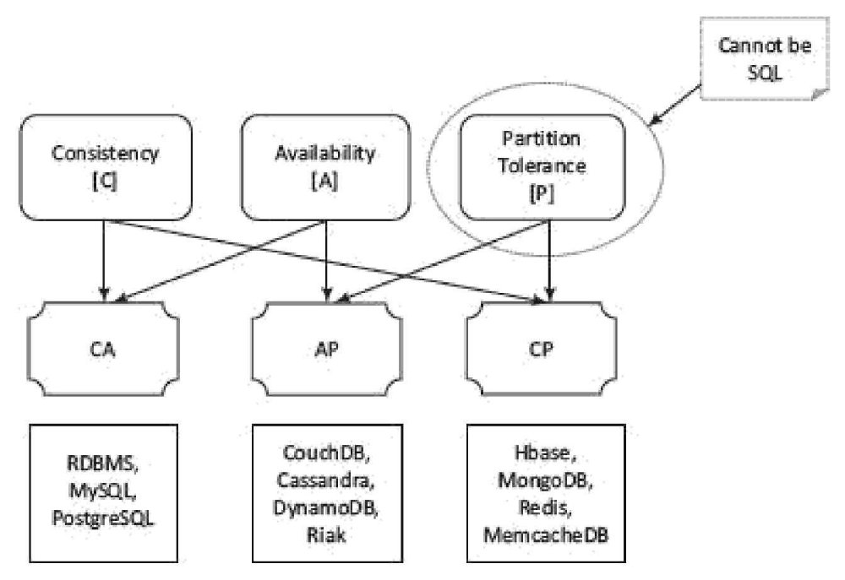
CA means consistency and availability,
AP means availability and partition tolerance and
CP means consistency and partition tolerance.

Slide 32
3.2.2 Schema-less Models
NoSQL data not necessarily have a fixed table schema. The systems do not use the concept of Join (between distributed datasets).
Data written at one node replicates to multiple nodes. Therefore, these are identical, fault-tolerant and partitioned into shards.
NoSQL data model offers relaxation in one or more of the ACID properties (Atomicity, consistence, isolation and durability) of the database.
Follows CAP theorem “states that out of the three properties, two must at least be present for the application/service/process”

Slide 33
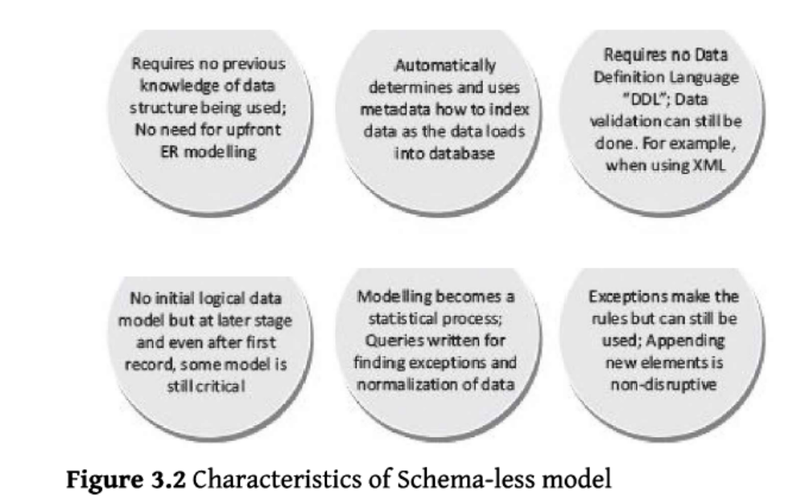
Characteristics of Schema-less model

Slide 34
Meta Data
NoSQL data stores use non-mathematical relations but store this information as an aggregate called metadata.
Metadata is a record with all the information about a particular dataset and the inter-linkages.
Metadata helps in selecting an object, specifications of the data and, usages Metadata specifies access permissions, attributes of the objects and enables additions of an attribute layer to the objects.
Files, tables, documents and images are also the objects.

Slide 35
3.2.3 Increasing Flexibility for Data Manipulation
NoSQL data store possess characteristic of increasing flexibility for data manipulation. The new attributes to database can be increasingly added. Late binding of them is also permitted.
BASE is a flexible model for NoSQL data stores. Provisions of BASE increase flexibility.
BASE Properties BA stands for basic availability, S stands for soft state and E stands for eventual consistency.

Slide 36
BASE Properties
1. Basic availability ensures by distribution of shards (many partitions of huge data store) across many data nodes with a high degree of replication. Then, a segment failure does not necessarily mean a complete data store unavailability.
2. Soft state ensures processing even in the presence of inconsistencies but achieving consistency eventually. A program suitably takes into account the inconsistency found during processing. NoSQL database design does not consider the need of consistency all along the processing time.
3. Eventual consistency means consistency requirement in NoSQL databases meeting at some point of time in future. Data converges eventually to a consistent state with no time-frame specification for achieving that. ACID rules require consistency all along the processing on completion of each transaction. BASE does not have that requirement and has the flexibility.

Slide 37
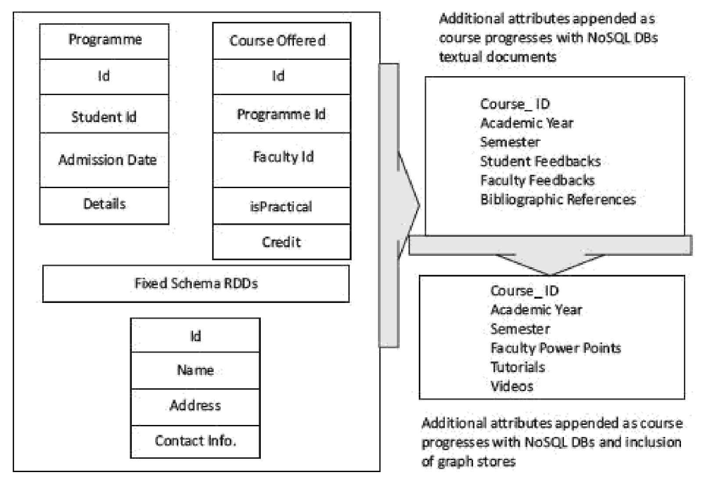
Increasing Flexibility in NoSql student Database

Slide 38
NoSQL data stores architectural patterns
NoSQL data stores broadly categorize into architectural patterns
Key Value Pairs
Document Stores
Tabular Data
Object Data Store
Graph Database

Slide 39
3.3.1 Key-Value Store
The simplest way to implement a schema-less data store is to use key-value pairs.
The data store characteristics are high performance, scalability and flexibility.
Data retrieval is fast in key-value pairs data store.
The concept is similar to a hash table where a unique key points to a particular item(s) of data.

Slide 40
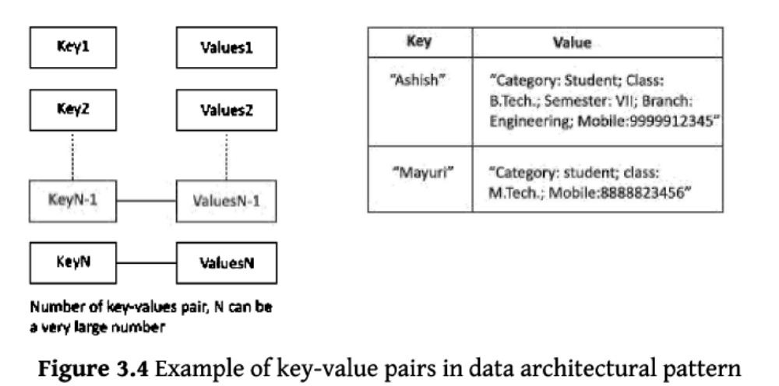
key-value pairs architectural pattern

Slide 41
Advantages of a key-value store are as follows:
Data Store can store any data type in a value field.
2. A query just requests the values and returns the values as a single item. Values can be of any data type.
3. Key-value store is eventually consistent.
4. Key-value data store may be hierarchical or may be ordered key-value store.
5. Returned values on queries can be used to convert into lists, table-columns, data-frame fields and columns.
6. Have (i) scalability, (ii) reliability, (iii) portability and (iv) low operational cost.
7. The key can be synthetic or auto-generated. The key is flexible and can be represented in many formats: (i) Artificially generated strings created from a hash of a value, (ii) Logical path names to images or files

Slide 42
The key-value store provides client to read and write values using a key as follows:
(i) Get (key) , returns the value associated with the key.
(ii) Put (key, value), associates the value with the key and updates a value if this key is already present.
(iii) Multi-get (key1, key2, .., keyN), returns the list of values associated with the list of keys.
(iv) Delete (key) , removes a key and its value from the data store.

Slide 43
Limitations of key-value store architectural pattern are:
(i) No indexes are maintained on values, thus a subset of values is not searchable.
(ii) Key-value store does not provide traditional database capabilities, such as atomicity of transactions, or consistency when multiple transactions are executed simultaneously. The application needs to implement such capabilities.
(iii) Maintaining unique values as keys may become more difficult when the volume of data increases. One cannot retrieve a single result when a key-value pair is not uniquely identified.
(iv) Queries cannot be performed on individual values. No clause like 'where' in a relational database usable that filters a result set.

Slide 44
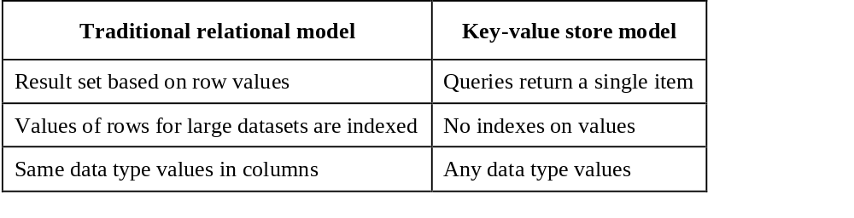
Traditional relational data model vs. the key-value store model

Slide 45
Riak Key-Value Data Store
Riak is open-source Erlang language data store.
It is a key-value data store system.
Data auto-distributes and replicates in Riak.
It is thus, fault tolerant and reliable.
Some other widely used key-value pairs in NoSQL DBs are Amazon's DynamoDB, Redis (often referred as Data Structure server), Memcached and its flavours, Berkeley DB, upscaledb (used for embedded databases), project Voldemort and Couchbase.

Slide 46
3.3.2 Document Store
Characteristics of Document Data Store are:
high performance and flexibility.
Scalability varies, depends on stored contents.
Complexity is low compared to tabular, object and graph data stores.

Slide 47
Following are the features in Document Store:
1. Document stores unstructured data.
2. Storage has similarity with object store.
3. Data stores in nested hierarchies. For example, in JSON formats data model XML document object model (DOM), or machine-readable data as one BLOB [Binary Large Object]. Hierarchical information stores in a single unit called document tree. Logical data stores together in a unit.
4. Querying is easy. For example, using section number, sub-section number and figure caption and table headings to retrieve document partitions.
5. Transactions on the document store exhibit ACID properties.

Slide 48
Typical uses of a document store are:
(i) office documents,
(ii) inventory store,
(iii) forms data,
(iv) document exchange and
(v) document search.
Examples of Document Data Stores are CouchDB and MongoDB.

Slide 49
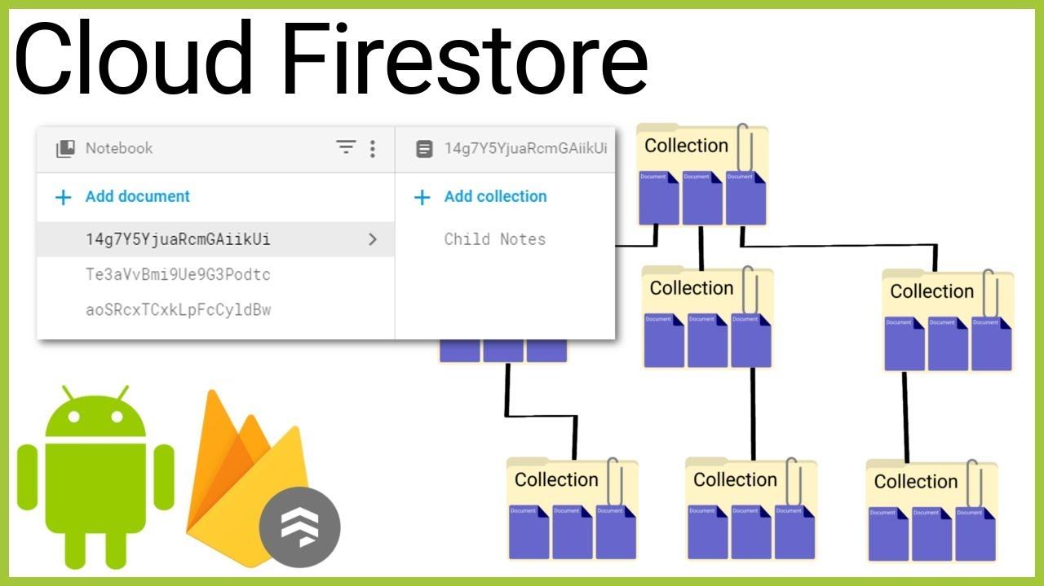
Document Store Example

Slide 50
CSV and JSON File Formats
CSV does not represent object-oriented databases or hierarchical data records.
JSON and XML represent semistructured data, object-oriented records and hierarchical data records.
JSON (Java Script Object Notation) refers to a language format for semistructured data.
JSON represents object-oriented and hierarchical data records, object, and resource arrays in JavaScript.

Slide 51
Example
Assume Preeti gave examination in Semester 1 in 1995 in four subjects. She gave examination in five subjects in Semester 2 and so on in each subsequent semester. Another student, Kirti gave examination in Semester 1 in 2016 in three subjects, out of which one was theory and two were practical subjects. Presume the subject names and grades awarded to them.

Slide 52
(i) Write two CSV files for cumulative grade-sheets for both the students. Point the difficulty during processing of data in these two files.
SOLUTION
(i) Two CSV file for cumulative grade-sheets are as follows:
CSV file for Preeti consists of the following nine lines each with four
Semester, Subject Code, Subject Name, Grade
1, CS101, ""Theory of Computations", 7.8.
1, CS102,1, "Computer Architecture", 7.8.
2, CS204, "Object Oriented Programming", 7.2.
2, CS205, "Data Analytics", 8.1.

Slide 53
The CSV file for Kirti consist of following five lines each with five columns: Semester, Subject Type, Subject Code, Subject Name, Grade
1, Theory, EL101, “Analog Electronics", 7.6.
1, Theory, EL102,"Principles of Analog Communication", 7.5.
1, Theory, EL103, “Digital Electronic", 7.8.
1, Practical, CS104, "Analog ICs", 7.2
1, Practical, CS105, "Digital ICs", 8.4

Slide 54
A column head is a key.
Number of key-value pairs are (4 x 9) = 36 for preetiGradeSheet.csv and
(5 x 5) = 25 for kirtiGradeSheet.csv.
Therefore, when processing student records, merger of both files into a single file will need a program to extract the key-value pairs separately, and then prepare a single file.

Slide 55
(ii) Write a file in JSON format with each student grade-sheet as an object instance. How does the object-oriented and hierarchical data record in JSON make processing easier?
SOLUTION
JSON gives an advantage of creating a single file with multiple instances and inheritances of an object.
Consider a single JSON file, studentGradeSheets json for cumulative grade-sheets of many students. Student Grades object is top in the hierarchy. Each student name object is next in the hierarchy with object consisting of student name, each with number of instances of subject codes, subject types, subject titles and grades awarded. Each student name object-instance extends in student grades object-instances.

Slide 56
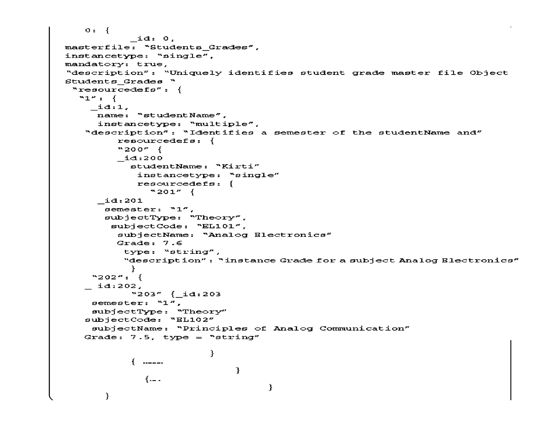

Slide 57
XML (extensible Markup Language)
XML is an extensible, simple and scalable language.
Its self-describing format describes structure and contents in an easy to understand format.
XML is widely used in data store and data exchanges over the network.
The document model consists of root element and their sub-elements.
XML document model has a hierarchical structure.
XML document model has features of object-oriented records.
XML is semi-structured.

Slide 58
Document JSON Format CouchDB Database
Its features are:
1. CouchDB provides querying, combining and filtering of information.
2. CouchDB uses JSON Data Store model for documents. Each document maintains separate data and metadata (schema).
3. CouchDB is a multi-master application. Write does not require field locking when controlling the concurrency during multi-master application.
4. CouchDB querying language is JavaScript.
CouchDB accesses the documents using HTTP API. HTTP methods are Get, Put and Delete
6. CouchDB data replication is the distribution model that results in fault tolerance and reliability.

Slide 59
Document JSON Format—MongoDB Database
MongoDB Document database provides a rich query language and constructs, such as database indexes allowing easier handling of Big Data.
Example of Document in Document Store:

Slide 60
The document store allows querying the data based on the contents as well.
For example, it is possible to search the document where student's first name is "Ashish".
Document store can also provide the search value's exact location.
The search is by using the document path.
A type of key accesses the leaf values in the tree structure.
Since the document stores are schema-less, adding fields to documents (XML or JSON) becomes a simple task.

Slide 61
XML document architecture pattern
An XML document architecture pattern is a document fragment and document tree structure.
The document store follows a tree-like structure (similar to directory structure in file system).
The root element there are multiple branches.
Each branch has a related path expression that provides a way to navigate from the root to any given branch, sub-branch or value.

Slide 62
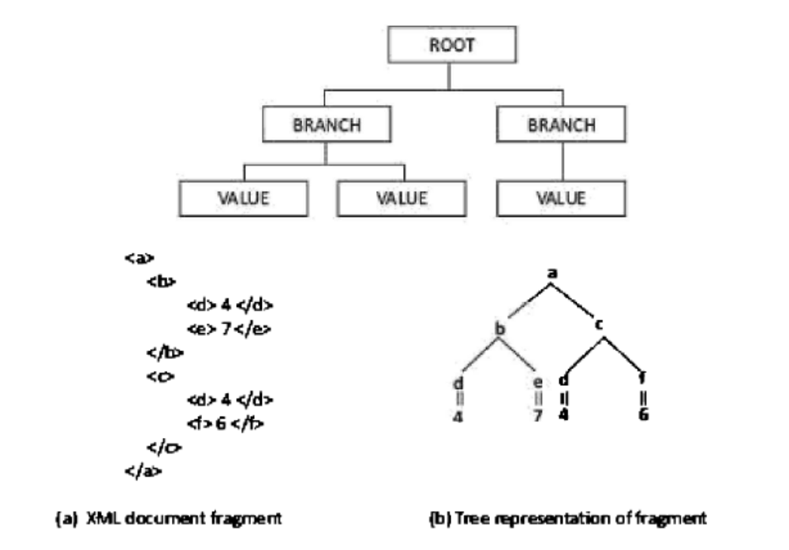

Slide 63
XQuery and XPath are query languages for finding and extracting elements and attributes from XML documents.
The query commands use sub-trees and attributes of documents.
The querying is similar as in SQL for databases.
XPath treats XML document as a tree of nodes. XPath queries are expressed in the form of XPath expressions.

Slide 64
Example
Give examples of XPath expressions. Let outermost element of the XML document is a.
SOLUTION
An XPath expression /a/b/c selects c elements that are children of b elements that are children of element a that forms the outermost element of the XML document.
An XPath expression /a/b[c=5] selects elements b and c that are children of a and value of c element is 5.
An XPath expression /a[b/c]/d selects elements c and d where c is child of b and, b and d are children of a.

Slide 65
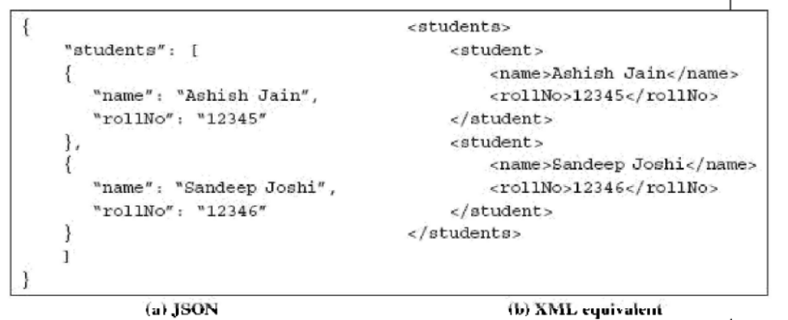

Slide 66
Benefits of JSON over XML
When compared with XML, JSON has the following advantages:
• XML is easier to understand but XML is more verbose than JSON.
• XML is used to describe structured data and does not include arrays, whereas JSON includes arrays.
• JSON has basically key-value pairs and is easier to parse from JavaScript.
• The concise syntax of JSON for defining lists of elements makes it preferable for serialization of text format objects.

Slide 67

Benefits of Document Collection
1. Group the documents together, similar to a directory structure in a file- system. (A directory consists of grouping of file folders.)
2. Enables navigating through document hierarchies, logically grouping similar documents and storing business rules such as permissions, indexes and triggers (special procedure on some actions in a database).
3. A collection can contain other collections as well.

Slide 68
3.3.3 Tabular Data
Tabular data stores use rows and columns.
Row Oriented or Row Format Data
Row-head field may be used as a key which access and retrieves multiple values from the successive columns in that row.
The OLTP is fast on in-memory row-format data.
In-memory row-based data is the example for row oriented data, in which a key in the first column of the row is at a memory address, and values in successive columns at successive memory addresses.
That makes OLTP easier. All fields of a row are accessed at a time together during OLTP.

Slide 69
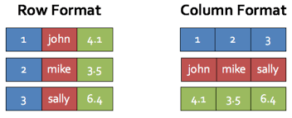
Column-based data Tabular Data:
In-memory column-based data has the keys (row-head keys) in the first row is the key of the each column.
The next column of each row after the key has the values at successive memory addresses.
The column-based data makes the OLAP easier.
All fields of a column can be accessed together. All fields of a set of columns may also be accessed together during OLAP.

Slide 70
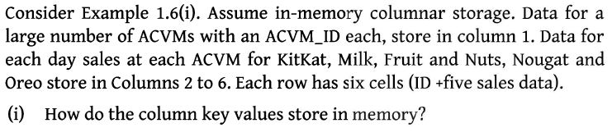
Example

Slide 71
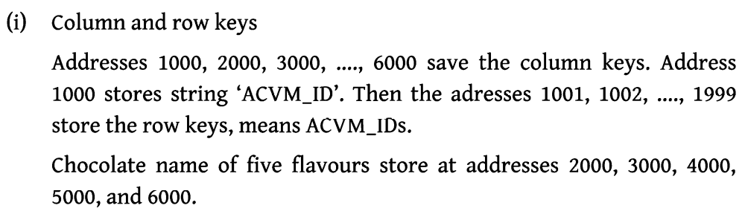
Solution

Slide 72
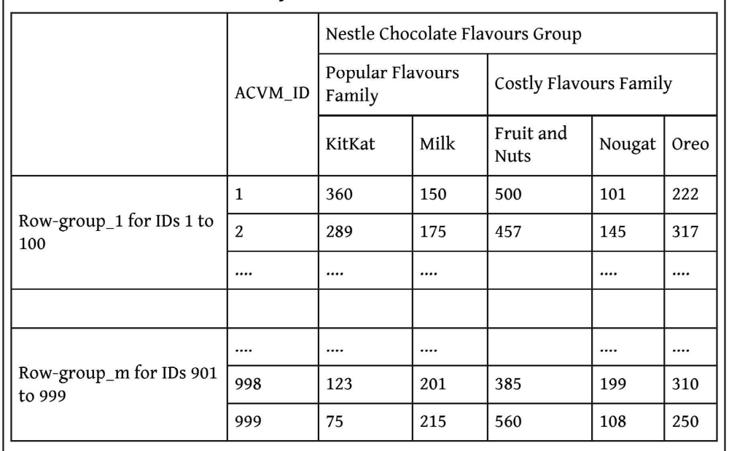

Slide 73
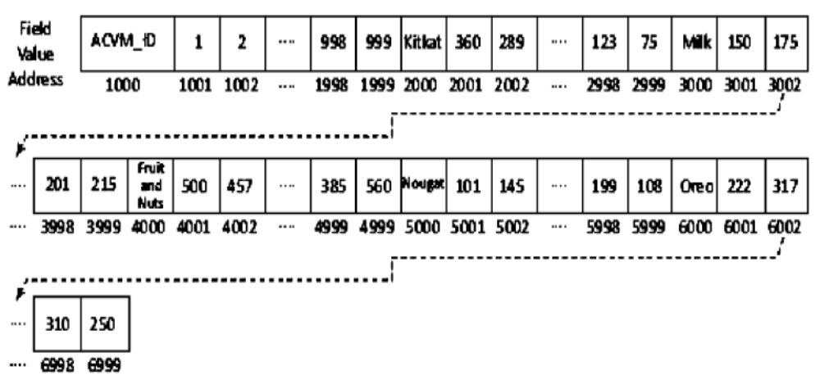

Slide 74
Advantages of column stores are:
1. Scalability: The database uses row IDs and column names to locate a column and values at the column fields. The back-end system can distribute queries over a large number of processing nodes without performing any Join operations.
2. Partitionability: For example, large data of ACVMs can be partitioned into datasets of size, say 1 MB in the number of row-groups. Values in columns of each row- group independently parallelly process in-memory at the partitioned nodes.
3. Availability: The cost of replication is lower since the system scales on distributed nodes efficiently. Thus, the data is always available in case of failure of any node.

Slide 75
4. Tree-like columnar structure A key for the column fields consists of three secondary keys: column-families group ID, column-family ID and column-head name.
Adding new data at ease: Permits new column Insert operations.
6. Querying all the field values in a column in a family, all columns in the family or a group of column-families, is fast in in-memory column-family data store.
7. Replication of columns: HDFS-compatible column-family data stores replicate each data store with default replication factor = 3.
8. No optimization for Join: Column-family data stores are similar to sparse matrix data. The data do not optimize for Join operations.

Slide 76
Examples of widely used column-family data store:
Google's BigTable, HBase and Cassandra.
Following are features of a BigTable:
1. Massively scalable NoSQL. BigTable scales up to 100s of petabytes.
2. Integrates easily with Hadoop and Hadoop compatible systems.
3. Compatibility with MapReduce, HBase APIs which are open-source Big Data platforms.
5. Handles million of operations per second.
6. Handle large workloads with low latency and high throughput
7. Consistent low latency and high throughput
8. APIs include security and permissions
9. BigTable, being Google's cloud service, has global availability and its service is seamless.

Slide 77
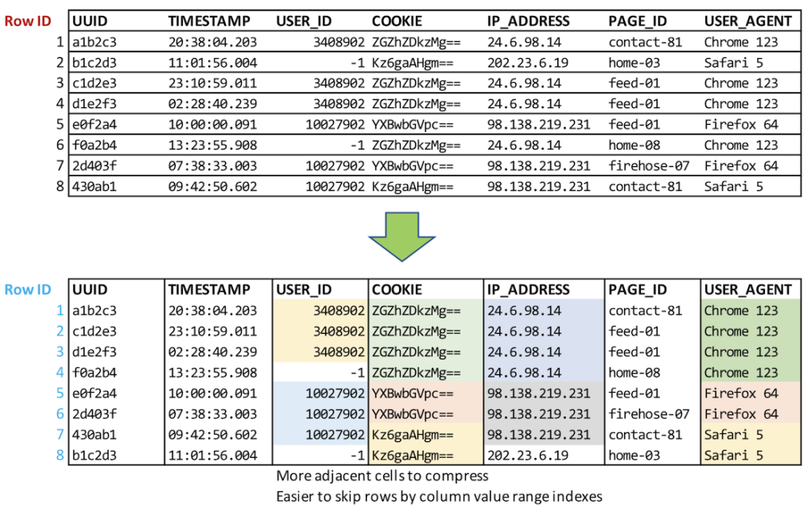
3.3.3.4 ORC File Format
ORC (Optimized Row Columnar).
ORC is an intelligent Big Data file format for HDFS and Hive.
An ORC file stores a collections of rows as a row-group.
Each row-group data store in columnar format.
This enables parallel processing of multiple row-groups in an HDFS cluster.
A mapped column has contents required by the query.
The columnar layout in each ORC file thus, optimizes for compression and enables skipping of data in columns.
This reduces read and decompression load.

Slide 78
An ORC thus, optimizes for reading serially the column fields in HDFS environment.
The throughput increases due to skipping and reading of the required fields at contents-column key.
Reading less number of ORC file content-columns reduces the workload on the NameNode.

Slide 79
3.3.3.5 Parquet File Formats
Apache Parquet is a columnar storage file format available to any project in the Hadoop ecosystem (Hive, Hbase, MapReduce, Pig, Spark).
What is a columnar storage format?
In order to understand Parquet file format in Hadoop better, first let’s see what is columnar format.
In a column oriented format values of each column of in the records are stored together.

Slide 80
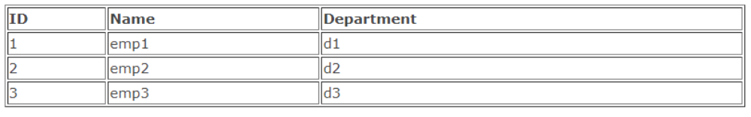
For example if there is a record which comprises of ID, emp Name and Department then all the values for ID column will be stored together, values for Name column together and so on.
If we take the same record schema as mentioned above having three fields ID (int), NAME (varchar) and Department (varchar)

Slide 81
row wise storage format :
For this table in a row wise storage format the data will be stored as follows-
Column oriented storage format-
data will be stored as follows in a Column oriented storage format-

Slide 82
How columnar storage format helps?
If you need to query few columns from a table then columnar storage format is more efficient as it will read only required columns since they are adjacent in memory thus minimizing IO.
If you want only the NAME column. In a row storage format each record in the dataset has to be loaded, parsed into fields and then data for Name is extracted.
With column oriented format it can directly go to Name column as all the values for that columns are stored together and get those values. No need to go through the whole record.

Slide 83
Column oriented format increases the query performance as less seek time is required to go the required columns and less IO is required as it needs to read only the columns whose data is required.
Another benefit that you get is in the form of less storage. Compression works better if data is of same type. With column oriented format columns of the same type are stored together resulting in better compression.

Slide 84
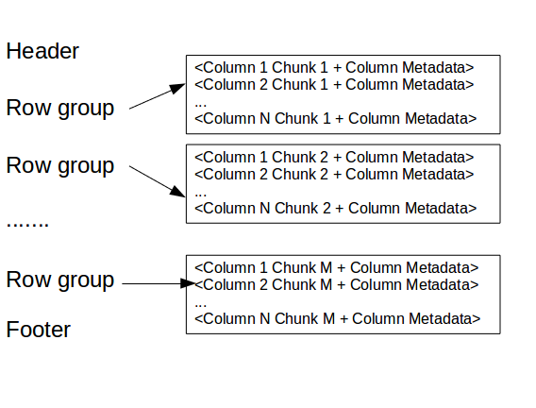
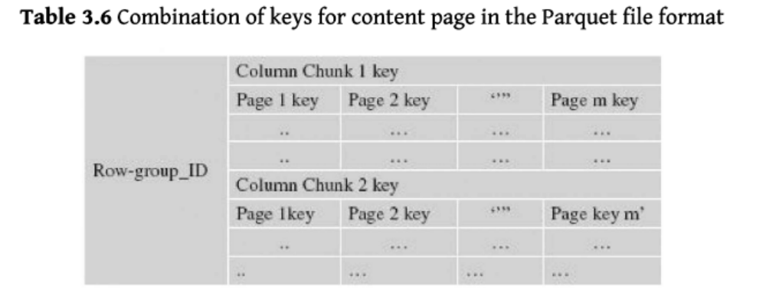
Parquet format
Parquet file format is also a column oriented format so it brings the same benefit of improved performance and better compression.
One of the unique feature of Parquet is that it can store data with nested structures also in columnar fashion.

Slide 85
3.3.4 Object Data Store
An object store refers to a repository which stores the:
1. Objects (such as files, images, documents, folders, and business reports)
2. System metadata which provides information such as filename, creation_date, last_modified, language_used (such as Java, C, C#, C++, Smalltalk, Python), access_permissions, supported query languages)
3. Custom metadata which provides information, such as subject, category, sharing permissions.

Slide 86
Eleven Functions Supporting APIs
An Object data store consists of functions supporting APIs for:
scalability,
indexing,
large collections,
querying language, processing and optimization (s),
Transactions,
data replication for high availability, data distribution model, data integration (such as with relational database, XML, custom code),

Slide 87
(vii) schema evolution,
(viii) persistency,
(ix) persistent object life cycle,
(x) adding modules and
(xi) locking and caching strategy.

Slide 88
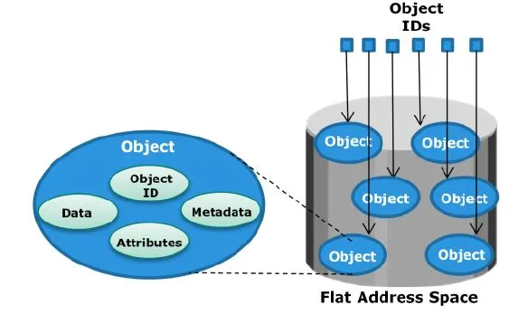
Examples of Object Store
Amazon S3 and Microsoft Azure BLOB support the Object Store.
Amazon S3 (Simple Storage Service) S3 refers to Amazon web service on the cloud named S3.
The S3 provides the Object Store.
The Object Store differs from the block and file-based cloud storage.
S3 assigns an ID number for each stored object.
The service has two storage classes: Standard and infrequent access.
Interfaces for S3 service are REST representational state transfer,
SOAP Simple Object Access Protocol and Bit Torrent.
S3 uses include web hosting, image hosting and storage for backup systems.
S3 is scalable storage infrastructure, same as used in Amazon e-commerce service.
S3 may store trillions of objects.

Slide 89
3.3.5 Graph Database
Another way to implement a data store is to use graph database.
Data store as series of interconnected nodes.
Data Store focuses on modeling interconnected structure of data. Data stores based on graph theory relation G = (E, V), where E is set of edges e_{l}, e₂, ... and V is set of vertices, v₁, v₂, ..., v_{n}.
Nodes represent entities or objects. Edges encode relationships between nodes. Some operations become simpler to perform using graph models.
Examples of graph model usages are social networks of connected people. The connections to related persons become easier to model when using the graph model.

Slide 90
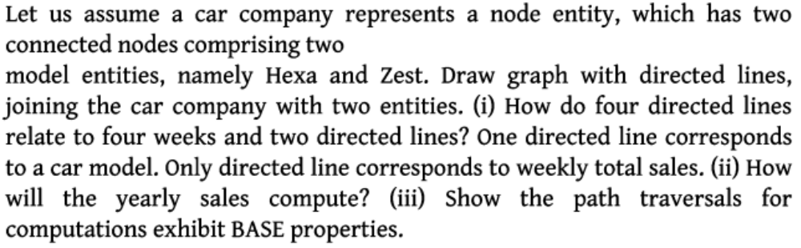
Example

Slide 91
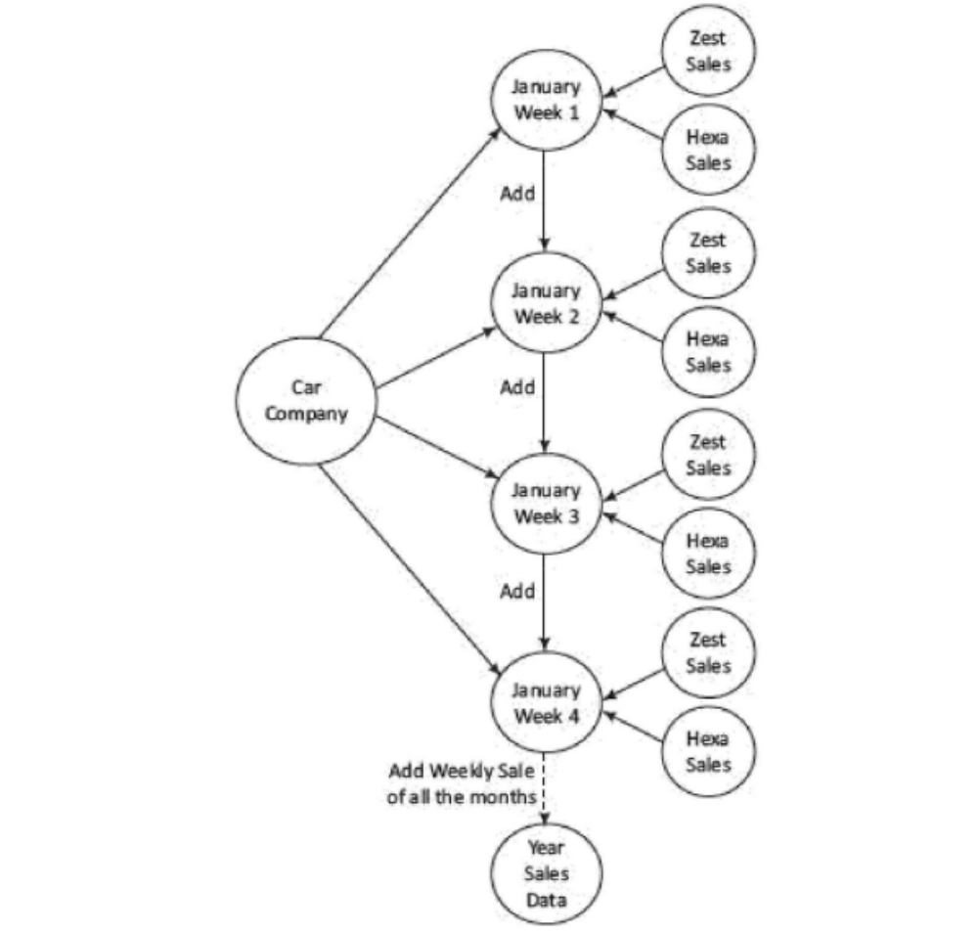
Solution:

Slide 92
(ii) Solution:
The yearly sales compute by path traversals from nodes for weekly sales to yearly sales data.
(iii) Solution:
The path traversals exhibit BASE properties because during the intermediate paths, consistency is not maintained. Eventually when all the path traversals complete, the data becomes consistent.

Slide 93
Typical uses of graph databases are:
(i) link analysis,
(ii) friend of friend queries,
(iii) rule checking and [Finite Automata Theory]
(iv) Pattern matching.
Limitations of Graph Data Base:
Graph databases have poor scalability.
They are difficult to scale out on multiple servers. This is due to the close connectivity feature of each node in the graph.
Write operations to multiple servers and graph queries that span multiple nodes, can be complex to implement.

Slide 94
Examples of graph DBs are
Neo4J,
AllegroGraph,
HyperGraph,
Infinite Graph,
Titan
and FlockDB.

Slide 95
3.4 NOSQL TO MANAGE BIG DATA
Using NoSQL to Manage Big Data
NoSQL
limits the support for Join queries, supports sparse matrix like columnar-family,
Has characteristics of easy creation and high processing speed, scalability and storability of much higher magnitude of data (terabytes and petabytes).
(iii) NoSQL sacrifices the support of ACID properties, and instead supports CAP and
BASE properties.
(iv) NoSQL data processing scales horizontally as well vertically.

Slide 96
Characteristics of Big Data NoSQL solution are:
1. High and easy scalability: NoSQL data stores are designed to expand horizontally. Horizontal scaling means that scaling out by adding more machines as data nodes (servers) into the pool of resources (processing, memory, network connections). The design scales out using multi-utility cloud services.
2. Support to replication: Multiple copies of data store across multiple nodes of a cluster. This ensures high availability, partition, reliability and fault tolerance.
3. Distributable: Big Data solutions permit sharding and distributing of shards on multiple clusters which enhances performance and throughput.

Slide 97
4. Usages of NoSQL servers which are less expensive. NoSQL data stores require less management efforts. It supports many features like automatic repair, easier data distribution and simpler data models that makes database administrator (DBA) and tuning requirements less stringent.
5. Usages of open-source tools: NoSQL data stores are cheap and open source. Database implementation is easy and typically uses cheap servers to manage the exploding data and transaction while RDBMS databases are expensive and use big servers and storage systems. So, cost per gigabyte data store and processing of that data can be many times less than the cost of RDBMS.
6. Support to schema-less data model: NoSQL data store is schema less, so data can be inserted in a NoSQL data store without any predefined schema. So, the format or data model can be changed any time, without disruption of application. Managing the changes is a difficult problem in SQL.

Slide 98
7. Support to integrated caching: NoSQL data store support the caching in system memory. That increases output performance. SQL database needs a separate infrastructure for that.
8. No inflexibility unlike the SQL/RDBMS, NoSQL DBs are flexible (not rigid) and have no structured way of storing and manipulating data. SQL stores in the form of tables consisting of rows and columns. NoSQL data stores have flexibility in following ACID rules.

Slide 99
3.4.1.2 Types of Big Data Problems
The following types of problems are faced using Big Data solutions.
1. Big Data need the scalable storage and use of distributed servers together as a cluster. Therefore, the solutions must drop support for the database Joins
NoSQL database is open source and that is its greatest strength but at the same time its greatest weakness also because there are not many defined standards for NoSQL data stores. Hence, no two NoSQL data stores are equal.
For example:
(i) No stored procedures in MongoDB (NoSQL data store)
(ii) GUI mode tools to access the data store are not available in the market
(iii) Lack of standardization
(iv) NoSQL data stores sacrifice ACID compliancy for flexibility and processing speed.

Slide 100
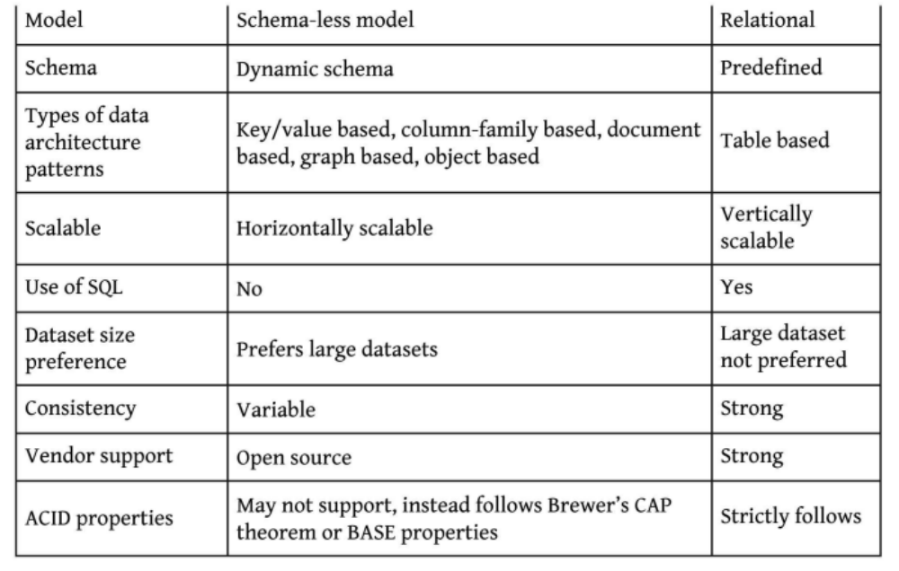
NoSQL vs RDBMS
NOSQL
RDBMS

Slide 101
SHARED-NOTHING ARCHITECTURE FOR BIG DATA TASKS
The columns of two RDBMS tables relate by a relationship.
A relational algebraic equation specifies the relation.
Keys share between two or more SQL tables in RDBMS.
Shared nothing (SN) is a cluster architecture. A node does not share data with any other node.
Big Data store consists of SN architecture.
Big Data store, therefore, easily partitions into shards.
A partition processes the different queries on data of the different users at each node independently. Thus, data processes run in parallel at the nodes.

Slide 102
The features of SN architecture are as follows:
1. Independence: Each node with no memory sharing; thus possesses computational self-sufficiency
2. Self-Healing: A link failure causes creation of another link
3. Each node functioning as a shard: Each node stores a shard (a partition of large DBs)
4. No network contention

Slide 103
3.5.1 Choosing the Distribution Models
Big Data requires distribution of data on multiple data nodes at clusters. Distributed software components give advantage of parallel processing, providing horizontal scalability.
Distribution gives
ability to handle large-sized data, and
processing of many read and write operations simultaneously in an application.
A resource manager manages, allocates, and schedules the resources of each processor, memory and network connection.
Distribution increases the availability when a network slows or link fails.

Slide 104
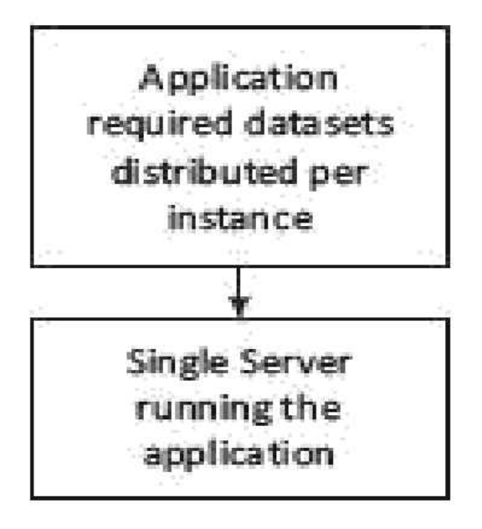
Four distribution models data store:
3.5.1.1 Single Server Distribution (SSD):
The SSD model suits well for graph DBs.
Datasets in the key-value pair, column-family or BigTable data stores which require sequential processing also use the SSD model.
An application executes the data sequentially on a single server.

Slide 105
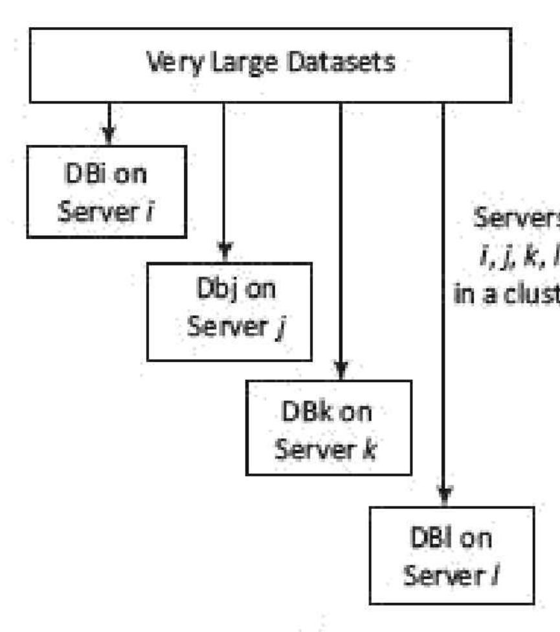
3.5.1.2 Sharding Very Large Databases:
Very large datasets is sharded into
four divisions, each running the application
on four i, j, k and l different servers at the
cluster.
DBi, DBj, DBk and DBl are four shards.

Slide 106
SN architecture makes application process run on multiple shards in parallel.
Sharding provides horizontal scalability.
The performance improves in the SN.
In case of a link failure, the application can migrate the shard DB to another node.

Slide 107
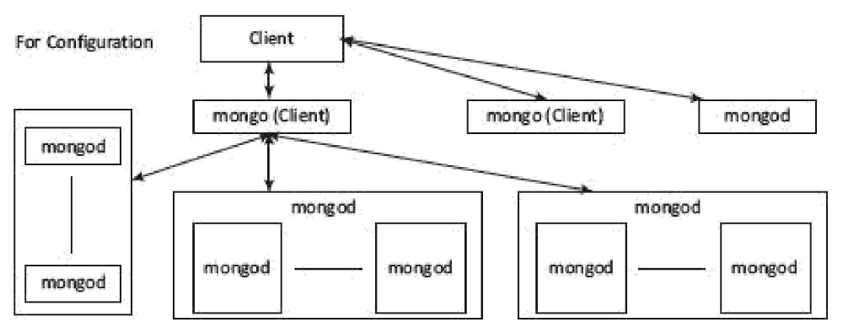
3.5.1.3 Master-Slave Distribution Model
Mongo – is a client, Mongod is the server

Slide 108
3.5.1.3 Master-Slave Distribution Model
A node serves as a master or primary node and the other nodes are slave nodes.
Master directs the slaves.
Data gets replicated on the slave nodes.
When a process updates the master, it updates the slaves also.
A process uses the slaves for read operations and write is done in master.
Processing performance improves when process runs large datasets distributed onto the slave nodes.

Slide 109
Limitations of Master Slave Distribution Model:
1. Processing performance decreases due to replication in MSD distribution model, if in case the data is not found on the salve node. [Then it has to be obtained from the other node on which the data is replicated]
2. Complexity increases: Cluster-based processing has greater complexity than the other architectures. Consistency can also be affected in case of problem of significant time taken for updating.

Slide 110
3.5.1.4 Peer-to-Peer Distribution Model [PPD Model]:
Peer-to-Peer distribution (PPD) model and replication has the following characteristics:
All replication nodes accept read request and send the responses.
All replicas function equally [read support and write support also].
Node failures do not cause loss of write capability, as other replicated node responds.
Cassandra adopts the PPD model.
Benefits:
Performance can further be enhanced by adding the nodes.
Since nodes read and write both, a replicated node also has updated data. Therefore, the biggest advantage in the model is consistency.

Slide 111
Peer-to-Peer Distribution Model [PPD Model]: Shards replicating on the nodes, which does read and write operations both

Slide 112
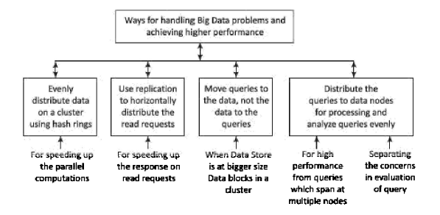
3.5.2 Ways of Handling Big Data Problems
Four ways for handling Big Data problems:

Slide 113
Evenly distribute the data on a cluster using the hash rings:
Uses the hashing algorithm which generates the pointer to the data collection.
Generated hash ID determines the data location in the cluster.
Hash Ring refers to a map of hashes with locations.
The client, use the hash ring for data searches.

Slide 114
Use replication to horizontally distribute the client read-requests: Replication means creating backup copies of data in real time.
Using replication enables horizontal scaling out of the client requests.
Moving queries to the data, not the data to the queries:
Moving client node queries to the data is efficient as well as a requirement in Big Data solutions.
Queries distribution to multiple nodes:
Evenly distribute the queries to data nodes/ replica nodes.
High performance query processing requires usages of multiple nodes.

Slide 115
3.6 MONGODB DATABASE
MongoDB is
non-relational,
NoSQL,
distributed,
open source,
document based,
(vi) cross-platform,
(vii) Scalable,
(viii) flexible data model,
(ix) Indexed,
(x) multi-master and
(xi) fault tolerant.
Store the document in JSON format.

Slide 116
Features of MongoDB
1. MongoDB data store is a physical container for collections. A number of DBs can run on a single MongoDB server. The database server of MongoDB is mongod and the client is mongo.
2. Collection stores a number of MongoDB documents. It is analogous to a table of RDBMS. Collections may store documents that do not have the same fields. Thus, documents of the collection are schema-less. Thus, it is possible to store documents of varying structures in a collection. Practically, in an RDBMS, it is required to define a column and its data type, but does not need them while working with the MongoDB.
3. Document model is well defined. Structure of document is clear, Document is the unit of storing data in a MongoDB database. Documents are analogous to the records of RDBMS table. Insert, update and delete operations can be performed on a collection. Document use JSON (JavaScript Object Notation) approach for storing data. JSON is a lightweight, self-describing format used to exchange data between various applications. JSON data basically has key-value pairs. Documents have dynamic schema.

Slide 117
4. MongoDB is a document data store in which one collection holds different documents. Data store in the form of JSON-style documents. Number of fields, content and size of the document can differ from one document to another.
Storing of data is flexible, and data store consists of JSON-like documents. This implies that the fields can vary from document to document and data structure can be changed over time; JSON has a standard structure, and scalable way of describing hierarchical data
Storing of documents on disk is in BSON serialization format. BSON is a binary representation of JSON documents. The mongo JavaScript shell and MongoDB language drivers perform translation between BSON and language-specific document representation.

Slide 118
Querying, indexing, and real time aggregation allows accessing and analyzing the data efficiently.
Deep query-ability—Supports dynamic queries on documents using a document-based query language that's nearly as powerful as SQL.
No complex Joins.
Distributed DB makes availability high, and provides horizontal scalability.
Indexes on any field in a collection of documents: Users can create indexes on any field in a document. Indices support queries and operations. By default, MongoDB creates an index on the _id field of every collection.

Slide 119
Comparison between RDBMS & MongoDB

Slide 120
MongoDB Replica Set
A replica set in MongoDB is a group of mongod (MongoDb server) processes that store the same dataset.
MongoDB replicates with the help of a replica set.
Replica sets provide redundancy but high availability.
A replica set usually has minimum three nodes.
Any one out of them is called primary.
The primary node receives all the write operations.
All the other nodes are termed as secondary.

Slide 121
The data replicates from primary to secondary nodes.
A new primary node can be chosen among the secondary nodes at the time of automatic failover or maintenance.
The failed node when recovered can join the replica set as secondary node again.

Slide 122
Following are the commands used for replication (Recoverability means even on occurrences of failures; the transactions ensure consistency).

Slide 123
Auto-sharding
Sharding is a method for distributing data across multiple machines in a distributed application environment.
Vertical scaling by increasing the resources of a single machine is quite expensive. Thus, horizontal scaling of the data can be achieved using sharding mechanism where more database servers can be added to support data growth and the demands of more read and write operations.
Sharding automatically balances the data and load across various servers. Sharding provides additional write capability by distributing the write load over a number of mongod (MongoDB Server) instances.
DB has a 1 terabyte dataset distributed amongst 20 shards, then each shard contains only 50 Giga Byte of data.

Slide 124
Data types which MongoDB documents support

Slide 127
MongoDB Querying Commands

Slide 128
To Create database:
Command is use — use command creates a database;
For example, Command use lego creates a database named lego. (A sample database is created to demonstrate subsequent queries.
The Lego is an international toy brand). Default database in MongoDB is test.
To see the existence of database:
Command is db — db command shows that lego database is created.
To get list of all the databases:
Command is show dbs — This command shows the names of all the databases.

Slide 129
To drop database:
Command is db.dropDatabase () - This command drops a database.
Run use lego command before the db.dropDatabase () command to drop lego Database.
If no database is selected, the default database test will be dropped.
To create a collection
Command is insert () - To create a collection, the easiest way is to insert a record (a document consisting of keys (Field names) and Values) into a collection. A new collection will be created, if the collection does not exist. The following statements demonstrate the creation of a collection with three fields (ProductCategory, Productld and ProductName) in the lego

Slide 130
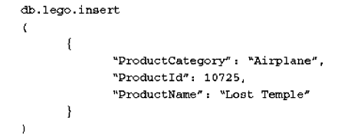
To create a collection
Command is insert () - To create a collection, the easiest way is to insert a record (a document consisting of keys (Field names) and Values) into a collection. A new collection will be created, if the collection does not exist. The following statements demonstrate the creation of a collection with three fields (ProductCategory, Productld and ProductName) in the lego

Slide 131
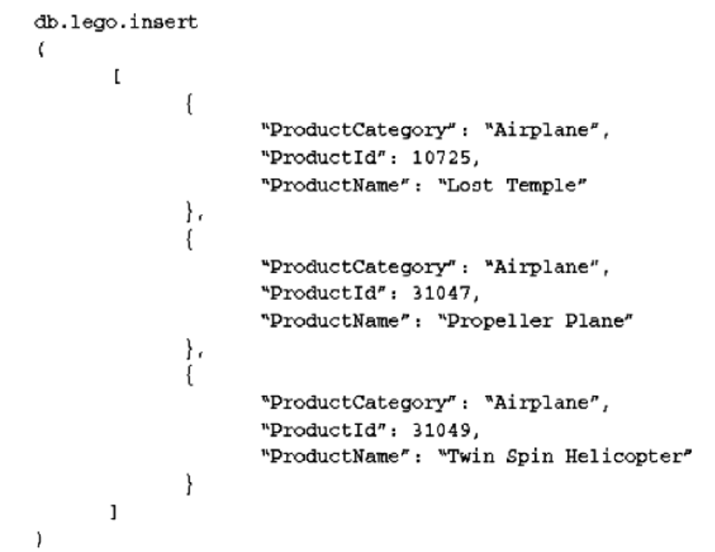
To add array in a collection:
Command is insert () - Insert command can also be used to insert multiple documents into a collection at one time.

Slide 132
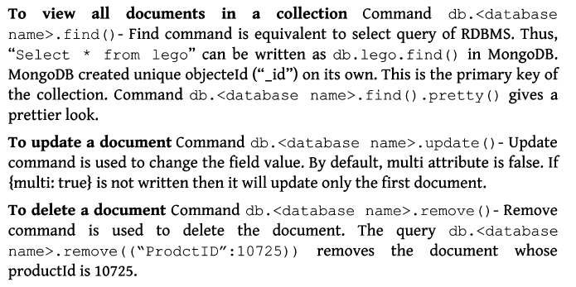

Slide 133
3.7 Cassandra Database
Cassandra was developed by Facebook and released by Apache.
Cassandra is basically a column family database that stores and handles massive data of any format including structured, semi-structured and unstructured data.
Cassandra is written in Java. Big organizations, such as Facebook, IBM, Twitter, Cisco, Rackspace, eBay, Twitter and Netflix have adopted Cassandra.

Slide 134
Characteristics of Cassandra
open source,
scalable
non-relational
NoSQL
Distributed
column based,
decentralized,
fault tolerant and
tuneable consistency.

Slide 135
Features of Cassandra are as follows:
1. Maximizes the number of writes - writes are not very costly (time consuming)
2. Maximizes data duplication
3. Does not support Joins, group by, OR clause and aggregations
4. Is fast and easily scalable as write operations spread across the cluster. The cluster does not have a master-node, so any read and write can be handled by any node in the cluster.
5. Is a distributed DBMS designed for handling a high volume of structured data across multiple cloud servers
6. Uses PPD (Peer to Peer Data distribution model) Data distribution model

Slide 136
Data Replication
Cassandra stores data on multiple nodes (data replication) and thus has no single point of failure, and ensures availability, a requirement in CAP theorem.
Cassandra returns the most recent value of the data to the client.
If it has detected that some of the nodes responded with a stale value, Cassandra performs a read repair in the background to update the stale values.

Slide 137
Components of cassandra

Slide 138
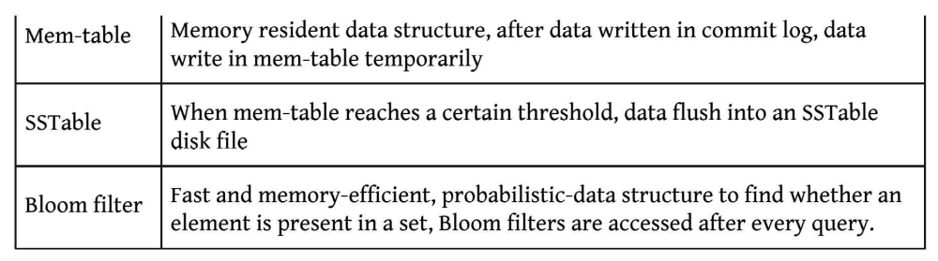

Slide 139
Scalability:
Cassandra provides linear scalability which increases the throughput and decreases the response time on increase in the number of nodes at cluster.
Transaction Support Supports ACID properties (Atomicity, Consistency, Isolation, and Durability).
Replication Option:
Specifies any of the two replica placement strategy. The strategy names are Simple Strategy or Network Topology Strategy.
1. Simple Strategy: Specifies simply a replication factor for the cluster.
2. Network Topology Strategy: Allows setting the replication factor for each data center independently.

Slide 140
Data types built into Cassandra, their usage and description

Slide 142
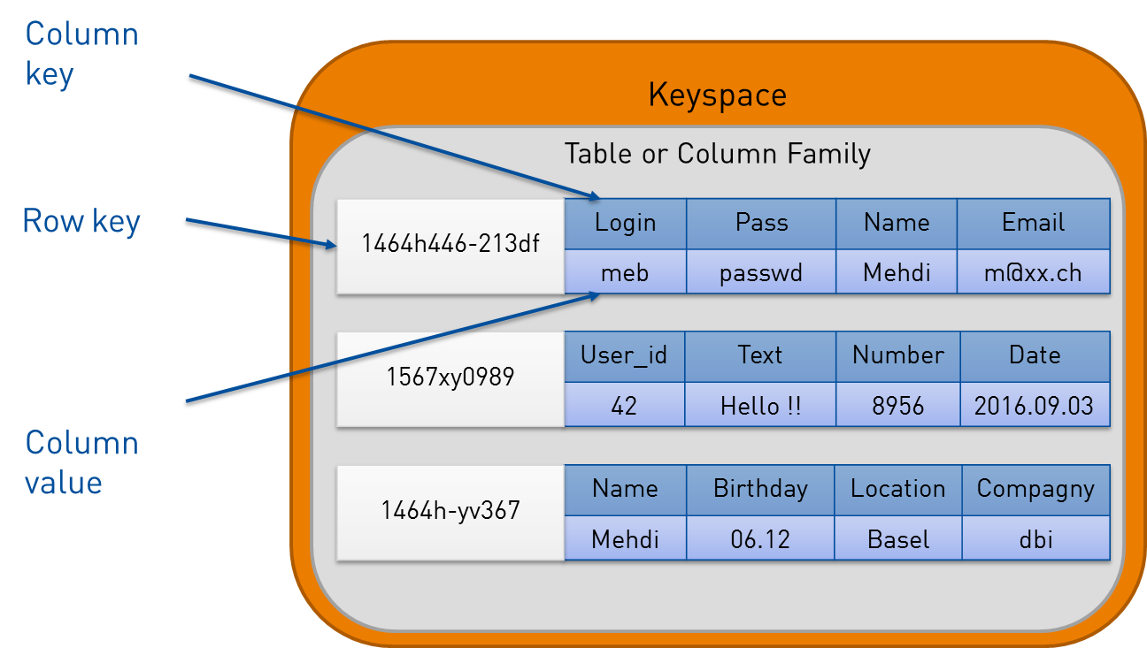
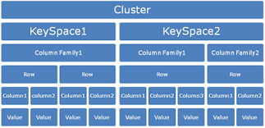
Cassandra Data Model consists of four main components:
Cluster: Made up of multiple nodes
and keyspaces,
Keyspace: a namespace to group multiple
column families, especially one per partition,
(iii) Column: consists of a column name,
value and timestamp and
(iv) Column-family: multiple columns with row key reference. Cassandra does keyspace management using partitioning of keys
into ranges and assigning different key-ranges to specific nodes.

Slide 143
Following Commands prints a description
DESCRIBE CLUSTER
DESCRIBE SCHEMA
DESCRIBE KEYSPACES
DESCRIBE KEYSPACE <keyspace name>
DESCRIBE TABLES
DESCRIBE TABLE <table name>
DESCRIBE INDEX <index name>
DESCRIBE MATERIALIZED VIEW <view name> DESCRIBE TYPES
DESCRIBE TYPE <type name>
DESCRIBE FUNCTIONS
DESCRIBE FUNCTION <function name>
DESCRIBE AGGREGATES
DESCRIBE AGGREGATE <aggregate function name>

Slide 144
Consistency Command CONSISTENCY shows the current consistency level. CONSISTENCY <LEVEL> sets a new consistency level.
Valid consistency levels are
ALL, ANY, ONE, TWO, THREE, QUORUM, LOCAL_ONE, LOCAL_QUORUM, EACH_QUORUM, SERIAL AND LOCAL_SERIAL.
1. ALL: Highly consistent. A write must be written to commitlog and memtable on all replica nodes in the cluster.
2. EACH_QUORUM: A write must be written to commitlog and memtable on quorum of replica nodes in all data centers.
3. LOCAL_QUORUM: A write must be written to commitlog and memtable on quorum of replica nodes in the same center.
4. ONE: A write must be written to commitlog and memtable of at least one replica node.
5. TWO, THREE: Same as One but at least two and three replica nodes, respectively.

Slide 145
6. LOCAL_ONE: A write must be written for at least one replica node in the local data center.
7. ANY: A write must be written to at least one node.
8. SERIAL: Linearizable consistency to prevent unconditional update.
9. LOCAL SERIAL: Same as Serial but restricted to the local data center.

Slide 146
Keyspaces
Keyspaces: A keyspace (or key space) in a NoSQL data store is an object that contains all column families data as a bundle.
Keyspace is the outermost grouping of the data in the data store.
Generally, there is one keyspace per application. Keyspace in Cassandra is a namespace that defines data replication on nodes. A cluster contains one keyspace per node.
Create Keyspace Command
CREATE KEYSPACE <Keyspace Name> WITH replication = {'class : '<Strategy name>', 'replication_factor': '<No. of replicas>'} AND durablewrites= '<TRUE/FALSE>';
CREATE KEYSPACE statement has attributes replication with option class and replication factor, and durable_write.

Slide 147
Default value of durable_writes properties of a table is set to true. This commands the Cassandra to use Commit Log for updates on the current Keyspace. The option is not compulsory.
ALTER KEYSPACE command changes (alter) properties, such as the number of replicas and the durable_writes of a keyspace:
ALTER KEYSPACE <Keyspace Name> WITH replication = {`class': '<Strategy name>', `replication_factor': '<No. of replicas>'};
2. DESCRIBE KEYSPACE command displays the existing keyspaces.
3. DROP KEYSPACE command drops a keyspace:
4. Re-executing the drop command to drop the same keyspace will result in configuration exception.
5. Use KEYSPACE command connects the client session with a keyspace.

Slide 148
Cassandra Query Language (CQL)
CQL commands and their functionalities:

Slide 149
Examples on CQL
Creating a table or column family within a keyspace:

Slide 150
Creating a table in keyspace lego

Slide 151
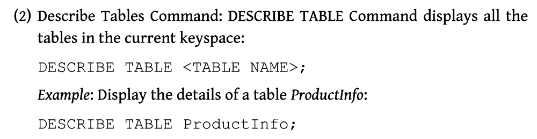
Describing a table in keyspace

Slide 152
Alter Table Commands

Slide 153
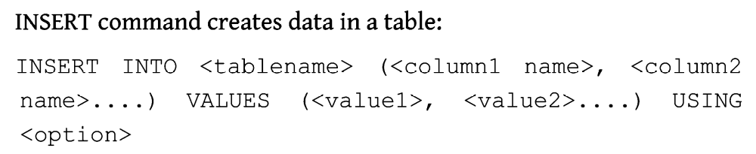
CURD Operations – Create, Update, Read, Delete Oprtaions
Insert Command:

Slide 154
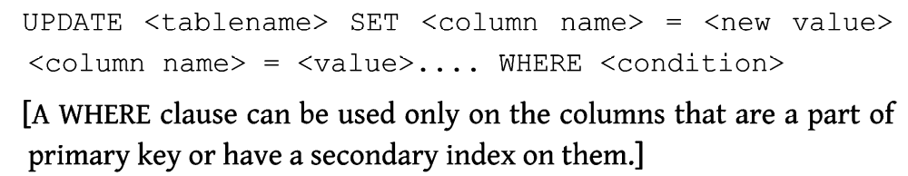
Update

Slide 155
Select Command

Slide 156
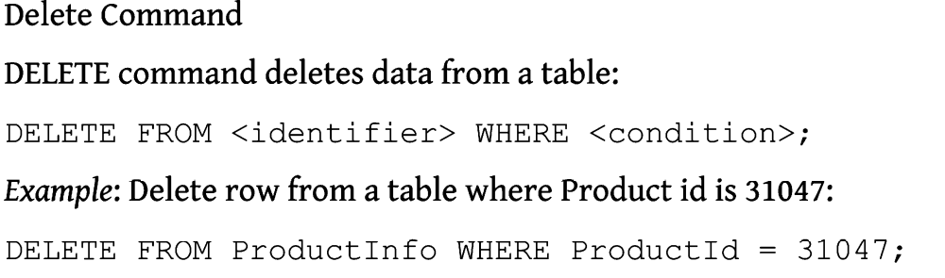
Delete Command

Slide 157
Creating a Table with the List

Slide 158
Inserting into Table That Has List

Slide 159
Updating Data into the List

Slide 160
Useful Links
https://youtu.be/XFE0EgT5oQE
https://www.youtube.com/watch?v=xh4gy1lbL2k
https://youtu.be/-56x56UppqQ
https://youtu.be/J-cSy5MeMOA

Slide 161
Thank You

