Slide 1
COMPUTER GRAPHICS & Visualization
(18CS62)
MODULE -1
Computer Graphics and OpenGL
Mrs. Sandhya A Kulkarni &Mrs.Amitha S
Assistant Professor
DEPARTMENT OF COMPUTER SCIENCE AND ENGINEERING
K S SCHOOL OF ENGINEERING AND MANAGEMENT

Slide 2
Syllabus Content
Module 1: Overview: Computer Graphics and OpenGL: Computer Graphics:
Basics of computer graphics, Application of Computer Graphics,
Video Display Devices: Random Scan and Raster Scan displays,graphics software.
OpenGL: Introduction to OpenGL ,coordinate reference frames, specifying two-dimensional world coordinate reference frames in OpenGL,
OpenGL point functions, OpenGL line functions, point attributes, line attributes, curve attributes, OpenGL point attribute functions.
OpenGL line attribute functions, Line drawing algorithms(DDA, Bresenham’s), circle generation algorithms (Bresenham’s).

Slide 3
Syllabus Content
Module 2: Fill area Primitives, 2D Geometric Transformations and 2D viewing
Fill area Primitives:
  Polygon fill-areas, OpenGL polygon fill area functions,
  fill area attributes, general scan line polygon fill algorithm, OpenGL fill-area attribute functions.
2D Geometric Transformations: Basic 2D Geometric Transformations, matrix representations and homogeneous coordinates.
Inverse transformations, 2D Composite transformations, other 2D transformations, raster methods for geometric transformations,
OpenGL raster transformations, OpenGL geometric transformation’s function,2D viewing: 2D viewing pipeline, OpenGL 2D viewing functions.

Slide 4
Syllabus Content
Module 3: Clipping, 3D Geometric Transformations, Color & Illumination Models:
Clipping: clipping window, normalization and viewport transformations, clipping algorithms,2D point clipping,
2D line clipping algorithms: cohen-sutherland line clipping only -polygon fill area clipping: Sutherland-Hodgeman polygon clipping algorithm only.
3DGeometric Transformations: 3D translation, rotation, scaling, composite 3D transformations, other 3D transformations, affine transformations, OpenGL geometric transformations functions.
Color Models: Properties of light, color models, RGB and CMY color models.
Illumination Models: Light sources, basic illumination models-Ambient light, diffuse reflection, specular and phong model, Corresponding openGL functions

Slide 5
Syllabus Content
Module 4: 3D Viewing and Visible Surface Detection:
3DViewing: 3D viewing concepts, 3D viewing pipeline,
3D viewing coordinate parameters , Transformation from world to viewing coordinates, Projection transformation, orthogonal projections, perspective projections,
The viewport transformation and 3D screen coordinates. OpenGL 3D viewing functions.
Visible Surface Detection Methods: Classification of visible surface Detection algorithms, depth buffer method only and OpenGL visibility detection functions.

Slide 6
Syllabus Content
Module 5: Input& interaction, Curves and Computer Animation:
Input and Interaction: Input devices, clients and servers, Display Lists, Display Lists and Modeling,
Programming Event Driven Input, Menus Picking, Building Interactive Models, Animating Interactive programs, Design of Interactive programs, Logic operations.
Curved surfaces, quadric surfaces, OpenGL Quadric-Surface and Cubic-Surface Functions, Bezier Spline Curves, Bezier surfaces, OpenGL curve functions.

Slide 7
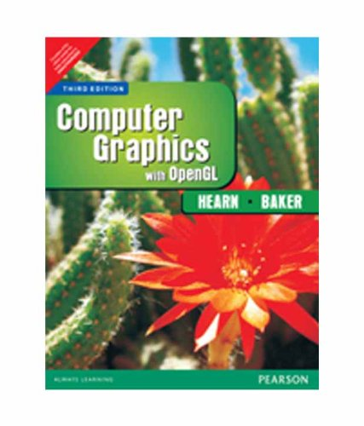
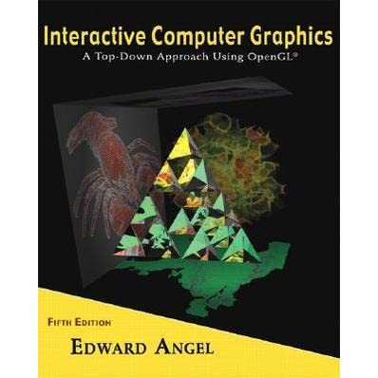
Text books

Slide 8
What is OpenGL ?

Slide 9
OpenGL ( Open Graphics Library )
Is a cross-language, cross-platform API for rendering 2D and 3D vector graphics.
The API is typically used to interact with a graphics processing unit (GPU), to achieve hardware-accelerated rendering
the people who make GPUs, are responsible for writing implementations of the OpenGL rendering system.
Their implementations, commonly called "drivers“ , translate OpenGL API commands into GPU commands

Slide 10
OpenGL History
Development started by SGI (Silicon Graphics INC.) at 1991 (
developers groups name was ARB ( IBM , Microsoft , Nvidia , … )
First release at 1992 ( OpenGL 1.0 )
Last release by SGI at 2 July 2006 ( OpenGL 2.1 )
Maintainer changed at July 2006 ( from SGI to Khronos Group( SGI , ATI , Nvidia , … ) )
First big release by Khronos at 11 Agust 2008 ( OpenGL 3.0 )
Last release by Khronos at 31 July 2017 ( OpenGL 4.6 )

Slide 11







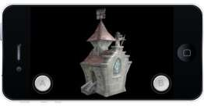

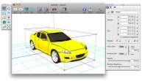

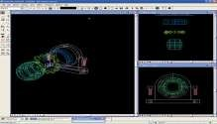

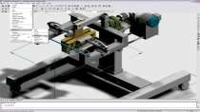

OpenGL usages
Games
Animations and Videos
Mobile phones
CAD (Computer Aided Design )
virtual reality

Slide 12
What is Computer Graphics?
“Computer graphics is a sub-field of computer science and is concerned with digitally synthesizing and manipulating visual content.”
Computer graphics deals with all aspects of creating images with a computer- Imaging, Rendering, Modeling, Animation.
  Hardware: PC with graphics card for modeling and rendering.
  Software: OpenGL
  Applications: Any

Slide 13
Graphics Applications
Graphs and charts
Computer-aided design
Virtual-Reality Environments
Scientific visualization
Education and Training
Computer art
Entertainment
Image Processing
Graphical User Interfaces

Slide 14
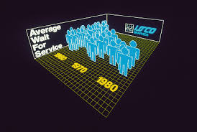
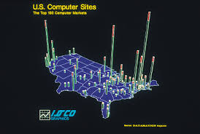
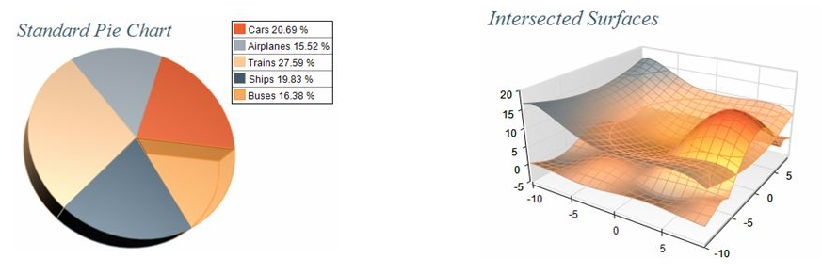
Data plotting with dramatic effect, commonly used to summarize financial, statistical, mathematical, scientific, engineering, and economic data for research reports, managerial summaries, consumer information bulletins and other types of publications
Graphs and charts
Computer-aided design
Virtual-Reality Environments
Scientific visualization
Education and Training
Computer art
Entertainment
Image Processing
Graphical User Interfaces

Slide 15
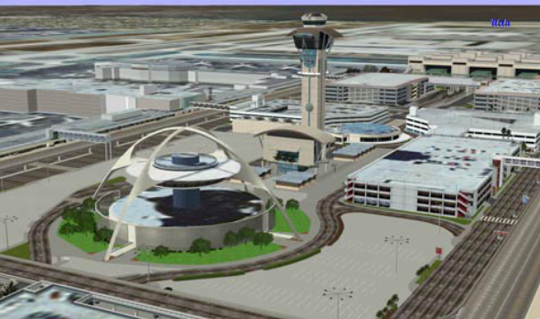
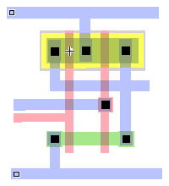
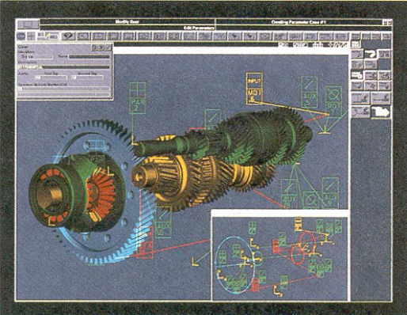
In design of building, automobiles, aircrafts, watercrafts, spacecrafts, computers, textiles, home appliances and a multitude of other products
Graphs and charts
Computer-aided design
Virtual-Reality Environments
Scientific visualization
Education and Training
Computer art
Entertainment
Image Processing
Graphical User Interfaces
Los Angeles Airport
Gear Shaft Design
CMOS Circuit Design
Contd…

Slide 16


Such animations are often used to train heavy-equipment operators, analyze the effectiveness of various cabin configuration and control placements, users can interact with the objects in a 3D scene.
Graphs and charts
Computer-aided design
Virtual-Reality Environments
Scientific visualization
Education and Training
Computer art
Entertainment
Image Processing
Graphical User Interfaces

Slide 17
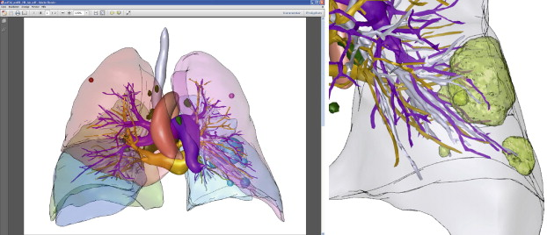
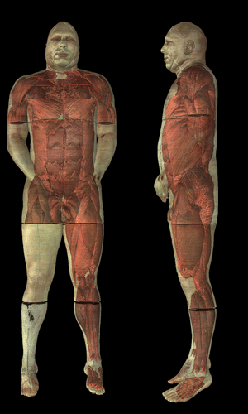
Also called data visualization: produces graphical representations for scientific, engineering and medical data sets and processes it. Business visualization is used in connection with data sets related to commerce, industry, and other nonscientific areas. Also used in understanding and analyzing complex processes and mathematical functions
Graphs and charts
Computer-aided design
Virtual-Reality Environments
Scientific visualization
Education and Training
Computer art
Entertainment
Image Processing
Graphical User Interfaces

Slide 18
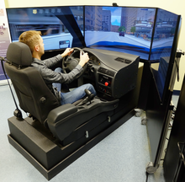
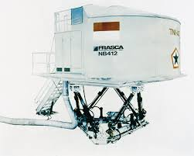
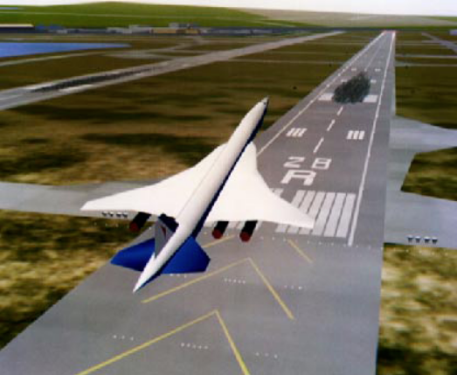
Computer generated models of physical, financial, political, social, economic, and other systems are often used as educational aids. Eg: color-coded diagram in operation of a nuclear reactor, aircraft, naval, spacecraft simulators
Graphs and charts
Computer-aided design
Virtual-Reality Environments
Scientific visualization
Education and Training
Computer art
Entertainment
Image Processing
Graphical User Interfaces
Flight Simulation
Driving Simulation

Slide 19

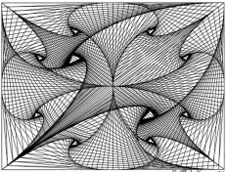
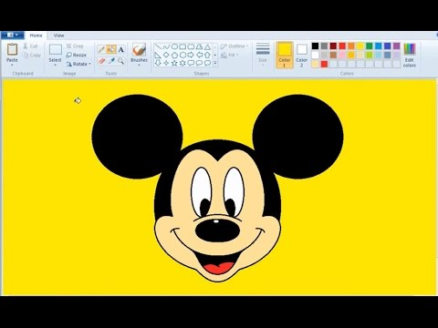
Graphics are used in Fine Art, Commercial Art applications and Mathematical Art. The artist uses a combination of 3D modeling packages, texture mapping, drawing programs and CAD software. Mathematical Art is produced using mathematical functions and fractal procedures. Pen plotters create Automatic Art.
Graphs and charts
Computer-aided design
Virtual-Reality Environments
Scientific visualization
Education and Training
Computer art
Entertainment
Image Processing
Graphical User Interfaces

Slide 20
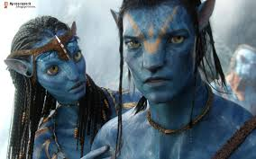

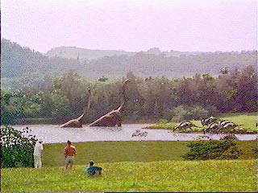
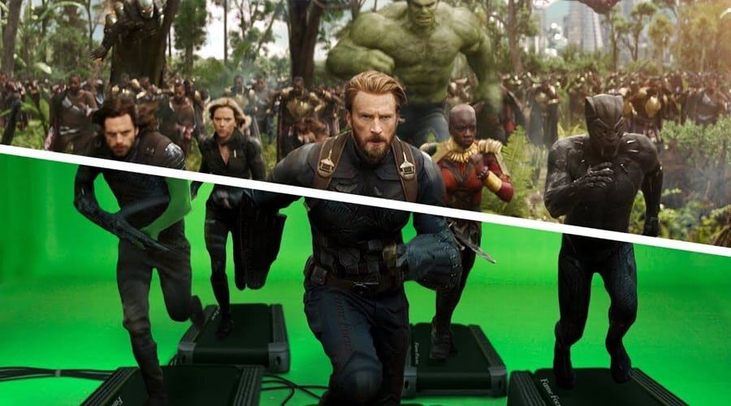
Graphics are commonly used in making motion pictures, music videos and television shows. Graphics objects can be combined with live actions. Eg. Avtar movie
Graphs and charts
Computer-aided design
Virtual-Reality Environments
Scientific visualization
Education and Training
Computer art
Entertainment
Image Processing
Graphical User Interfaces
Jurasic Park

Slide 21

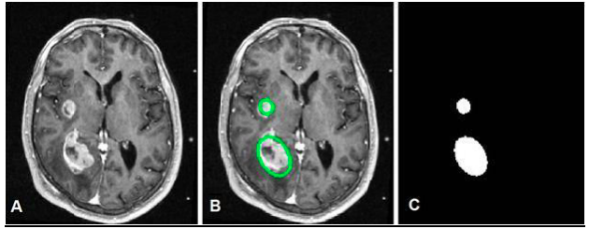
Image processing applies techniques to modify or interpret existing pictures (photographs, TV scans).to apply image processing methods, the image must be digitized first. Medical applications also make extensive use of image processing techniques for picture enhancement, simulations of surgical operations. It used to improve picture quality, analyze or recognize visual patterns.
Graphs and charts
Computer-aided design
Virtual-Reality Environments
Scientific visualization
Education and Training
Computer art
Entertainment
Image Processing
Graphical User Interfaces

Slide 22

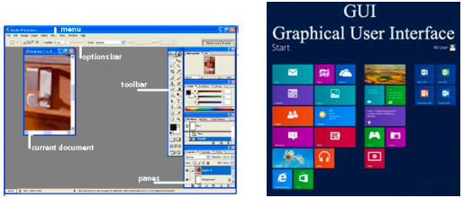
User is provided with point and click facility to select menu items, icons and objects on the screen. User can manage multiple windows simultaneously. Word-processing spreadsheets and desktop-publishing programs are typical applications that take advantage of such user interface techniques.
Graphs and charts
Computer-aided design
Virtual-Reality Environments
Scientific visualization
Education and Training
Computer art
Entertainment
Image Processing
Graphical User Interfaces

Slide 23
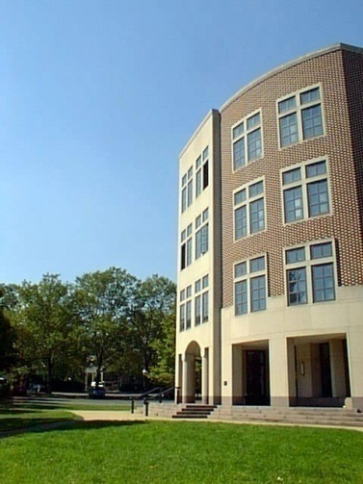
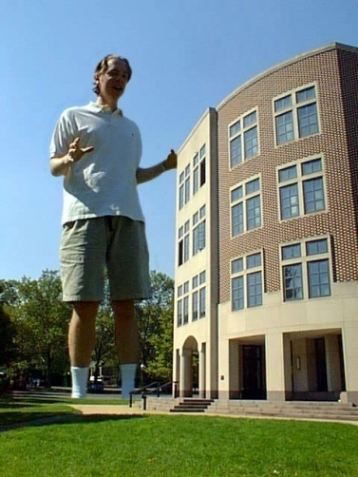
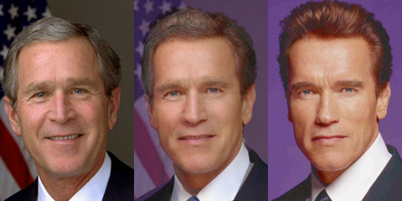
Imaging (Representing 2D images)
Image Representation
  Sampling
  Reconstruction
Image Processing
  Filtering
  Morphing
Raster Graphics
  Display devices
  Color models
Image composition
Image morphing

Slide 24
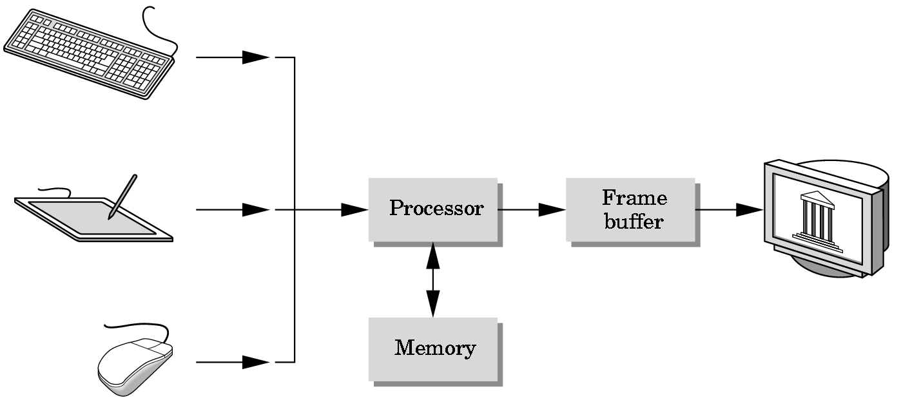
Basic Graphics System
Output device
Input devices
Image formed in FB

Slide 25
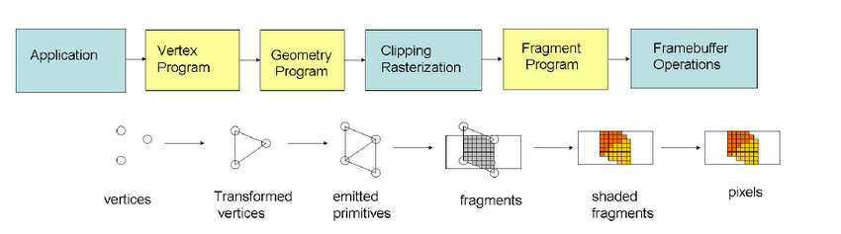
Graphics pipeline architecture

Slide 26
2D Graphics Pipeline
Clipping
Object
World Coordinates
Applying
world window
Object
subset
window to
viewport
mapping
Simple 2D Drawing Pipeline
Display
Rasterization
Object
Screen coordinates

Slide 27
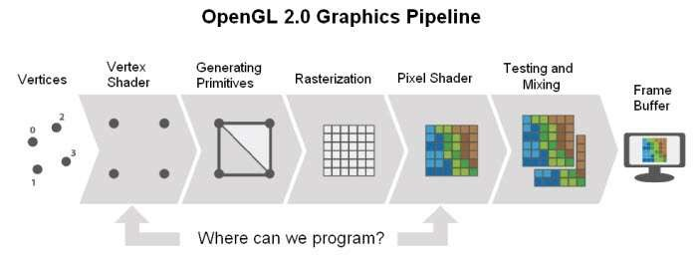
OpenGL rendering pipeline
Another simple view of OpenGL pipeline
Fragment shader (color chooser )

Slide 28
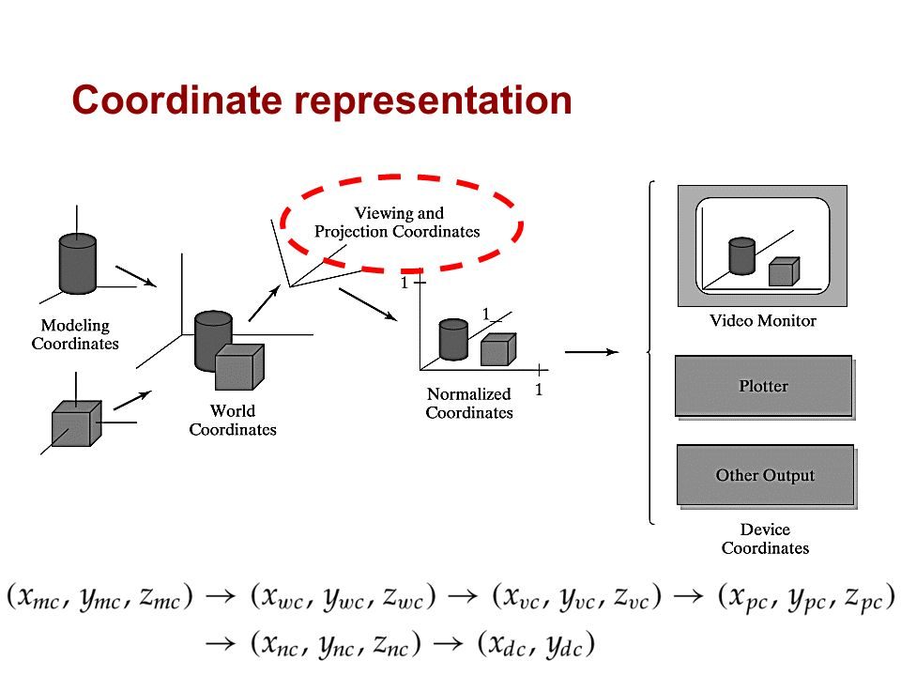

Slide 29
From model to image
Model
World
View
NDC
Display
Graphics pipeline
Coordinates and transformations

Slide 30
From model to image
Model
World
View
NDC
Display
Cylinder:
Local or modeling coordinates
Geometric modeling

Slide 31
From model to image
Model
World
View
NDC
Display
Position cylinders in scene:
World coordinates

Slide 32
From model to image
Model
World
View
NDC
Display
Look at cylinders,
project on virtual screen
Viewing coordinates
Visible surfaces, shading

Slide 33
From model to image
Model
World
View
NDC
Display
1
Display:
Normalized Device Coordinates
0
1

Slide 34
From model to image
Model
World
View
NDC
Display
0
1024
Display on screen:
Device Coordinates
768
Interaction

Slide 35
Video Display Devices
Emissive display - Convert electrical energy into light
- Cathode ray tube (CRT)
- Flat panel CRT
- Plasma panels (gas-discharge display)
- Light-emitting diodes
Non-Emissive display - Optical effect: convert sunlight or light from other source into graphic patterns.
- Liquid-crystal device (LCD)
– flat panel

Slide 36
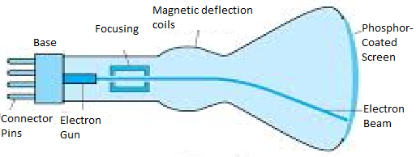
Cathode Ray Tube (CRT)
Cathode Ray – beam of electrons
emitted by an electron gun
accelerated by a high positive voltage near the face of the tube
forced into a narrow stream by a focusing system
directed toward a point on the screen by the magnetic field generated by the deflection coils
hit onto the phosphor-coated screen
phosphor emits visible light, whose intensity depends on the number of electrons striking on the screen
Basic design of a magnetic-deflection CRT

Slide 37
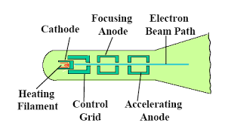
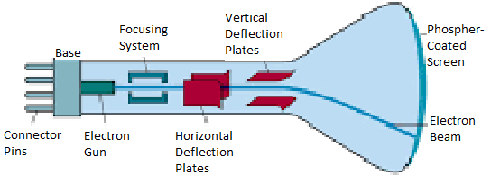
Cathode Ray Tube
Operation of an electron gun with an accelerating anode.
2 primary components: Heated metal cathode and control grid.
Intensity is controlled by voltage at the control grid..
Focusing system forces electron beam to converge to a smaller cross section.
Accelerating anode produces positive voltage.
Electrostatic deflection of the electron beam in a CRT

Slide 38
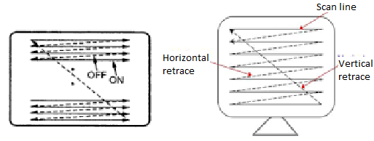
Display trace
Horizontal retrace: return to the left of the screen, after refreshing each scan line.
Vertical retrace: electron beam returns to the top left corner of the screen to begin the next frame.
Refresh rates are described in units of cycles per seconds, or Hertz(Hz).

Slide 39
Raster-Scan Displays and Random Scan Displays
Raster-Scan Displays
❖ The electron beam is swept across the screen one row at a time from top to bottom.
❖ As it moves across each row, the beam intensity is turned on and off to create a pattern of illuminated spots.
❖ This scanning process is called refreshing. Each complete scanning of a screen is normally called a frame. The refresh rate is the number of times per second that a raster-based display device displays a new image.
❖ The refreshing rate, called the frame rate, is normally 60 to 80 frames per second, or described as 60 Hz to 80 Hz.
❖ Picture definition is stored in a memory area called the frame buffer.
❖ This frame buffer stores the intensity values for all the screen points. Each screen point is called a pixel (picture element).
❖ Property of raster scan is Aspect ratio, which defined as number of pixel columns divided by number of scan lines that can be displayed by the system(W/H).

Slide 40
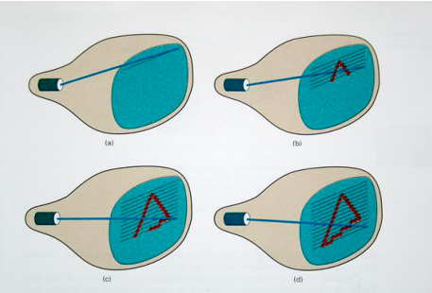
Raster-Scan Displays
On black and white systems,
the frame buffer storing the values of the pixels is called a bitmap.
Each entry in the bitmap is a 1-bit data which determine the on (1) and off (0) of the intensity of the pixel.

Slide 41
Raster-Scan Displays and Random Scan Displays
2. Random Scan Displays
When operated as a random-scan display unit, a CRT has the electron beam directed only to those parts of the screen where a picture is to be displayed.
Pictures are generated as line drawings, with the electron beam tracing out the component lines one after the other.
For this reason, random-scan monitors are also referred to as vector displays (strokewriting displays or calligraphic displays).
The component lines of a picture can be drawn and refreshed by a random-scan system in any specified order.
A pen plotter operates in a similar way and is an example of a random-scan, hard-copy device.
Picture definition is now stored as a set of line-drawing commands in an area of memory referred to as the display list, refresh display file, vector file, or display program.
Random-scan displays are designed to draw all the component lines of a picture 30 to 60 times each second, with up to 100,000 “short” lines in the display list.

Slide 42
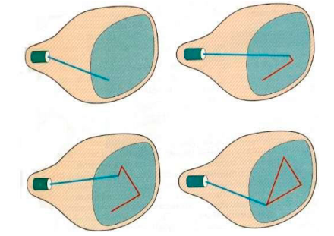
Random Scan Displays
In random-scan display unit, a CRT has the electron beam directed only to those parts of the screen where a picture is to be displayed.

Slide 43
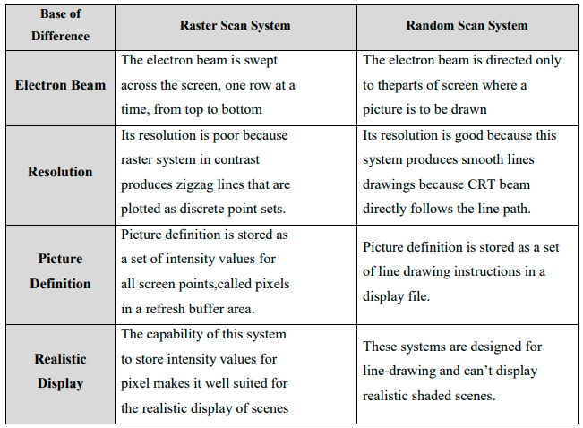
Differences between Raster scan and random scan

Slide 44
Basic definitions
Raster: A rectangular array of points or dots.
Pixel (Pel, picture elements): One dot or picture element of the raster, defined as smallest addressable area on screen.
Scan line: A row of pixels.
Resolution: # of pixel positions that can be plotted.
Aspect Ratio: # of horizontal points to vertical points(or vice versa).
Depth: # of bits per pixel in a frame buffer.
Bitmap: a frame buffer with one bit per pixel
Pixmap: a frame buffer with multiple bits per pixel
(frame buffer storing the values of the pixels is called a pixmap)

Slide 45
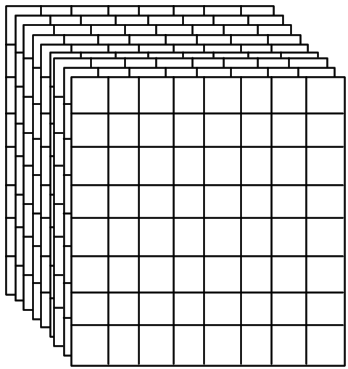
Frame Buffer
A frame buffer may be thought of as computer memory organized as a two-dimensional array with each (x, y) addressable location corresponding to one pixel.
Bit Planes or Bit Depth is the number of bits corresponding to each pixel.
A typical frame buffer resolution might be
640 x 480 x 8
1280 x 1024 x 8
1280 x 1024 x 24

Slide 46
Architecture of a raster-graphics system with a display processor
Peripheral
Devices
CPU
System bus
Display Processor
System
Memory
Display
Video
Controller
Display
Processor
Memory
Frame
Buffer

Slide 47
Introduction To OpenGL
OpenGL basic(core) library :-A basic library of functions is provided in OpenGL for specifying graphics primitives, attributes, geometric transformations, viewing transformations, and many other operations
Function names in the OpenGL basic library (also called the OpenGL core library) are prefixed with gl.
The component word first letter is capitalized.
  Eg:- glBegin, glClear, glCopyPixels, glPolygonMode
Symbolic constants that are used with certain functions as parameters are all in capital letters, preceded by “GL”, and component are separated by underscore.
  Eg: GL_RGB, GL_POLYGON, GL_AMBIENT_AND_DIFFUSE.

Slide 48
OpenGL Libraries
OpenGL Core library ( rendering , drawing vertices , … )
glu: OpenGL Utility library ( transforming , rotating , mathematical operations over GPU , … )
glut: OpenGL Utility Toolkit library ( multiplatform window system
interface )
Apple GL(AGL), Windows-to-OpenGL(WGL), Presentation Manager to OpenGL(PGL), GLX.

Slide 49
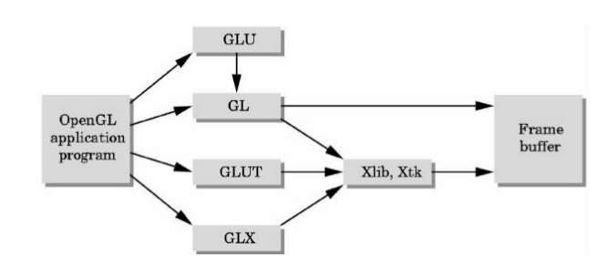
OpenGL Libraries

Slide 50
Headers Files
GLUT :
  OpenGL Utility Toolkit(GLUT)
  Headers Files
    #include <GL/gl.h>
    #include <GL/glu.h>
    The above lines can be replaced by using GLUT header file which ensures gl.h and glu.h are included correctly
    #include <GL/glut.h>
  For example :
  gl means OpenGL
    glVertex();
  glu means GLU
    gluPerspective();
  glut means GLUT
    glutCreateWindow();

Slide 51
OpenGL sample code
#include <GL/glut.h>
void display()
{
glClear(GL_COLOR_BUFFER_BIT);
glClearColor(1.0,1.0,1.0,1.0);
//gluOrtho2D(500.0,550.0,500.0,550.0);
}
    void main (int argc, char** argv)
    {
    glutInit (&argc, argv); // Initialize GLUT.
    glutInitDisplayMode (GLUT_SINGLE | GLUT_RGB); // Set display mode.
    glutInitWindowPosition (50, 100); // Set top-left display-window position.
    glutInitWindowSize (400, 300); // Set display-window width and height.
    glutCreateWindow ("An Example OpenGL Program"); // Create display window.
    //myinit ( ); // Execute initialization procedure.
    glutDisplayFunc (display); // Send graphics to display window.
    glutMainLoop ( ); // Display everything and wait.
    }

Slide 52
Step 1: initialization of GLUT
We are using the OpenGL Utility Toolkit, our first step is to initialize GLUT.
This initialization function could also process any command line arguments, but we will not need to use these parameters for our first example programs.
We perform the GLUT initialization with the statement glutInit (&argc, argv);

Slide 53
Step 2: title
We can state that a display window is to be created on the screen with a given caption for the title bar. This is accomplished with the function
glutCreateWindow ("An Example OpenGL Program");
where the single argument for this function can be any character string that we want to use for the display-window title.

Slide 54
Step 3: Specification of the display window
Then we need to specify what the display window is to contain. For this, we create a picture using OpenGL functions and pass the picture definition to the GLUT routine glutDisplayFunc, which assigns our picture to the display window.
Example: suppose we have the OpenGL code for describing a line segment in a procedure called lineSegment.
Then the following function call passes the line-segment description to the display window:
  glutDisplayFunc (lineSegment);

Slide 55
Step 4: one more GLUT function
But the display window is not yet on the screen.
We need one more GLUT function to complete the window-processing operations.
After execution of the following statement, all display windows that we have created, including their graphic content, are now activated:
  glutMainLoop ( );
This function must be the last one in our program. It displays the initial graphics and puts the program into an infinite loop that checks for input from devices such as a mouse or keyboard

Slide 56
Step 5: these parameters using additional GLUT functions
We use the glutInitWindowPosition function to give an initial location for the upper left corner of the display window.
After the display window is on the screen, we can reposition and resize it.
Example: the following command specifies that a single refresh buffer is to be used for the display window and that we want to use the color mode which uses red, green, and blue (RGB) components to select color values:
glutInitDisplayMode (GLUT_SINGLE | GLUT_RGB);

Slide 57
OpenGL Functions
Primitives
  Points
  Line Segments
  Polygons
Attributes
Transformations
  Viewing
  Modeling
Control
Input (GLUT)

Slide 58
OpenGL Function Format
function name
3 is Dimension can be 2 or 3
glVertex3f(x,y,z)
x,y,z are floats
belongs to GL library
glVertex3fv(p)
p is a pointer to an array , v is a vector

Slide 59
OpenGL Point Functions
The type within glBegin() specifies the type of the object and its value can be as follows:
  GL_POINTS
Each vertex is displayed as a point.
The size of the point would be of at least one pixel.
Unless we specify other attribute values, OpenGL primitives are displayed with a default size and color.
The default color for primitives is white, and the default point size is equal to the size of a single screen pixel

Slide 60
OpenGL Point Functions
Syntax: Case 1:
    glBegin (GL_POINTS);
    glVertex2i (50, 100);
    glVertex2i (75, 150);
    glVertex2i (100, 200);
    glEnd ( );
    Where 2 is for 2D (X,Y) and i stands for int.

Slide 61
OpenGL Point Functions
Syntax :Case 2:
we could specify the coordinate values for the preceding points in arrays such as
int point1 [ ] = {50, 100};
int point2 [ ] = {75, 150};
int point3 [ ] = {100, 200};
and call the OpenGL functions for plotting the three points as
glBegin (GL_POINTS);
glVertex2iv (point1); // v is vector and point1 is an array
glVertex2iv (point2);
glVertex2iv (point3);
glEnd ( );

Slide 62
OpenGL Point Functions
Syntax: Case 3:
specifying two point positions in a three dimensional world reference frame.
In this case, we give the coordinates as explicit floating-point values:
glBegin (GL_POINTS);
glVertex3f (-7.5, 9.7, 10.6);
glVertex3f (2.9, -5.6, 18.3);
glEnd ( );
Where 3 is for 3D(x,y,z) and f is float

Slide 63
OpenGL LINE FUNCTIONS
Primitive type is GL_LINES
Successive pairs of vertices are considered as endpoints and they are connected to form an individual line segments.
Note that successive segments usually are disconnected because the vertices are processed on a pair-wise basis.
we obtain one line segment between the first and second coordinate positions and another line segment between the third and fourth positions.
if the number of specified endpoints is odd, so the last coordinate position is ignored.

Slide 64
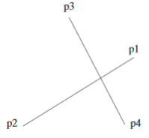
Case 1: Lines
  glBegin (GL_LINES);
    glVertex2iv (p1);
    glVertex2iv (p2);
    glVertex2iv (p3);
    glVertex2iv (p4);
    glVertex2iv (p5);
  glEnd ( );

Slide 65
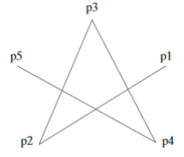
Case 2: Lines
  Successive vertices are connected using line segments. However, the final vertex is not connected to the initial vertex.
  glBegin (GL_LINES_STRIP);
    glVertex2iv (p1);
    glVertex2iv (p2);
    glVertex2iv (p3);
    glVertex2iv (p4);
    glVertex2iv (p5);
  glEnd ( );

Slide 66
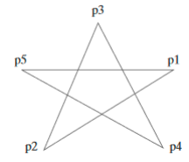
Case 3: Lines
  Successive vertices are connected using line segments to form a closed path or loop i.e., final vertex is connected to the initial vertex.
  glBegin (GL_LINES_LOOP);
  glVertex2iv (p1);
  glVertex2iv (p2);
  glVertex2iv (p3);
  glVertex2iv (p4);
  glVertex2iv (p5);
  glEnd ( );

Slide 67
OpenGL Primitives Types
GL_POINTS
GL_LINES
GL_LINE_STRIP
GL_LINE_LOOP
GL_POLYGON
GL_TRIANGLE_STRIP
GL_TRIANGLES
GL_TRIANGLE_FAN
GL_QUAD_STRIP

Slide 68
Line Drawing Algorithms
A line in Computer graphics is a portion of straight line that extends indefinitely in opposite direction.
It is defined by its two end points.
Its density should be independent of line length.
the slope intercept equation for a line:
y = mx + b (1)
where, m = Slope of the line
b = the y intercept of a line

Slide 69
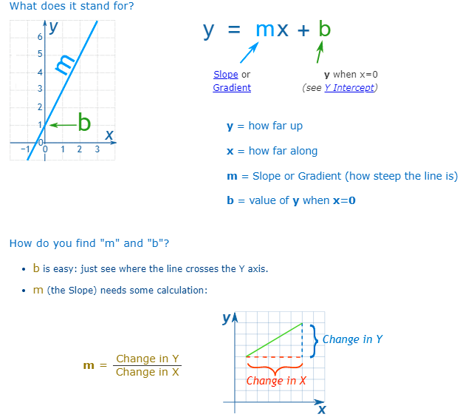

Slide 70
The two endpoints of a line segment are specified at positions (x0,y0) and (x1,y1).
We can determine the value for slope m & b intercept as
m = y2-y1/x2-x1
i.e. m= Δy/ Δx - (2)
y
P2(x1,y1)
P1(x0,y0)
b
0
x

Slide 71
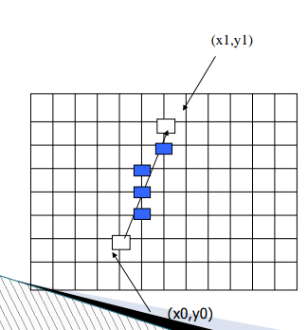
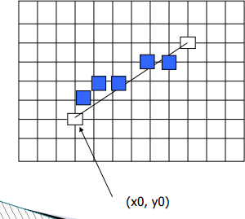
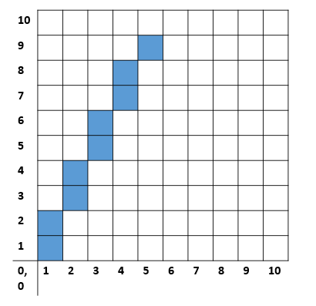
Plotting of pixels

Slide 72
Digital Differential Analyzer (DDA)
Line Drawing Algorithm
The Digital differential analyzer (DDA) algorithm is an incremental scan-conversion method.
Such an approach is characterized by performing calculations at each step using results from the preceding step.
Given the starting and ending coordinates of a line,
DDA Algorithm attempts to generate the points between the starting and ending coordinates.

Slide 73
DDA Algorithm
int round (const float a)
{
return int (a + 0.5);
}
void lineDDA (int x0, int y0, int xEnd, int yEnd)
{
int dx = xEnd - x0, dy = yEnd - y0, steps, k;
float xIncrement, yIncrement, x = x0, y = y0;
if (fabs (dx) > fabs (dy))
{
steps = fabs (dx);
else
steps = fabs (dy);
}
xIncrement = float (dx) / float (steps);
yIncrement = float (dy) / float (steps);
setPixel (round (x), round (y));
for (k = 0; k < steps; k++)
{
x += xIncrement;
y += yIncrement;
setPixel (round (x), round (y));
}
}

Slide 74
DDA Algorithm
Given-
  Starting coordinates = (X₀, Y₀)
  Ending coordinates = (X_{n}, Y_{n})
The points generation using DDA Algorithm involves the following steps:
Step-01:
Calculate ΔX, ΔY and M from the given input.
  These parameters are calculated as-
    ΔX = X_{n} – X₀
    ΔY =Y_{n} – Y₀
  M = ΔY / ΔX

Slide 75
DDA algorithm
Step-02:
Find the number of steps or points in between the starting and ending coordinates.
if (absolute (ΔX) > absolute (ΔY))
Steps = absolute (ΔX);
else
Steps = absolute (ΔY);

Slide 76
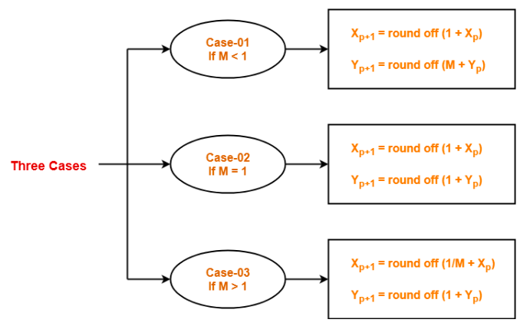
DDA algorithm
Step-03:
Suppose the current point is (X_{p}, Y_{p}) and the next point is (X_{p+1}, Y_{p+1}).
Find the next point by following the below three cases-
Step-04:
Keep repeating Step-03 until the end point is reached or the number of generated new points (including the starting and ending points) equals to the steps count.

Slide 77
1) Calculate the points between the starting point
(5, 6) and ending point (8, 12).
Given-
  Starting coordinates = (X₀, Y₀) = (5, 6)
  Ending coordinates = (X_{n}, Y_{n}) = (8, 12)
Step-01:
Calculate ΔX, ΔY and M from the given input.
  ΔX = X_{n} – X₀ = 8 – 5 = 3
  ΔY =Y_{n} – Y₀ = 12 – 6 = 6
  M = ΔY / ΔX = 6 / 3 = 2

Slide 78
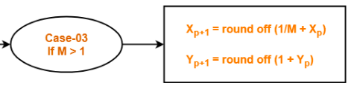
Step-02:
Calculate the number of steps.
  as |ΔX| < |ΔY| = 3 < 6,
  so number of steps = ΔY = 6
Step-03:
As M > 1, so case-03 is satisfied.
Now, Step-03 is executed until Step-04 is satisfied.

Slide 79
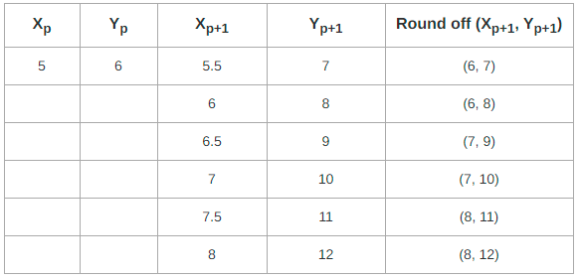

  M = ΔY / ΔX = 6 / 3 = 2

Slide 80
2) Calculate the points between the starting point
(1, 7) and ending point (11, 17).
Given:
  Starting coordinates = (X₀, Y₀) = (1, 7)
  Ending coordinates = (X_{n}, Y_{n}) = (11, 17)
Step-01:
Calculate ΔX, ΔY and M from the given input.
  ΔX = X_{n} – X₀ = 11 – 1 = 10
  ΔY =Y_{n} – Y₀ = 17 – 7 = 10
  M = ΔY / ΔX = 10 / 10 = 1

Slide 81

Step-02:
Calculate the number of steps.
As |ΔX| = |ΔY| = 10 = 10, so number of steps = ΔX = ΔY = 10
Step-03:
As M = 1, so case-02 is satisfied.
Now, Step-03 is executed until Step-04 is satisfied.

Slide 82


  M = ΔY / ΔX = 10 / 10 = 1

Slide 83
3) Calculate the points between the starting point
(5, 6) and ending point (13, 10).
Given-
  Starting coordinates = (X₀, Y₀) = (5, 6)
  Ending coordinates = (X_{n}, Y_{n}) = (13, 10)
Step-01:
  Calculate ΔX, ΔY and M from the given input.
  ΔX = X_{n} – X₀ = 13 – 5 = 8
  ΔY =Y_{n} – Y₀ = 10 – 6 = 4
  M = ΔY / ΔX = 4 / 8 = 0.50

Slide 84

Step-02:
  Calculate the number of steps.
  As |ΔX| > |ΔY| = 8 > 4, so number of steps = ΔX = 8
Step-03:
  As M < 1, so case-01 is satisfied.
  Now, Step-03 is executed until Step-04 is satisfied.

Slide 85


  M = ΔY / ΔX = 4 / 8 = 0.50

Slide 86
DDA Algorithm
Advantages of DDA Algorithm-
It is a simple algorithm.
It is easy to implement.
It avoids using the multiplication operation which is costly in terms of time complexity.
Disadvantages of DDA Algorithm-
There is an extra overhead of using round off( ) function.
Using round off( ) function increases time complexity of the algorithm.
Resulted lines are not smooth because of round off( ) function.
The points generated by this algorithm are not accurate.

Slide 87
Bresenham’s Line-Drawing Algorithm
Accurate and efficient
Uses only incremental integer calculations
The method is described for a line segment with a positive slope less than one
The method generalizes to line segments of other slopes by considering the symmetry between the various octants and quadrants of the xy plane

Slide 88
Bresenham’s Line-Drawing Algorithm
Decide what is the next pixel position
  (11,11) or (11,12)
13
Specified
line path
12
11
10
10
11
12
13

Slide 89
Bresenham’s Line-Drawing Algorithm
y_{k+3}
For the pixel position x_{k+1}=x_{k}+1, which one we should choose:
(x_{k+1},y_{k}) or (x_{k+1}, y_{k+1})
y_{k+2}
y=mx+b
y_{k+1}
y_{k}
x_{k}
x_{k+1}
x_{k+2}
x_{k+3}

Slide 90
Bresenham’s Approach
y=m(x_{k} + 1)+b
d_{lower}=y-y_{k}
=m(x_{k} + 1)+b-y_{k}
d_{upper}=(y_{k}+1)-y
= y_{k}+1 -m(x_{k} + 1)-b
y_{k+1}
d_{upper}
y
d_{lower}
y_{k}
x_{k+1}
d_{lower}- d_{upper}= 2m(x_{k} + 1)-2y_{k}+2b-1
Rearrange it to have integer calculations:
  m=Δy/Δx
  Decision parameter: p_{k}= Δx(d_{lower}- d_{upper})=2Δy.x_{k} - 2Δx. y_{k} + c

Slide 91
Bresenham’s Line-Drawing Algorithm for slope |m| < 1.0
Procedure :
Given-
Starting coordinates = (X₀, Y₀)
Ending coordinates = (X_{n}, Y_{n})
The points generation using Bresenham Line Drawing Algorithm involves the following steps-
Step-01:
Calculate ΔX and ΔY from the given input.
These parameters are calculated as-
ΔX = X_{n} – X₀
ΔY =Y_{n} – Y₀

Slide 92

Step-02: Calculate the decision parameter P_{k}.
It is calculated as : P_{k} = 2ΔY – ΔX
Step-03:
Suppose the current point is (X_{k}, Y_{k}) and the next point is (X_{k+1}, Y_{k+1}).
Find the next point depending on the value of decision parameter P_{k}.
Follow the below two cases-
Step-04:
Keep repeating Step-03 until the end point is reached or number of iterations equals to (ΔX-1) times.

Slide 93
Example 1 : Calculate the points between the starting coordinates (9, 18) and ending coordinates (14, 22).
Solution-
Given-
Starting coordinates = (X₀, Y₀) = (9, 18)
Ending coordinates = (X_{n}, Y_{n}) = (14, 22)
Step-01:
Calculate ΔX and ΔY from the given input.
ΔX = X_{n} – X₀ = 14 – 9 = 5
ΔY =Y_{n} – Y₀ = 22 – 18 = 4

Slide 94

Step-02:
Calculate the decision parameter.
P_{k} = 2ΔY – ΔX
= 2 x 4 – 5
= 3
So, decision parameter P_{k} = 3
Step-03:
As P_{k} >= 0, so case-02 is satisfied.
Thus,
P_{k+1} = P_{k} + 2ΔY – 2ΔX = 3 + (2 x 4) – (2 x 5) = 1
X_{k+1} = X_{k} + 1 = 9 + 1 = 10
Y_{k+1} = Y_{k} + 1 = 18 + 1 = 19
Similarly, Step-03 is executed until the end point is reached or number of iterations equals to 4 times.
(Number of iterations = ΔX – 1 = 5 – 1 = 4)

Slide 95



Slide 96
Example 2 :Calculate the points between the starting coordinates (20, 10) and ending coordinates (30, 18).
Draw the line with endpoints (20,10) and (30, 18).
  Δx=30-20=10, Δy=18-10=8,
  p₀ = 2Δy – Δx=16-10=6
  2Δy=16, and 2Δy - 2Δx=-4
Plot the initial position at (20,10), then

Slide 97


Slide 98
Bresenham’s Line-Drawing Algorithm for slope |m| >1.0
Note:
If |m|>1.0 Then
p0 = 2∆x −∆y and
If pk < 0, the next point to plot is (xk , yk +1) and
p_{k+1} = p_{k} + 2∆x
Otherwise, the next point to plot is (xk + 1, yk + 1) and
p_{k+1} = p_{k} + 2∆x − 2∆y

Slide 99
Bresenham's Line-Drawing Algorithm for slope |m| < 1.0
Input the twoline endpoints and store the left endpoint in (x₀ ,y₀).
Load (x₀ ,y₀) into the frame buffer; that is, plot the first point.
Calculate constants Δx, Δy, 2Δy, and 2Δy - 2Δx, and obtain the starting value for the decision parameter as
p₀=2 Δy - Δx
4. At each x_{k} along the line, starting at k = 0, perform the following test:
If p_{k} < 0, the next point to plot is (x_{k+1}, y_{k}) and
p_{k+1}=p_{k} + 2Δy
Otherwise, the next point to plot is (x_{k+1}, y_{k+1}) and
p_{k+1}=p_{k} + 2Δy - 2Δx
5. Repeat step 4 Δx -1 times.

Slide 100
Pseudocode: Bresenham line-drawing procedure for |m| < 1.0.
void lineBres (int x0, int y0, int xEnd, int yEnd)
{
int dx = fabs (xEnd - x0), dy = fabs(yEnd - y0);
int x, y, p = 2 * dy - dx;
int twoDy = 2 * dy, twoDyMinusDx = 2 * (dy - dx);
/* Determine which endpoint to use as start position. */
if (x0 > xEnd) {
x = xEnd; y = yEnd; xEnd = x0;
}
else {
x = x0; y = y0;
}
setPixel (x, y);
while (x < xEnd) {
x++;
if (p < 0)
p += twoDy;
else {
y++;
p += twoDyMinusDx;
}
setPixel (x, y);
}
}

Slide 101
Advantages of Bresenham Line Drawing Algorithm-
It is easy to implement.
It is fast and incremental.
It executes fast but less faster than DDA Algorithm.
The points generated by this algorithm are more accurate than DDA Algorithm.
Disadvantages of Bresenham Line Drawing Algorithm-
Though it improves the accuracy of generated points but still the resulted line is not smooth.
This algorithm is for the basic line drawing.
It can not handle diminishing jaggies.

Slide 102

Properties of a Circle
A circle is defined as the set of points that are all at a given distance r from a center position (x_{c} , y_{c} ).
For any circle point (x, y), this distance relationship is expressed by the Pythagorean theorem in Cartesian coordinates as
We could use this equation to calculate the position of points on a circle circumference by stepping along the x axis
One problem with this approach is that it involves considerable computation at each step. Moreover, the spacing between plotted pixel positions is not uniform.
Expressing the circle equation in parametric polar form yields the pair of equations

Slide 103

Midpoint Circle Algorithm
Midpoint circle algorithm generates all points on a circle centered at the origin by incrementing all the way around circle.
The strategy is to select which of 2 pixels is closer to the circle by evaluating a function at the midpoint between the 2 pixels.
To apply the midpoint method, we define a circle function as
To summarize, the relative position of any point (x, y) can be determined by checking the sign of the circle function as follows

Slide 104



Midpoint Circle Algorithm
Circle Symmetry
Calculation of a circle point(x,y) in one octant yields the circle point shown for other seven octants

Slide 105
Midpoint Circle Algorithm
Input radius r and circle center (x_{c} , y_{c} ), then set the coordinates for the first point on the circumference of a circle centered on the origin as
(x0, y0) = (0, r )
Calculate the initial value of the decision parameter as
p0 = 1-r
3. At each x_{k} position, starting at k = 0, perform the following test:
If p_{k} <0, the next point along the circle centered on (0, 0) is (x_{k}+1, yk ) and
p_{k+1} = p_{k} + 2x_{k+1} + 1
Otherwise, the next point along the circle is (x_{k} + 1, y_{k} − 1) and
p_{k+1} = p_{k} + 2x_{k+1} + 1 – 2y_{k+1}
(where 2x_{k}+1 = 2x_{k} + 2 and 2y_{k}+1= 2y_{k} − 2.)
4. Determine symmetry points in the other seven octants.
5. Move each calculated pixel position (x, y) onto the circular path centered at (x_{c} , y_{c} ) and plot the coordinate values as follows:
x = x + x_{c} , y = y + y_{c}
6. Repeat steps 3 through 5 until x ≥ y.

Slide 106
Midpoint Circle Algorithm
Procedure-
Given-
Centre point of Circle = (X₀, Y₀)
Radius of Circle = R
The points generation using Mid Point Circle Drawing Algorithm involves the following steps-
Step-01:
Assign the starting point coordinates (X₀, Y₀) as-
X₀ = 0
Y₀ = R
Step-02:
Calculate the value of initial decision parameter P₀ as-
P₀ = 1 – R

Slide 107

Step-03:
Suppose the current point is (X_{k}, Y_{k}) and the next point is (X_{k+1}, Y_{k+1}).
Find the next point of the first octant depending on the value of decision parameter P_{k}.
Follow the below two cases-

Slide 108
Step-04:
If the given centre point (X₀, Y₀) is not (0, 0), then do the following and plot the point-
X_{plot} = X_{c} + X₀
Y_{plot} = Y_{c} + Y₀
Here, (X_{c}, Y_{c}) denotes the current value of X and Y coordinates.
Step-05:
Keep repeating Step-03 and Step-04 until x_{k+1} >= Y_{K+1}.
Step-05 generates all the points for one octant.
To find the points for other seven octants, follow the eight symmetry property of circle.
This is depicted by the following figure-

Slide 109
Given the centre point coordinates (0, 0) and radius as 10, generate all the points to form a circle.
Solution : Given-
Centre Coordinates of Circle (X₀, Y₀) = (0, 0)
Radius of Circle = 10
Step-01:
Assign the starting point coordinates (X₀, Y₀) as-
X₀ = 0
Y₀ = R = 10
Step-02:
Calculate the value of initial decision parameter P₀ as-
P₀ = 1 – R
P₀ = 1 – 10
P₀ = -9

Slide 110

Step-03:
As P_{initial} < 0, so case - 01 is satisfied.
Thus,
X_{k+1} = X_{k} + 1 = 0 + 1 = 1
Y_{k+1} = Y_{k} = 10
P_{k+1} = P_{k} + 2 x X_{k+1} + 1 = -9 + (2 x 1) + 1 = -6
Step-04:
This step is not applicable here as the given centre
point coordinates is (0, 0).
X_{plot} = X_{c} + X₀
Y_{plot} = Y_{c} + Y₀
Step-04:
Step-03 is executed similarly until X_{k+1} >= Y_{k+1}
P_{k} | P_{k+1} | (X_{k+1}, Y_{k+1}) | 2X_{k+1} | 2Y_{k+1}
 |  | (0, 10)
-9 | -6 | (1, 10) | 2 | 20
-6 | -1 | (2, 10) | 4 | 20
-1 | 6 | (3, 10) | 6 | 20
6 | -3 | (4, 9) | 8 | 18
-3 | 8 | (5, 9) | 10 | 18
8 | 5 | (6, 8) | 12 | 16
5 | 10 | (7,7) | 14 | 14
Algorithm Terminates when (X>=Y)
These are all points for Octant-1

Slide 111
Step-03:
As P_{K+1} < 0, so case - 01
X_{k+1} = X_{k} + 1 = 1 + 1 = 2
Y_{k+1} = Y_{k} = 10
P_{k+1} = P_{k} + 2 . X_{k+1} + 1 = -6 + (2 x 2) + 1 = -1
As P_{K+1} < 0, so case - 01
X_{k+1} = X_{k} + 1 = 2 + 1 = 3
Y_{k+1} = Y_{k} = 10
P_{k+1} = P_{k} + 2 . X_{k+1} + 1 = - 1 + (2 x 3) + 1 = 6
As P_{K+1} > 0, so case - 02
X_{k+1} = X_{k} + 1 = 3 + 1 = 4
Y_{k+1} = Y_{k} - 1= 10-1 = 9
P_{k+1} = P_{k} - 2 . Y_{k+1} +2 . X_{k+1} +1= 6-(2.9)+(2.4 )+ 1 = -3
Step-03:
As P_{K+1} < 0, so case - 01
X_{k+1} = X_{k} + 1 = 4 + 1 = 5
Y_{k+1} = Y_{k} = 9
P_{k+1} = P_{k} + 2 . X_{k+1} + 1 = -3 + (2 x 5) + 1 = 8
As P_{K+1} > 0, so case - 02
X_{k+1} = X_{k} + 1 = 5 + 1 = 6
Y_{k+1} = Y_{k} -1 = 9-1 = 8
P_{k+1} = P_{k} - 2 . Y_{k+1} + 2 . X_{k+1} = 8- (2 x 8) +(2.6)+1 = 5
As P_{K+1} > 0, so case - 02
X_{k+1} = X_{k} + 1 = 6 + 1 = 7
Y_{k+1} = Y_{k} - 1= 8-1 = 7
P_{k+1} = P_{k} - 2 . Y_{k+1} +2 . X_{k+1} +1= 9 - (2.7)+(2.7 )+ 1 = 10

Slide 112
8 octants with (x,y) points
Octant-1 Points (X,Y) | Octant-2 Points (X,Y) | Octant-3 Points (-X, Y) | Octant-4 Points (-X,Y) | Octant-5 Points (-X,-Y) | Octant-6 Points (-X,-Y) | Octant-7 Points (X,-Y) | Octant-8 Points (X,-Y)
(0, 10) | (7,7) | (0, 10) | (-7,7) | (0, -10) | (-7,-7) | (0, -10) | (7,-7)
(1, 10) | (8, 6) | (-1, 10) | (-8, 6) | (-1, -10) | (-8,- 6) | (1, -10) | (8, -6)
(2, 10) | (9, 5) | (-2, 10) | (-9, 5) | (-2, -10) | (-9, -5) | (2, -10) | (9, -5)
(3, 10) | (9, 4) | (-3, 10) | (-9, 4) | (-3,-10) | (-9, -4) | (3, -10) | (9, -4)
(4, 9) | (10, 3) | (-4, 9) | (-10, 3) | (-4, -9) | (-10,- 3) | (4, -9) | (10, -3)
(5, 9) | (10, 2) | (-5, 9) | (-10, 2) | (-5, -9) | (-10,- 2) | (5, -9) | (10, -2)
(6, 8) | (10, 1) | (-6, 8) | (-10, 1) | (-6, -8) | (-10, -1) | (6, -8) | (10, -1)
(7,7) | (10, 0) | (-7,7) | (-10, 0) | (-7,-7) | (-10, 0) | (7,-7) | (10, 0)
Eight-way Symmetry

Slide 113



Slide 114
Pseudocode: midpoint circle algorithm
void draw_pixel(GLint cx, GLint cy)
{
glColor3f(0.5,0.5,0.0); glBegin(GL_POINTS);
glVertex2i(cx, cy);
glEnd();
}
void plotpixels(GLint h, GLint k, GLint x, GLint y)
{
draw_pixel(x+h, y+k);
draw_pixel(-x+h, y+k);
draw_pixel(x+h, -y+k);
draw_pixel(-x+h, -y+k);
draw_pixel(y+h, x+k);
draw_pixel(-y+h, x+k);
draw_pixel(y+h, -x+k);
draw_pixel(-y+h, -x+k);
}
void circle_draw(GLint xc, GLint yc, GLint r)
{
GLint d=1-r, x=0,y=r;
while(y>x)
{
plotpixels(xc, yc, x, y);
if(d<0) d+=2*x+3;
else
{
d+=2*(x-y)+5;
--y;
}
++x;
}
plotpixels(xc, yc, x, y);
}

Slide 115
Advantages of Mid Point Circle Drawing Algorithm-
The advantages of Mid Point Circle Drawing Algorithm are-
It is a powerful and efficient algorithm.
The entire algorithm is based on the simple equation of circle X² + Y² = R²
It is easy to implement from the programmer’s perspective.
This algorithm is used to generate curves on raster displays.

Slide 116
Useful websites
http://www.opengl.org/
http://math.hws.edu/graphicsbook/c3/index.html
https://www.glprogramming.com/red
https://www.javatpoint.com/computer-graphics-tutorial
https://www.gatevidyalay.com/tag/dda-algorithm-example-pdf/
https://nptel.ac.in/courses/106/106/106106090/
https://www.youtube.com/watch?v=50ddeMhzEi8
https://www.journals.elsevier.com/computers-and-graphics
https://www.computer.org/csdl/journals/tg

Slide 117
THANK YOU

