Slide 1

MODULE-3
ALTERNATIVE BUILDING MATERIALS
Subject & Subject CODE
ALTERNATIVE BUILDING MATERIALS (18CV643)
Name 0f the Faculty:
MANJUNATH B
Dept. of Civil Engg
K S School of Engg & Management

Slide 2
MODULE:3
Alternate Building Materials: Lime, Pozzolana cements, Raw materials, Manufacturing process, Properties and uses. Fibers- metal and synthetic, Properties and applications. Fiber reinforced plastics, Matrix materials, Fibers organic and synthetic, Properties and applications. Building materials from agro and industrial wastes ,Types of agro wastes, Types of industrial and mine wastes, Properties and applications. Masonry blocks using industrial wastes. Construction and demolition wastes.

Slide 3
LIME STONE
The basic raw materials for all the lime based mortars in lime stone. Lime stone is essentially calcium carbonates in nature.
Calcium being one of the fairly abundant metals on earth.
Natural lime stone is one of the purer forms of calcium carbonates occurring in nature.
Calcium carbonates is mildly soluble in water and can sometimes be leached out of water and ultimately deposited with clay as an impurity in the form of ‘Kankar’ lime stone.
There is also an organic source of lime stone in the form of shell lime which is usually available in coastal areas.

Slide 4
MANUFACTURING OF LIME
The burning of lime stone to produce quick lime (CaO) is generally carried out in vertical kiln using either fire wood or coal or fuel.
Temperature of the order 900-1000C are needed to release CO₂ from lime stone.
This 100kg of lime stone will yield 56kg of CaO.
Again when quick lime is staked, 56kg of CaO will give rise to 74kg Ca(OH)₂.
Thus 1 tone of lime stone, when burnt will give 740kg Ca(OH)₂ if there are no impurities. The proportion will be less if there is impurities.
This lime kiln is designed for small scale rural applications.
The height and dia of kiln can be adjusted to burn 0.5 to 1.0 tin of limestone.
500kg kiln will need about 45% of fine wood by weight while, 1 ton of kiln will need about 35% of fire wood by weight.

Slide 5
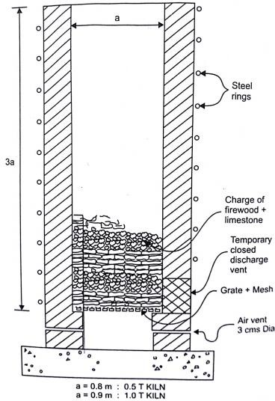
MANUFACTURING OF LIME
The figure shows the manner in which firewood and limestone are stacked in alternative layers.
The process of burning is started by igniting the lower most layer of fire mood from below.
When the fire wood catches fire, the openings at the base are to be closed leaving 2.05cm dia holes for air entry.
The half-ton plant will have 3 holes and 1 ton plant will have 4 holes. These holes will control the rate of wood burning and also will prevent entry of excess air.
The kiln must have steel rings from bottom to the top to prevent cracking of the kiln due to heat.
After the completion of burning process the quick lime (CaO) can be discharged by opening the temporary closed holes at the base.
The quick lime may now be slaked and the slaked lime is stored in suitable containers (or) bags Burning of lime stone.

Slide 6
POZZOLONA
Pozzolona is a material which consists of essentially of amorphous silica (or) a mixture of amorphous silica and alumina.
This is not cementitious by itself, but forms cementitious compound when it combines with Ca (OH)₂ at ambient temperature in the presence of moisture.
A mixture if finely ground Ca (OH)₂ and Pozzolona is known as lime Pozzolona cement.
The following sources of Pozzolona are commonly used
Powered burnt clay (commonly known as surkhi)
Fly ash
Rice husk ash

Slide 7
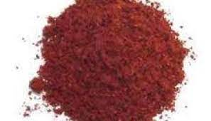
POZZOLONA: POWERED BURNT CLAY
This can be made either by artificially burning clay in a kiln (or) by wastes of burnt clay materials like brick, tiles and pottery.
When clay is burnt in a kiln for the purpose of making pozzolona, it is desirable to select a soil with a high proportion of clay.
If the clay occurs with large amount of sand, the sand may be removed by sieving to obtain high clay soil.
This is necessary since sand is a diluent and does not react lime in the manner in which the pozzolona does.

Slide 8
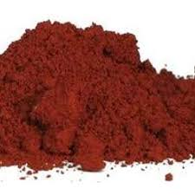
POZZOLONA: POWERED BURNT CLAY
The high clay soil may now be made in to thin briquettes.
The wet clay may be spread on level ground to a thickness of 2.5cm and these sliced into the cakes of 10cmx10cmx2.5cm.
Cakes are dried and then charged into the kiln with alternative layers of firewood.
The amount of fire wood used could be around 10% of the weight of the clay with a temperature of about 700C
The burnt clay now be pulverized to about 90µ size particles ball mills are used for this purpose.

Slide 9
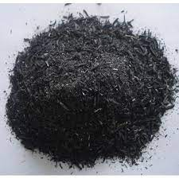
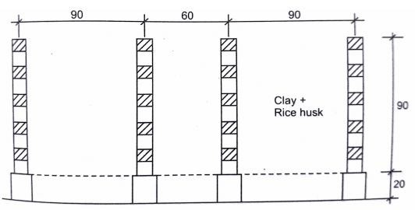
POZZOLONA: RICE HUSK ASH
Rice husk ash is a natural source of silica.
It contains 20% silica and rest of its is combustible material. This silica is amorphous and if the husk is burnt under controlled condition a high pozzolana can be produced.
The technique developed by yoganand etc burn rice husk is an annular honey comp brick as shown.

Slide 10
POZZOLONA: RICE HUSK ASH
Brick structure is created and closely spaced mesh is placed at a height of 20cm above the ground alternative layers of rice husk and clay were placed in a kiln such that husk is about 30 to 40% by weight of clay.
The width of clay layer should be about 15cm less than width of rice husk to permit easy air movement through the bed of husk.
The stack is now set fire from below. The entire mass burns over one or two days.
The end product is mixture of burnt clay and rice husk ash. This may be ground in ball mill to obtain fine pozzolona.

Slide 11
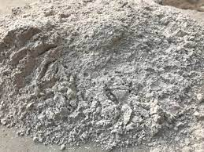
POZZOLONA: FLY ASH
This is obtained from the thermal power plant which and pulverized coal as fuel.
The exceedingly fine particles of burnt coal which are collect in electrostatic precipitation are known as fly ash.
Fly ash contains significant amount of amorphous silica and alumina.
Thermal power plant produces significant amount of coal ash in the form of pond ash and bottom ash. These types of ashes are generally not good Pozzolana.
Fly ash is a waste product and can be considered as zero thermal energy.

Slide 12
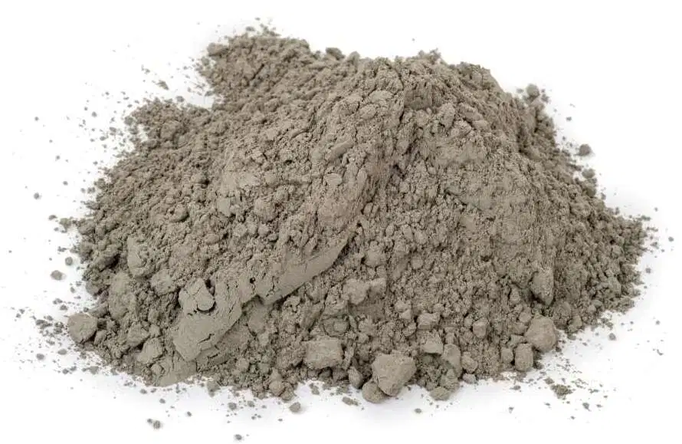
LIME POZZOLANA CEMENT
An intimate mixture of lime and Pozzolana well set in presence of water forming calcium silicate and calcium aluminate compounds.
The efficiency of the lime Pozzolana cement depends on the intimacy of the mixing of lime and Pozzolana experiments conducted by researchers showed that by integrating lime and Pozzolana power for an hour, the strength of lime Pozzolana sand mortar can be increased to double the value.

Slide 13
LIME POZZOLANA CEMENT :
Dry Blending
The slaked lime and Pozzolana should be separated processed as dry powders.
The Pozzolana may be dried and ground to fineness of 90µ.
The two powders may now be blend in a ball mill for a duration of about 1hr.
In this technique, the size reduction of lime and Pozzolana is carried out first and then the mixing of two is carried out subsequently.
This mixture is then added to sand and after through dry mixing water is added to complete the preparation of mortar.
This procedure also means that the dry mixture of lime and Pozzolana have to be stored in bags.
It was found that lime and Pozzolana mixture will lose strength rapidly on storage.

Slide 14
LIME POZZOLANA CEMENT :
Dry Blending
Storage in gunny bags or woven LDPE bags is especially bad for shelf life.
When stored in such bags the 21 days strength shows a 60% reduction after 45 days of storage wherever when stored in impervious plastics (or) paper bags the strength fall is about 35% after 45 days of store.
The residual moisture present in the lime (or) Pozzolana will initiate reaction b/w the two even when stored in dry condition.
It is important to note that the blending dry mixture of lime and Pozzolana should not be stored for more than 14 days if the strength reduction is to be less than 10%.

Slide 15
LIME POZZOLANA CEMENT :
Wet Blending
  The Pozzolana has to be produced and ground to 90µ fineness and stored in gunny (or) woven LOPE bags.
  The Pozzolana can be stored in definitely.
  Slaked lime and freshly produced by slaking quick lime at the site.
  The slaked lime and freshly produced by slaking quick lime at the site.
  The slaked lime and well ground Pozzolana may now be mixed in a simple drum (or) hand operated concrete mixer in the presence of water.
  After blending the two for 80 min the lime-Pozzolana slurry may be poured over sand mixed thoroughly to get the lime Pozzolana mortar.

Slide 16
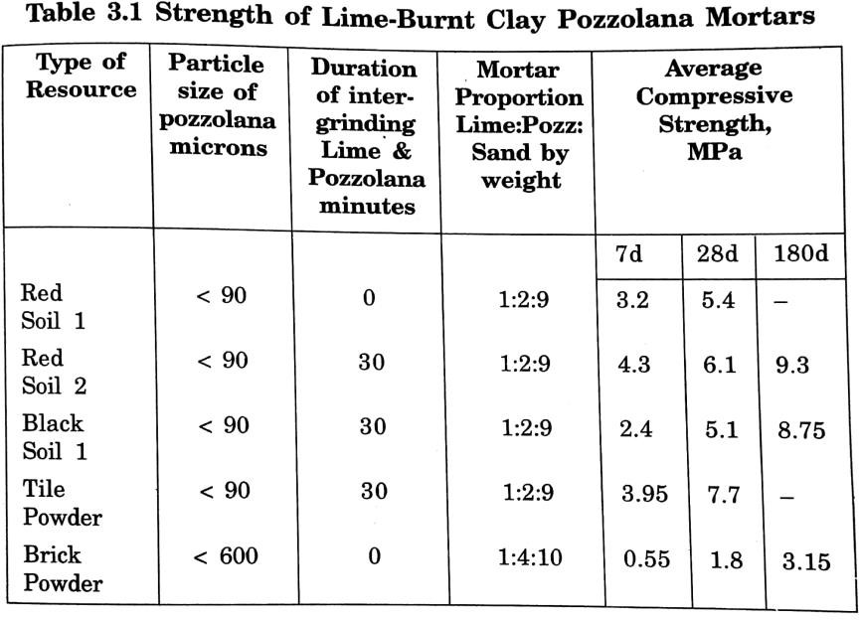
LIME POZZOLANA CEMENT :
Properties

Slide 17
LIME POZZOLANA CEMENT :
Properties
The listed proportions indicate proportion by weight. It can be seen that the 28 days strengths of most of the mortars are above the BIS codal requirement of 3.0 MPa.
It must be noted that bulk density of lime–burnt clay mixture is quite low and hence the mortar proportions by volume are quite rich when compared to the usual cement mortar proportions
This means that greater proportion of lime-pozzolona cement has to be used to achieve satisfactory mortar strengths.
It is seen that when the burnt clay and rice husk are separately produced adequate rice husk ash can be added to provide good strength.
When rice husk is used to burn the clay, the process become more economical but the strengths are moderate. It must be noted that 6 months strengths are substantially high.
A clay rice-husk ratio of 1:0:6 is ideal from the point of view of strength and economy.

Slide 18
  BUILDING MATERIALS FROM AGRO & INDUSTRIAL WASTES
Traditional housing in all civilizations has depended heavily on biomass resources including Agro wastes.
Typical examples of Agro wastes utilization may be mentioned as use of thatch for roofing, use of wattle and daub for walls and use of cow dung for flooring.
However, with increasing industrialization and urbanization use of agro wastes is becoming less common. Some attempts have been made in recent times to improve their properties.
Use of biomass resource resources like bamboo, reeds and timber, with and without treatment is however useful even now in view of their renewable nature.
The management of such resources is however fraught with difficulties as there is a tendency to overexploit forest resource.

Slide 19
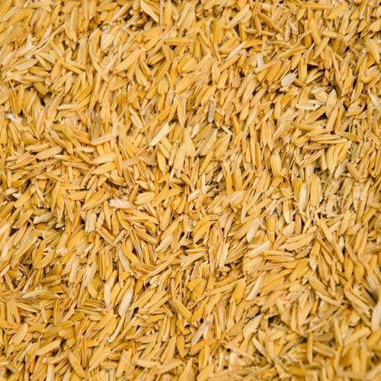
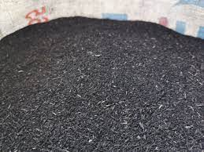
  BUILDING MATERIALS FROM AGRO & INDUSTRIAL WASTES
Some of the agro wastes with can have application in building construction may be listed as under:
Rice husk Rice Husk Ash

Slide 20
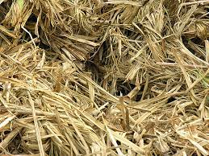
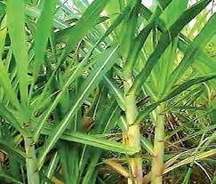
  BUILDING MATERIALS FROM AGRO & INDUSTRIAL WASTES
Some of the agro wastes with can have application in building construction may be listed as under:
3. Bagasse 4. Sugar cane tops

Slide 21
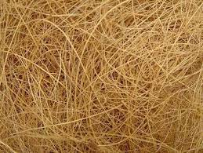
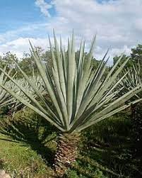
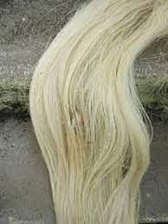
  BUILDING MATERIALS FROM AGRO & INDUSTRIAL WASTES
Some of the agro wastes with can have application in building construction may be listed as under:
5. Coir fiber 6. Sisal fiber
7. Straw
8. Coconut and Areca nut tree trunks
9. Coconut leaf

Slide 22
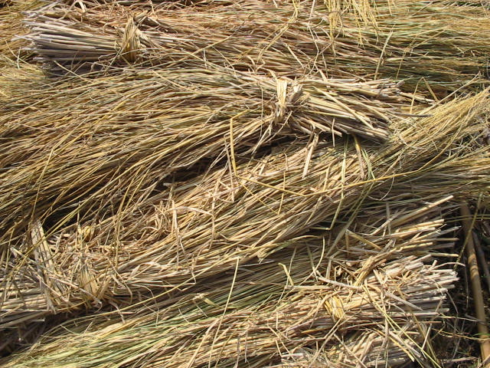
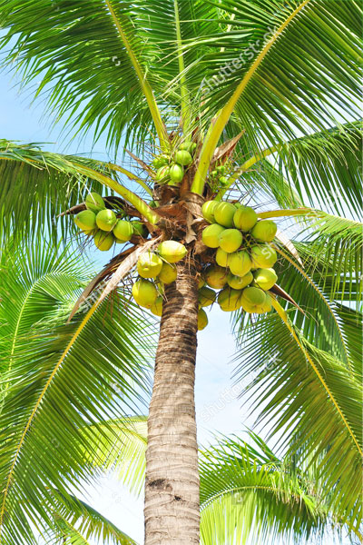
  BUILDING MATERIALS FROM AGRO & INDUSTRIAL WASTES
Some of the agro wastes with can have application in building construction may be listed as under:
7. Straw 8. Coconut and Areca nut tree trunks

Slide 23
  INDUSTRIAL WASTES
A large number of industries produce waste material which needs to be either disposed off or utilized for some purpose. Very often disposal of wastes could pose problems.
There are instances where large chunks of land are rendered useless or unavailable due to deposition of such wastes, fly ash and marble dust are two typical wastes which can pose serious disposal problem.
Some of the typical industrial wastes may be listed as under.

Slide 24
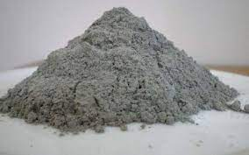
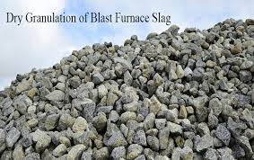
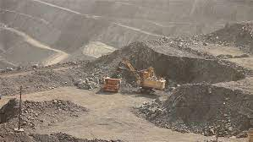
  INDUSTRIAL WASTES
Fly ash from thermal power station.
Blast furnace slag from steel plants.
Mine wastes from iron ore mines.

Slide 25
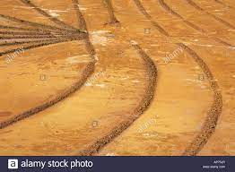
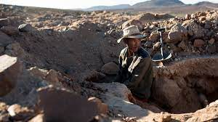
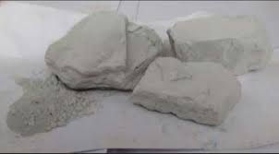
  INDUSTRIAL WASTES
Tailing from copper mines.
Fine rock dust from gold mines.
Granite polishing wastes.

Slide 26
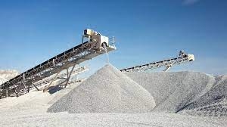
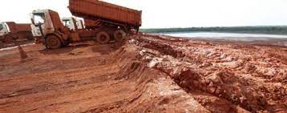
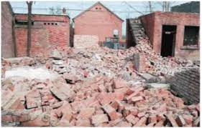
  INDUSTRIAL WASTES
Rock dust from stone crushers.
Red mud from aluminum factories.
Brick, mortar and concrete wastes from demolished building.

Slide 27
Construction & Demolished(C&D) Building Wastes
Construction and Demolition debris (C&D) is defined as all non-hazardous solid waste resulting from construction and demolition activities.
Construction and demolition (C&D) waste also defined as waste materials consist of the debris generated during the construction, renovation, and demolition of buildings, roads, and bridges.
The use of C & D wastes as recycled aggregates in concrete mixes has become more common in recent times as it conserves depletion of natural resources but also minimizes environmental pollution.

Slide 28
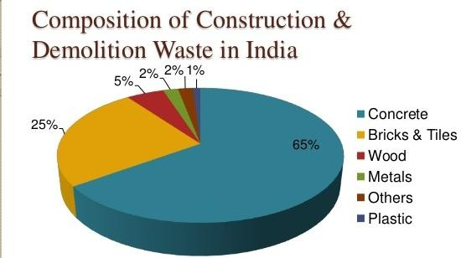
Construction & Demolished(C&D) Building Wastes
According to data published by the Building Materials and Technology Promotion Council in New Delhi in 2016, the total generation of construction and demolition (C&D) waste in India over the period 2005–2013 was 165–175 million tonnes per annum

Slide 29
Construction & Demolished(C&D) Building Wastes
Properties of C& D wastes in concrete
The workability of the recycled aggregate concrete mixes decreases, with an increase in recycled coarse aggregates replacement level.
The reduction in compressive, split tensile and flexural strength of concrete mixes is observed with increase in recycled coarse aggregates replacement level in recycled aggregate concrete mixes.
The modulus of elasticity of the recycled aggregate concrete is comparable to that of Control Mix.
The microstructural analysis reveals that recycled aggregate concrete shows pore structure compared to controlled concrete.

Slide 30
USEFUL LINKS
https://www.youtube.com/watch?v=AcngC5KH1Gk.
https://www.youtube.com/watch?v=OXJGbyRg210.
https://onlinecourses.nptel.ac.in/noc21_ce46/preview.

