Slide 1

Module 1
Introduction
Subject Name: Air Pollution and Control
Subject Code: 18CV732
Name of the Faculty: Dr Vyshali
K S School of Engineering and Management, Bangalore-560109

Slide 2
Classification of Pollutants
Natural contaminants: e.g., natural fog, pollen grains, bacteria and products of volcanic eruption
Aerosols (particulates): e.g., dust, smoke, mists, fog and fumes
3. Gases and vapours

Slide 3
Air contaminants
No | Group | Examples
1 | Sulphur compounds | SO₂, SO₃, H₂S, mercaptants
2 | Nitrogen compounds | NO, NO₂, NH₃
3 | Oxygen compounds | O₃, CO, CO₂
4 | Halogen compounds | HF, HCL
5 | Organic compounds | Aldehydes, hydrocarbons
6 | Radioactive compounds | Radioactive gases

Slide 4
1. Natural Contaminants
Among natural contaminants pollen is important because of its irritating properties.
Because of wind pollination, thousands of polen grains are liberated. While air transported pollen grains range chiefly between 10 and 50 μ in diameter.
From the point of view of pollution, air borne pollutants are significant because of the allergic responses produced in sensitive individuals. Many people suffer from asthma or hay fever.

Slide 5
2. Aerosols:
Aerosols refer to the dispersion of solid or liquid particles of microscopic size in gaseous media, such as dust, smoke or mist.
An aerosol can also be defined as a colloidal system in which the dispersion medium is a gas and the dispersed phase is solid or liquid.
The term aerosol is used during the time it is suspended in the air. After it has settled either by benefit of its weight, by accumulation, or by impact on a solid or liquid surface, the term no longer applies. Thus, particulate matter is an air pollutant only when it is an aerosol.
Aerosols differ widely in terms of particulate size, particulate density and their importance as pollutants. Their diameter generally ranges from 0.1μ.

Slide 6
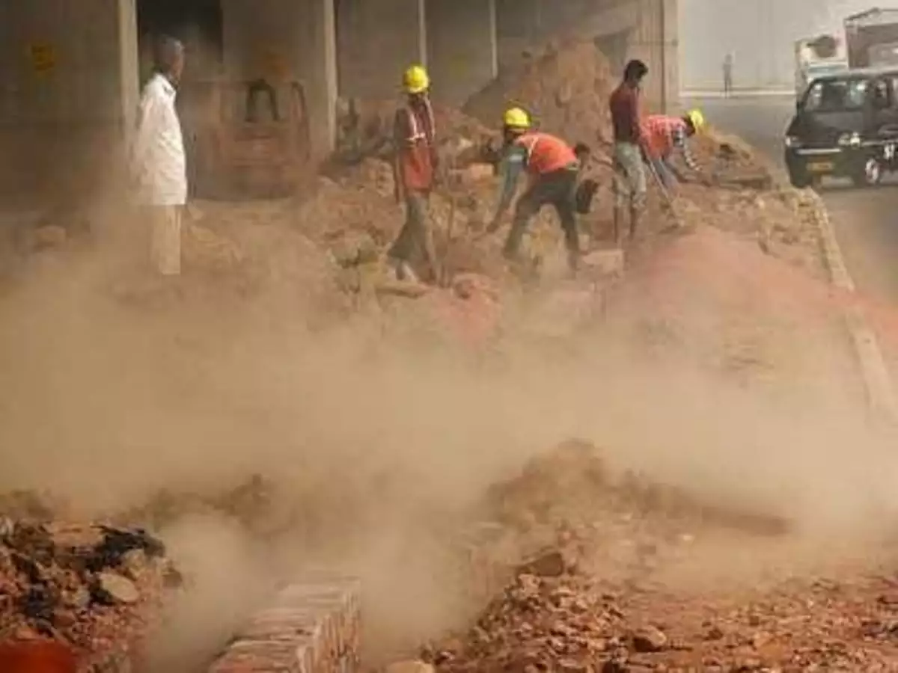
1. Dust
Dust is made up of solid particles predominantly larger than those found in colloids and capable of temporary suspension in air or other gases.
They do not tend to flocculate except under electrostatic forces: they also do not diffuse but settle under the influence of gravity.
Dust is produced by the crushing, grinding of organic and inorganic materials. They are over 20 μ in diameter.
Most of the dust particles settle to the ground as dust fall, but particles 5μ or smaller tend to form stable suspensions.

Slide 7
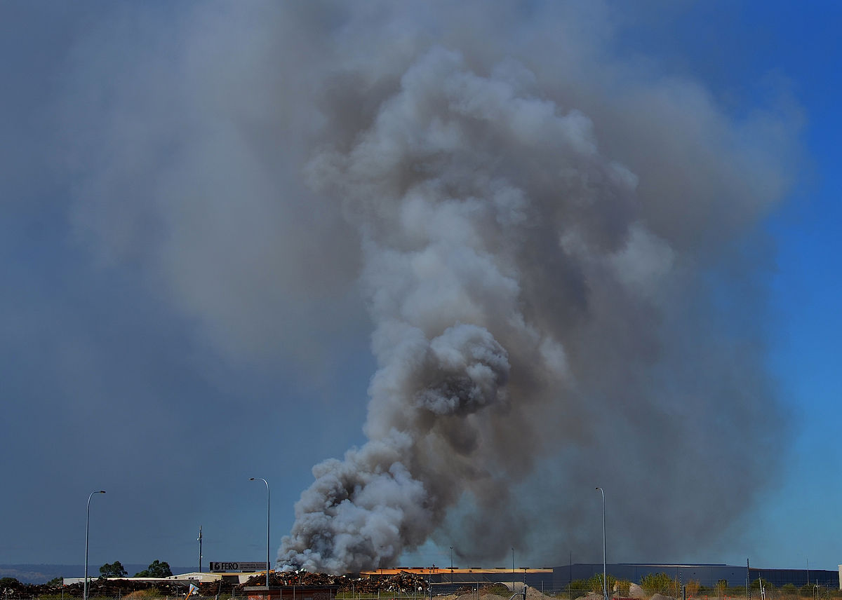
b. Smoke:
Smoke consists of finely divided particles produced by incomplete combustion.
It consists predominantly of carbon particles and other combustible materials. Generally, the size of the particles is less than 1µ.

Slide 8
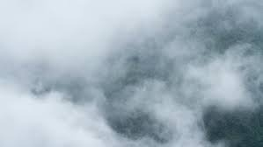
c. Mist
Mist refers to a low concentration dispersion of liquid particles of large size.
In meteorology, it means a light dispersion of minute water droplets suspended in the atmosphere.
Natural mist particles formed from water vapour in the atmosphere are rather large, ranging from 500-40µ n size. The particles may coalesce.

Slide 9
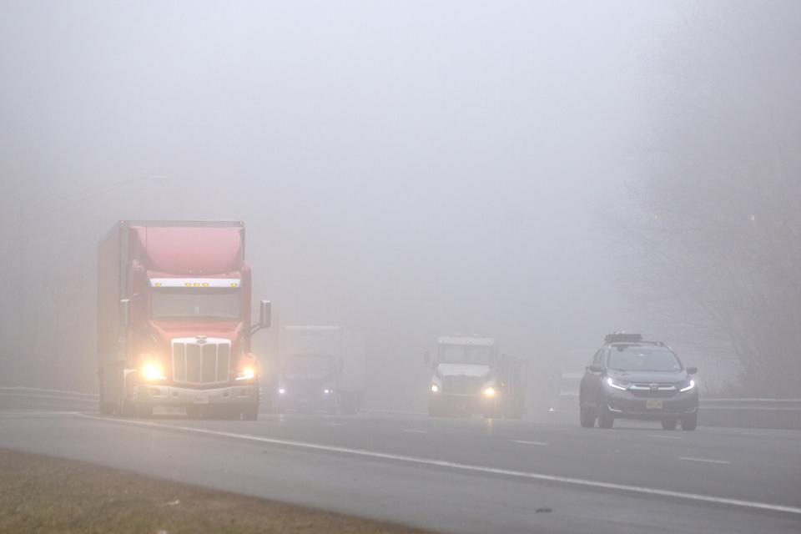
d) Fog:
Fog refers to visible aerosols in which the dispersed phase is liquid. Formation by condensation is usually implied.
Formation by condensation is usually implied. In meteorology, it refers to dispersion of water or ice in the atmosphere near the earth’s surface reducing visibility less than half kilometer.
In natural fog the size of the particles ranges from 40-1µ.

Slide 10
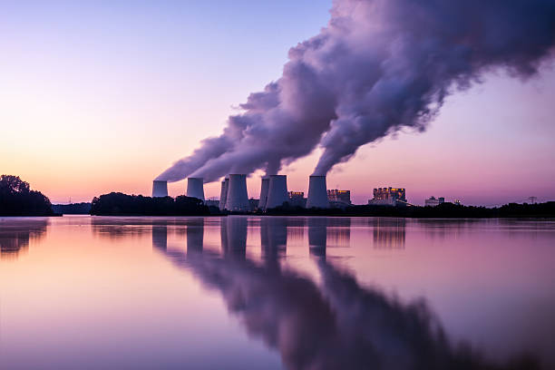
e. Fumes
These are solid particles generated by condensation from the gaseous state, generally after volatilization from melted substances, and often accompanied by a chemical reaction such as oxidation.
Fumes flocculate and sometimes coalesce.

Slide 11
f. Gases
1. Sulphur Dioxide
This is one of the principal constituents of air pollutants. The main source of SO₂ is the combustion of fuels, especially coal.
Its concentration in the atmosphere depends upon the sulphur content of the fuel used for heating and power generation.
The sulphur content of fuels varies from less than 1% for good quality anthracite to over 4% for bituminous coal.
During the smelting of many ores like zinc, copper and lead, sulphur dioxide is evolved in stack concentrations of 5-10% (SO₂).
But this can be recovered in the form of sulphuric acid. Among the miscellaneous operations releasing sulphur dioxide into the atmosphere are sulphuric acid plants and paper manufacturing plants. The quantities are usually low and therefore easily amenable to control measures. The open burning of refuse and municipal incinerators also contribute some amount of sulphur dioxide to the atmosphere.

Slide 12
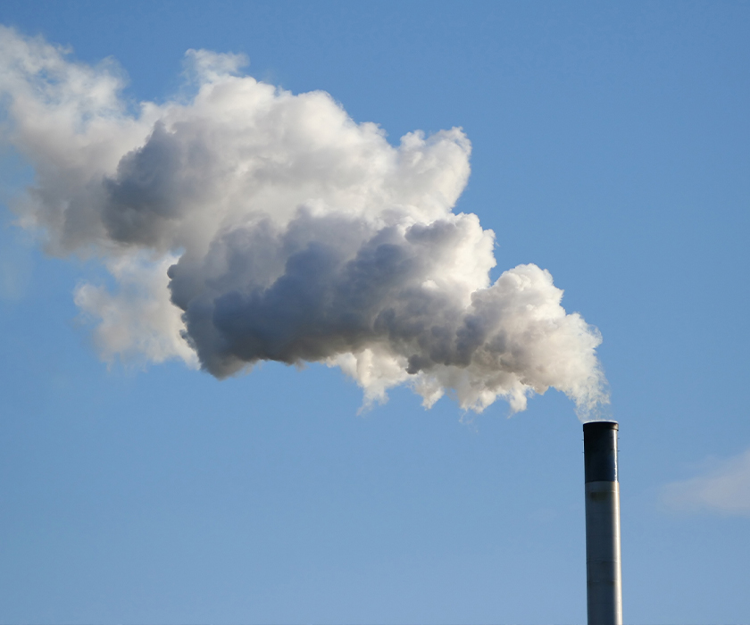

Slide 13
Hydrogen Sulphide (H₂S)
H₂S is a foul-smelling gas.
The sources of its natural emission include anaerobic biological decay processes on land, in marshes and in oceans.
Volcanoes and natural water springs emit H₂S to some extent. One of the major sources of H₂S is the Kraft pulp industry, which uses a sulphide process for manufacturing paper.
The other industrial sources of H₂S are petroleum refineries, coke-oven plants, viscose rayon plants, and some chemical operations.
Other sulphur compounds that are of interest in air pollution, principally because of their strong odours, are methyl mercaptans (CH₃ SH), dimethyl sulphide (CH₃ S CH₃), dimethyl disulphide (CH₃ SS CH₃) and their higher molecular homologs. The mercaptans are emitted in mixtures of pollutants from some pulp mills, petroleum refineries, and chemical manufacturing plants.

Slide 14
iii. Hydrogen Fluoride
The major sources of fluorides are manufacture of phosphate fertilizers, the aluminium industry, brick plants, pottery, and ferro-enamel works.
Small amounts are also emitted from other metallurgical operations, such as zinc foundries and open-hearth steel furnaces.
Small amounts are also liberated in the burning of coal, which normally contains about 0.01% fluorine. Hydrogen fluoride is an important air contaminant even in extremely low concentrations of 0.001-0.1ppm by volume.
In these concentration levels, hydrogen fluoride is more important in terms of injury to vegetation and animals than in terms of injury to humans.
The high degree of toxicity of fluorine compounds renders the control of such emissions imperative for industries manufacturing aluminium and phosphate fertilizers.

Slide 15
iv. Chlorine and Hydrogen Chloride
Chlorine is found in polluted atmosphere as the element itself(chlorine), as hydrogen chloride, as chlorine-containing organic compounds such as perchloroethylene and as inorganic chlorides.
The last-mentioned compounds are solids and hence found in particulate form: the other materials mentioned are present as gases.
The most common sources of chlorine in the atmosphere are from operations in which it is manufactured or used to produce other chemicals.

Slide 16
Also, as chlorine is used in water purification plants, in sewage plants and in swimming pools, equipment failure sometimes leads to leakage of chlorine into the atmosphere.
Hydrogen chloride is evolved in numerous industrial chemical processes, but it is so easy to recover, that little reaches the atmosphere.
The main effects of chlorine and its compounds are respiratory irritation from chlorine, corrosion by hydrogen chloride, and damage to vegetation from chlorine and hydrogen chloride.

Slide 17
Oxides of Nitrogen
The highest concentration of nitrogen oxides in gaseous emissions occurs in effluents from industries where nitric acid is produced or used in chemical reactions.
The next highest concentration is in automobile exhausts. Then come effluents from large power plants, and then to a small extent those from low heat burners and furnaces.
Out of seven oxides of nitrogen (N₂O, NO, NO₂, NO₃, N₂O₃, N₂O₄, N₂O₅), only nitric oxide and nitrogen dioxide arise from many human activities and are classified as pollutants.
In atmospheric analyses, they are usually reported as total oxides of nitrogen or NO_{x}. it is a standard practice in the chemical industry to absorb and recover significant quantities of oxides of nitrogen. Ammonia and ammonium salts are not important air contaminants.

Slide 18
Carbon Monoxide
It is an odourless and colourless gas has its major origin in incomplete combustion of carbonaceous materials. It is a highly poisonous gas and is generally classified as an asphyxiant.
The chief source of CO in the atmosphere is combustion, especially due to automobile exhausts.
Certain industrial operations, such as electric and blast furnaces, gas manufacturing plants, some petroleum refining operations and coal mines are potential contributors of CO.

Slide 19
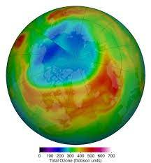
Ozone
The origin of ozone that is found in the air has not been clarified, but it is likely that combustion and sunlight are involved in its production. Ozone is poisonous and smelly.
It exists in great abundance under natural conditions in the upper atmosphere.

Slide 20
Aldehydes:
These are produced by the combustion of gasoline, diesel oil, fuel oil and natural gas. Incomplete oxidation of motor and lubricating oil leads to the formation of aldehydes.
They may also be formed in the air because of photochemical reactions. Formaldehyde is irritating to the eyes.

Slide 21
Organic Vapours:
These contaminants include a large number of chemical compounds, including paraffins, olefins, acetylenes, aromatic hydrocarbons, chlorinated hydrocarbons etc.
They are produced by combination process, household incinerators, and petroleum processes.

Slide 22
Radioactive Gases
A major source of radioactive gases and particulate are the nuclear power reactor ad related fuel handling facilities.
The other sources are experimental accelerators, testing of nuclear bombs in the atmosphere, agricultural, industrial and medical use of radioactive isotopes.

Slide 23
Source Type
Source type refers to natural and anthropogenic sources as well as to additional sub classifications within each group.
Natural sources include wind blow dust, pollen grains, sea salt nuclei, volcanic gas and ash, smoking and trace gases from forest fires. Anthropogenic sources cover a wide spectrum of types.

Slide 24
SOURCE TYPE | CATEGORY | IMPORTANT SOURCES | TYPICAL POLLUTANTS
Combustion | a) Stationary | Power plants, industrial boilers, diesel generations, municipal and industrial incineration refused | Oxides of sulphur, NOx, co, smoke fly ash, trace metal oxides.
 | b)Mobile | Motor vehicles aircraft | CO, HC‟s, NOx, SO₂, particulars
Roasting and Heating processes | a)Non-Ferrous metallurgical | Roasting, smelting and refilling operations | Dust, Smoke, metal fumes (Cu, pd, Zn) SO_{X}
 | b)Ferrous metallurgical | Materials handling are sintering & palletizing, coke owns, blast furnace, steel furnaces | Smoke, fumes, co odours, H2S2, organic vapours, fluorides
 | c) non-metallic minerals | Crushed stone, gravel sand processing, cement glass, refractories and ceramic manufactures etc., | Mineral and organic SO₂ particulates, NOx, dust fumes
Chemical petroleum | a)Petroleum refilling | Biogas, process heaters, catalyst regenerators, tractors, Store, storage | SO_{X}, HC‟s, NOx, particulate matter, CO, aldehydes,
Pulp and paper |  | tanks compressor engines | ammonia, odour
 | b) Inorganic chemicals | Sulphuric acid, plants, fertilizer, manufacture, nitric acid and ammonia plants, phosphoric acid manufacture | SO2, HF, H2S, NOx, NH3, particulate matter H3PO4, etc.

Slide 25
 | c) Organic chemicals | Plastics, paint and varnish manufacture, synthetic rubber, rayon insecticide, soap and detergent manufacture, methanol, phenol etc | Particulate matter, odours, SO2, CO, organic intermediates, product gases and vapours, solvent vapours etc.,
 | d) Pulp and paper (Kraft process) | Digester below system pulp washers, recovery furnace, evaporators, oxidation towers | Particulate matter, odours sulphur, compounds (H2S Methyne,,. Dimethyl sulphide and SO2 (sulphite process)
Food and Agriculture | a) Food processing | Drying, preserving and packaging | Vapours, odours dust
 | b) Crop spraying and dusting | Pest and weed control | Organic phosphates Chlorinated HC arsenic, lead
 | c) Field burning | Refuse burning | Smoke, Fly ash and soot

Slide 26
CLASSIFICATION AND PROPERTIES OF AIR POLLUTION
The variety of matter emitted into the atmosphere by natural and anthropogenic sources are so diverse that it is difficult to classify air pollutants neatly at easily.
However usually they are divided into two categories
Primary pollutants
Secondary pollutants

Slide 27
Primary Air Pollutants | Secondary Air Pollutants
Primary air Pollutants are those emitted directly from identifiable. | Secondary pollutants are those formed in the atmosphere by chemical reactions between primary pollutants and normal atmospheric constituents.
Typical pollutants are particulate matter such as ash, smoke, dust, fumes and mist; inorganic gases such as SO₂, H₂S, , nitric oxide, ammonia, CO, CO₂, hydrogen fluoride, olefinic and aromatic hydro carbons and also radio carbon and also radioactive components | Pollutants such as SO₃, NO₂, Peroxy acetyl nitrate (PAN), ozone, aldehydes, ketones and various sulphate and nitrate salts are included in this category.
Of the large number of primary pollutants into the present in sufficient – concentration to be of immediate concern. | Secondary pollutants are formed from the chemical and photo chemical reaction in the atmosphere.
These are 5 major types particulate matter, sulphur dioxide, oxides of nitrogen hydrocarbons. | The reaction mechanisms are influenced by concentration of reactants at pollutants, the amount of moisture contents, degree of photo activation, meteorological forces and local photography.
CO₂ is generally not considered because of its increased global concentration, its influence on the global climate patterns is of great concern.

Slide 28
Effects of Air Pollution on Human Health
Eye Irritation
Nose and throat irritation
Irritation of respiratory tract
Gases like hydrogen sulphide, ammonia ad mercaptans cause odour nuisance even at low concentrations.
Increase in mortality rate and morbidity rate.
A variety of particulates particularly pollens, initiate asthmatic attacks.
Chronic pulmonary diseases like brochitus and asthma, are aggravated by a high concentration of SO₂, NO₂, particulate matter and photochemical smog.

Slide 29
Carbon monoxide combines with the haemoglobin in the blood and consequently increases stress on those suffering from cardiovascular and pulmonary diseases.
Hydrogen fluoride causes disease of the bone (fluorosis), and mottling of teeth.
Carcinogenic agents cause cancer.
Dust particles cause respiratory diseases. Diseases like silicosis, asbestosis etc., result from specific dusts.
Certain heavy metals like lead may enter the body through the lungs and cause poisoning.

Slide 30
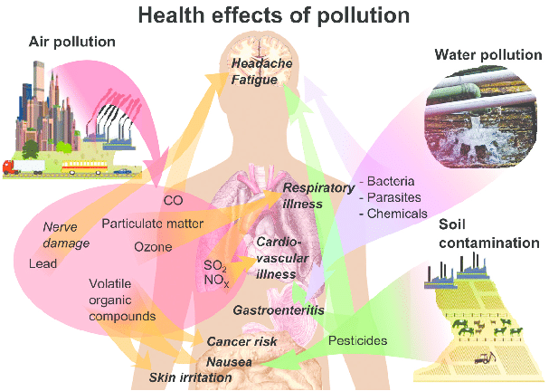

Slide 31
Air Pollutants Affecting Plants
Hydrogen cyanide
Mercury
Ethylene
PAN (peroxy acetyl nitrate)
Herbicides (sprays of weed killers)
Smog
Sulphur dioxide
Fluoride compounds (like hydrogen fluoride)
Ozone
Chlorine
Hydrogen chloride
Nitrogen oxides (NO, NO₂, etc)
Ammonia
Hydrogen sulphide

Slide 32
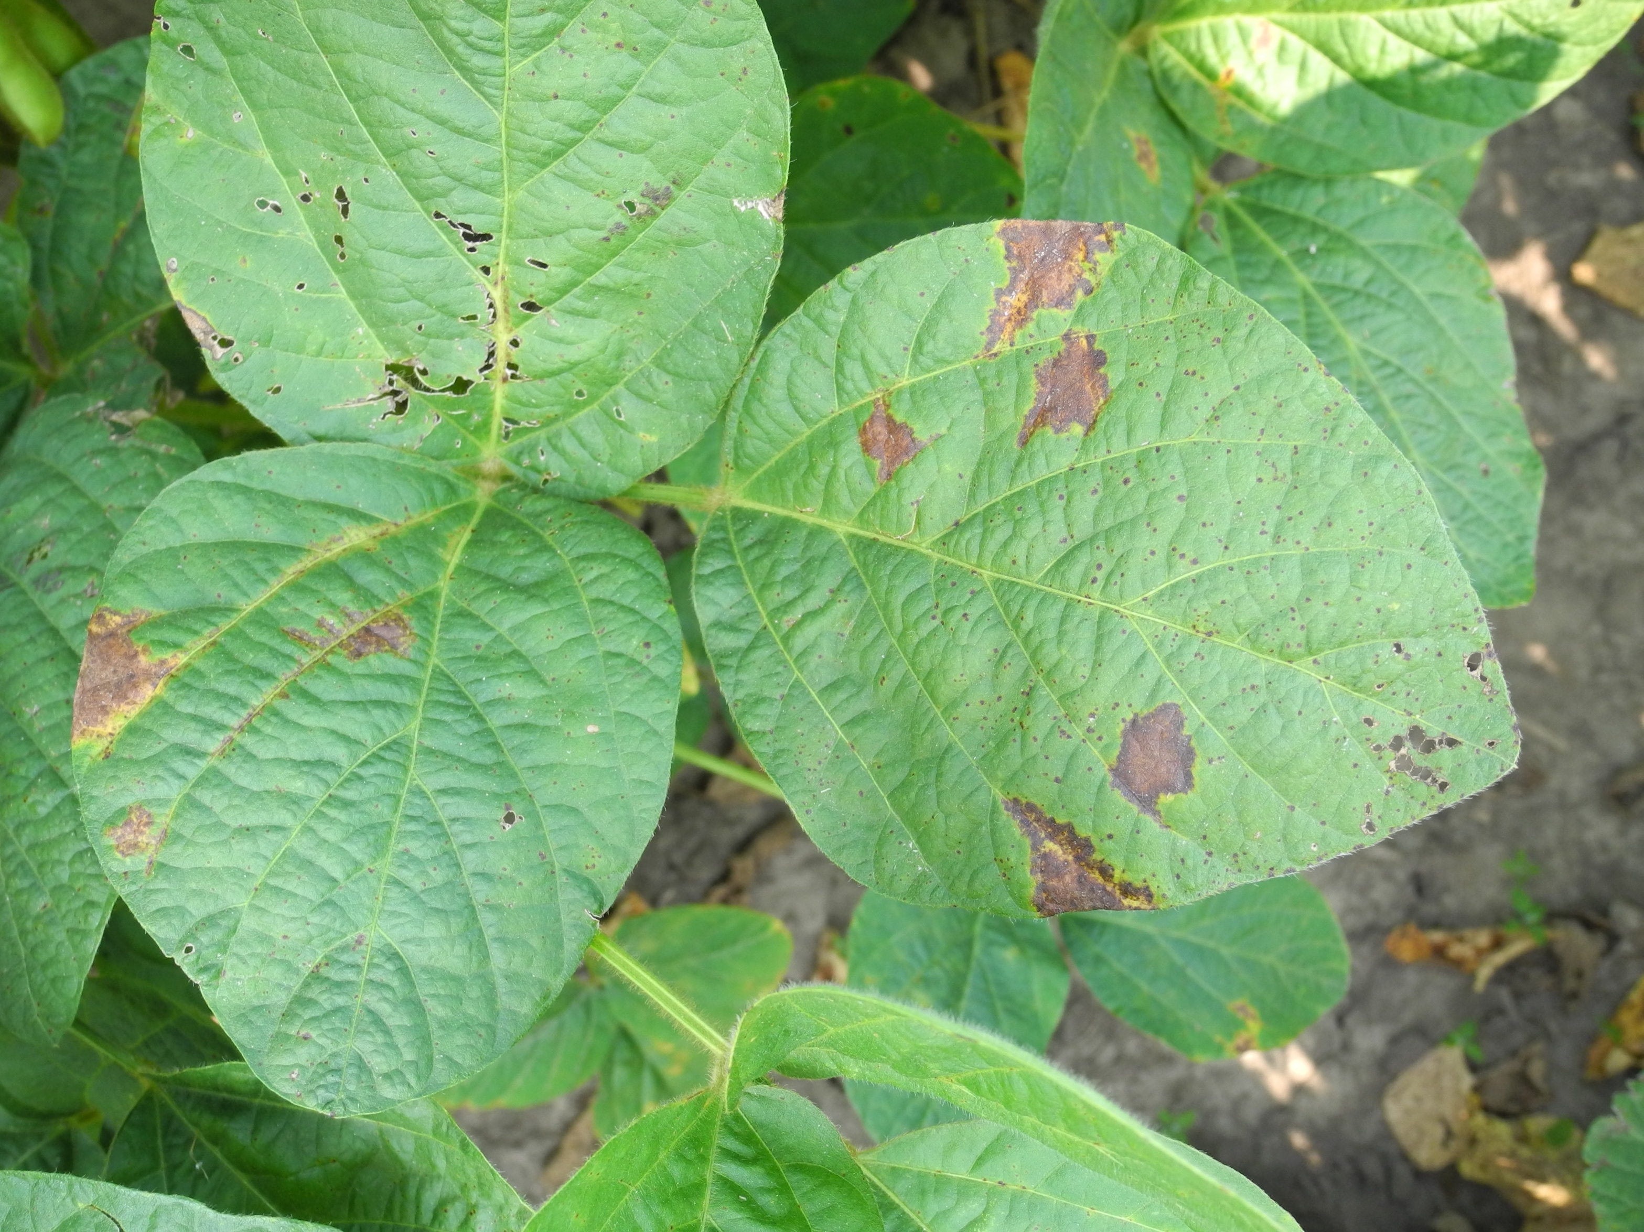
Forms of Damage of Leaves
Necrosis: Necrosis is the killing or collapse of tissues

Slide 33
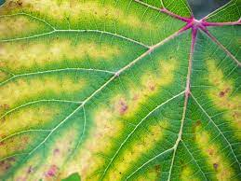
2. Chlorosis
Chlorosis is the loss or reduction of the green plant pigment, chlorophyll. The loss of chlorophyll usually results in pale green or yellow pattern. Chlorosis generally indicates a deficiency of some nutrient required by the plant. In many respects, it is analogous to anaemia in animals

Slide 34
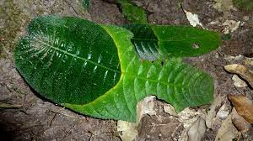
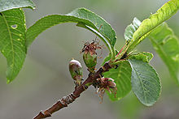
3. Abscission
Leaf abscission is dropping of leaves

Slide 35
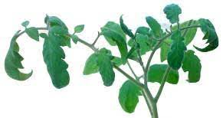
4. Epinasty
Leaf epinasty is a downward curvature of the leaf due to higher rate of growth on the upper surface.

Slide 36
Kinds of Injury to Plants
1. Acute Injury: It results from short time exposures to relatively high concentrations, such as might occur under fumigation conditions. The effects are noted within a few hours to few days and may result in visible markings on the leaves due to collapse and death of cells. This leads to narcotic patterns i.e. areas of dead tissues.
2. Chronic Injury: It results from long-term low-level exposure and usually causes Chlorosis (or) leaf abscission.
3. Growth or Yield Retardation: Here the injury is in the form of an effect on growth without visible markings [invisible injuries]. Usually, a suppression of growth or yield occur.

Slide 37
Effects on Materials
Abrasion: Solid particles of sufficient size and travelling at high velocities can cause abrasive action. Also, large sharp-edged particles imbedded in fabrics can accelerate wear.
2. Deposition and Removal: Solid and liquid particles deposited on a surface may not damage the material itself but it may spoil its appearance. The removal of these particles may cause some deterioration. Although a single washing or cleaning may not cause noticeable deterioration. Although a single washing or cleaning may not cause noticeable deterioration, frequent cleaning ultimately does.

Slide 38
3. Direct chemical attack: Some air pollutants react directly and irreversibly with materials to cause deterioration. For example, the bleaching of marble by sulphur dioxide, the tarnishing of silver by hydrogen sulphide and the etching of a metallic surface by an acid mist.
4. Indirect chemical attack: Certain materials absorb some pollutants and get damaged when the pollutants undergo chemical changes. For example, sulphur dioxide absorbed by leather is converted to sulphuric acid, which deteriorates the leather.
5. Corrosion: The atmospheric deterioration of ferrous metals is by an electrochemical process, i.c. corrosion. This is due to the action of air pollutants facilitated by the presence of moisture.

Slide 39
Factors Influencing Atmosphere Deterioration
Moisture: The presence of moisture in the atmosphere, there the process of corrosion. Without moisture in the atmosphere, there would be little atmospheric corrosion. In case of SO₂ and various particulars, the rate of corrosion of metals will increase as relative humidity in the air increases.
Temperature: Temperature affects the rate of the chemical reaction and consequently it affects the rate of deterioration.
Sunlight: In addition to producing damaging agents such as ozone, PAN through a series of complex photo chemical reactions, sunlight can cause direct deterioration of certain materials.
Air Movement: Wind direction is an important factor to be considered in places where deterioration is caused by pollutants released from nearby factories. Similarly, wind speed is also an important factor in determining the impact of air pollutants on the receiving surfaces.

Slide 40
Economic Losses: (Material Damage)
Building Materials: Building materials are corroded ad disfigured by air pollutants in a number of ways in addition to the usual weathering process. Smoke and aerosols adhere to stone, brock and other building surfaces to produce unsightly coatings.
Sulphur dioxide and sulphur trioxide in the presence of moisture can react with lime stone (CaCO₃) to form calcium sulphate (CaSO₄) and gypsum (CaSO₄, 2H₂O), both of which are soluble in water. For example: the world-famous Taj Mahal of Agra, which is constructed out of the marble.
Carbon dioxide in the presence of moisture, produces carbonic acid. This acid converts limestone in to a water-soluble bicarbonate, which is then leached away.

Slide 41
2. Paints: Paint is also affected by air pollutants. Areas of high pollution require more frequent painting. Paints contain both pigments and a vehicle. Pigments provide colour, hiding power and durability.
Air pollutants may limit both of these functions by damaging the protective coating and by exposing the underlying surface to attack. Some of the common pollutants that can cause the damage are sulphur dioxide, ozone, hydrogen sulphide and aerosols.

Slide 42
3. Textiles: Sulphur oxides cause deterioration of natural and some synthetic textile fibres. For example, cotton which is a cellulose fibre is weakened by sulphur dioxide. The most common from the permanent damage to textiles has been the deterioration of nylon hose.

Slide 43
4. Rubber: Another form of property damage which is becoming increasingly common in the USA and other countries is rubber cracking. The main affected areas are the side walls of tyres and various forms of electrical insulation. This type of damage is caused by ozone. The mechanism appears to be an attack at the double bonds in the hydrocarbon polymer compounds used in the rubber.
5. Leather: Sulphur dioxide causes leather to lose much of its strength and ultimately disintegrate. The bindings of books stored in the open in rooms with polluted air were found to deteriorate much more rapidly than those stored in confined spaces or inside glass cases.

Slide 44
6. Glass and Ceramics: Although glasses and enamels are especially resistant to the chemicals action of air pollutants, it has been observed that during a long exposure for three years, porcelain enamels showed a change in their surface appearance. Moisture and atmospheric pollution by acidic substances seems to have played a major role in surface degradation.

Slide 45
7. Electronics Industry: Particulate matter and gaseous pollutants have been constant sources of trouble to the electronics industry. Many kinds of electronic components and equipment have been damaged.
Air pollutants cause thin insulating film to develop on contacts resulting in open circuits and malfunctioning of the equipment.
Sulphur dioxide and hydrogen sulphide tarnish copper and silver contacts by producing sulphide films.
Air-borne particulate matter is deposited on high-voltage transmission line insulators. During conditions of high humidity, fog, or rain, the deposited material serves as a conductor ad results in insulator flash over.

Slide 46
INVERSION: When the reverse or negative lapse rate occurs, a dense cold stratum of air at ground level gets covered by lighter warmer air at higher level. This phenomenon is known as inversion.
Radiation inversion
This type of inversion occurs at night, when the earth loses heat by radiation and cools the air in contact with it.
It occurs when the vertical movement of air is stopped until the sun warms the lower air, next morning.
Fog forms in this type of inversion if air is moist and temperature is below the dew point.
It is common in winter due to longer nights.
It frequently occurs in valley areas because of the restriction of horizontal air movement by surrounding high ground, may frequently have such inversions.

Slide 47
2. Subsidence inversion
This type of inversion occurs at modest altitudes and remains for several days.
It is caused due to sinking of air in high pressure areas surrounded by low pressure areas.
As the air sinks, it is compressed and gets heated to form a warm dense layer that prevents upward movement of contaminants.
Inversion height varies from ground layer to a height of 1600 m.
At inversion height of 200 m, extreme pollution occurs.
If radiation and subsidence inversion occur simultaneously, the phenomenon is called "double inversion".

Slide 48
Photochemical Smog
Photochemical smog is formed due to photochemical oxidation of hydrocarbons and nitrogen oxides.
It has been found that ay the time of photochemical smog formation, there is a considerable increase in the amount of ozone and oxidant material.
The ozone is not found in appreciable amounts at night, but only during the day.
The facts clearly indicate that photochemical formation of ozone or oxidant from impurities, takes place due to the action of sunlight.

Slide 49
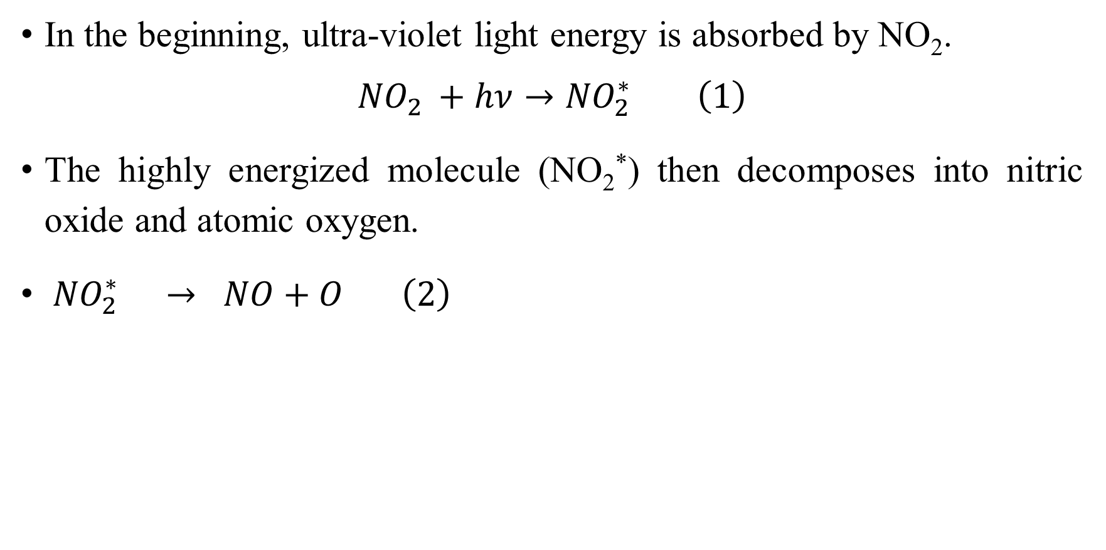
Nitrogen Dioxide Photochemical Reaction
In the beginning, ultra-violet light energy is absorbed by NO₂.
$${NO}_{2 }+hν→{NO}_{2}^{∗} \left(1\right)$$
The highly energized molecule (NO₂*) then decomposes into nitric oxide and atomic oxygen.
${ NO}_{2 }^{∗}→ NO+O \left(2\right)$

Slide 50
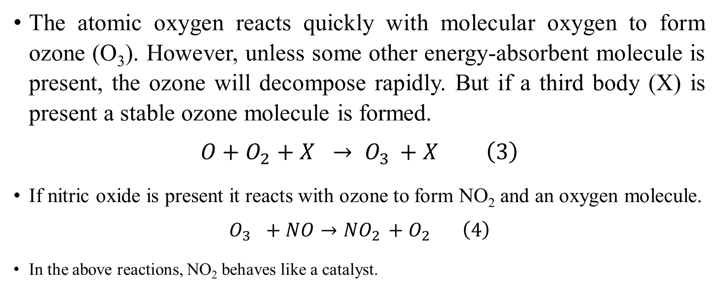
The atomic oxygen reacts quickly with molecular oxygen to form ozone (O₃). However, unless some other energy-absorbent molecule is present, the ozone will decompose rapidly. But if a third body (X) is present a stable ozone molecule is formed.
$$O+O_{2}+X → O_{3 }+X \left(3\right)$$
If nitric oxide is present it reacts with ozone to form NO₂ and an oxygen molecule.
$$O_{3 }+NO→{NO}_{2 }+O_{2} \left(4\right)$$
In the above reactions, NO₂ behaves like a catalyst.

Slide 51
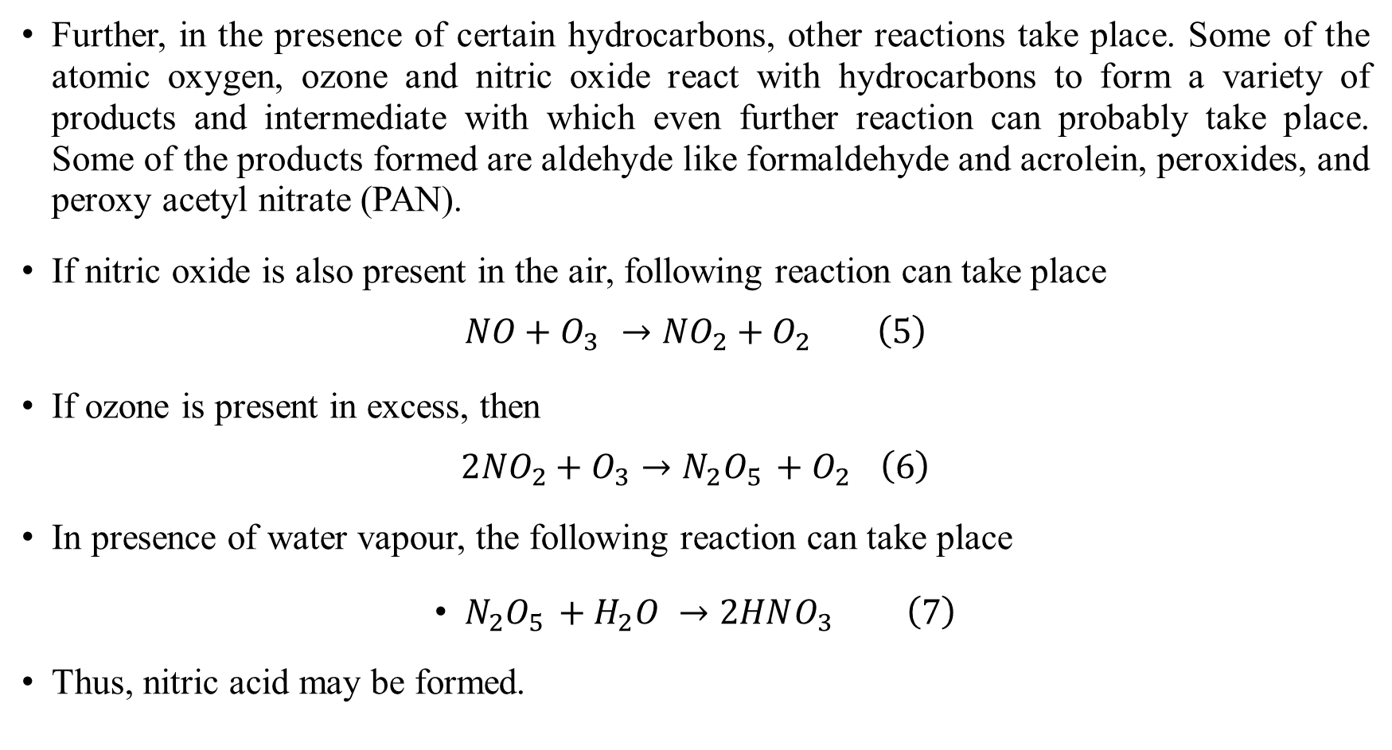
Further, in the presence of certain hydrocarbons, other reactions take place. Some of the atomic oxygen, ozone and nitric oxide react with hydrocarbons to form a variety of products and intermediate with which even further reaction can probably take place. Some of the products formed are aldehyde like formaldehyde and acrolein, peroxides, and peroxy acetyl nitrate (PAN).
If nitric oxide is also present in the air, following reaction can take place
$$NO+O_{3 }→{NO}_{2}+O_{2} \left(5\right)$$
If ozone is present in excess, then
$$2{NO}_{2}+O_{3}→N_{2}O_{5 }+O_{2 }\left(6\right)$$
In presence of water vapour, the following reaction can take place
$N_{2}O_{5 }+H_{2}O →2HNO_{3} \left(7\right)$
Thus, nitric acid may be formed.

Slide 52
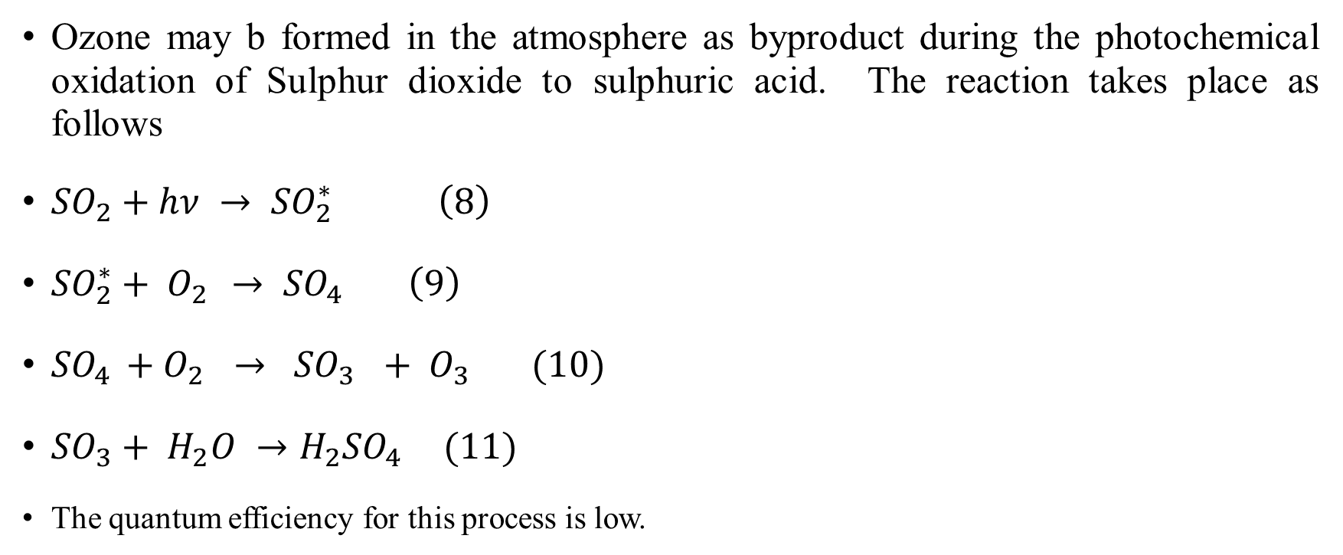
Sulphur Dioxide Photochemical Reaction
Ozone may b formed in the atmosphere as byproduct during the photochemical oxidation of Sulphur dioxide to sulphuric acid. The reaction takes place as follows
${SO}_{2}+hν → {SO}_{2 }^{∗}\left(8\right)$
${SO}_{2}^{∗}+ O_{2 }→ {SO}_{4 } \left(9\right)$
${SO}_{4 }+O_{2 }→ {SO}_{3 }+ O_{3 } (10)$
${SO}_{3}+ H_{2}O →H_{2}{SO}_{4 } (11)$
The quantum efficiency for this process is low.

Slide 53
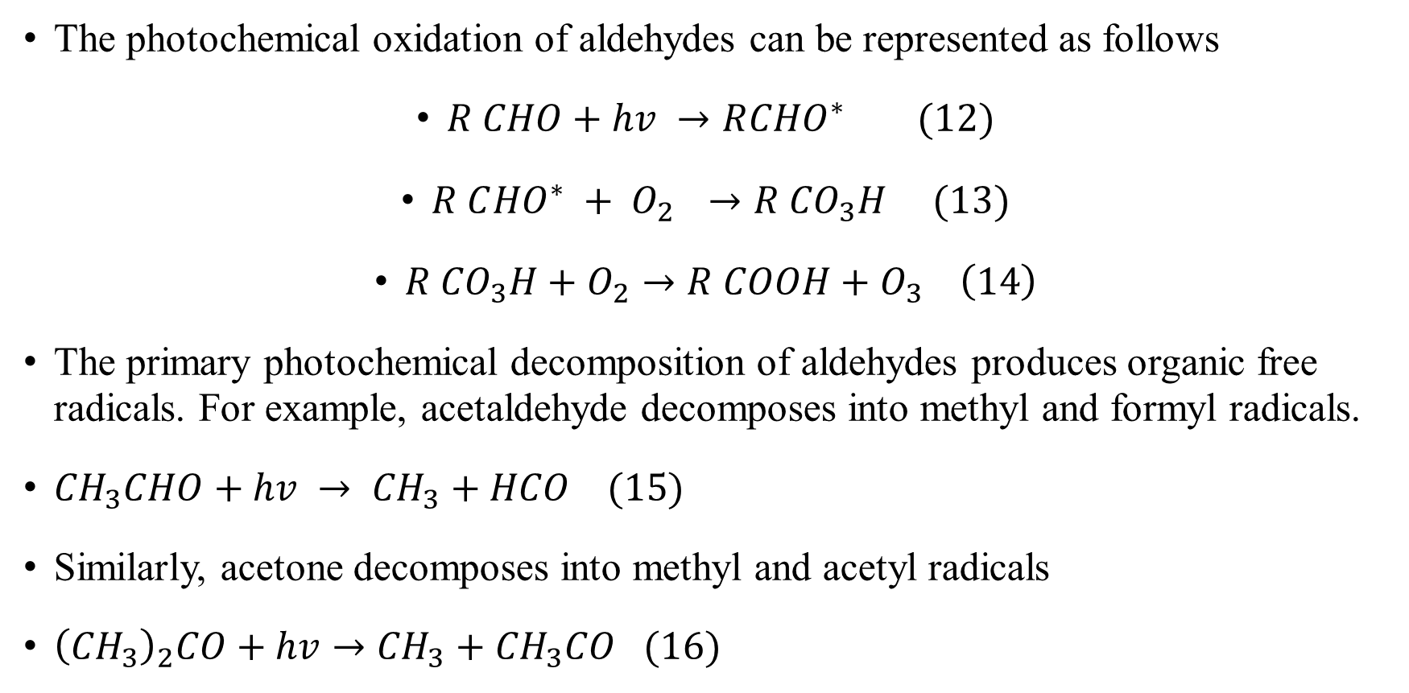
Aldehydes Photochemical reactions
The photochemical oxidation of aldehydes can be represented as follows
$R CHO+hv →R{CHO}^{∗} (12)$
$R C{HO}^{∗} + O_{2 } →R {CO}_{3}H (13)$
$R {CO}_{3}H+O_{2}→R COOH+O_{3} \left(14\right)$
The primary photochemical decomposition of aldehydes produces organic free radicals. For example, acetaldehyde decomposes into methyl and formyl radicals.
${CH}_{3}CHO+hv → {CH}_{3}+HCO (15)$
Similarly, acetone decomposes into methyl and acetyl radicals
${\left({CH}_{3}\right)}_{2}CO+hv→{CH}_{3}+{CH}_{3}CO (16)$

Slide 54
Factors Affecting Photochemical Reactions
The nature of the photochemical reactions that take place in the atmosphere depends on a number of factors.
Some of these factors are light intensity, hydrocarbon reactivity, ratio of hydrocarbons to nitric oxide, presence of light absorbers and meteorological variables.
The height and intensity of atmospheric inversion is a prime factor. Other things being equal, the lower the inversion base, the more intense will be the smog.

Slide 55
Measurement of Photochemical Smog
Photochemical smog is a complex mixture of Several compounds. Among its various constituents, ozone and PAN (Peroxy acetyl nitrate) are significant. Even though ozone is the major oxidizing agent in smog, there are small amounts of other agents which vary in quantity and interfere with ozone determination.
The oxidants are measured by passing the air stream containing the oxidant into a neutral solution of potassium iodide. The oxidant reacts to release iodine and the tri-iodide ion, which can be measured calorimetrically. The two interfering gases during the measurement are NO₂ and SO₂. PAN may be measured either by gas chromatography or infrared spectroscopy.

Slide 56
Useful Web Links
https://www.youtube.com/watch?v=af9fG7SoR6o
https://nptel.ac.in/courses/105104099

