Slide 1

Module 2
Petrology and Geomorphology
Subject Name: Engineering Geology
Subject Code: 18CV36
Name of the Faculty: Dr Vyshali
K S School of Engineering and Management, Bangalore-560109

Slide 2
Petrology
Petrology: The branch of geology dealing with various aspects of rocks such as their formation, classification and occurrence is called petrology.
Rocks: Rocks are defined as “natural solid massive aggregates of minerals forming the crust of the Earth”.
Classification of Rocks: All the rocks of earth crust are divided into three main groups.
i. Igneous Rocks
ii. Sedimentary Rocks and
iii. Metamorphic Rocks

Slide 3
1. Igneous Rocks
All rocks that have formed from an originally hot molten material through the process of cooling and crystallisation may be defined as Igneous rocks
The igneous rocks are formed by the direct consolidation of magma and they are formed first in the earth crust therefore they are called primary rocks.
Magma: the hot molten material occurring naturally below the surface of the earth is called magma. It is called lava when erupted through volcanoes.

Slide 4
Formation of Igneous Rocks
Magma or lava from which igneous rocks are formed may not be entirely a pure melt: it may have a crystalline or solid fraction and also a gaseous fraction thoroughly mixed with it.
The solid and gaseous fractions form only a small part of the magma or lava, which are predominantly made up of liquid material.
In most cases magma is believed to be a sufficiently mobile melt. In fact this mobility is one of the important quality that enables it to cool down igneous rocks.

Slide 5
This is because magma can exist as a melt as long as physical and chemical environment surrounding it remains unchanged.
But as and when there is a change in one or more of these conditions, cooling and crystallization of magma may start and end up with the formation of an igneous rock.
Igneous rocks are also sometimes called Eruptive rocks.

Slide 6
Intrusive and Extrusive Igneous Rocks:
The hot molten magma, existing below the surface of the Earth, is enormous heat and pressure and therefore, it has a tendency to penetrate into the cracks and the weaker places of thin solid crust of the earth.
This magma, thus tries to make its way out towards the surface of the earth, either by melting away the overlying rocks (a process called assimilation) or by forcing them aside.
During the process of forcing its way into the surrounding and overlying rocks, a process called intrusion, the magma cools, forming igneous rocks.

Slide 7
Sometimes, the magma during its efforts to come out on to the Earth’s surface is successful in doing so, and sometimes, it is held up by the strong and massive rock masses existing below the Earth’s surface.
If the magma is successful in erupting out on to the Earth’s surface from some weak point, it will come out with a great force in the form of what is known as volcano.
This erupting lava from a volcano will spread out on the Earth’s surface and due to cool temperatures of the atmosphere; it will quickly get solidified, forming Extrusive igneous rocks.

Slide 8
If the magma remains confined within the rocks below the Earth’s surface and slowly cool down in the fissures or cavities etc., it will solidify to form what are known as Intrusive igneous rocks.
The intrusive igneous rocks will not be exposed to the surface unless the top cover has been eroded by the external agents of weathering. The extrusive igneous rocks remain exposed on the surface unless covered by some external eroded material.

Slide 9
Igneous rocks are divided in to following three sub groups
a) Plutonic Rocks
b) Hypabyssal Rocks
c) Volcanic Rocks

Slide 10
a. Plutonic Rocks
These are igneous rocks formed at considerable depths generally between 7-10 km below the surface.
Because of a very slow rate of cooling at these depths, the rocks resulting from magma are coarse grained.
These rocks get exposed on the surface of the earth as consequence of erosion of the overlying strata.
These rocks are also called intrusive igneous rocks. E.g.: Granite, Syenites and Gabbros.

Slide 11
b. Hypabyssal Rocks
These igneous rocks are formed at intermediate depths, generally up to 2 km below the surface of the earth and exhibit mixed characteristics of volcanic and plutonic rocks.
This rock has also been given to those intrusive igneous rocks which are formed below the surface of the earth but at a short distance inside it. e.g.: Porphyries of various compositions of hypabyssal rocks.

Slide 12
c. Volcanic Rocks
These are the igneous rocks formed on the surface of the earth by cooling and crystallization of lava erupted from volcanoes.
Since the lava cools down at very fast rate, the grain size of the crystals formed in these rocks is very fine.
Cooling of lava may take place on the surface or even under waters of seas and oceans. These rocks are the extrusive igneous rocks.
E.g.: Deccan Traps of India, The Panjal Traps in Kashmir Himalayas, The Basalts of Columbia Plateau.

Slide 13
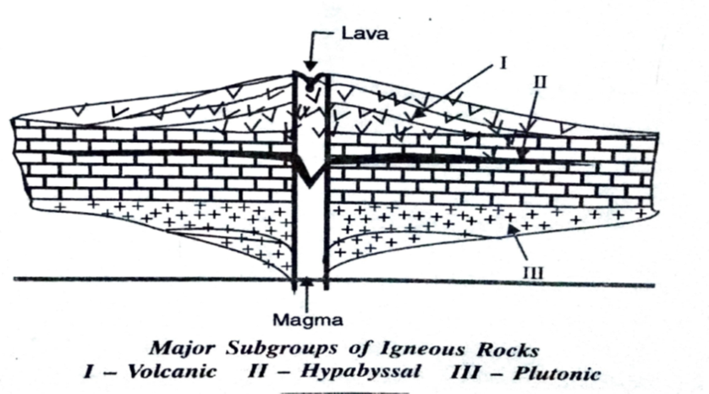

Slide 14
Mode of occurrence of Igneous Rocks
Igneous rocks may occur in two ways, either as intrusive bodies (those rocks which occur below the surface of the earth) or as extrusive bodies (those rocks which occur above the surface of the earth).
These intrusive and extrusive bodies may occur in different forms depending upon factors, such as the capability and strength of magma, the type, texture and strength of adjoining rocks etc.

Slide 15
Forms of Intrusive Igneous Rocks:
The hot molten magma, during its efforts to come up to the surface, sometimes gets successful in melting and disturbing the existing adjoining rocks and sometimes it may fail to do so.
In the latter case, when the magma is unable to disturb and cut across the existing intruded rocks, it may get cooled and solidified within fissures and cavities prevailing in the existing rocks.
Such intrusions which are not influenced by the structural features of the intruded rocks will produce the bodies which are known as concordant bodies.

Slide 16
Concordant intrusive bodies are generally more or less parallel to the bedding of the intruded rocks. Concordant bodies may occur in different forms such as: Sills, Phacoliths and Laccoliths.
If the intrusive magma solidifies after disturbing and cutting across the existing intruded rocks by melting or keeping them aside, it will produce the bodies which are known as discordant bodies.
Discordant bodies generally cut across the older existing rocks. Discordant bodies may occur as: Dykes, Volcanic necks and Batholiths.

Slide 17
1.ConcordantBodies:
Sills: When the magma is pushed into the existing bedding layers of the intruded rocks and solidifies there, in the form of a thin sheet as shown in figure it is called a sill.
The thickness of a sill always much less than its width and length that tapers out at the ends.
If a sill formed from a single intrusion of magma it is called a simple sill.
If it is formed from two or more intrusions but of the same kinds a compositions of magmas, then it is called a multiple sill.
When it is formed of two or more intrusions, but of different kinds of magmas, then it is called a composite sill.

Slide 18
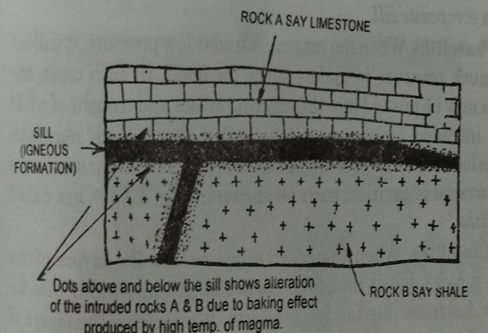

Slide 19
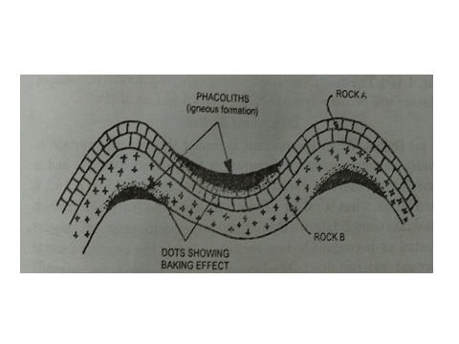
b. Phacoliths
When the magma is under low pressure, it will not exert much pressure to makes space for itself.
In such cases, the magma may be pushed into the existing crests and troughs of a fold in the intruded rocks, and get solidified there.
Such magmatic igneous formations, which are in the form of a crescentric structures in the available cavities, such as shown in the figure and are called Phacoliths.

Slide 20
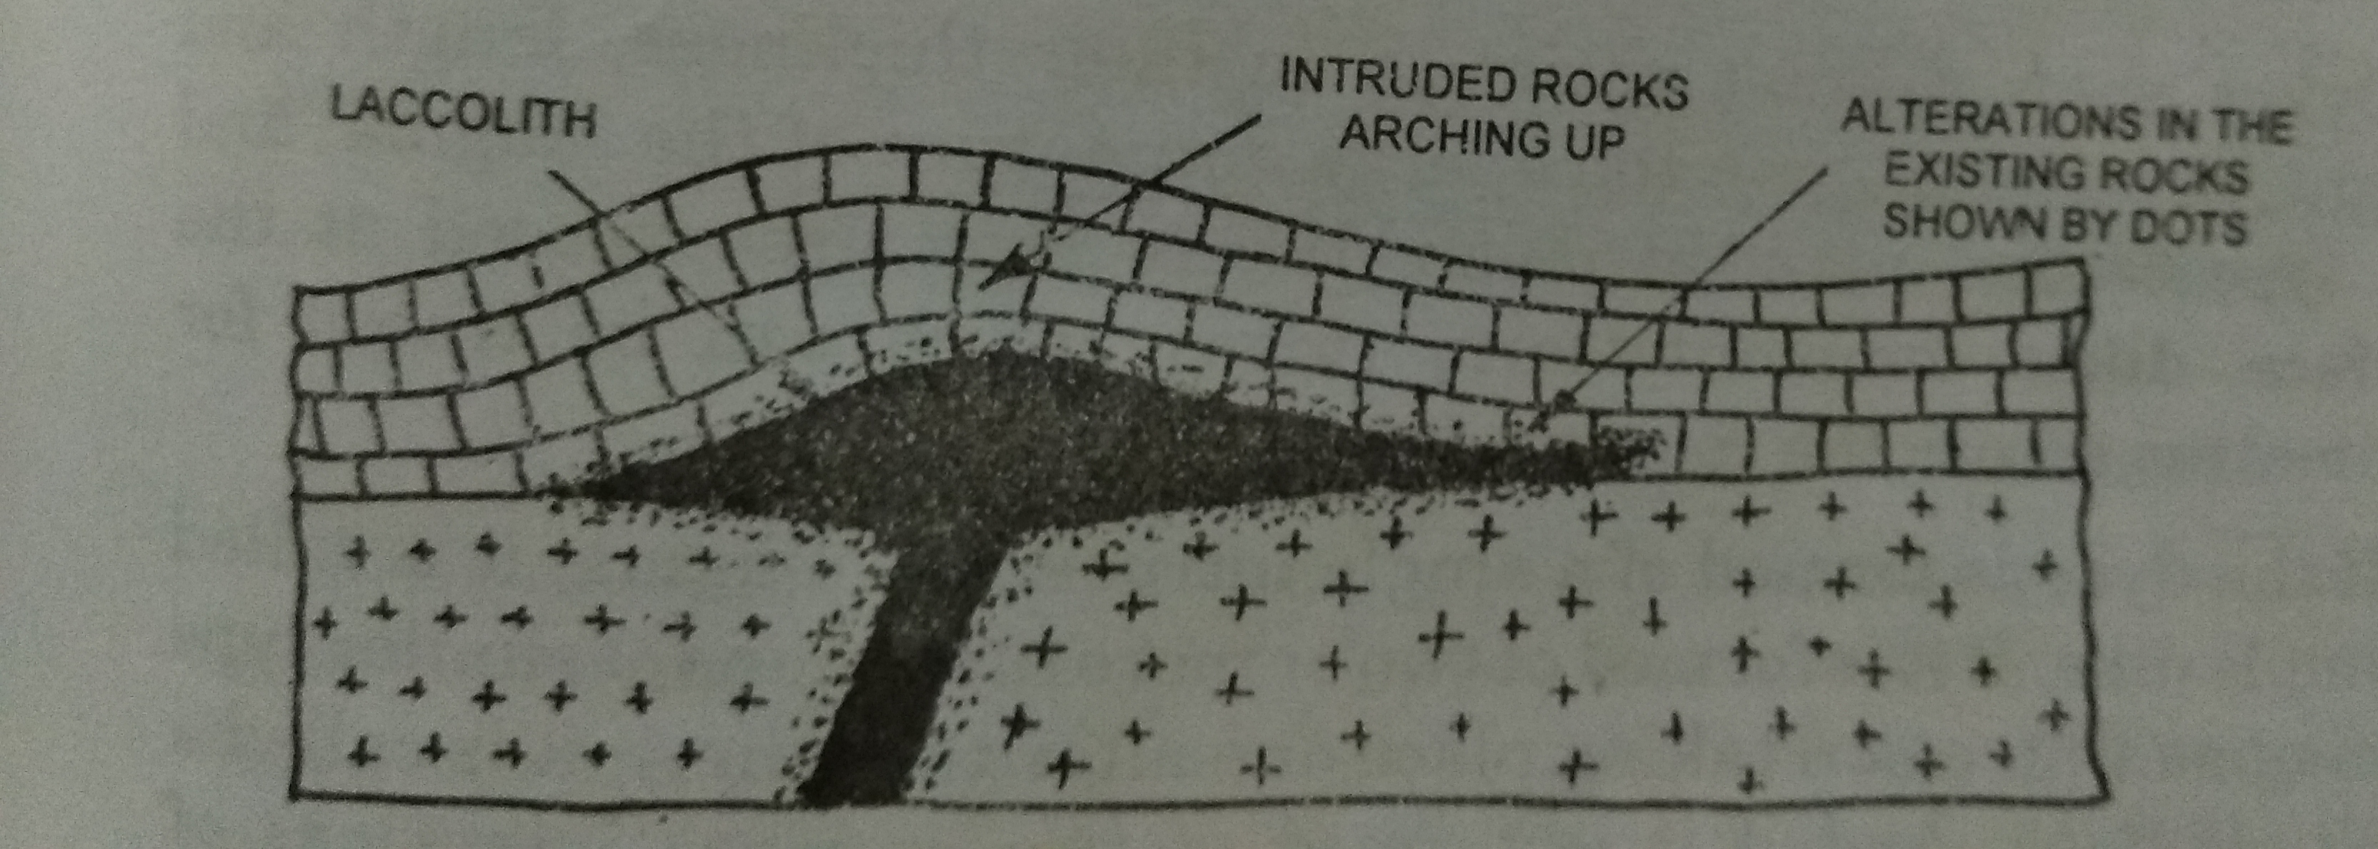
c. Laccoliths
When the magma injects into the layers of the intruded rocks, but unable to spread length and width wise for greater distances due to high viscosity, it may force the layers of rocks upwards, in the form of a dome or an arch, as shown in the figure.
The magma confining and solidifying in such bun-shaped masses will produce igneous rocks known as Laccoliths.

Slide 21
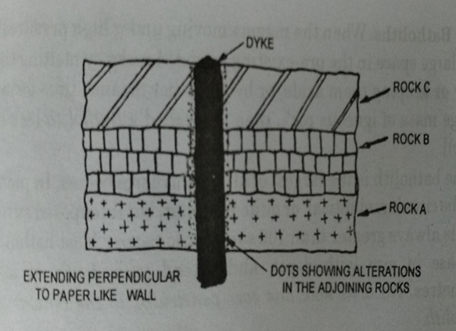
II. Discordant Bodies
Dykes: When the magma is forced through the vertical or nearly vertical cracks or fissures in the intruded rocks, and is consolidated there as a wall like structures as shown in the figure, it then forms, is called a Dyke.
Dykes show a great variation in their thickness, length and height, depending upon the energy and nature of the magma, and the type of the intruded rocks.
When they are exposed at the surface, dikes commonly form ridges, which can be traced for kilometres across the countryside.

Slide 22
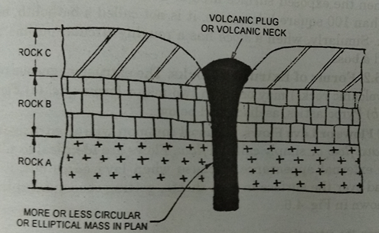
ii. Volcanic Necks
When the magma is forced into the holes of inactive volcanoes and get solidifies there, in the form of more or less a circular thick pipe, then it is called a volcanic neck or volcanic plug.

Slide 23
iii. Batholiths
When the magma moving under high pressure fills up a large space in the pre-existing intruded rocks by melting them away or keeping them aside, or by any other means; thus forming a huge mass of igneous rock, then it is called a Batholith.
The Batholith is the largest of all the intrusive bodies. Most batholiths increase in size with depth and extended to a depth of many kilometres. No drill hole has ever penetrated to the bottom of a batholith.
When the exposed surface area of a batholith type intrusion is less than 100 km², it is not called a batholith.

Slide 24
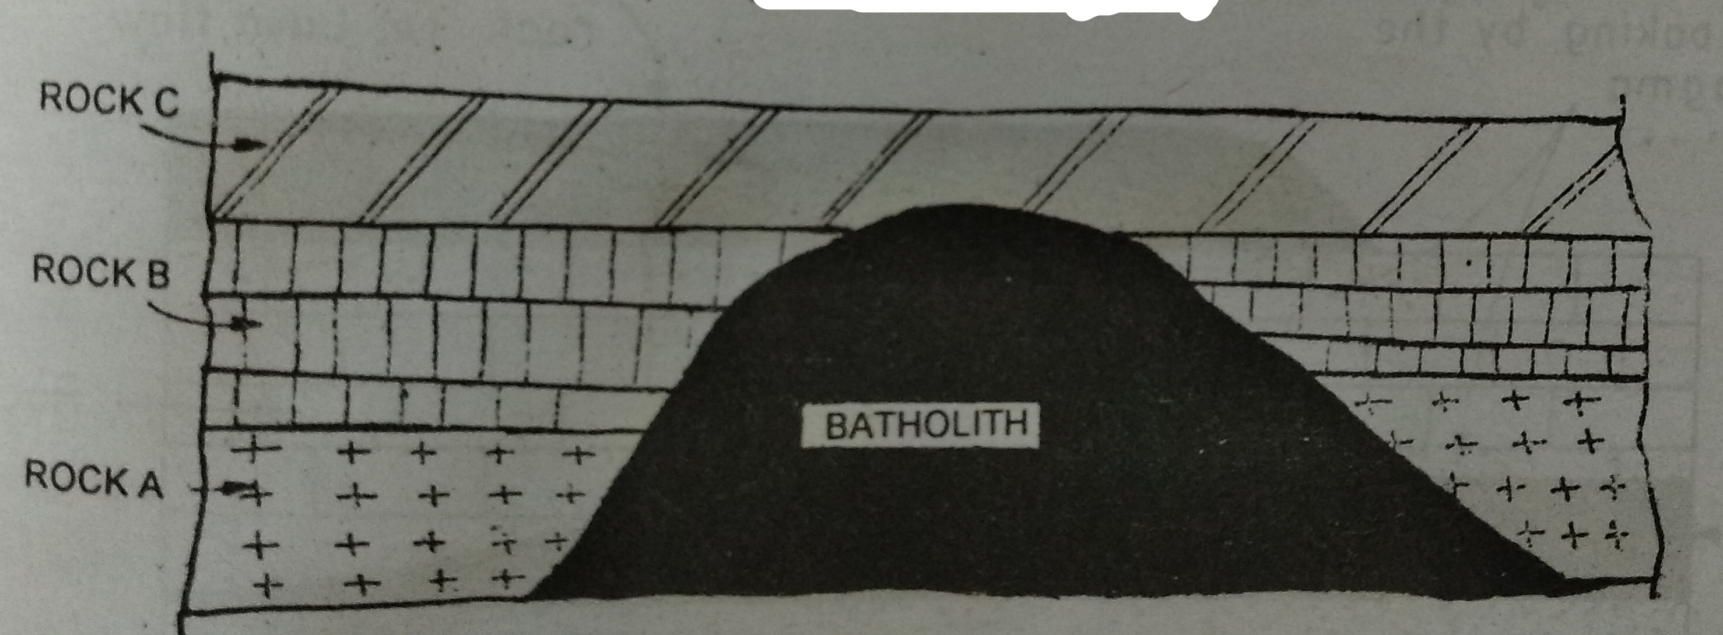

Slide 25
Forms of Extrusive Rocks:
The extrusive igneous rocks occur in two major forms: i.e. a) Flows and b) Pyroclastics
a) Flows or Lava Flows: The most common type of extrusive rock is a lava flow or simply called a flow.
Flows are identified to sills in their external appearance, because when lava oozes out it will spread over the surface in thin sheets, getting consolidated there as shown in the figure.
The flows and sills appear identical as both of them may be tabular and may have identical textures and compositions. The adjoining intruded rocks below the fills and not above but in sills the adjoining intruded rocks present in both below and above.

Slide 26
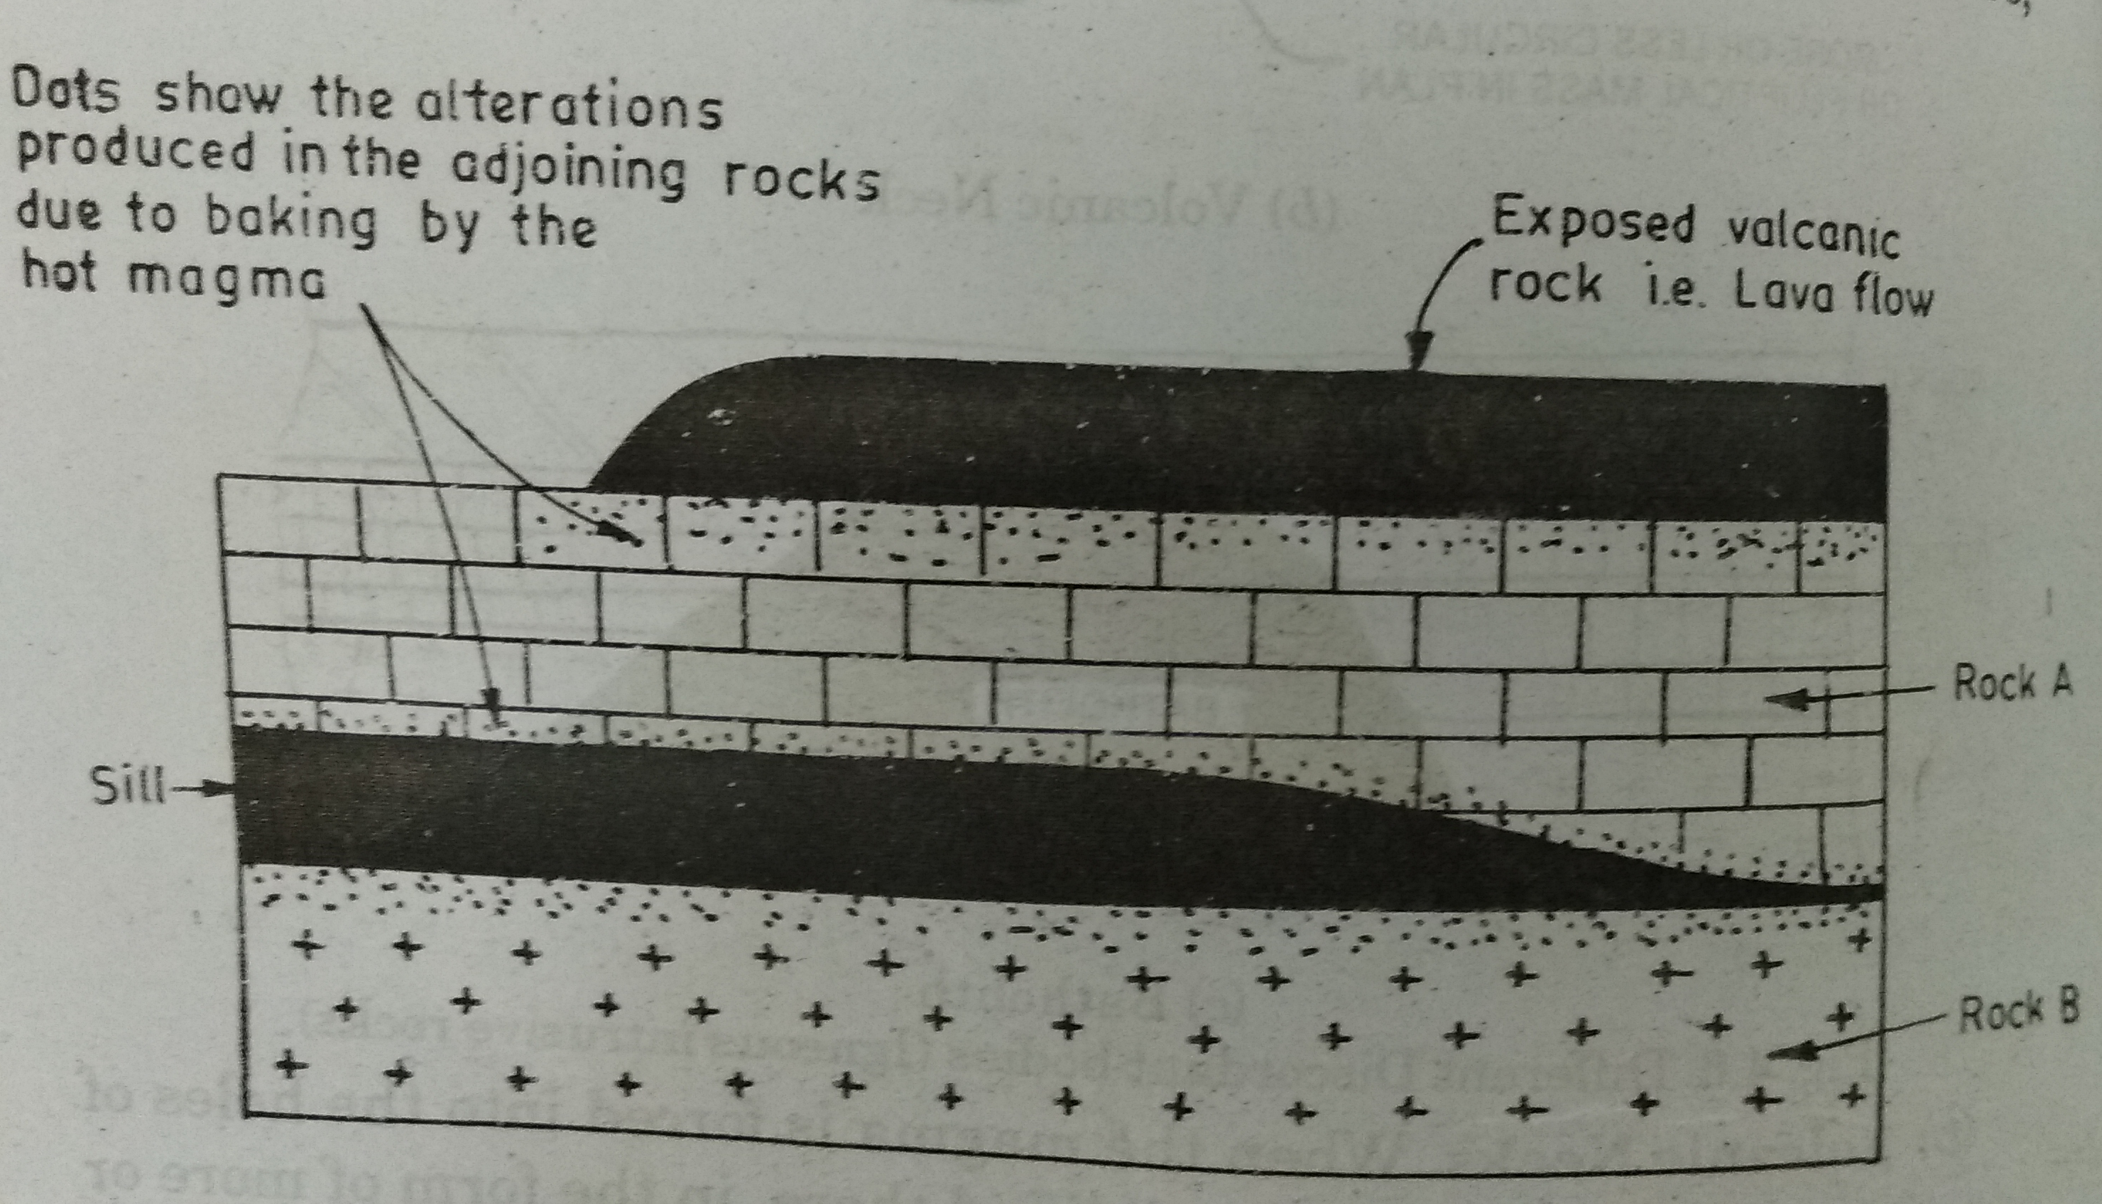

Slide 27
b) Pyroclastics
Another group of extrusive igneous rocks consists of the pyroclastics.
These are all associated with volcanism and represent rock fragments blown out of volcanoes during eruptions.
They are classified according to size, and include volcanic bombs (Volcanic bombs include materials from a few cm to meters in diameter), Cinders (Cinders include materials from 5 mm to several cm in diameter), Tuffs (Tuffs include materials less than 5 mm in diameter) and Volcanic ash (Volcanic ash is the finest dust particles which remain suspended in the atmosphere for months together before settling down on the earth).

Slide 28
Classification of Igneous Rocks:
1. Chemical Classification: The most commonly followed system of chemical classification. It is due to four American petrologists Cross, Iddington, Pirsson and Washington. This classification is also known as C.I.P.W classification. In this classification, a standard of minerals is selected which is known as norm. The norm is divided into two groups a) Salic and b) Femic
a) The salic minerals-Quartz, Feldpsar, Orthoclase, Corundum
b) The Femic minerals- Hyepersthene, Pyrite, Chromite, Olivine and Magnetite

Slide 29
2. Textural Classification
The texture of a rock is defined as the natural relationship of its mineral grains. The different types of textures are as follows.
i. Crystallinity: It is the degree of crystallization which be complete or absent. Different types are
a) Holohyaline- Igneous rocks in which crystallization is complete and consists of amorphous glassy material.
b) Holocrystalline: This term is used for these rocks in which the crystallization is complete and consists of crystals.
c) Hemicrystalline: This is between holohyaline and holocrystalline. This type of textures consists of both crystals and glassy materials.

Slide 30
ii. Granularity
It indicates the grain size. Different types are :
a) Coarse grained: If the grain size is more than 5 mm
b) Medium grained: If the grain size is between 1 mm- 5mm
c) Fine grained: If the grain size is less than 1 mm.

Slide 31
iii. Outline of the Crystals
The outline of the crystal depends upon the degree of crystallization. It is differentiated in to
a) Euhedral: This term is used for those rocks in which the crystal faces are completely developed
b) Anhedral: Those rocks in which the crystal faces are not at all developed
c) Sub-hedral: Those rocks in which the crystal faces are partly developed.

Slide 32
iv. Inner relationship of the minerals
This is the mutual relationship of the mineral grains of the rocks, on the basis of which the rocks are termed as Equigranular and Inequigranular.
a) Equigranular: if the mineral grains are more or less equal in size.
b) Inequigranular: if the mineral grains are different sizes. Among the inequigranular rocks the different types of textures are seen. They are

Slide 33
a) Porphyritic texture: The porphyritic texture is that in which a rock mainly consists of smaller crystals or a fine grained mass within which a few large crystals are embedded.
b) Poikilitic Texture: The poikilitic texture is that in which the rock mainly consists of large crystals within which small crystals are enclosed.
c) Ophitic Texture: Inclusions of one mineral within the other gives rise to ophitic texture.

Slide 34
1. Granites:
Definition: Granites may be defined as plutonic light coloured igneous rocks. These are the most common igneous rocks.
Composition: Two most common essential minerals of granite are: Quartz and Feldspar. The accessory minerals are mica (muscovite and biotite), hornblende, augite, hypersthene, magnetite, apatite, garnet and tourmaline.
Colour: Light coloured (leucocratic) appearance, such as grey, pink, brownish and yellowish.
Texture: Granites are coarse to medium grained, holocrystalline and equigranular rocks. Granitic, graphic, porphyritic and intergrowth textures are the most common types of textures.

Slide 35
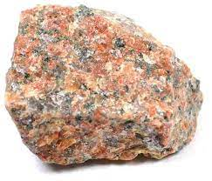
Types: Many types of granites are distinguished on the basis of mineral composition. When muscovite is present it is known as muscovite granite. When biotite is rich then granite is called as biotite granite. Sometimes granite may also be named on the basis of its texture such as graphic granite, porphyritic granite.
Occurrence: Granites are the most widely distributed igneous rocks in the crust of the earth. They occur as deep seated intrusion bodies like sills and batholiths.
Uses: Granites find extensive use in architectural and massive construction where they are abundance. These rocks have been used in monuments and memorials, as columns and steps and as flooring in buildings.

Slide 36
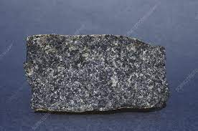
2. Dolerite
Definition: These are igneous rocks of hypabyssal origin having formed as shallow sills and dykes.
Composition: The Essential mineral is calcic plagioclase. Accessory minerals are augite, olivine and iron oxide.
Colour: Blackish brown (Melanocratic)
Texture: Dolerites are medium to fine grained rocks. Ophitic and porphyritic textures are quite common.
Occurrence: Sills and dykes of doleritic composition have been recorded at many places associated with magmatic activity.
Uses: Dolerites are used as a construction aggregates for road beds, buildings, rail ballast and within dams.

Slide 37
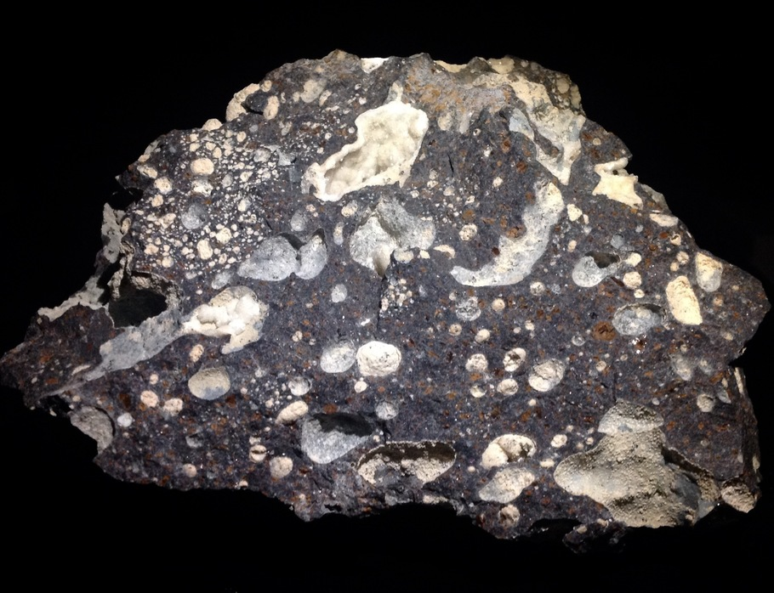
3. Basalts
Definition: Basalts are volcanic igneous rocks formed by rapid cooling from lava flows from volcanoes either over the surface or under water on oceanic floors.
Composition: The essential minerals are calcic plagioclase feldspar. The accessory minerals are ferromagnesian minerals like augite, hornblende, hypersthene, olivine, biotite and iron oxides.
Colour: Dark grey to Black in colour (Melanocratic)
Texture: Basalts are fine grained rocks. Some varieties of basalts show Porphyritic or vesicular texture.
Occurrence: Basaltic rocks form extensive lava flows on the continents and also on the oceanic floors in almost all the regions of the world.
Uses: Basalt is used in construction as building block or in the ground work, making cobblestone and in making statues. Heating and extruding basalt yields stone wool which as potential to be an excellent thermal insulator.

Slide 38
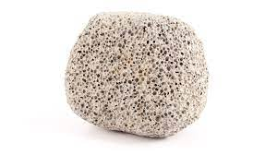
4. Pumice
Definition: It is one of the glassy volcanic rocks. Its structure is highly vesicular and the resulting low specific gravity enables pumice lumps to float on water.
Composition: The essential minerals are quartz and feldspar. The accessory minerals are ferromagnesian minerals like augite, hornblende, hypersthene, olivine, biotite and iron oxides.
Colour: The colour of Pumice is grey to yellow.
Texture: Pumice consists of highly vesicular rough textured volcanic glass, which may or not may not contain crystals.

Slide 39
Occurrence: It forms when volcanic gases exsolving from viscous magma from bubbles that remain within the viscous magma as it cools s to glass. Pumice is a common product of explosive eruptions and commonly forms zones in upper parts of silicic lavas.
Uses: Pumice a very light weight, porous and abrasive material and it has been used for centuries in the construction and beauty industry as well as in early medicine. It is also used as an abrasive in polishes and pencil erasers. There is high demand for pumice, particularly for water filtration, chemical spill containment and cement manufacturing.

Slide 40
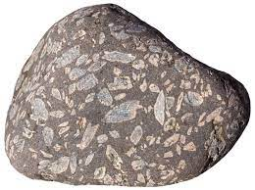
5. Granite Porphyry
Definition: Granites may be defined as plutonic light coloured igneous rocks. These are the most common igneous rocks.
Composition: Two most common essential minerals of granite are: Quartz and Feldspar. The accessory minerals are mica (muscovite and biotite), hornblende, augite, hypersthene, magnetite, apatite, garnet and tourmaline.
Colour: Black colour
Texture: These are coarse to medium grained, porphyritic and intergrowth textures are the most common types of textures.
Occurrence: Granites are the most widely distributed igneous rocks in the crust of the earth. They occur as deep seated intrusion bodies like sills and batholiths.
Uses: Granites find extensive use in architectural and massive construction where they are abundance. These rocks have been used in monuments and memorials, as columns and steps and as flooring in buildings.

Slide 41
Engineering Importance of Igneous Rocks:
Many of igneous rocks are extensively used as materials for construction. Granites and dolerites are characterized by very high crushing strengths and hence can be easily trusted in most of construction works.
Basalts and other dark coloured igneous rocks, though equally strong, may not be used in residential building but find much use as foundation and road stones.
The igneous rocks are typically impervious, hard and strong and for very strong foundations for most of civil engineering projects such as dams and reservoirs. They can be trusted as wall and roof rocks in tunnels of all types unless traversed by joints.
Some igneous rocks like peridotites and pegmatites are valuable as they may contain many valuable minerals of much economic worth.

Slide 42
2. Sedimentary Rocks
Sedimentary rocks are also called secondary rocks. This group includes a wide variety of rocks formed by the accumulation, compaction and consolidation of sediments.
The sediments may be defined as particles produced from the decay and weathering of pre-existing rocks or may be derived from remains of Dead Sea or land animals in suitable environments.
The accumulation and compaction of these sediments commonly takes place under water or at least in the process of water.

Slide 43
Formation of Sedimentary Rocks:
The process of sedimentary rocks is ever prevailing. Even present, millions of tonnes of existing rocks are broken every year in different areas of the earth by natural process.
The sediments so produced are transported to the settling basins such as sea floors where they are deposited, get compact and consolidated and transported into a cohesive solid mass. That is a sedimentary rock.
Similarly, millions of sea and oceanic organisms die every month and their hard parts are accumulating at the floors of these water bodies.
These hard parts gradually get compacted and converted into sedimentary rocks of a different origin.
Some chemical processes especially evaporation and precipitation regularly operate on surface of water bodies containing dissolved salts and produce solids that settle down in those bodies.

Slide 44
Classification of Sedimentary Rocks:
Sedimentary rocks ate grouped into three classes on the basis of their mode of formation.
I. Mechanically formed or Clastic rocks
II. Non Clastic Rocks

Slide 45
1. Clastic (Mechanically formed) Rocks:
a) Decay and Disintegration: Rocks existing on the surface of the earth are exposed to decay and disintegration by the action of natural agencies like atmosphere, water and ice on them. The rock bodies are broken down into smaller and still smaller fragments, grains and particles. The disintegrated, loosened material so formed and accumulated near the source is called detritus. Hence, clastic rocks are often called as detrital rocks.

Slide 46
b) Transport of Sediments: The detritus produced from the decay and disintegration of the pre-existing rocks forms the source of the sedimentary rocks but it has to be transported to a suitable place for transformation again into a rock mass. The wind, running water and ice in the form of glaciers are the agents of transport for carrying tonnes of sediments and particles from one place to another including seas and oceans.

Slide 47
c) Gradual Deposition: The sediments as produced through weathering and erosion are transported to settling basins. These basins may be located in different environments such as on the continents, along the seashores or in deep sea environments. As such sedimentary rocks formed in different environments will show different characters.
The sediments deposited in the settling basins gradually get converted to cohesive, hard and massive rock formations through the process of compaction, consolidation and cementation, which is known as diagenesis.

Slide 48
d) Diagenesis: The process of transformation of loose sediments deposited in the settlement basins to solid cohesive rock masses either under pressure or because of cementation is known as diagenesis. It may be achieved by two methods: i) welding ii) cementation

Slide 49
i) Welding: is the process of compaction of the sediments accumulated in lower layers of a basin due to the pressure exerted by the load of the overlying sediments. This results in squeezing out all or most of the water from in between the sediments, thus bringing them closer and closer and consolidating them virtually in a solid rock mass.
ii) Cementation: is the process by which loose grains or sediments in a settlement basin get held together by binding material. The binding material maybe derived from within the accumulated particles or the fluids that percolate through them and also evaporate or precipitate around those particles thus binding them in a rock like mass.

Slide 50
Classification of Clastic Rocks
Clastic rocks are classified based on the average grain size or grade of the sediments making the rock.
They are i. Gravels
ii. Sands
iii. Silts
iv. Clays.

Slide 51
i. Gravels
All sediments and clastic fragments of rocks above the size of 2mm irrespective of their composition and shape are broadly termed as gravels. However, specific terms are used to name the gravels on the basis of their range of grain size in which they actually fall
a) Boulders: Grain size is bigger than 256mm
b) Cobbles: Grain size is between 256-16 mm
c) Pebbles: Grain size lies between 16-2 mm.

Slide 52
ii. Sands:
All sediments that lie within the size range of 2 mm and 1/16 mm are grouped as sands. Pertologically the term is generally used for siliceous sediments. Sand may be further divided into three sub-groups on the basis of grain size as follows
a) Coarse sands: Size range between 2mm and ½ mm
b) Medium sands: Size range between ½ mm to ¼ mm
c) Fine sands: Size range between ¼ mm to 1/16 mm

Slide 53
iii. Silts: These are very fine sized particles of varying composition lying in the range between 1/16 mm to 1/256 mm. They are furher divided into coarse, medium and fine silts.
iv. Clays: All particles finer in size than 1/256 mm are commonly referred to as clays.

Slide 54
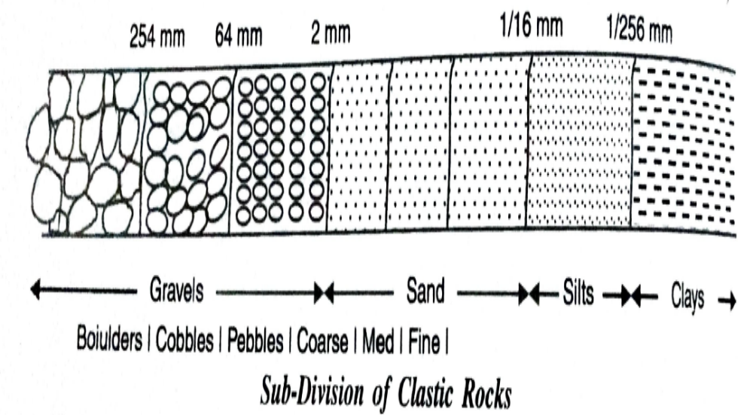

Slide 55
Based on the predominance of sediments of a particular grade , the clastic rocks are further sub divided into following three groups:
a. Rudites: These are also called rudaceous rocks and include all coarse garined rocks of heterogeneous composition. The average grain size is greater than 2 mm.
b. Arenites: These are called arenaceous rocks. These are made up of sediments of sand grade (2mm -1/16 mm).
c. Lutites: These are called argillaceous rocks. Lutites may be defined as sedimentary rocks of the finest grain size (less than 1/16 mm). E.g.: Shales, Siltstones.

Slide 56
II. Non Clastic Rocks
i. Operation of simple chemical processes such as evaporation, precipitation and crystallization at ordinary temperature and pressure from natural solution in different environments.
ii. Accumulation of hard parts of organisms or remains of plant life followed by their compaction and consolidation.
The non-clastic rocks are also called non-detrital rocks.
Non clastic rocks further divided into two sub divisions: i. Chemically formed rocks and ii. Organically formed rocks.

Slide 57
i. Chemically Formed Rocks: They are generally formed by precipitation, evaporation or crystallization from natural aqueous solutions carrying the weathered material in the form of dissolved load. These are sub divided into following groups:
a) Siliceous Deposits: In which silica is the chief constituent. When solutions saturated with silica enter environments where evaporation is possible, deposits of siliceous masses are made.
b) Carbonate Deposits: These are precipitated from carbonate rich water under different conditions that control the concentration of carbon dioxide.
c) Ferruginous Deposits: Oxides and hydroxides of iron are examples of chemically precipitated iron deposits. At places these deposits make huge formations extending over several kilometres so that they can be extracted as a source of iron.
d) Phosphatic Deposits: These deposits form from sea waters rich in phosphoric acid.
e) Evaporites: These may be treated as a distinct class of sedimentary rocks formed by the process of evaporation. Loss of moisture from bodies of sea water (such as bays and estuaries) due to evaporation with passage of time increased the concentration of the salts to an extent that salts separated out as rock masses.

Slide 58
ii. Organically Formed Rocks: Sedimentary deposits formed from remains of organisms (both plants and animals) fall under this group. The rocks in which the bulk of their material is made of the remains of the organisms have their direct contribution. E.g. Coral Lime stone. Indirect contribution is made by organism in a different manner. Some bacteria may help or even be solely responsible for precipitating the rock components from solution.
Following types of organic deposits are distinguished on the basis of their chemical composition.
a) Carbonate Rocks: A great part of the lime stones found in different areas of the world is actually marine and organic in origin. It has been formed by gradual accumulation and compaction of shells and skeletal bones of sea organisms like foraminifera, corals etc.

Slide 59
b) Carbonaceous Rocks: Sedimentary rocks rich in carbon are called as carbonaceous rocks. In their formation, the source material for carbon is derived from plants.
c) Phosphatic Deposits-Guano: Guano is the name given to small volumes of phosphatic composition that are actually accumulation of excreta of some birds and hence considered organic in origin. These birds live on islands and mostly eat fish. Their excreta naturally contain high content of phosphate. When accumulated over a period of time guano forms rich source of phosphate salt.
d) Ferruginous Deposits: These are mostly iron carbonate deposits of good volume. In many fresh water lakes and also in swamps some bacteria are thought to be responsible for reduction of ferric oxide to ferrous oxide and finally to its precipitation of iron carbonate.

Slide 60
Textures of Sedimentary Rocks
i. Origin of Grains: A sedimentary rock may be partially or wholly composed of clastic grains, or of chemically formed or organically contributed parts. Thus the rock may show a clastic texture and non-clastic texture.
ii. Size of Grains: The grain size of the sedimentary rocks varies within wide limits. Individual grains of less than 0.002 mm and more than 250 mm may form a part or whole of these rocks. Three textures recognized on the basis of grain size are
Coarse grained rocks- average grain size >5 mm
Medium grained rocks- average grain size between 5 and 1 mm
Fine grained rocks- average grain size < 1 mm

Slide 61
iii. Shape of Grains: The sediments making the rocks may be of various shapes: rounded, sub rounded, angular and sub angular. They show spherecity to various degrees. Roundness and spherecity are the indications of varying degree of transport and abrasion suffered during that process.
iv. Packing of Grains: Sedimentary rocks may be open packed or porous in textures or densely packed depending upon their environment of formation. The degree of packing is generally related to the load of the overlying sediments during the process of deposition.

Slide 62
v. Fabric of Grains: A given sedimentary rock may contain many elongated particles. Their orientation is studied and described in terms orientation of their longer axes.
vi. Crystallization Trend: In sedimentary rocks of chemical origin, the texture is generally defined by the degree and nature of the crystallized grains. Rocks may show perfectly interlocking grains giving rise to crystallization granular texture or they made be made up of non-crystalline, colloidal particles when they are termed as amorphous.

Slide 63
Structures of Sedimentary Rocks:
1. Mechanical Structure: These are the most prevalent structures of clastic group of sedimentary rocks. They are developed due to physical processes operating at the time of deposition of the sediments.
The different types of mechanical structures are as follows

Slide 64
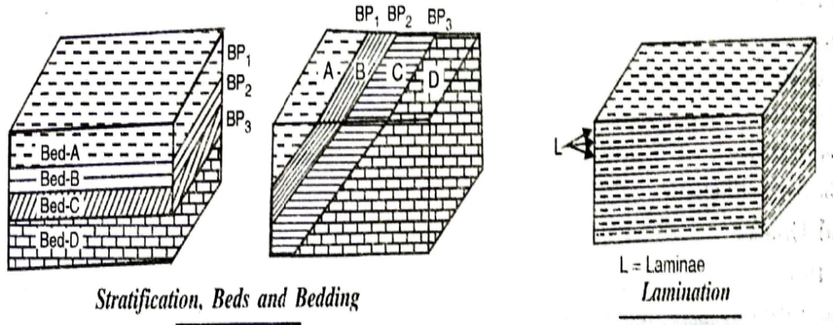
i. Stratification: is a layered arraignment in a sedimentary rock. The different layers, also called beds or strata may be similar or dissimilar in colour, composition, grains size and texture. The thickness of each layer in a sedimentary formation may show great variation: from a few centimeteres to many meters and sometimes for several meters to hundreds of kilometers.

Slide 65
ii. Lamination: This is also a layered structure similar to stratification. In lamination the individual layers are quite thin (less than 1 cm), Lamination is a characteristic structure of fine grained sedimentary rocks like clays and shales. The individual layers are called laminae and are distinguished commonly on the basis of difference in colour.

Slide 66
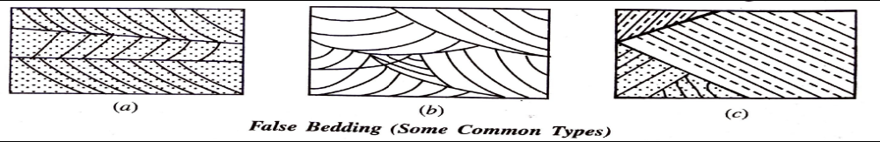
iii. Cross Bedding: It is a sedimentary structure in which various layers lying one above another are not parallel but bear in irregular or inclined relationship to each other. Such a structure often results from deposition having taken place in a shallow water environment. The structure is sometimes referred as false bedding or current bedding. Common types are
a) Tabular- here cross bedding in which the top and bottom surfaces of the deposit are essentially parallel.
b) Lenticular: All the layers are extreme irregularity in their shape and disposition; each individual layer may be intersected by many others lying at different angles.
c) Wedge shaped: In this, the cross bedding structure is highly complex: the individual layers exit in well-defined sets of parallel layers but these sets bear angular relationships to each other.

Slide 67
iv. Graded Bedding: In some stratified rocks the component sediments in each layer appear to be characteristically sorted and arranged according to their grain size, the coarsest being placed at the bottom and the finest at the top. Such an individual layer is said to be graded. When a sequence of rocks is made of such graded layers, the structure is called graded bedding.

Slide 68
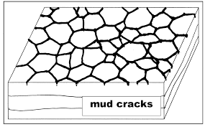
v. Mud Cracks: These are common structural features of many fine grained sedimentary rocks. The structures consist of polygonal or irregular cracks spread along the surface of an exposed sedimentary layer. Their development is explained by an analogy of development of similar cracks on the surface of drying mud in shallow environments even at present. Once these cracks are covered under further layers of mud, they get preserved in the body of the deposits.

Slide 69
vi. Rain prints: These are irregular, small crater shaped depressions seen on fine grained dried sediments. Rain falling forcefully on fine grained compacted clays often makes crater like depressions. These may get dried up and subsequently preserved under another layer of mud. The imprints become a part of the deposit.
vii. Ripple Marks: These are quite common types of sedimentary structures of mechanical origin found in deposits made in shallow water environment. They are defined as symmetrical or asymmetrical wave like undulation or irregularly in a layer. Ripple marks generally result from interplay of wind action and wave action during the process of deposition.

Slide 70
II. Chemical Structures
Many sedimentary rocks are formed due to chemical processes such as evaporation, precipitation and crystallisation.
These rocks often show peculiar structures quite different from those found in clastic rocks.

Slide 71
i. Concretionary Structures
In certain sedimentary rocks, rounded bodies with irregular shapes are found embedded in the main rock masses.
This foreign material generally differs from the adjoining rock mass, in its chemical as well as mineralogical composition.
This material is called concretions, and such a structure in a rock is called concretionary structure.

Slide 72
ii. Oolitic and Pisolitic structures
Certain varieties of sedimentary rocks are made up of small spherical rounded grains (ranging between 0.1 to 1 mm in size), resembling insect’ eggs in appearance.
These particles are called oolitics, and the rock is then said to have Oolitic structure.
iii. Geode structure: Geode structure is represented by the presence of a hollow shell, which is made up of one mineral, and contains lining of projecting crystals of another mineral inside the shell.

Slide 73
III. Organic Structures
Some structures develop in the sedimentary rocks due to the manner in which the organic source material gets accumulated and compacted to form a rock.
The fossiliferous structure and the stromatolitic structures may be known as organic structures.
The fossiliferous structure is due to the presence of fossils of plants or animal life in the rocks. Sedimentary rocks are known as the only source of fossils.
The stromatolitic structure is produce by the presence of remains of algae.

Slide 74
1. Sandstone
Definition: Sandstones are mechanically formed sedimentary rocks of Arenaceous Group. These are formed by the lithification of sand beds. The component grains of sandstone range in size between 2 mm and 1/16 mm.
Colour: Sandstones naturally occur in a variety of colours: red, brown, grey and white being the most common colours.
Composition: Essential mineral is Quartz and accessory minerals are Feldspar, Mica, Garnet and magnetite. The cementing material may be siliceous, argillaceous, ferruginous or carbonate in nature.
Texture and Structures: Depending upon their grain size, they may be of coarse or fine grained varieties. They exhibit common structures like cross bedding, ripple marks, rain marks and fossils.

Slide 75
Types
i. Siliceous Sandstones: They are those which contain silica as the cementing material.
ii. Calcareous Sandstones: They are those which contain calcium and magnesium carbonates as cementing material.
iii. Argillaceous Sandstones: They are those in which clayey matter forms the cementing matrix.
iv. Ferruginous Sandstones: They are those in which iron compounds form the cements.

Slide 76
On the basis of their mineralogical composition, the following varieties of sandstones are generally recognized.
i. Arkoses: They are those sandstones, which are exceptionally rich in Feldspars. They are derived from granitic parent rocks.
ii. Greywacks: Greywacks are impure Sandstones of grey colour, and contain Quartz, Feldspars and pieces of rocks like Granite, Feldspars, Shales, etc.
iii. Flagstones: Flagstones is the name given to those Sandstones which are rich in Mica. The mica is generally present in these stones in the form of thin layers and the rock can easily split along them.
iv. Freestones: The massive fine grained variety of Sandstones, containing almost no layering, a compact character is called Freestone.
v. Glauconitic Sandstones: These are those which contain some amount of Glauconite.

Slide 77
Occurrence: Sandstones are the most abundant sedimentary rocks, constituting about 15% of the total sedimentary rocks in the Earth’s crust. They generally occur in thick or thin beds and sometimes as lenticular bodies within the beds of other rocks.
Uses: Sandstones are most commonly used as materials of construction, building stones, pavements stones and road stones and also as a source material for concrete.

Slide 78
2. Limestones:
Definition: These are the most common sedimentary rocks from the non-clastic group and are composed chiefly of carbonate of calcium with properties of carbonate of magnesium. They are formed both biochemically and mechanically.
Colour: White, Pink, Pale Blue
Composition: Essential mineral is Calcite. Accessory minerals are Dolomite, Quartz, Feldspar, Pyrite, Clay etc.
Texture and Structures: Lime stones are generally fine grained compact rocks. The rocks formed by the accumulation and cementation of organic remains may be sometimes be loosely packed and thus exhibit coarse textures.
Lime stones are generally compact and massive but sometimes exhibit oolitic, pisolitic and concretionary structures. The organic structures such as fossils are also found in many Limestones.

Slide 79
Varieties
i. Chalk: It is the purest form of Lime stone (i.e., pure CaCO₃). It is white in colour and is having fine grained earthy texture. It is very soft in nature.
ii. Argillaceous Lime stones: These are those which contain clay in considerable properties. When the CaCO₃ and clay are present is roughly equal amounts, the rock is called Marl.
iii. Shelley Limestones: These are those fosiliferous limestones in which some remains of organisms are found buried or preserved as fossils.
iv. Lithographic Limestones: The compact, homogeneous and extremely fine grained calcareous variety of Limestone is called Lithographic limestone.
v. Kankar: The nodules or concretions made more or less of CaCO₃, and generally found present in the soil just near the surface is called kankar.
vi. Siliceous Limestones: These are those which contain silica as the chief accessory constituent. These limestones are hard and tough, and more resistant to weathering.
vii. Calc-Tuff: It is the carbonate residue deposited by spring water. It is also called as Travertine.

Slide 80
Occurrence: Lime stones generally occur as thin and thick beds (up to 30 m or more). They may also occur in the form of concretions as kankar, and also organically formed structures. Organic or inorganic, they are generally marine in origin, and occur in sea beds.
Uses: Lime stones are used as crushed stones, for load making, for concrete aggregates, etc. They are also used as a fluxing stones in metallurgical fields. Lime stones are one of the leading building stones, being utilised both for internal and external work.
Lime stones are used as the chief ingredient in the manufacture of cement. Lime stones may also be used in the manufacture of rock wool, glass manufacture, sugar refining etc.

Slide 81
3. Shale
Definition: Shales are in general are argillaceous clastic sedimentary rocks, formed by clay particles of less than 0.01 mm in size.
Colour: Grey, Red, Purple, Green, Black depending upon the clay minerals and the impurities present in the rock.
Composition: Essential minerals are Kaolinite, Montmorillonite and Illite. Accessory minerals such as Mica, Chlorite, Quartz. Besides these minerals, several impurities in the form of carbonaceous material and calcareous particles may also be present.
Texture and Structures: Shale is a fine grained rock and the variable shapes of the various clay minerals present. Shales are generally porous. The linear arrangement of flakey minerals parallel to bedding enables the Shales to split into parallel flat fragments. This important characteristic feature of Shales is called feasibility.
Shales may exhibit structures such as mud cracks, rain prints, ripple marks, concretionary structures and some organic structures.

Slide 82
Varieties:
i. Calcerous Shales: These are those which contain calcium and magnesium carbonate as a accessory constituent.
ii. Siliceous or Sandy Shales: These are those which contain some prominent quantities of sand.
iii. Carbonaceous or Bituminous Shales: These are those which are rich in organic matter, especially carbon, and re generally black
iv. Alum Shales: These are those which are rich in iron sulphide or iron sulphate.
v. Oil Shales: These are actually those carbonaceous Shales which yield oil on destructive distillation.

Slide 83
Occurrence: Shales occur as thin and thick beds; and sometimes as small bands and irregular inclusions within other sedimentary rock formations. Of all types of sedimentary rocks, Shales are most abundant, forming 70-80% of the sedimentary rocks of the earth’s crust.
Uses: Shales are used in the manufacture of clay products, such as brocks, tiles, sewer pipes and Portland cement.

Slide 84
4. Laterites
Definition: Laterite is a soil and rock type rich in iron and aluminium and is commonly considered to have formed in hot and wet tropical areas. Nearly all laterites are of rusty-red coloration, because of high iron oxide content. They develop by intensive and prolonged weathering of the underlying parent rock.
Composition: Laterites are a source of aluminium ore; the ore exists largely in clay minerals and the hydroxides, gibbsite, boehmite, and diaspore, which resembles the composition of bauxite.
Uses: Laterite soils have high clay content, which mean they have higher cation exchange capacity and water-holding capacity than sandy soils. Laterites are also used as a building stones, road blocks etc.

Slide 85
5. Conglomerates
Definition: These are sedimentary rocks of clastic nature and also belong to rudaceous group. They consist of rounded fragments of various sizes but generally above 2 mm, cemented together in clayey or ferruginous or mixed matrix.
Colour: Reddish Brown
Composition: The constituent gravels of conglomerates may differ considerably in their chemical composition: they may be the pure minerals or rock gravels of different classes that got cemented together in a natural manner. .
Types: Conglomerates are generally distinguished on the basis of the dominant grade of the constituent gravels in following three types.
1. Boulder Conglomerates (gravels > 256 mm)
2. Cobble Conglomerate (gravels 64-256 mm)
3. Pebble Conglomerate (gravels 2-64 mm)

Slide 86
Sometimes Conglomerates are distinguished on the basis of the source of fragments, such as a) Volcanic conglomerates-having fragments of volcanic origin
b) Basal conglomerates: having been deposited by sea waves during their advance over subsiding land mass
c) Glacial Conglomerates: In which gravel making the conglomerates are distinctly of glacial origin.
Occurrence: Conglomerates generally occur as thick beds and have variety of colours, and texturally present a heterogeneous appearance.
Uses: The harder and denser varieties of conglomerates may be used as mile stones. Because of their hardness and durability, they are used as crushed stones for roads, making concretes and as railroad ballasts.

Slide 87
Engineering importance:
Sedimentary rocks cover a great part of the crust of the earth; they make up more that 75% of the surface area of the land mass.
It is with these types of rocks that an engineer has to deal with in majority of cases. Sedimentary rocks are the most important rocks to act as natural reservoirs of oil and ground water supplies.

Slide 88
III. Metamorphic Rocks
The new rocks which are formed from the alteration of the pre-existing rocks of any type, by the process of metamorphism are called metamorphic rocks.
Metamorphic rocks are defined as those rocks which have formed through the operation of various types of metamorphic processes on the pre-existing igneous and sedimentary rocks involving changes in textures, structures and mineralogical composition.
The direction of change depends upon the type of the original rock and the type of metamorphic process that operates on the rock.

Slide 89
Metamorphism
Metamorphism is in fact, a natural process whereby the existing rocks are altered under conditions of high pressure and temperature associated with depths several thousand meters beneath the surface.
Also, the formation of metamorphic rocks takes place in the solid state (Solid state- The rocks remain solid and do not undergo melting) although some kinds of metamorphic processes take place in the presence of hot liquids and gases, chiefly water.
The igneous and sedimentary rocks when subjected to metamorphism undergo changes that are either physical, chemical, or both. Physical changes are reflected as changes produced in the texture of the old rocks, whereas chemical changes produce the formation of new minerals; thus, giving rise to this new group of rocks, called metamorphic rocks.

Slide 90
E.g.: Granite, an igneous rock on metamorphism produces a metamorphic rock Gneiss.
Sandstone, a sedimentary rock on metamorphism produces a metamorphic rock called Quartzite.
Limestone changes into metamorphic rock called Marble.
Shale gives rise to a metamorphic rock called Slate and Conglomerates results in the formation of Conglomerate Schist.

Slide 91
Types of Metamorphism
i. Thermal metamorphism
ii. Dynamic metamorphism
iii. Dynamothermal metamorphism

Slide 92
i. Thermal metamorphism
All those metamorphic processes in which heat is the chief gent of metamorphism and pressure and fluids play only secondary roles are included under the term thermal metamorphism.
The most important type of thermal metamorphism is called contact metamorphism. And other types of thermal metamorphism are pyro- metamorphism and plutonic metamorphism.

Slide 93
a) Contact Metamorphism: is a common type of thermal metamorphism observed in rocks existing close to the magmatic intrusions, injections and lava flows. In this case, the heat from magmatic source travels through the body of the surrounded rocks those undergo structural and mineralogical changes depending upon their original composition and intensity of the heating effects.
b) Pyro-Metamorphism: is another type of thermal metamorphism in which represents very much localised metamorphic changes produced by heat, such as in the case of block of sedimentary rock incidentally falling in to a body of flowing lava, and undergoing recrystallization and formation of new minerals.

Slide 94
c) Plutonic Metamorphism: is a process of metamorphism that takes place due to equally important role of imposed loads (due to burial at great depths) and very high temperatures that become natural at those great depths.
Such changes take place in rocks that are pushed down during crustal movements to positions where high temperature and high pressure become almost a permanent feature.

Slide 95
ii. Dynamic or Cata-clastic Metamorphism
It is also known as mechanical metamorphism or dislocation metamorphism.
All those metamorphic changes in which the dynamic or lateral pressure caused by the earth movements is the dominating agent of metamorphism, and heat and fluids play only secondary roles are included under the term dynamic metamorphism.
This is an important type of metamorphism, as very effective changes are produced in the rocks in the form of production of folds and other structures, such as joints, faults, foliations etc.
In this type of metamorphism, there is no or very little formation of new minerals.

Slide 96
iii. Dynamo-thermal Metamorphism or Regional Metamorphism
It is considered as the most important as well as prevalent type of metamorphic processes.
This involves development of large scale changes in the structural and chemical constitution of the pre-existing rocks under the combined action of pressure, temperature and fluids.

Slide 97
Textures of Metamorphic Rocks
a) Crystalloblastic Textures: which include all those textures that have been newly imposed upon the rock during the process of metamorphism and are, therefore, essentially product of metamorphism.
b) Palimpsest Textures: That includes textures which were present in the parent rock and have been retained by the rock despite metamorphic changes in other aspects.

Slide 98
Structures of Metamorphic Rocks:
i. Cataclastic Structure: It is characterized by the development of extremely fine rock mass under the influence of severe crushing and shearing effects of stresses operating during metamorphism. E.g.: Breccia, Slate
ii. Schistose Structure: The rock with schistose structure is made up of broadly parallel or sub parallel layers or bands of flaky, platy or rod like minerals making it very weak in the direction of parallelism. E.g.; Schist
iii. Gneissose Structure: In this structure, bands or folia of platy and flaky minerals alternate with those of equidimenisonal and granular minerals. These bands are generally of contrasting colours, composition and textures.

Slide 99
iv. Maculose Structure: It is characterised by a spotted appearance of the rock that may be caused due to the formation of large sized crystals (porphyroblasts) within an otherwise fine grained rock.
Augen Structure is similar to maculose type and is typical metamorphic rocks in which the effects of crushing under the pressure and clearly associated with recrystallization. In this structure some minerals get deformed into thin, lenticular, lense like shapes giving a characteristic appearance to the rock.
v. Granulose Structure: It is typical structure of metamorphic rocks like marble and Quartzite and is characterized by an essentially granular character of the constituent minerals.

Slide 100
1. Gneiss:
Definition: Gneiss is a megascopically crystalline foliated metamorphic rock characterised by segregation of constituent minerals into layers or bands of contrasting colour, texture and composition.
Composition: Essential minerals are feldspar and quartz. Accessory minerals are pyroxene and amphibole group minerals.
Texture and Structure: Coarsely crystalline texture and gneissose structures. They called augen gneisses show a cataclastic structure.
Varieties:
i. Orthogneiss: formed as a result of metamorphism of Granites and other igneous rocks.
ii. Paragneiss: these are formed from metamorphism of sedimentary rocks like sandstones.
iii. Banded gneiss: in which tabular and flaky minerals are segregated in very conspicuous bands of alternating dark and light colours.
.

Slide 101
iv. Augen gneiss: formed as a result of dynamic metamorphism of granites and sedimentary rocks showing a typically cataclastic structure
Occurrence: Gneisses of all varieties are generally the result of advanced stages of metamorphism.
Uses: These rocks are used as road stones and in some cases as building stones.

Slide 102
2. Slate:
Definition: Slate is fine grained metamorphic rock characterized by a slaty cleavage by virtue of which it can be split into thin sheets having parallel smooth surfaces.
Composition: Essential minerals are mica, chlorite. Accessory minerals are quartz, feldspar, oxides of iron.
Occurrence: Slate is a product of low grade regional metamorphism of argillaceous rocks like clays and Shales.
Uses: Slate is used locally for construction purpose as a roofing and paving material.

Slide 103
3. Muscovite & Biotite schist:
Definition: these are megascopically crystalline foliated metamorphic rocks characterized by a typical schistose structure.
Composition: Essential minerals are Muscovite and Biotite. Accessory minerals are chlorite, hornblende, kyanite etc.
Texture and Structure: Crystalline texture and schistose structure.
Uses: because of low strength no economic uses.

Slide 104
4. Marble:
Definition: Marble is granular metamorphic rock composed of recrystallized lime stone.
Composition: Essential mineral is Calcite (CaCO₃) in its recrystallized form. Accessory minerals are olivine, garnet, and serpentine.
Texture and Structure: Granulose texture and banded structure.
Varieties: Various types of marble are distinguished on the basis of their colour, composition and structure. White marble, pink marble and black marble are known on the basis of their colours.
Dolomitic Marble is variety distinguished on the basis of composition; it may show schistose structure.
Occurrence: marble is formed from contact metamorphism of carbonate group of sedimentary rocks. Pure white marble results from pure lime stones.
Uses: Marble is commonly used in the construction of monumental buildings in the form of blocks, slabs, arches and in the crushed form as chips for flooring. Because of its restricted occurrence and transport costs, it is mostly used as ornamental stone in costly construction.

Slide 105
5. Quartzite
Definition: Quartzites are granular metamorphic rocks composed chiefly of intersutured grains of quartz.
Composition: Essential mineral is quartz and accessory minerals ate mica, feldspar, garnets and amphiboles.
Occurrence: Metamorphic quartzites result from the recrystallization of rather pure sandstones under the influence of contact and dynamic metamorphism.
Varieties:
Orthoquartzite: is used for a sedimentary rock of similar composition but having a different origin, in which quartz grains are cemented tighter by siliceous cement.
Uses: The rock is generally very hard, strong, and dense and uniformly grained. It finds extensive use in building and road construction.

Slide 106
Useful Weblinks
https://www.youtube.com/watch?v=PrN7jygu4cQ
https://www.nptelvideos.com/video.php?id=1721&c=11

