Slide 1

Module -1
SUBJECT: Environmental studies
SUBJECT CODE: 18CIV59
DEPT. OF CIVIL ENGG.
K.S. SCHOOL OF ENGG. & MANAGEMENT
NAME OF THE FACULTY: Dr Rashmi H R,
Asst. Prof.

Slide 2
ECOLOGY AND BIODIVERSITY

Slide 3
TYPES OF ECOSYSTEMS
Natural ecosystems
  A biological environment that is found in nature (e.g. a forest) rather than created or altered by man (a farm).
  Types
    Terrestrial
      In terrestrial ecosystems, organisms interact with land (the word "terra" means land).
    Aquatic
      In aquatic ecosystems, organisms interact with water (the word "aqua" means water).

Slide 4
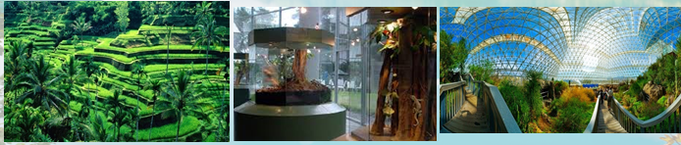
TYPES OF ECOSYSTEMS
Artificial ecosystems
  Humans have modified some ecosystems for their own benefit. These are artificial ecosystems.
  Cultivated farms and gardens are types of artificial (human made) ecosystems.

Slide 5
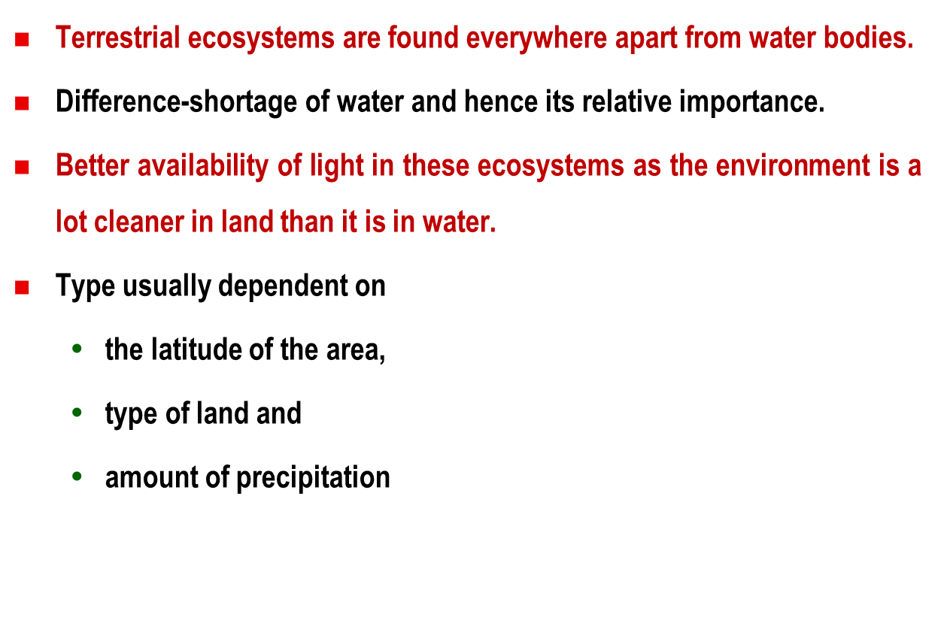
Terrestrial Ecosystems

Slide 6
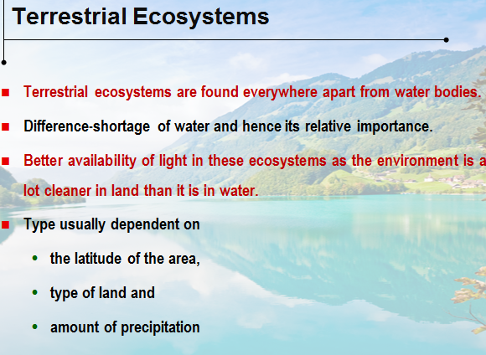

Slide 7
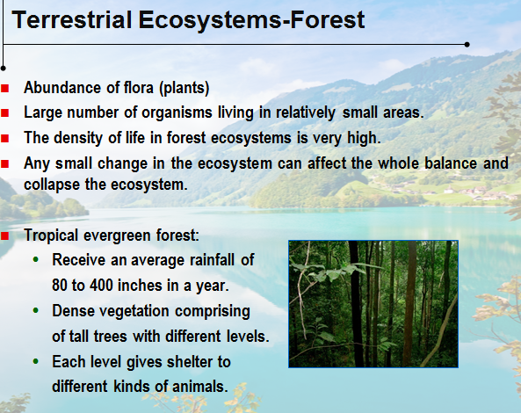

Slide 8
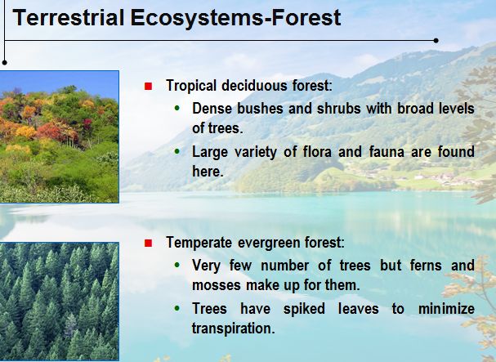

Slide 9
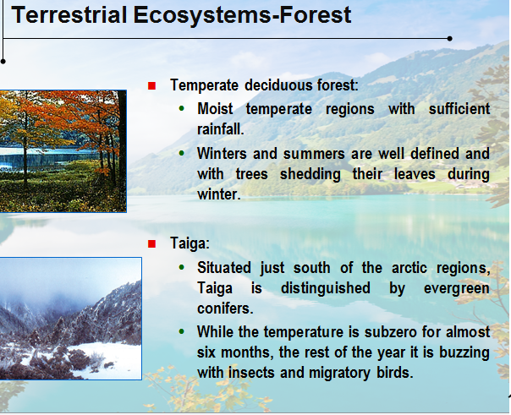

Slide 10
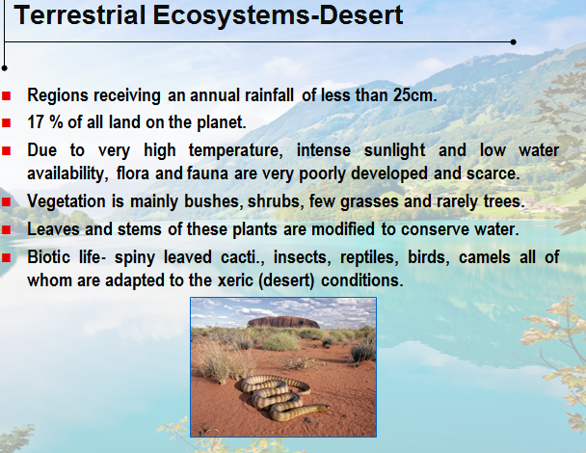

Slide 11
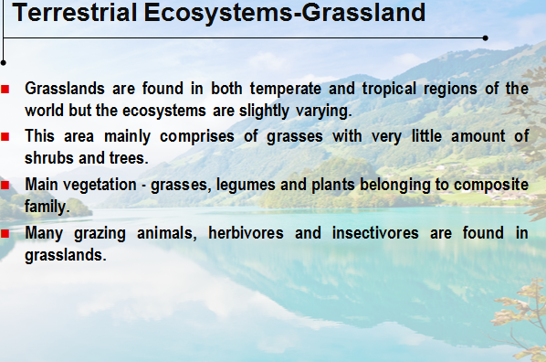

Slide 12
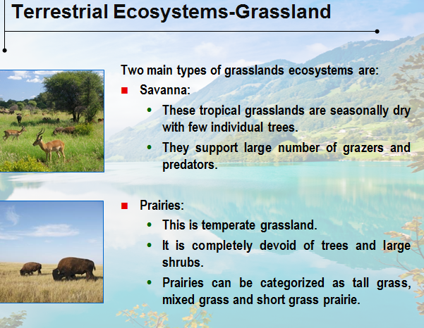

Slide 13
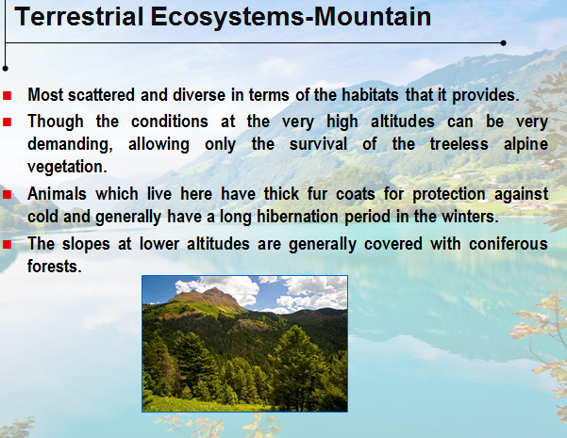

Slide 14
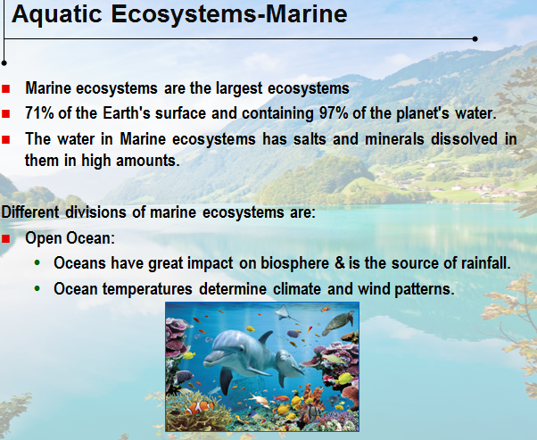

Slide 15
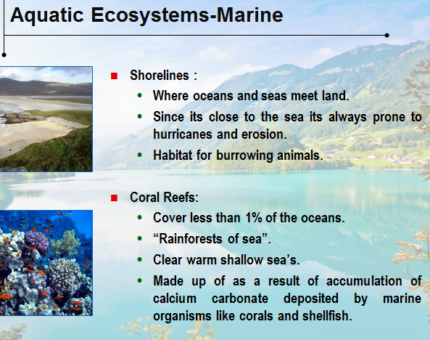

Slide 16
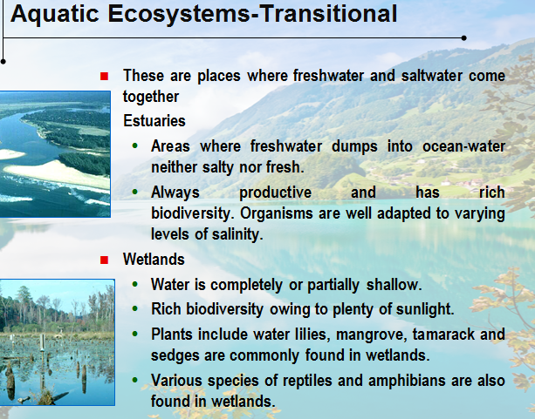

Slide 17
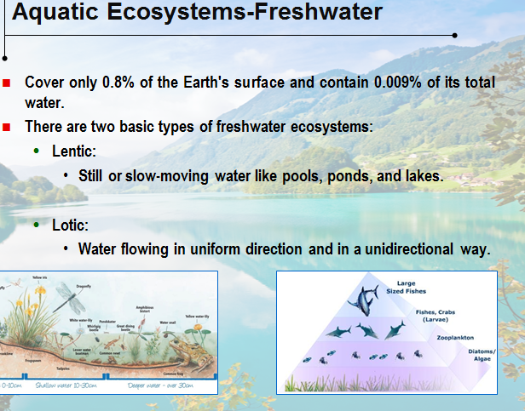

Slide 18
Biodiversity

Slide 19
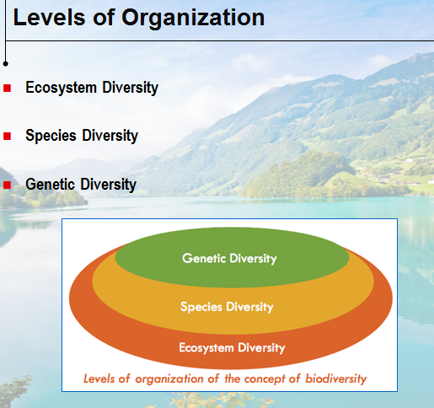

Slide 20

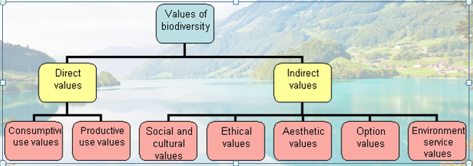

Slide 21
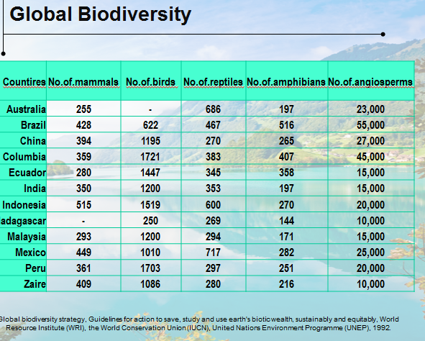

Slide 22
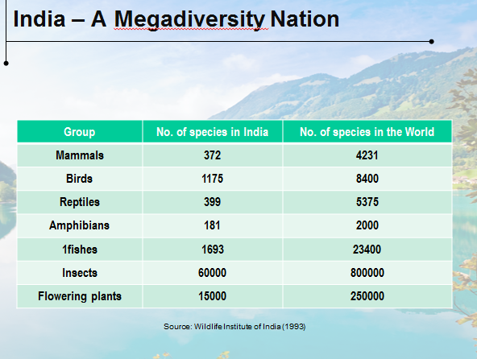

Slide 23
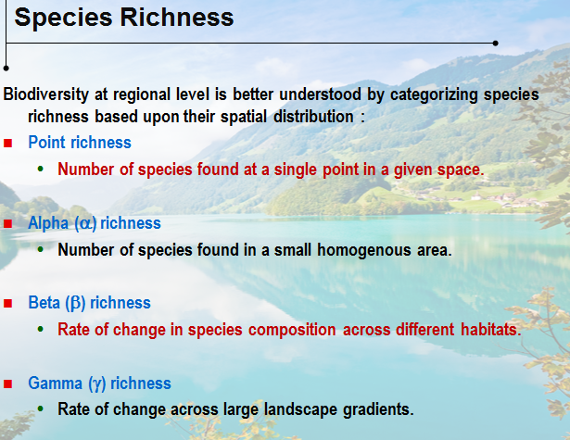

Slide 24
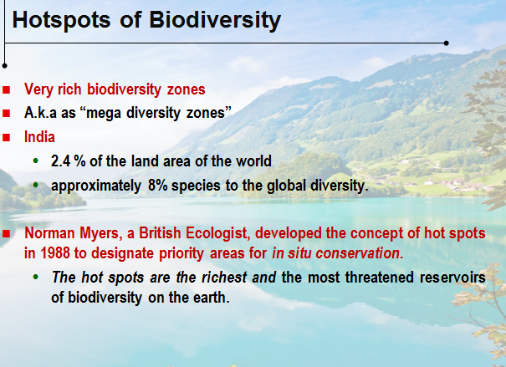

Slide 25
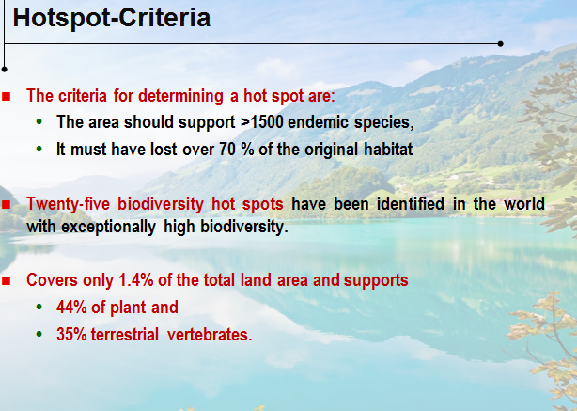

Slide 26
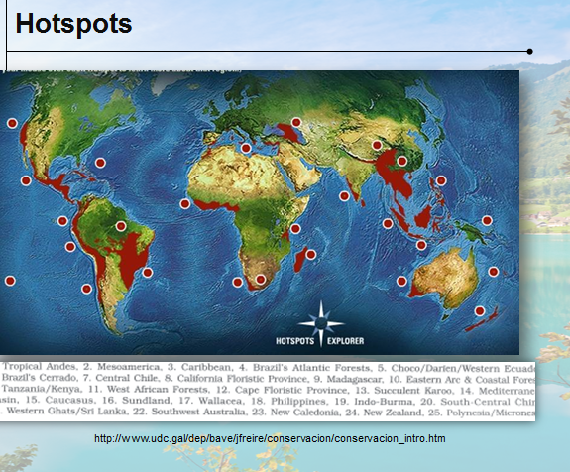

Slide 27
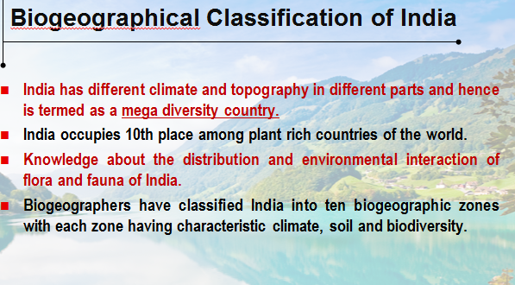

Slide 28
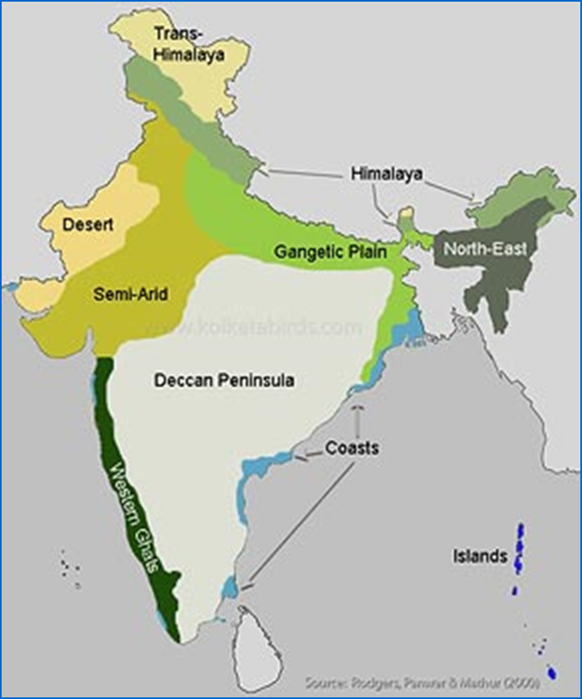

Slide 29
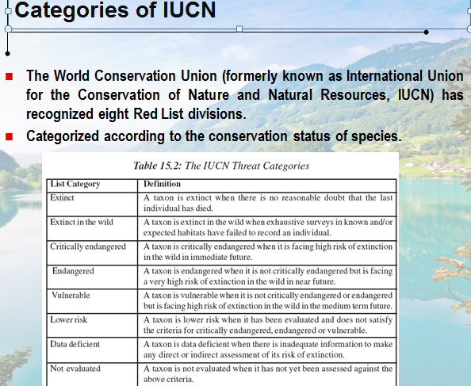

Slide 30
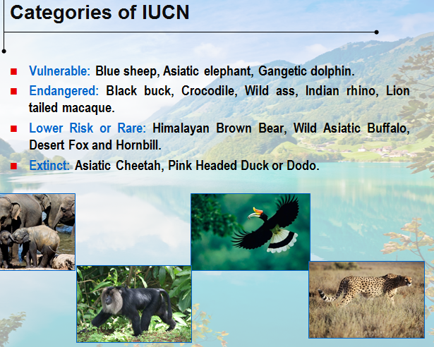

Slide 31
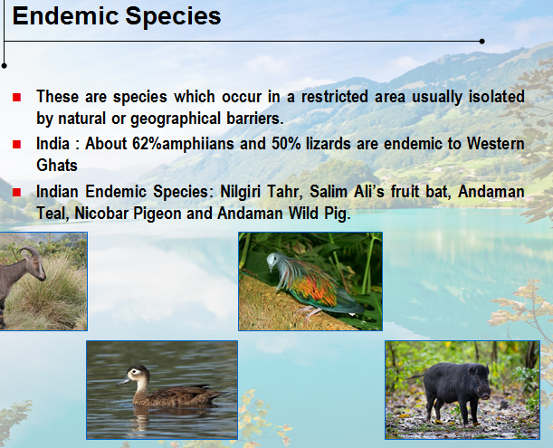

Slide 32
Useful links
https://www.youtube.com/watch?v=pBtPCXUltB8
https://www.youtube.com/watch?v=MQuWlTDDecs
https://www.youtube.com/watch?v=7G3eXI_DPn8

