Slide 1

ANALYSIS OF DETERMINATE STRUCTURES
SUSHMA M
ASST. PROFESSOR, DEPT. OF CIVIL ENGINEERING
K S SCHOOL OF ENGINEERING & MANAGEMENT

Slide 2
ENGINEERING MECHANICS
STRUCTURAL ANALYSIS
Treating the entire structure as a single rigid body and finding the reactions from supports is the first step in analysing a structure which is covered under “Engineering Mechanics”
While transferring the loads acting on the structure, the members of the structure are subjected to internal forces like axial forces, shearing forces, bending and torsional moments. “Structural Analysis” deals with analysing these internal forces in the members of the structures
STRENGTH OF MATERIALS
The behaviour of the materials of the structures subjected to different types of internal forces are covered under “Strength of Materials”

Slide 3
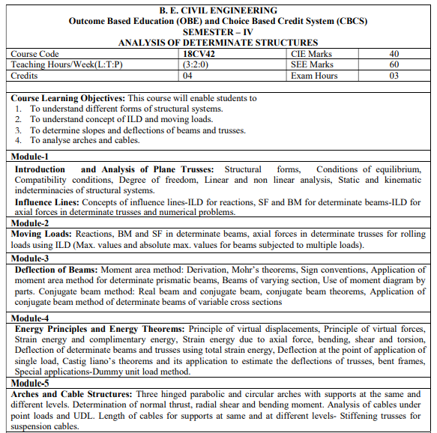

Slide 4
STRUCTURAL FORMS
ONE- DIMENSIONAL ELEMENT
TWO- DIMENSIONAL ELEMENTS
THREE- DIMENSIONAL ELEMENTS

Slide 5
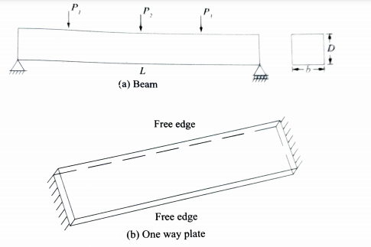
ONE-DIMENSIONAL ELEMENTS
In this type of structural element, the loads are acting along the length of the member. The length of such members is quite large in comparison with other dimensions.
The bending takes place along the length in one direction

Slide 6
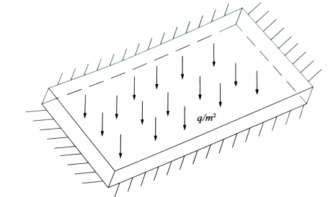
TWO-DIMENSIONAL ELEMENTS
These elements are widely used in practice. These elements can bend in both directions (i.e length and breadth)
The thickness of the element is small when compared to other dimensions

Slide 7
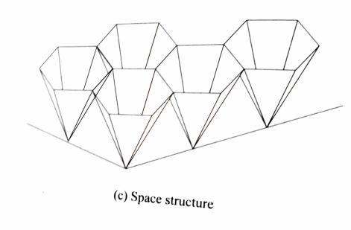
THREE-DIMENSIONAL ELEMENTS
Its deformations are with respect to three axes

Slide 8
CONDITIONS OF EQUILIBRIUM
When taken an entire structure under consideration, the reactions from the support and the loads on the structure should be in static equilibrium
The equations of static equilibrium are as follows:
The summation of all the forces along any axis is zero
The summation of all the moments about any axis is also zero

Slide 9
COMPATIBILITY CONDITIONS
The members meeting at a joint will continue to meet at the same joint even after deformation takes place
At rigid-joints, the angle between any two members remains the same even after deformation takes place.
The compatibility conditions will help in formulating additional equations

Slide 10
LINEAR AND NON-LINEAR ANALYSIS
A system is called a “Linear System” if its material has linear stress- strain relationship and a small deflection.
A system will be treated as a non-linear system if its material does not have linear stress-strain relationship or its deformation is so large that a change of geometry cannot be neglected in the analysis
If the non-linearity is due to stress-strain relationship, it is called material non-linearity and if the non-linearity is due to considerable changes in the geometry, it is called geometric non-linearity

Slide 11
STATICALLY DETERMINATE AND INDETERMINATE STRUCTURES
A Structural system which can be analysed by using equations of statically equilibrium only is called as “Statically Determinate Structure”
A structure which cannot be analysed by using equations of equilibrium only is called a “Statically Indeterminate Structure”
To analyse indeterminate structures, apart from using equations of equilibrium one has to determine the various deformations and make use of compatibility conditions

Slide 12
USEFUL LINKS
https://nptel.ac.in/courses/105/105/105105166/
https://www.youtube.com/watch?v=s4CN6aVKhPo&ab_channel=nptelhrd

