Slide 1

Department of MBA
4th Semester
Subject Name – Personal Growth and Interpersonal Effectiveness
Subject Code - 20MBAHR402
Dr. Shekar H.S
Professor and HOD
K.S. SCHOOL OF ENGINEERING AND MANAGEMENT, BENGALURU - 560109
Module-5
Interpersonal Needs and Personal Growth

Slide 2
INTERPERSONAL RELATIONSHIPS – AN OVERVIEW
William Schultz has identified three such of interpersonal relations needs.
Inclusion - Inclusion is the need to establish identity with others.
Control - Control is the need to exercise leadership and prove one's abilities.
Affection - Affection is the need to develop relationships with people.

Slide 3
FIRO – B
Fundamental Interpersonal Relations Orientation (FIRO) is a theory of interpersonal relations, introduced by William Schultz in 1958.
The Theory is based on the belief that when people get together in a group, there are three main interpersonal needs they are looking to obtain - affection/openness, control and inclusion.
Schultz developed a measuring instrument that contains six scales of nine-item questions that he called FIRO-B.
This technique was created to measure or control how group members feel when it comes to inclusion, control, and affection/openness or to be able to get feedback from people in a group.
These categories measure how much interaction a person wants in the areas of socializing, leadership and responsibilities, and more intimate personal relations.

Slide 4
Video Link
Personal Development | Powerful Jim Rohn Motivational Compilation
https://www.youtube.com/watch?v=mmU56vZs72A

Slide 5
Students are advised to read the articles with the link provided
Title : " Personality mapping: tool to understand interpersonal need and enhance performance "
https://www.researchgate.net/publication/318827059_Title_Personality_mappingtool_to_understand_interpersonal_need_and_enhance_performance

Slide 6
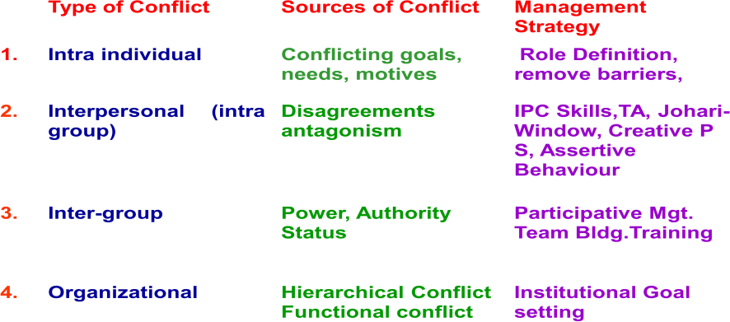
Types and Sources of Conflict

Slide 7
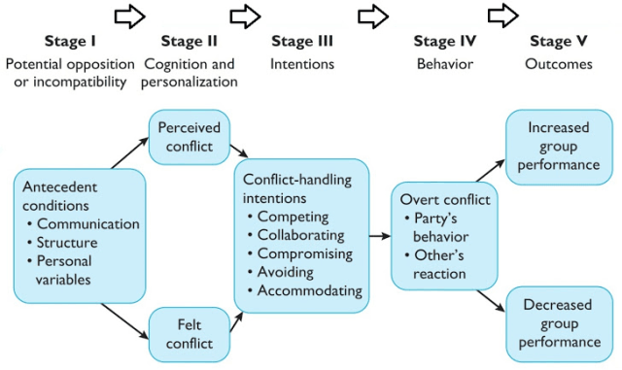
PROCESS OF CONFLICT

Slide 8
Conflict Resolution / Management Skills
Problem solving skills
Interpersonal skills
Skills of Emotional Intelligence
Skills of stress management
Listening skills
Communication skills
Negotiation skills

Slide 9
The four step commitment honoring process is as follows
Deliberately choosing your commitments
Making a strong, inspired decision
Understanding the downside
Raising the probability of following through all the way to success

Slide 10
THANK YOU

