Slide 1

K.S. SCHOOL OF ENGINEERING AND MANAGEMENT, BENGALURU - 560109
Department of MBA
3RD Semester
Subject Name – TECHNOLOGY AND OPEREATIONAL STRATERGY
Subject Code – 20MBA302
Miss. V.Vidyashree
Assistant Professor
Module- 3
Lean Manufacturing

Slide 2
Concept of Lean Manufacturing;
meaning of lean manufacturing; History of Lean Operations, Types of Waste,
Module -3 Lean Manufacturing
“5S” Technique of Eliminating the Waste,
Lean Operations in the service sector,
Role of Leadership,
Lean Operations Just In Time(JIT).

Slide 3
Concept of Lean Manufacturing
– Lean management is based on the Toyota production system which was established in the late 1940s. Toyota put into practice the five principles of lean management with the goal being to decrease the amount of processes that were not producing value; this became known as the Toyota Way. By implementing the five principles, they found that significant improvements were made in efficiency, productivity, cost efficiency and cycle time.

Slide 4
5 principles of lean management
Lean management incorporates five guiding principles that are used by managers within an organization as the guidelines to the lean methodology. The five principles are:
  Identify value
  Value stream mapping
  Create a continuous workflow
  Establish a pull system
  Facilitate continuous improvement

Slide 5
Benefits of lean management
Lean management benefits organizations by focusing on improving all parts of the work process throughout every level of the company's hierarchy. Specifically, managers benefit from advantages such as:
  A more intelligent business process - The pull system ensures work is only carried out when there is an actual demand and need for it.
  Improved use of resources - The pull system also ensures the organization is only using resources when they are needed since it operates based on real customer demand.
  Improved focus - Lean management decreases the amount of wasteful activities, therefore allowing the workforce to increase their focus on tasks that produce value.
  Enhanced productivity and efficiency - Improved focus leads to a more productive and efficient workforce since attention is not given to unnecessary activities.

Slide 6
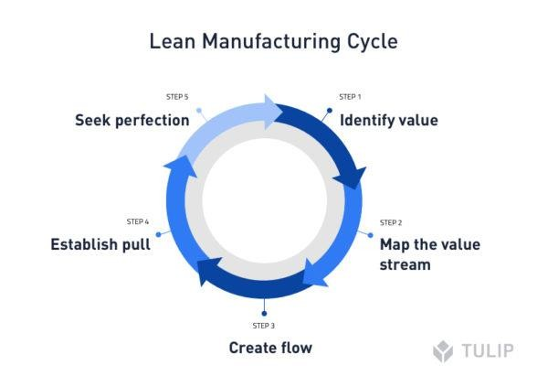

Slide 7
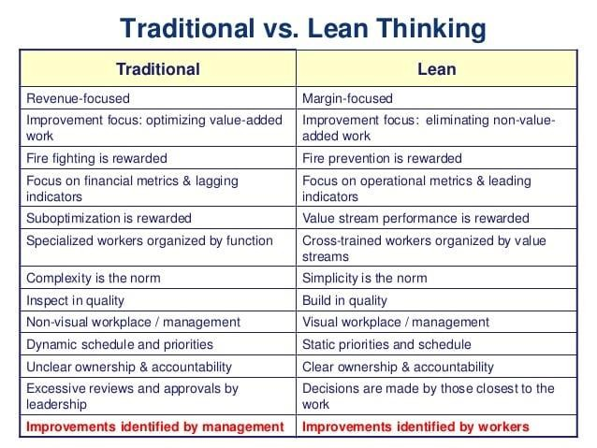

Slide 8
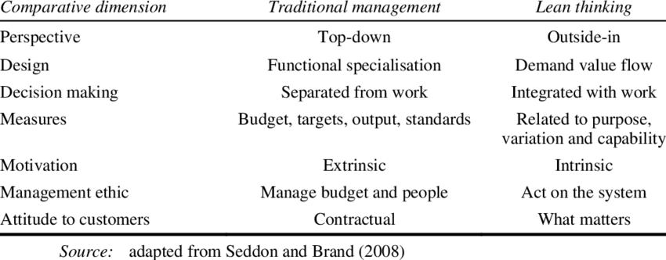

Slide 9
HISTORY OF LEAN MANUFACTURING
https://www.youtube.com/watch
?v=ejhYJ6sMMSY

Slide 10
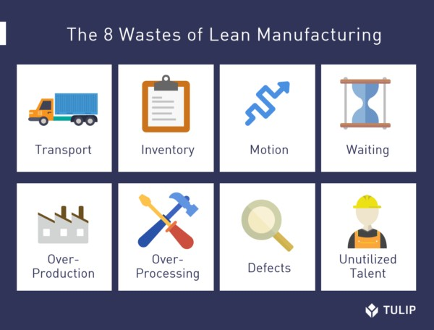
https://www.lean.org/lexicon-terms/seven-wastes/

Slide 11
7 Wastes of Lean Manufacturing
Transportation – in production, it may mean moving parts and materials from one place to another
Inventory – undelivered products or parts. Overstocking with equipment that may be in need somewhere in the future
Motion – unnecessary movement of employees or machinery
Waiting – waiting for goods to be delivered
Overproduction – too many items produced “just in case”
Over-processing – Spending a lot of time on a given task. Adding a feature that
doesn’t bring value
Defects – broken parts or defective parts that need to be reworked

Slide 12
7 Wastes in Software Development
Transportation – switching between tasks too often, countless interruptions from colleagues.
Inventory – undelivered code or undelivered features
Motion – unnecessary meetings or extra effort to find information
Waiting – waiting for testing to complete, waiting for code review, and so on
Overproduction – producing features that nobody is going to use
Over-processing – unnecessary complex algorithms solving simple problems
Defects – bugs

Slide 13
7 Wastes in Marketing
Transportation – task switching, interruptions, unnecessary long marketing funnel
Inventory – fully-prepared marketing campaigns which stay unlaunched. Licensed tools that nobody uses
Motion – unnecessary meetings, extra effort to find information, attending events without clear agenda
Waiting – waiting for approval from higher management
Overproduction – performing many different marketing activities without having a clear vision and strategy
Over-processing – generating countless marketing reports manually, while they can be automated
Defects – wrong brand communication, mistakenly branded materials

Slide 14
5S – A VIDEO ON THE CONCEPT
https://www.creativesafetysupply.com/content/education-research/5S/index.html

Slide 15

