Slide 1

Department of MBA
1st Semester
Subject Name – Managerial Communication
Subject Code - 20MBA16
Mr. Sreedhar .N
Assistant Professor
K.S. SCHOOL OF ENGINEERING AND MANAGEMENT, BENGALURU - 560109
Module-4
Business Letters and Reports

Slide 2
Business letters
Business Letters are also called Commercial Letters.
It is the handwritten, typewritten, or printed.
It is used for business correspondence.
It is used to communicate with suppliers, customers, government departments, banks, insurance agencies, transporters, job-seekers and so on.
It is unique piece of information

Slide 3
Basic principles
Give importance to readers : reader’s background, relationship, needs
Keep to the point: clarity of objectives, outline
Set the right tone: friendly & efficient
Write a strong opening : gain attention, most important information first, should stand out
End emphatically : polite and business-like note, summarize key points

Slide 4
Writing strategies
State the main business / purpose / subject
Keep paragraphs short
Provide topic indicators
Place important information strategically
Focus on recipient’s needs
Give an action ending whenever appropriate

Slide 5
Components/ELEMENT/STRUCTURE
1.HEADING: The sender name ,address and contact details can be typed.
2.DATE : Date, name of the month and year .never write letter without date it show the write careless.
Eg: 23 NOVEMBER 2017 or 23rd Nov 2017
3.INSIDE ADDRESS: name of the firm or the individual to whom the letter is written .if you don’t know the name begin with job title or departmental: (the sale manager ) .Use courtesy titles like (Mr., Miss,Mrs,Dr,Prof etc)
4.SUBJECT : it helps reader to immediately know what the letter is about..
5. SALUTATION : complementary or greeting .it depends upon gender, position etc
Eg: Dear Sir /Madam/ Dear Sales Manager
6.BODY OF THE LETTER: begins two spaces below the salutation contain introductory paragraph, middle paragraph ,closing paragraph

Slide 6
-Students are advised to go through the link provided.
Seven parts of Letter
https://www.theclassroom.com/the-seven-parts-of-a-letter-12084087.html
Description : Alison Datko is a professional editor with experience as a journalist, writer and blogger. He has briefed about the components of the letter through the interactive session in US . This link is helpful to understand the depth of the topic at the international level.

Slide 7
Sales Letter to Current Client
August 17th 2010
MACRO Associates,
Texas,
Missouri.
Dear Sir,
We are appreciating you for your service to this industry by regular purchase of Car tires from our Company in wholesale since last four years. We are thanking you for the confidence kept in our product and the continuous business support you have been giving us. It my believe that we both will never make any compromise in quality of the products and you will also not face problem regarding our on time delivery services. We are taking extra care for the quality of our product and we have set up new machine tools for the same. We are also giving training to our staff members so that we can serve you in more better way.
We are expecting that your assistance will continue like this in future also. We promise you to continue with our quality, quantity and delivery time assurances.
Once again wishing you all the success in all your future activities!
Yours truly,
Mr. Charles John
Senior Sales Manager,
MRF Tires

Slide 8
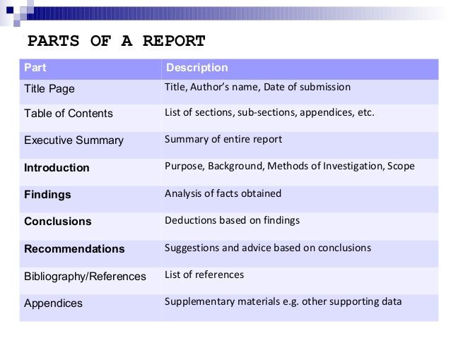
Business Reports- Definition
Logical presentation of facts and information Orderly arrangement of some factual information Compilation of information that has been sought, collected, organized and written to convey a specific message.

Slide 9
Video Link – Business Reports Structure
https://study.com/academy/lesson/writing-a-business-report-structure-examples.html

Slide 10
Business Reports – Characteristics
Accuracy : In Both Information And Writing :
Factual Information, Reliable Sources, Accuracy In Reporting, Accuracy In Writing
Objectivity: Free From Personal Prejudices :
Distinguish Between Facts And Opinions.
Present Both Positive And Negative Information
Simplicity
Completeness
Brevity
Readability
Logical Content

Slide 11
Business Reports – Writing Steps
Be Clear With Purpose And Scope
Determine Audience
Collect Information
Analyse Data
Identify Solutions/OUTLINE AN REPORT
Organize The Report

Slide 12
Video link on Effective Minutes of Meeting
https://www.youtube.com/watch?v=q5-B_FsXoyg
Description : This link is helpful to learn how to take effective meeting notes in Microsoft OneNote . how to note down action items and ownership, how to take notes by hand and how to share notes after the meeting.
Here is an updated tutorial on taking effective meeting minutes with OneNote :

Slide 13
Thank you

